Slide 1
Fukushima-Daiichi Accident
Update on Fukushima
(focus) Consequences and restoration
2. Lessons Learned: Emergency preparedness
3. Lessons Learned : prevention
akira OMOTO, Tokyo Institute of Technology
Akira.omoto@mac.com

Slide 2
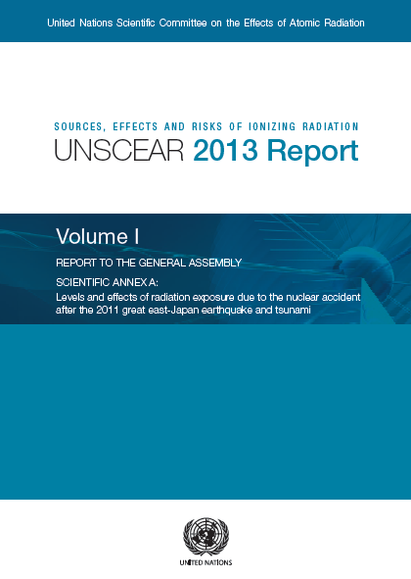
  Health effect by radiation
No direct casualty by the nuclear accident,
however;
  <60 died among evacuees from hospitals
  ~18,000 died by earthquake/tsunami
External exposure to evacuees 99.3% <10mSv*
Intake by contaminated food
~ 0.1mSv/a < natural BG 0.41 mSv/a**
UNSCEAR 2013 report & 2017 WP on Fukushima
  “No discernible increased incidence of radiation-related health effects are expected among exposed members of the public or their descendants. “
  “The most important health effect: mental and social well-being”
*[source] Fukushima prefecture, http://www.pref.fukushima.jp/imu/kenkoukanri/240612shiryou.pdf
**[SOURCE] http://www.mhlw.go.jp/stf/shingi/2r9852000001ip01-att/2r9852000001ipae.pdf

Slide 3
SCJ (Science Council of Japan) report Sept 2017 *** discussed
  Increased cases of thyroid cancer (incl. suspect) will be attributable to “screening effect”
  Estimated children thyroid dose over 50mSv among monitored:
  99% (Belarus/Ukraine)
  0.2% (Japan)
National Diet report on Fukushima accident
  KI tablet intake: in four township
Food control in place from early time into the accident, but this may suggest need for food control (not only milk) for extended period of time
***[source] http://www.scj.go.jp/ja/info/kohyo/pdf/kohyo-23-h170901.pdf,
http://www.scj.go.jp/ja/info/kohyo/pdf/kohyo-23-h170929-4.pdf

Slide 4
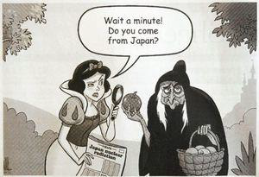
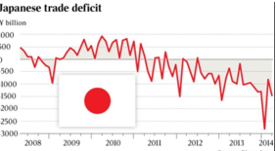
Socio-economic impact
  social disruption
    Land contamination and relocation
    Significant socio-economic impact (including environmental remediation, image cost, power replacement, decommissioning)
    Estimated accident cost > 215B$ ([SOURCE] METI, 2016.12.9)
    Decommissioning (80), Compensation (79), Offsite Decontamination
    (40), Offsite waste interim storage(16)
image cost
power replacement cost
~30 B$/year for 2011-2015
A. Omoto, Titech, 6Dec2017@CBRN

Slide 5
Fukushima Daiichi NPS - Status Updates
Stabilized with closed cooling
Reduced amount of ingress of underground water
Accumulated AGW(Accident-generated water)
  Million tons (TMI: 70 tons) in 800 tanks
  Tritium contamination
Long-term plan
  Start removal
  of Spent Fuel
  (Nov2013)
  Start removal
  of fuel debris
  (Dec2021)
March2011
  30-40 years
  Stabilization
  Preparation for debris removal
  Debris removal & Decommissioning
A. Omoto, Titech, 6Dec2017@CBRN

Slide 6
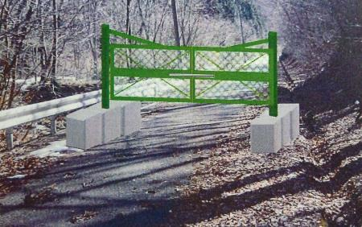
Evacuation order as of April 2011
Affecting 11 municipalities
“Difficult
to return”
Zone (>50mSv/y)
Restricted
Zone (50>Z>
20mSv/y)
Zone
prepared for lifting EP (L.T.20mSv/y)
A. Omoto, Titech, 6Dec2017@CBRN

Slide 7
Lifting of orders enabled by reduced dose rate
As of April 2017 (6 years later)
Areas where restriction has been lifted
Conditions to lift restriction
Dose rate (<20mSv/year)
Consensus by dialogue between Gov’t
and local municipality (discussion
on social infrastructure etc.)
Decontamination of offsite areas
Target: Less than 1mSv/year of additional
exposure
Paid by Gov’t: Areas declared Difficult-to-
return
Paid by TEPCO: rest

Slide 8
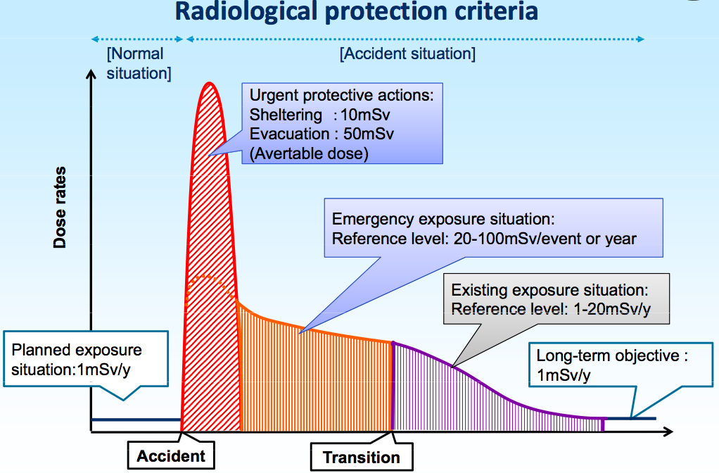
Emergency protective actions against radiation
[For reference]
Natural BG ~2.4mSv/year
Occupational exposure limit:
50mSv/year
A. Omoto, Titech, 6Dec2017@CBRN
[SOURCE] T. Homma, JAEA, FNCA Study panel, July 2012

Slide 9
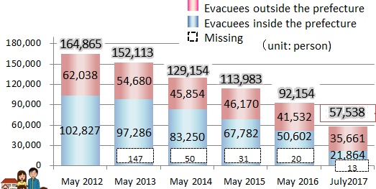
Return of evacuees
0
Difficulties
  Anxiety about health risk
  Job
  Infrastructure (hospital, school, shop, administrative services…)
(Chernobyl) Land contamination by Pu…“return of the population to the exclusion zone is impossible” (State Nuclear Regulatory Inspectorate of Ukraine)
A. Omoto, Titech, 6Dec2017@CBRN
9

Slide 10
Restoration of local infrastructure applied to all 3.11 disaster
（reconstruction tax= additional 2.1% x income tax)
  Municipality’s administration office, housings
  Shopping Center, Schools, Hospitals, Roads
  Railways
Restored by 2017.4
Collapsed bridge
Restored by 2017.10
[SOURCE] JR
Destroyed station
A. Omoto, Titech, 6Dec2017@CBRN
Rail lost

Slide 11
Tomioka station

Slide 12
Update on Fukushima
(focus) Consequences and restoration
2. Lessons Learned: Emergency preparedness
3. Lessons Learned : prevention
A. Omoto, Titech, 6Dec2017@CBRN

Slide 13
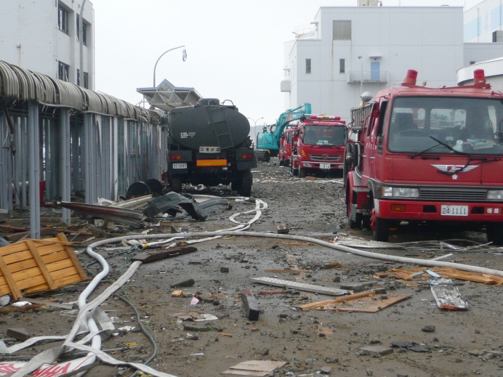
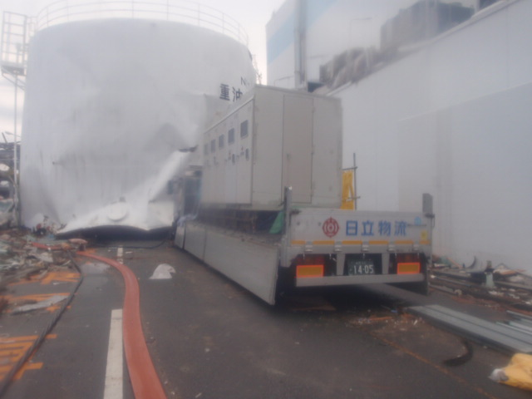
a) Need preparedness for Multi-hazards, Multi-units accident situation
  Earthquake, Tsunami and N Accident in multiple units
  (For onsite preparedness)
  Accident Management (AM) was prepared after Chernobyl, but
  - not assuming extended SBO + loss of UHS
  - not assuming extensive damages by external events
  Recovery actions hampered by Tsunami debris and hydrogen explosions
Adjacent unit’s hydrogen explosion destroyed
preparation when water injection to Unit 2
was ready
A. Omoto, Titech, 6Dec2017@CBRN

Slide 14
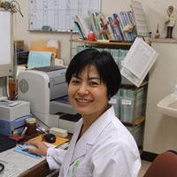
b) Need balanced EPR
A paper by a medical doctor in a Fukushima hospital
  The real threats to evacuee’s health are;
    Forced evacuation
    Prolonged “evacuation” (de-fact relocation)
    Screening of children thyroid (causing unnecessary fear and operation of thyroid)
  [source] http://agora-web.jp/archives/1611061.html
All those threats are brought about
  by good intention. (paradox)
Balance based on consideration of all risks in their entirety
A. Omoto, Titech, 6Dec2017@CBRN

Slide 15
SHAMISEN PROJECT (EC, 2015 Dec~)
Objective: set recommendations
that would contribute to health
surveillance and related
communication with N. accidents
Some recommendations (September 2017)
  Emphasized ethical principle of doing more good than harm: radiation protection actions (incl. health surveillance) vs. societal/health consequence
  Evacuation: appropriate balancing of life-protection actions against the potential health impacts of evacuation
  Communication: Dialogue between experts and affected communities
A. Omoto, Titech, 6Dec2017@CBRN

Slide 16
c) Clear delineation of role and responsibility
Basics:
  Onsite by plant manager, Offsite by local authority
Confusion for offsite action
  Lack of coordination
  Lack of accurate information
  Not clear delineation of responsibility
Early morning on the next day to
criticize TEPCO & urge containment venting,
and stopped works for 2 hours
Five days into the accident with his wife
A. Omoto, Titech, 6Dec2017@CBRN

Slide 17
President Carter’s statement at Middletown, Pennsylvania
My primary concern in coming here has been to learn as much as I possibly can, as President, about the problems at the TMI nuclear power plant and to assure the people, of this region that everything possible is being done.
I would like to say to the people who live
around the Three Mile Island plant that if it
does become necessary, your Governor, Governor Thornburgh, will ask you and others in this area to take appropriate action to ensure your safety.
If he does, I want to urge that these instructions be carried out calmly and exactly……
[source] http://www.presidency.ucsb.edu/ws/index.php?pid=32133
A. Omoto, Titech, 6Dec2017@CBRN

Slide 18
Nuclear Accident
Graded response depending
on level of emergency
Licensee and local Gov to take
Emergency Response (prevention, mitigation, sheltering,
Evacuation, food
Control etc.)
as required by law
Cabinet decision to establish Nuclear Emergency Response HQ.
Nuclear Emergency Response HQ
  Head: PM, Location: PM office
  Functions: Info. collection, Coordination of emergency operation by each ministry, Provide directions/advices* to the licensee/local gov., Can order support by SDF etc.
* Direction by the head excludes
Technical/professional area covered by NRA
NRA (Info. & technical advice on nuclear & radiological safety)
MoE (Info. & technical advice on public health and environment)
Other ministries
[SOURCE] Law of Nuclear Emergency Countermeasure and others

Slide 19
d) Offsite precautionary actions by plant condition
Offsite actions:
Reliance on computer simulation using monitored release from the containment : did not work due to loss of power
Emergency Plan Zoning has been changed
[was] EPZ : 8-10km
[new] PAZ (Precautionary Action Zone) : 5km
  UPZ (Urgent Protective Action Planning Zone):~30km
  PPA (Plume Protection Planning Zone): ~50km
  (IAEA GS-G-2.1 suggests PAZ 3-5km, UPZ 5-30km)
Basis of precautionary action
[was] measured/predicted dose → [new] plant condition
A. Omoto, Titech, 6Dec2017@CBRN

Slide 20
e) Others
Arrangement for evacuation of hospital patients
Infrastructure
  Offsite center’s function lost due to earthquake
  Redundancy and diversity for communication system
Education and drill
  Excessive fear of radiation
  Need realistic drill and feedback
Caring about neighboring countries and international relations
    Preemptive consideration of post-accident reentry criteria and restoration
    etc.
A. Omoto, Titech, 6Dec2017@CBRN

Slide 21
Update on Fukushima
(focus) Consequences and restoration
2. Lessons Learned: Emergency preparedness
3. Lessons Learned : prevention
A. Omoto, Titech, 6Dec2017@CBRN

Slide 22
  Key elements for decision-making on risk management strategy with emphasis on prevention
    Complementary use of probabilistic assessment and deterministic assessment
    especially, decision-making under huge uncertainties
    as recognized in PRA…such as tsunami height
    Consideration of achievement goal
    Value/Impact assessment for resources allocation
    Defense-in-Depth for overall risk management
A. Omoto, Titech, 6Dec2017@CBRN

Slide 23
Probabilistic risk assessment
What can go wrong?（S：scenario）
How frequent? （L：likelihood）
What is the consequence? （Ｘ：consequence）
Improvements being made in light of Fukushima
  1) Extreme natural hazards with large epistemic
  uncertainties
  2) Multi-hazards, multi-units, multi-sources situation
  3) Human reliability under harsh and stressful
  environment
  4) Superposition of tsunami by multi-segment failure
  ……..
A. Omoto, Titech, 6Dec2017@CBRN

Slide 24
Deterministic approach
Analysis focusing on accident types, releases and
consequences, without considering the probabilities
Improvements in light of Fukushima
1) Stress test in design stage and periodically as new findings:
  Assessment of Margin
  “Where is cliff edge”, “How to increase distance to
  cliff edge”
2) Enhanced Design Extension Condition
  Extended SBO (Station Blackout) + Loss of Heat Sink
  Containment integrity after core melt
A. Omoto, Titech, 6Dec2017@CBRN

Slide 25
Safety goals
Historically the goals focused on health risk by radiation (acute fatality, latent cancer fatality)
However, Fukushima accident made it clear this was a narrow view
  No acute fatality, no discernible increase of
  latent cancer fatalities (UNSCEAR)
  2) Fatality and sickness triggered by
  evacuation/relocation (hospital patient,
  degraded QOL and mental sickness)
A. Omoto, Titech, 6Dec2017@CBRN

Slide 26
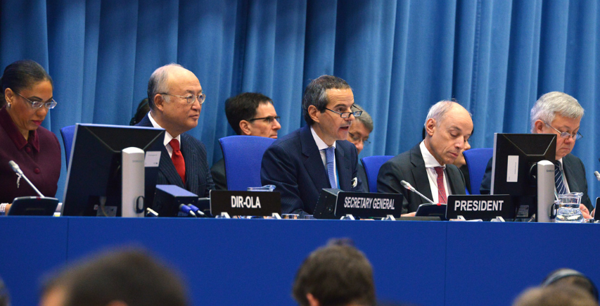
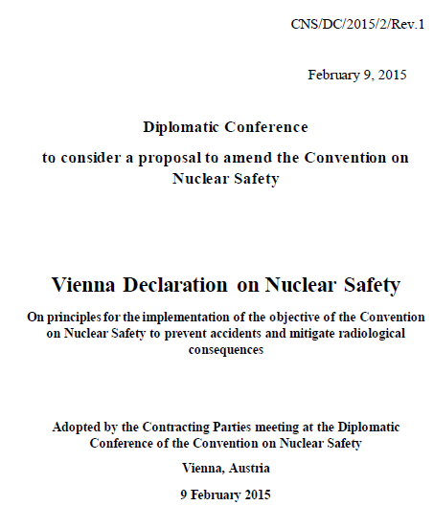
Safety goal is expected to address…
The whole risk in its totality including social disruption
Requirement for new NPP :
  “No large early release leading to long-term relocation by offsite contamination”
  EC Directive (Aug2014)
  CNS Vienna declaration (Feb2015)
  IAEA revised SSR-2/1, Rev1, 2.13
multi-hazard, multi-unit,
multi-source issue situation
A. Omoto, Titech, 6Dec2017@CBRN
Notes:
Suggest to delete to shorten you make the point with SF1

Slide 27
Value-impact analysis for evaluation of options
for risk aversion to better allocate resources
Value: reduced risks
  Δ (Probability of occurrence) x Consequences
  health effect + socio-economic impact (Gov’t perspective)
  asset loss & power replacement cost (Utility’s perspective)
Impact: Costs incurred by taking a risk-reduction countermeasure
  Post-Fukushima per-unit investment to improve safety
  40M$(US) 200~300M$ (Europe) 1000-1300M$(J)
Difficulties in formulating a decision criteria
  Even in Core Melt conditions, consequence (incl. socio-economic) varies significantly depending on release category & amount
  TMI, Chernobyl, Fukushima
  Decision based on Δ (Probability of occurrence) by use of matrix
  Regulatory Guide 1.174
A. Omoto, Titech, 6Dec2017@CBRN

Slide 28
  Application of Defense-in-Depth concept
What is DinD for?
  To compensate for uncertainty and incompleteness in our knowledge of accident initiation and progression” (Sorensen et al. 1999)
Defense-in-Depth by itself does not guarantee safety, what’s important is application of the concept
Where to improve in light of Fukushima?
  Independence of each layer of Defense in Depth
  Beware of damages to all layers of Defense in Depth by Extreme External Event
  Thickness and/or multi-phase of each defense layer
A. Omoto, Titech, 6Dec2017@CBRN

Slide 29
Review of application of DinD concept in level 1,4 &5, reveals possibly underlying common cultural issues
Basic assumption
  Over-confidence on safety (as if quality component assures safety)
  Government support to nuclear
2. Weakness
  As learning organizations
  In questioning attitude & raising concern
  Humbleness to natural disasters
3. Group think :
[example] “Decision-making approach did not provide for
independent challenge or second checks by other groups within
the organization.” (INPO LL report, 2013)
4. Ownership on safety: heavy outsourcing to contractors
A. Omoto, Titech, 6Dec2017@CBRN

Slide 30
Learnings from the Fukushima-Daiichi accident
  1. Failure of risk management in a country prone to natural disasters of various kinds, including Preparedness to multiple disasters (earthquake, tsunami, nuclear accident)
  2. Safety by Human, Technology, Organization, and Institutional arrangement (HTO plus I)
    Whereas focus used to be on technology
  3. Recognized needs for further improvements in risk assessment and management to reduce risks further
A. Omoto, Titech, 6Dec2017@CBRN

Slide 31
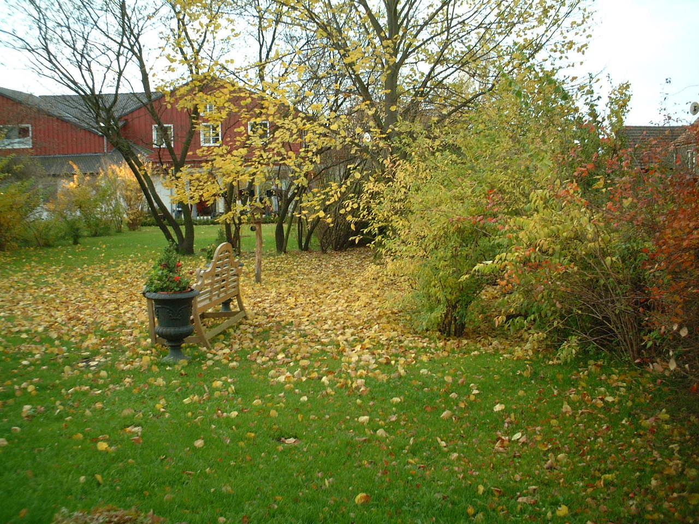
Thank you for your attention

