Slide 1
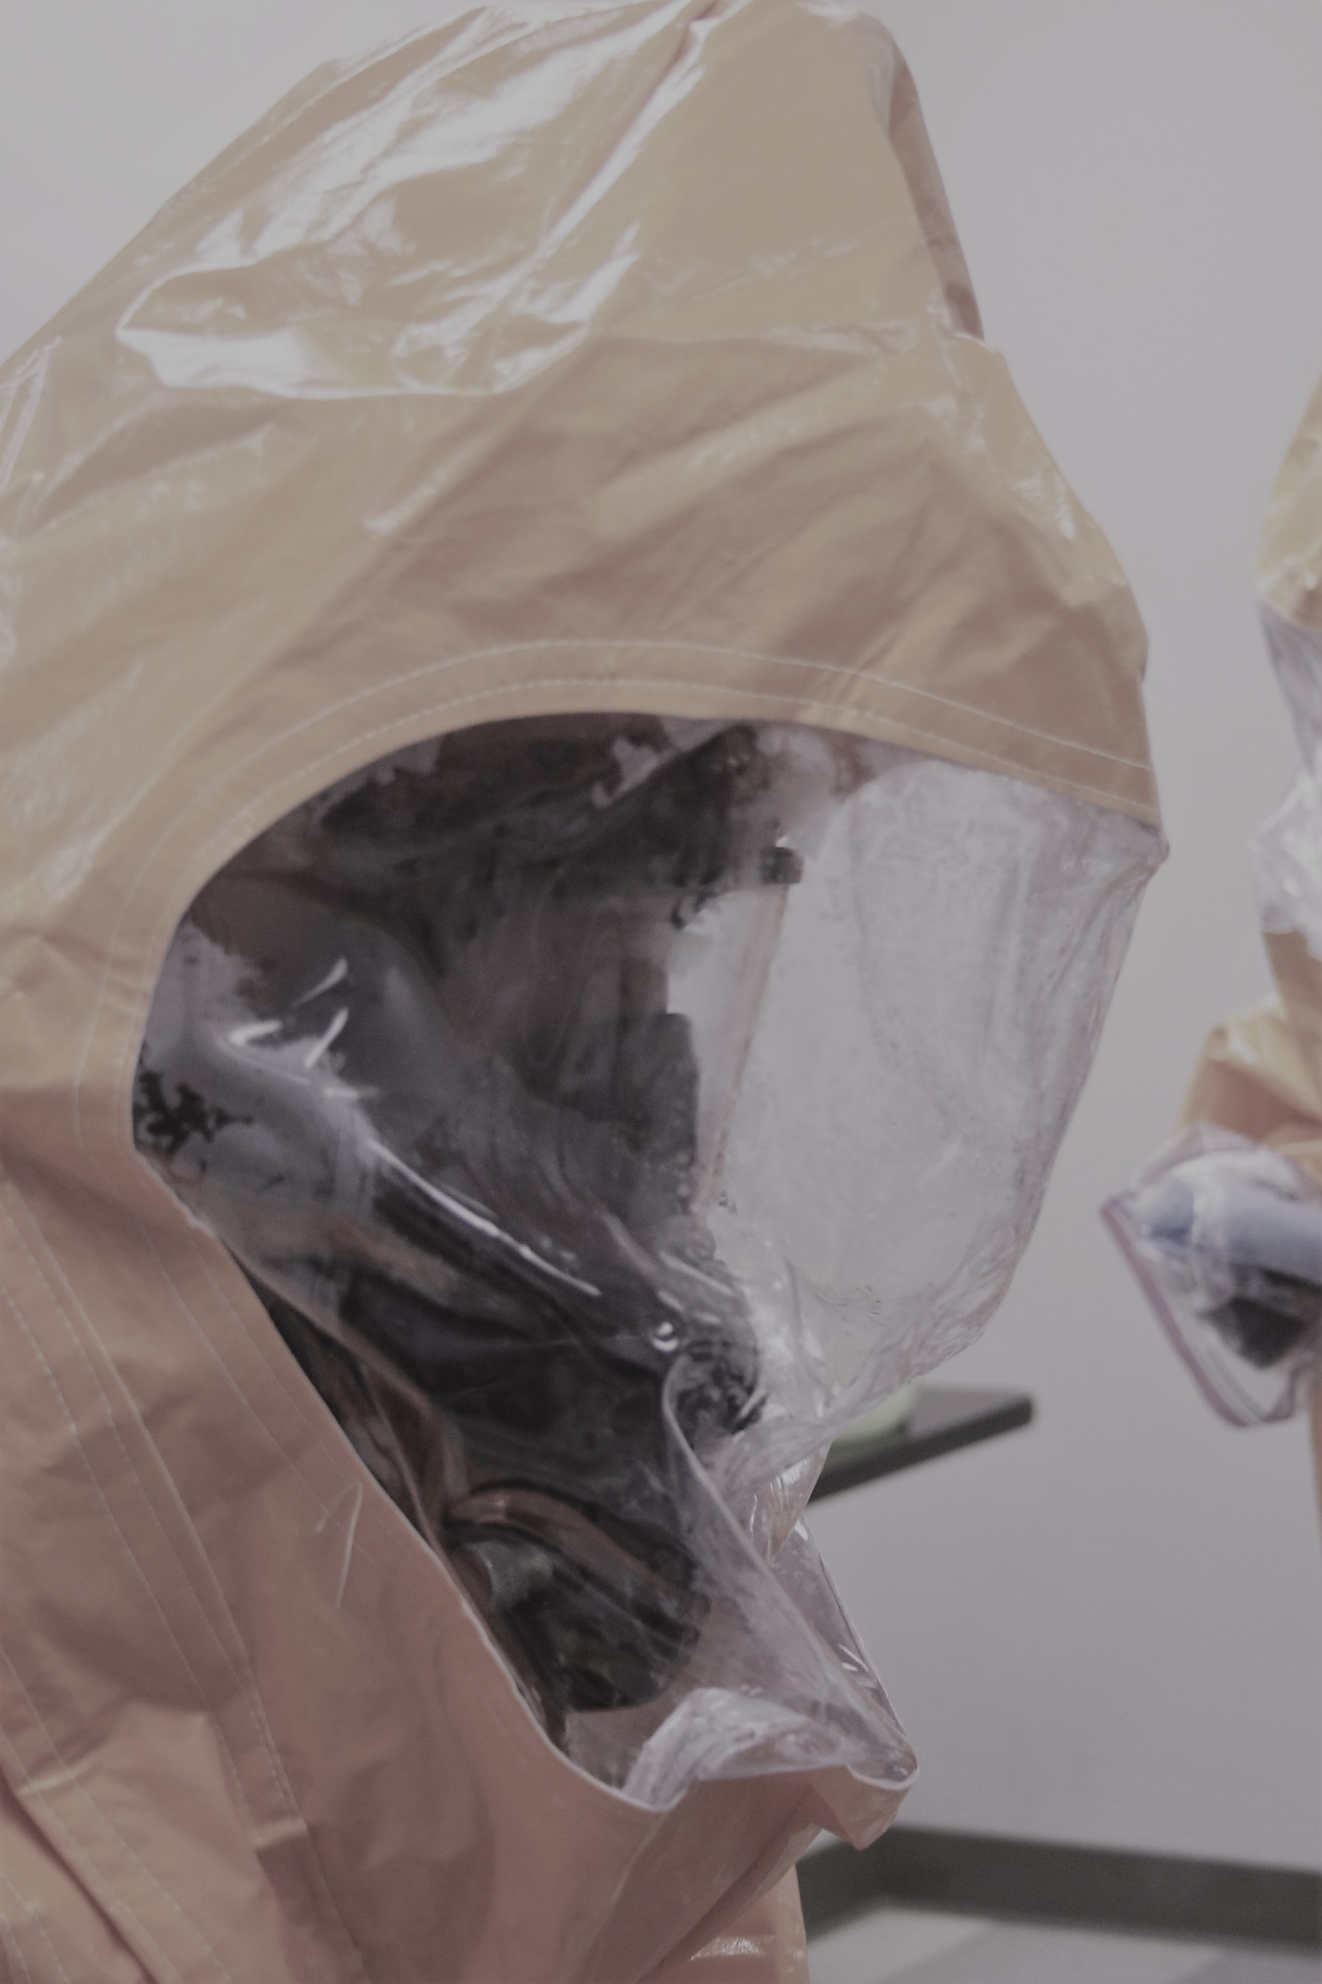
The ‘grey’ CBRN threat
How CBRN Criminality Becomes CBRN Terrorism
Gwyn Winfield, Editor, CBRNe World.

Slide 2
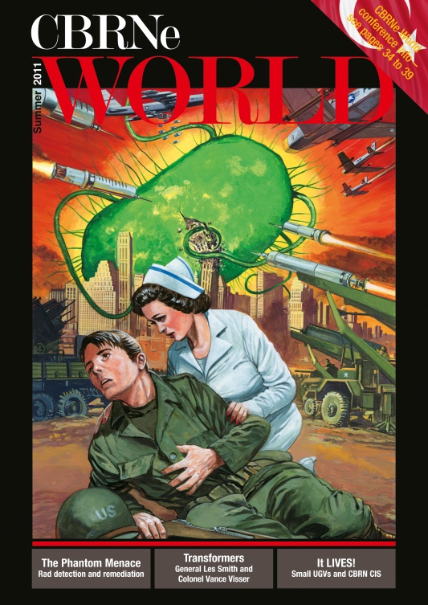
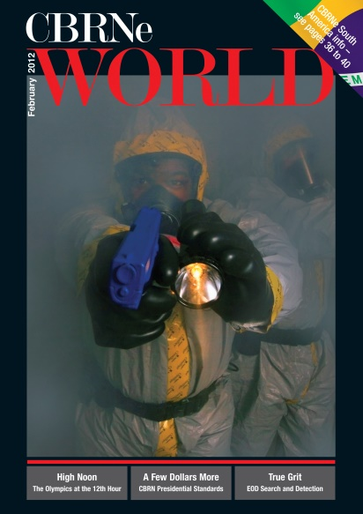
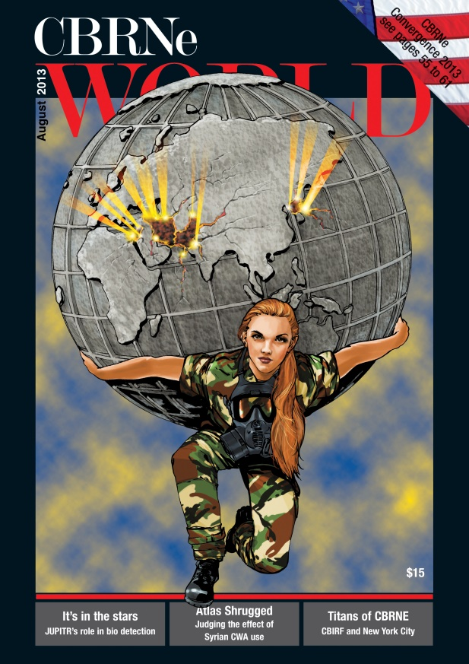

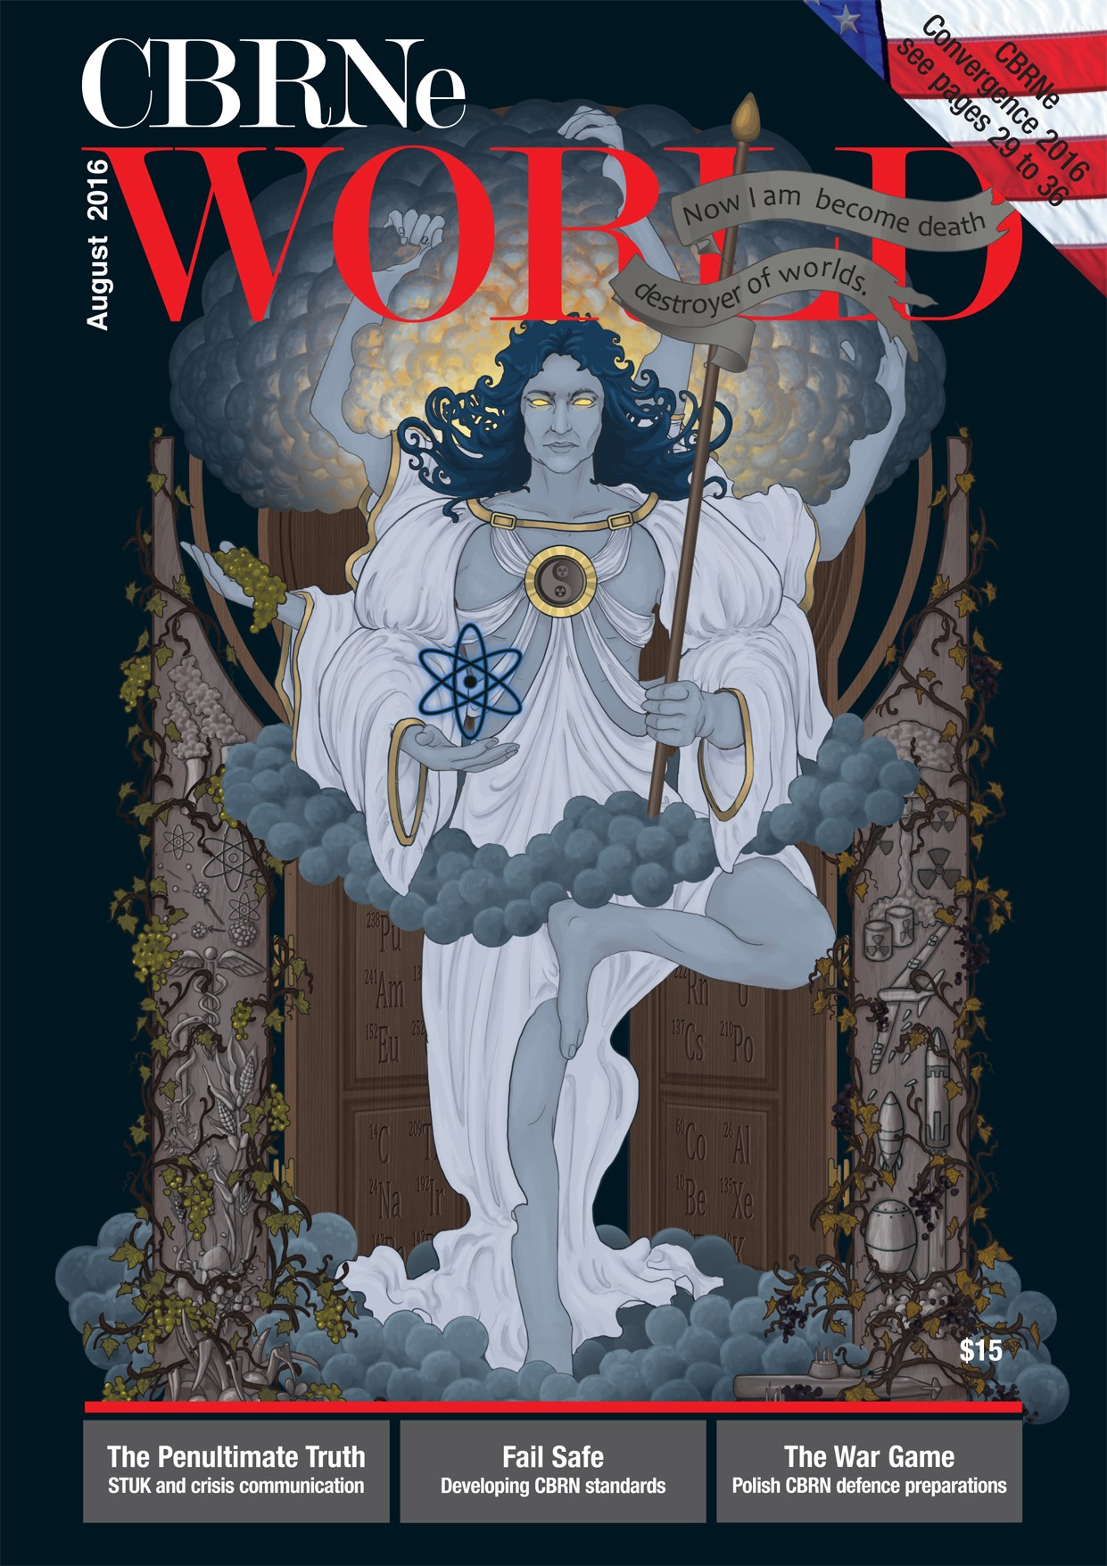
Who am I?
Editorial Director at Falcon Communications
16 years experience of writing on CBRN matters + 4 years prior on defence matters
Presented to Nato, American Academy of Forensic Science, EDA, EC etc
Written for many broadsheets as well as TV and radio.
Author

Slide 3


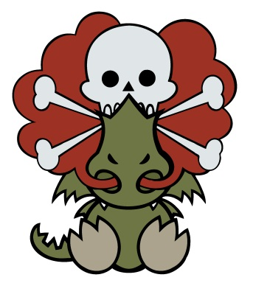
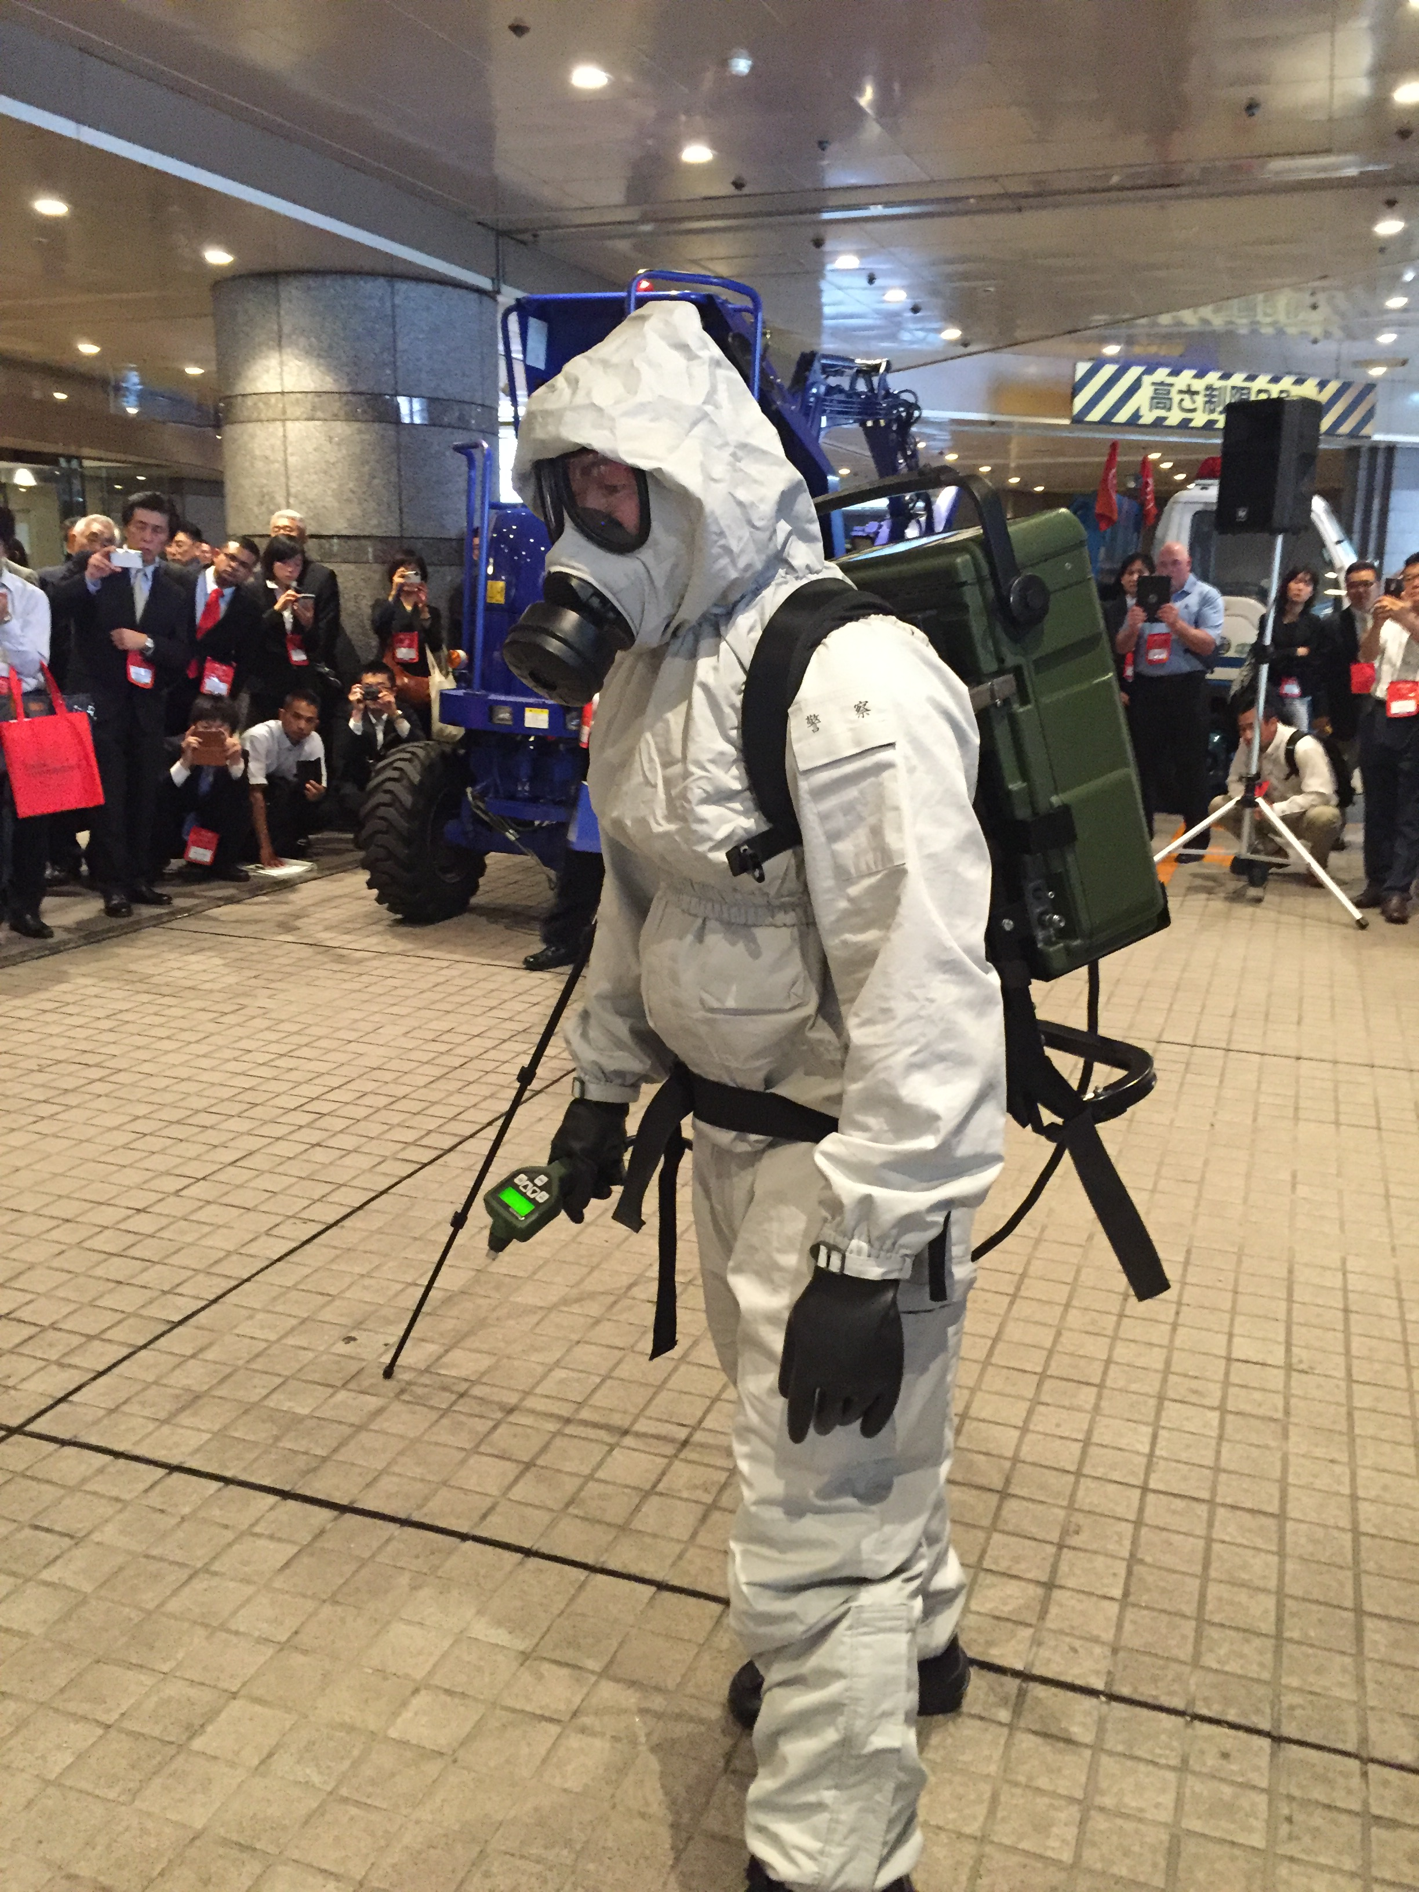


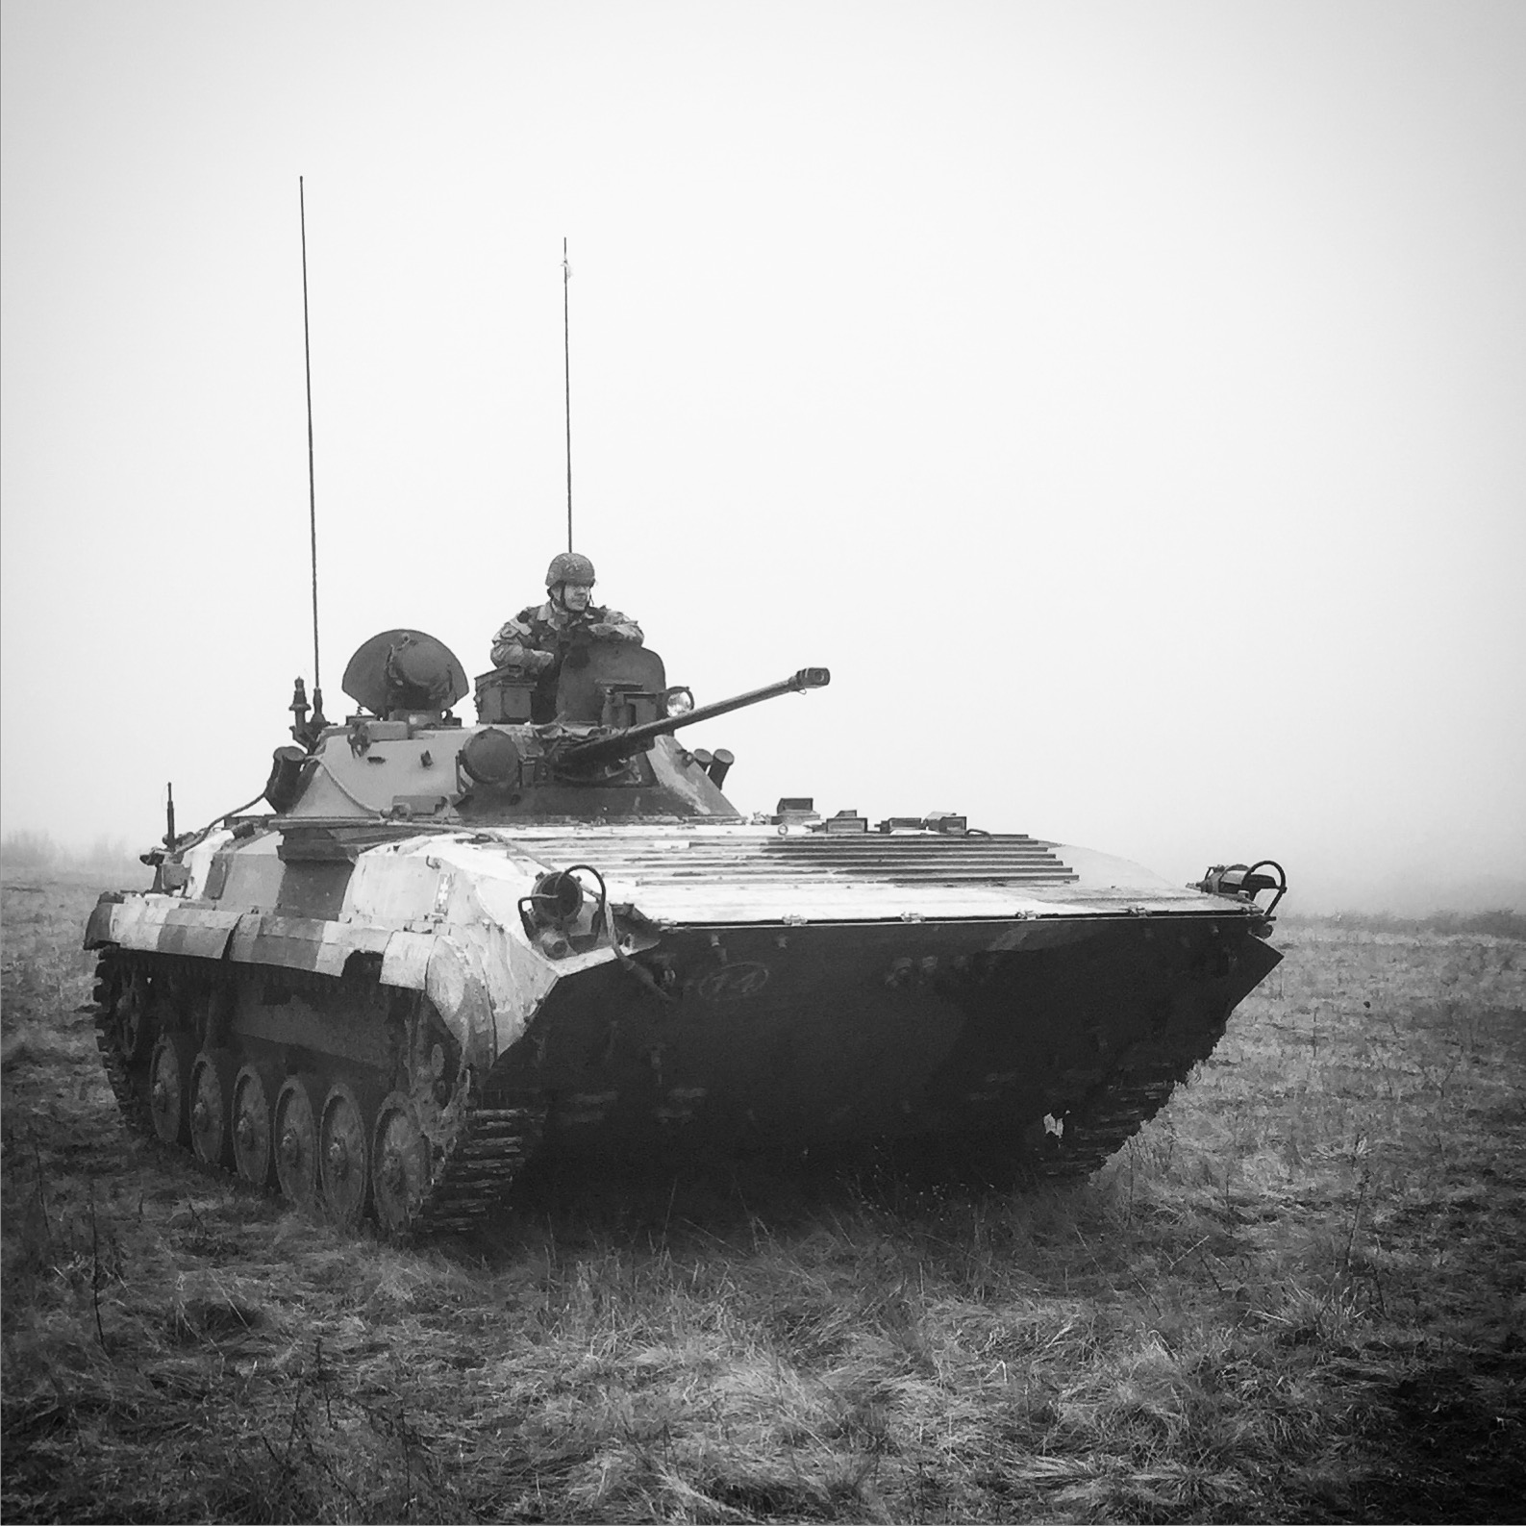
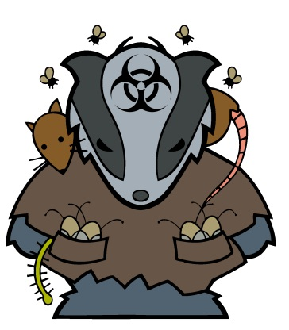
CBRNe World
CBRNe World – published six times a year, 50,000 readers worldwide.
Established in 2006 – first people to de-capitalise the ‘E.’ Came from same team that started NBC International in 2003.
CBRNe World – The information exchange for the CBRNE community – military, civilian, scientific, academic and other government departments (Health, Environment etc).
Covers every aspect of CBRNE for every type of individual – responder, scientist, military, academic, policy maker etc.
Routinely Google ranked #1 for CBRNe (we fight it out with Wikipedia!) – www.cbrneworld.com – and have the largest CBRN following on Twitter (#cbrneworld) and also Linked In.

Slide 4

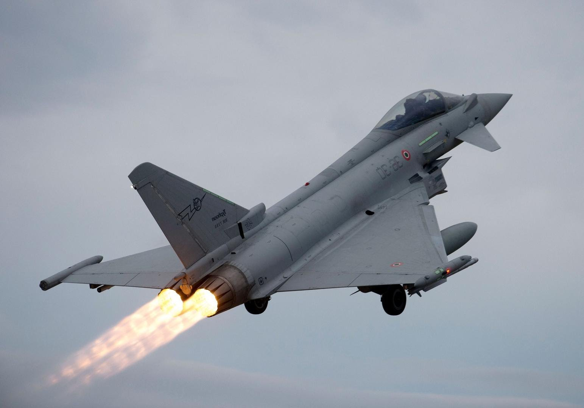
What is the ‘grey’ threat?
Comes from USAF 1995 report on Assessing the Next Generation Fighters… what isn’t currently a threat, but could be in the hand of ‘bad actors.’
Winfield’s CBRN definition: Agents and actors that don’t constitute a traditional threat, but are likely to become one.

Slide 5
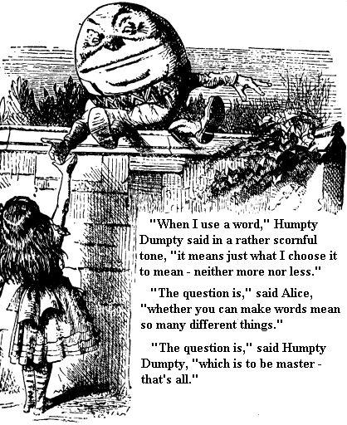
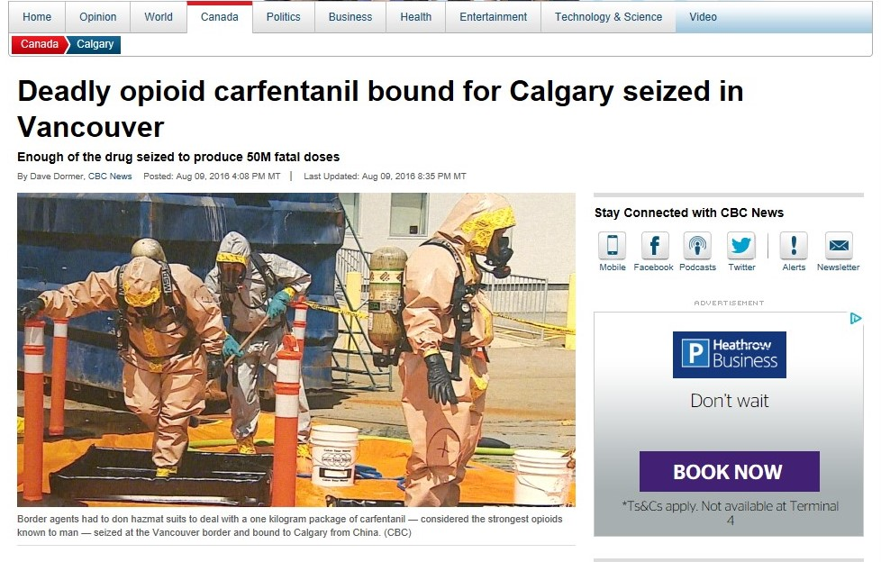
What is in a name??
Before CBRN, there was NBC and before that ABC, and in the beginning was chemical defence
Traditionally it is chemical, biological, radiological and nuclear weapons…
More recently it came to include toxic industrial chemicals, in whatever form they are released
There’s nothing to say that it has to conform – the whole concept is to be different.
Does it need a ‘bang’ or a mass body count? Many dispersal methods require no explosion and the onset of symptoms can range from hours to years
It doesn’t even need to be a weapon

Slide 6

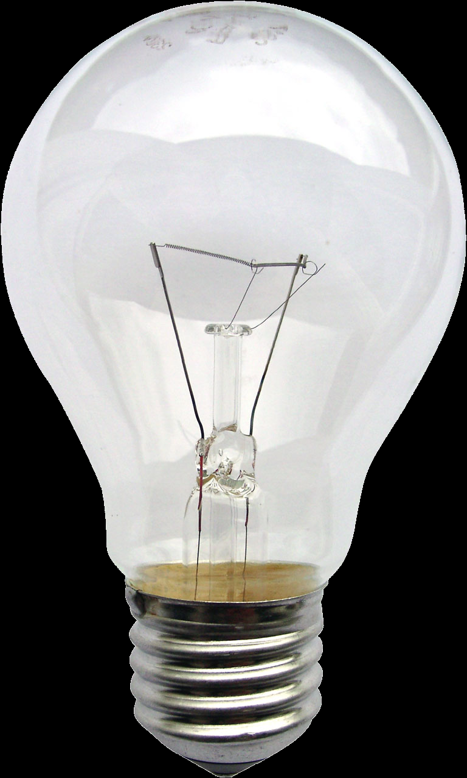


Terrorist CBRN Requirements chain
Chance of detection
Chance of detection
Chance of detection
Idea
Research
Agent creation
Device creation
Testing and Evaluation
Emplacement
Dissemination/ detonation
Technical challenges

Slide 7
Troubling times at Ridgemont High
Agent creation
Device creation
Testing and evaluation
Complex substances
Licensed substances
Need for protective equipment
Need to ensure that it is scalable
Need to ensure that it is toxic
Need to ensure that its potency is maintained until use
Different set of complex substances
Engineering problems
Tools are often expensive and noisy
Not everything is available online
Shortage of blueprints to follow
Difficult to find ranges
Difficult to remain undiscovered
Need for protective equipment
Difficult to do diagnostics of what went wrong.
Limited testing cycle due to shortage of material.

Slide 8

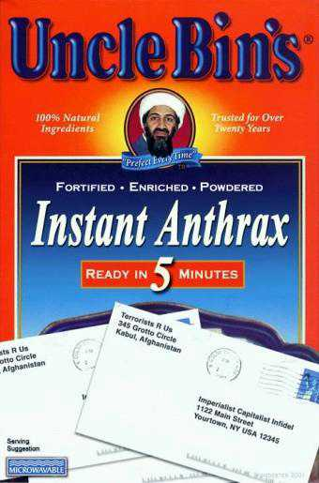
Individual needed for lucrative position that has understanding of chemistry and synthesising mixtures from range of precursors.
Incentivised working.
Must be able to work well as part of a team and on own.
Problem solver
Used to working in austere environments
Suits motivated individual that is happy with ‘cash in hand.’
No week like another…

Slide 9


If only there was someone that could help?
Criminals can provide most of the answers to these problems – labs, expertise and no questions asked in return for cash.
Jordan Gonzalez, arrested in 2013, pharmacist in NJ, 1,000s of ricin and abrin seeds, explosive precursors and ammunition for other people.
Jesse William Korff, arrested in 2014, 19yr old student in FL, sold ricin and abrin to customers in UK, Denmark, India and Austria as well as US. Hid the ampules of ricin inside candles.

Slide 10

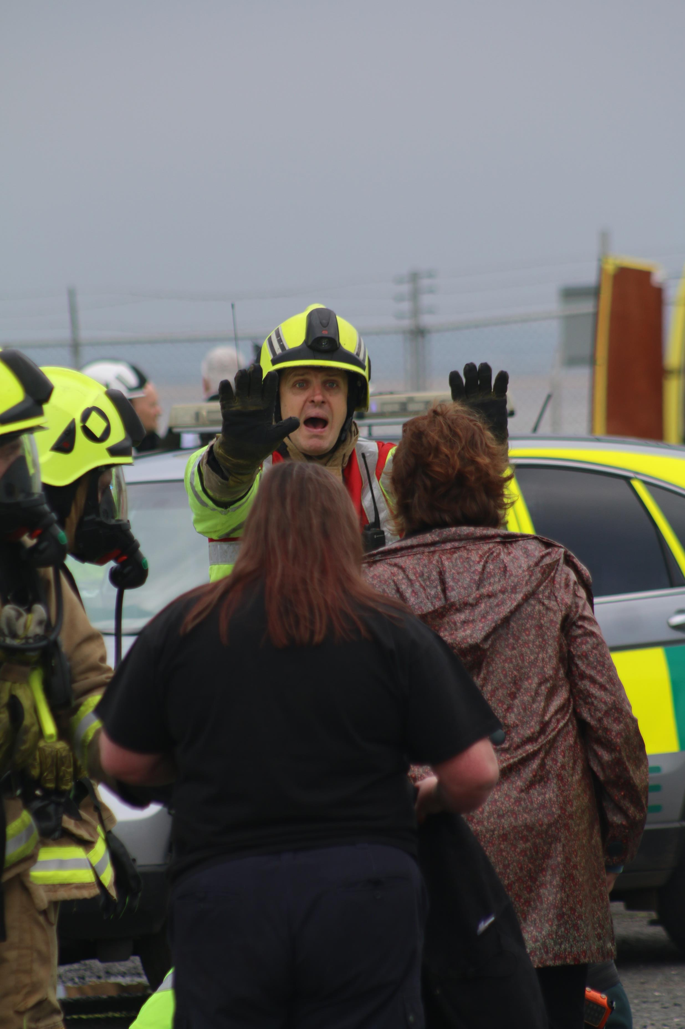
UK police force
Two cases going through court at the moment, limited information that can be made available.
Criminal gangs are moving from cannabis, to meth to home made explosives. Interested in providing chemistry expertise to highest bidder.
50% of terrorist attacks in UK have used explosives, 100% of those explosives have been HME. There is a growing market for HME in the UK.
Using drug funds to allow terrorist attacks
Growing interest in using fentanyl as a murder weapon, including technology to weaponise it and kill more than one person.
Joint Terrorist Assessment in the UK for CBRN has increased threat level due to all this chatter

Slide 11
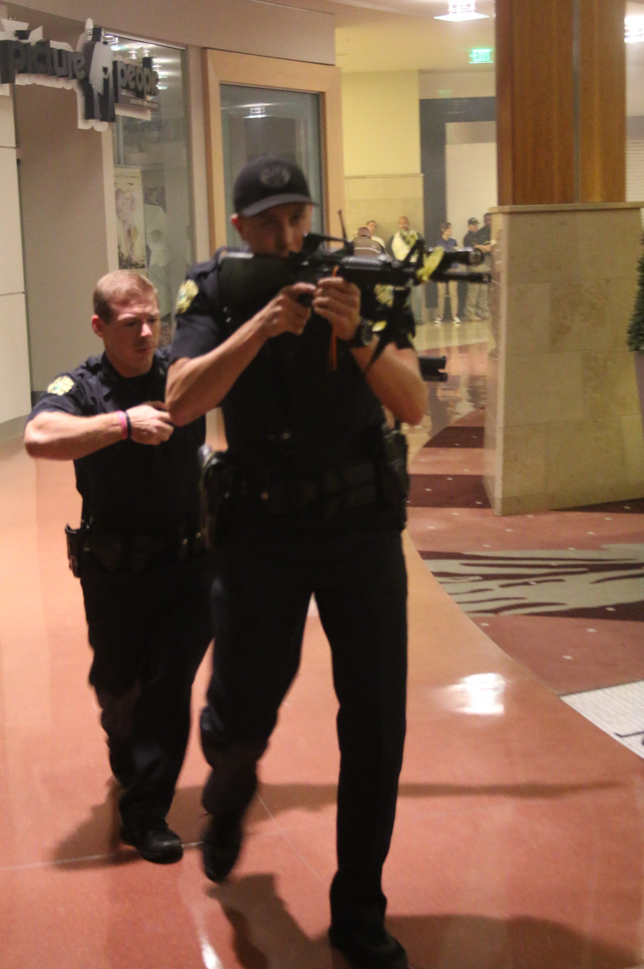
Something rotten in Nashville
1 in six people in Tennessee are addicted to synthetic opiates, second highest in the US.
1451 died from overdose in 2015 and this is expected to rise.
‘Front man’ sets up a pharmacy ‘business,’ buys fentanyl from China, then closes business and ships fentanyl to third party for cutting.
Current court case for an individual accused of seven deaths and suspected of 80 murders.
Labs have been found with booby traps to throw pure fentanyl into the faces of law enforcement

Slide 12
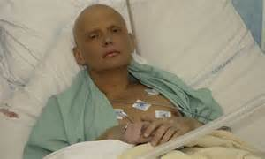
The scale of the problem
Profiles of Incidents Involving CBRN Use by Non-state Actors (POICN) Database from the University of Maryland currently contains 518 total cases since 1990
These cases include radiological, biological and chemical…. But not synthetic opioids.
If it did it would be 10x (100x?) higher.
Many of them contain poisoning of food/beverages to kill family members and friends.
Like Nam, there is a shortage of CBRN forensics. Pakistan, May 2016, 70+ injured, 30 dead from eating sweets poisoned with pesticide. Police extracted three confessions from family and competitors.
Sunanda Pushkar, Wife of Indian Ex-Prime Minister. Killed after a period of marital difficulty. Initial verdict was ruled a suicide, verdict overturned and a new one of murder was given. Government lab has given a list of things they cannot detect

Slide 13
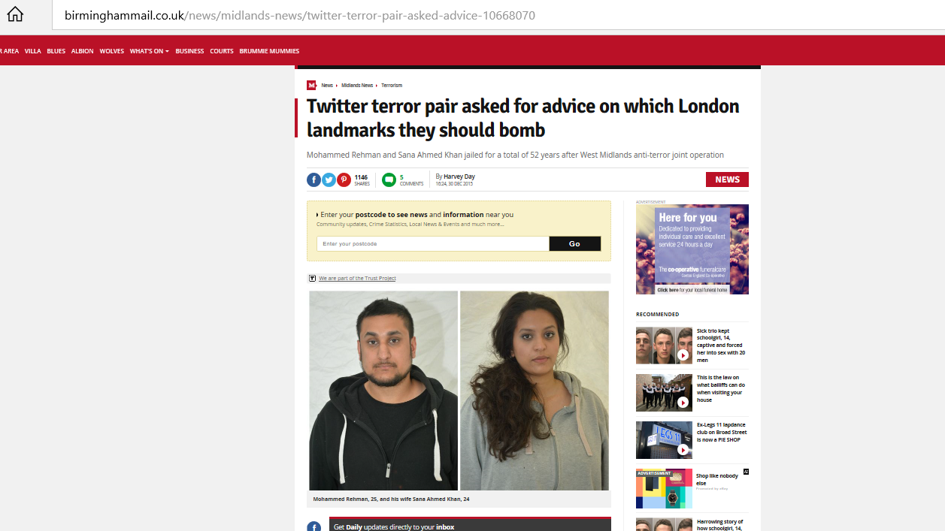
We can’t always get lucky…
Mohammed Rehman stockpiled explosives and asked Twitter followers whether to target shopping centre or London Underground
“Westfield shopping centre or London underground?” Any advice would be appreciated greatly…”
10kg of Urea Nitrate
Sentenced to 52 years between them

Slide 14
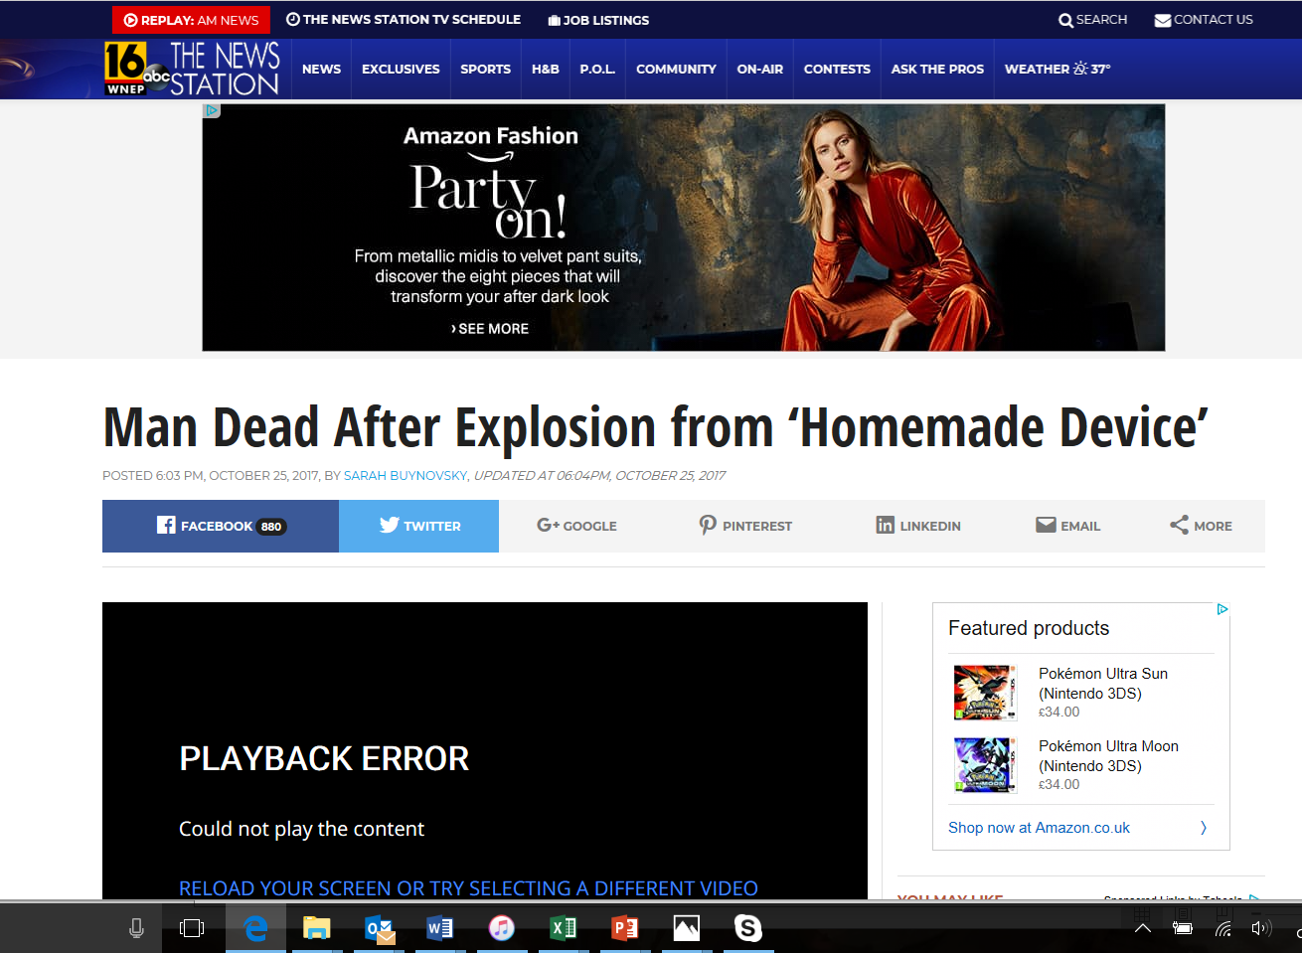
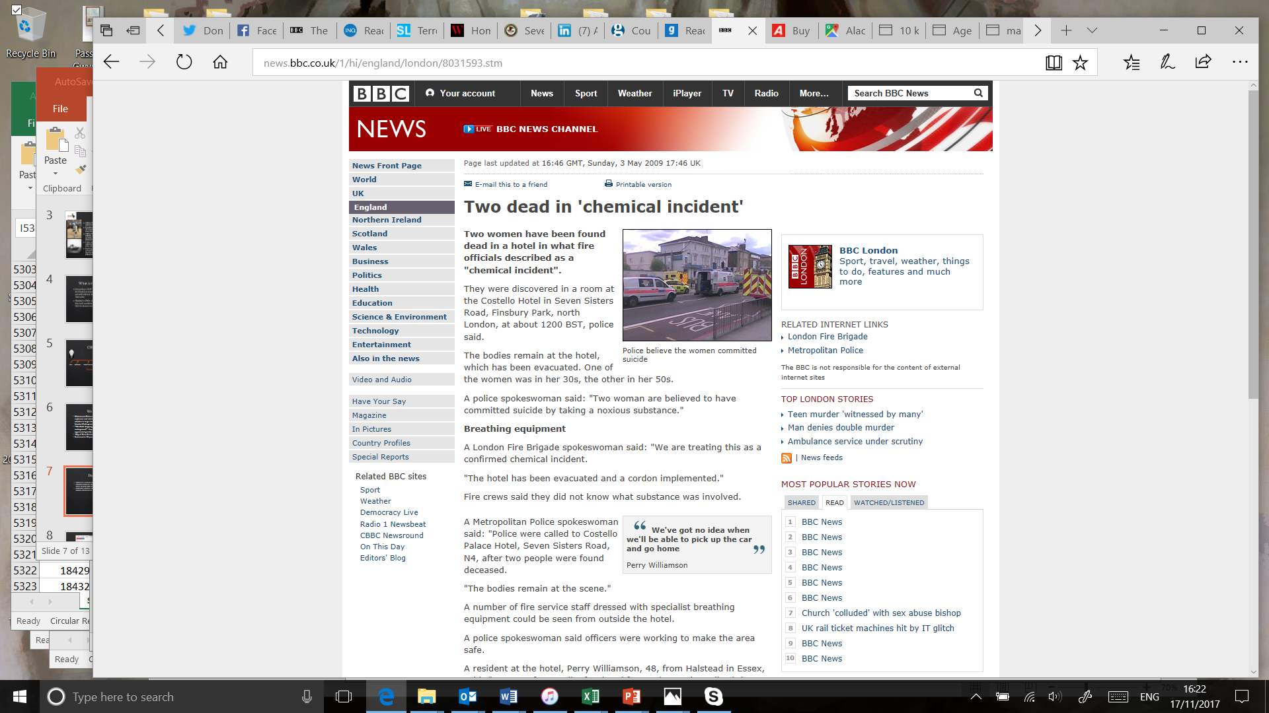
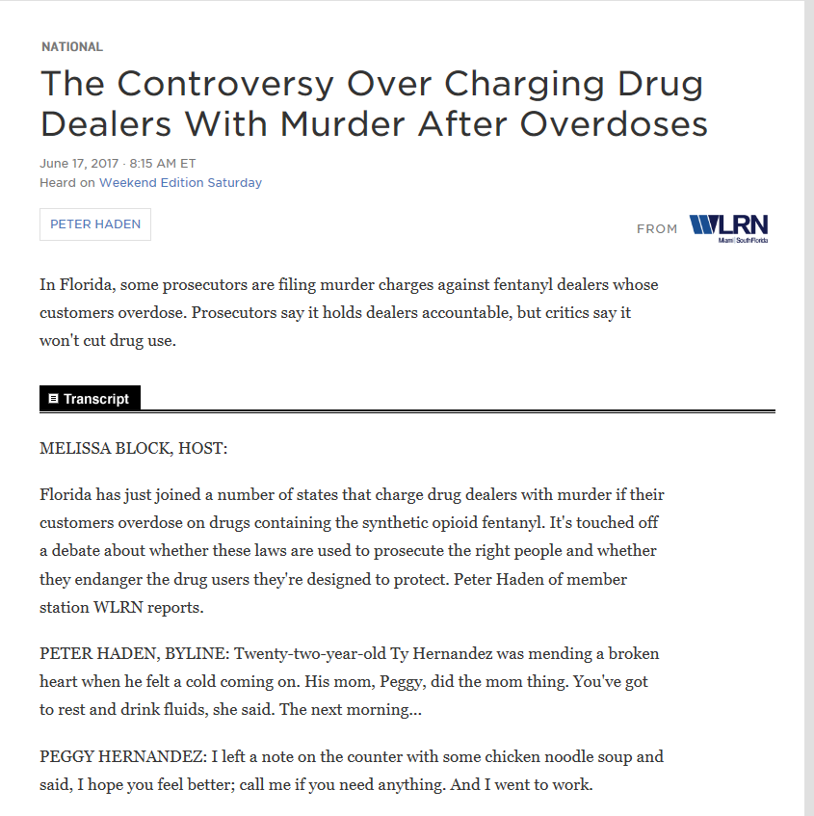
Darwin does play a role…
Chemistry is far harder than it looks on TV.
Thankfully explosives tend to thin out the herd… but what about toxic chemicals?
When does a drug overdose become a drug murder…
Deaths involving toxic substances are becoming more common

Slide 15
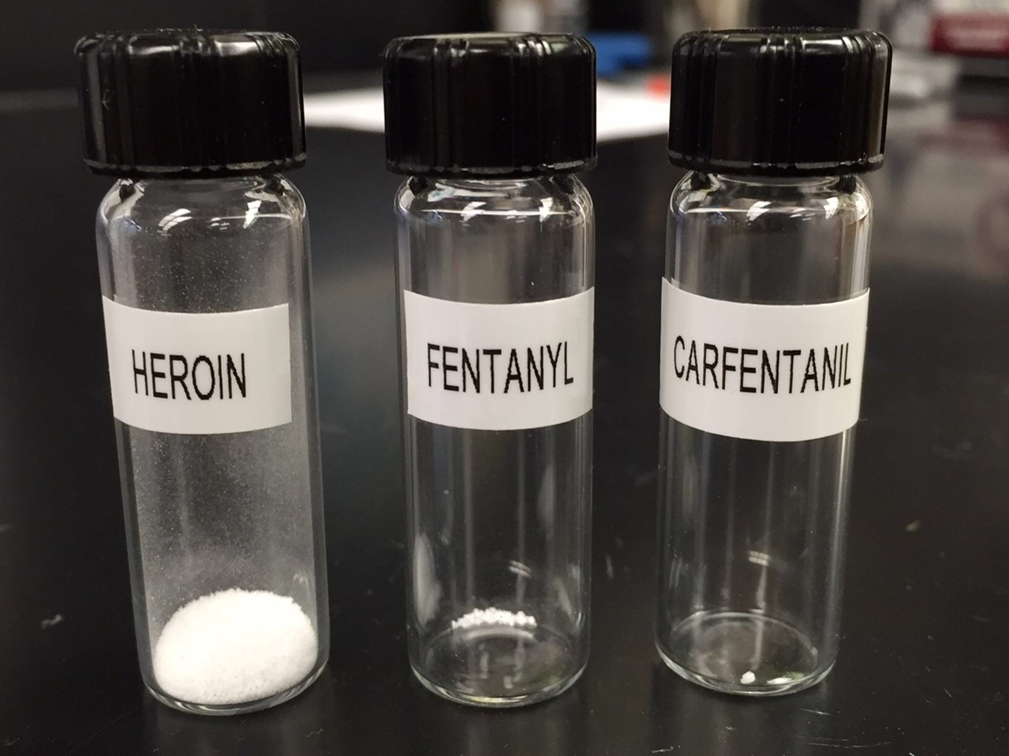
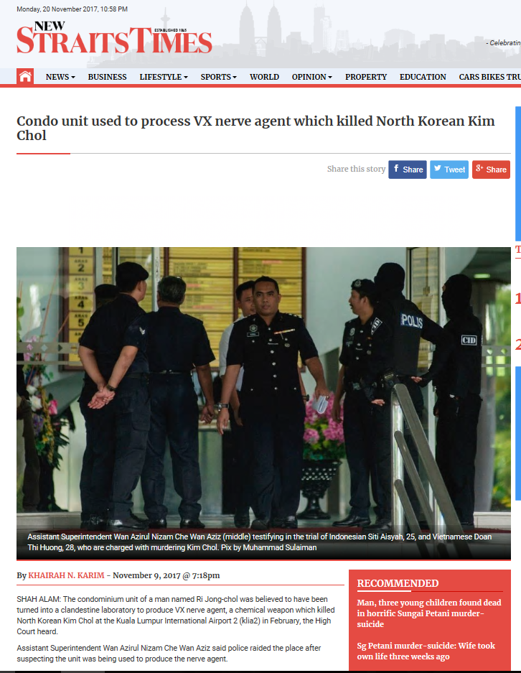
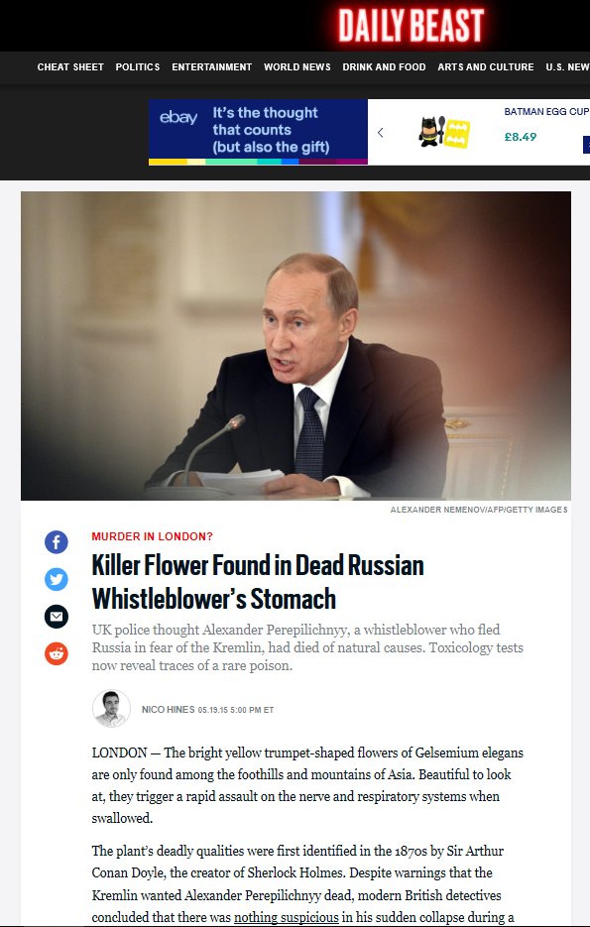
So what?
Normal law enforcement are not trained to look for many of the signifiers of a CBRN incident, and many hazmat/CBRN individuals are not trained to go into a crime scene.
“When asked by Gooi why police did not seize any of Jong-chol's clothes or nail clippings to detect the existence of VX agent, Assistant Superintendent Wan Azirul Nizam Che Wan Aziz said it was not necessary at that time.”
“The plant, which is also known as heartbreak grass, had not been identified in any of the original toxicology investigations.”
Synthetic opioids are much easier to buy than traditional CW, and can be equally, or more, toxic.
Difficult to detect, especially as it will be a mixture and in small quantities
Requires careful decontamination and attention to detail

Slide 16
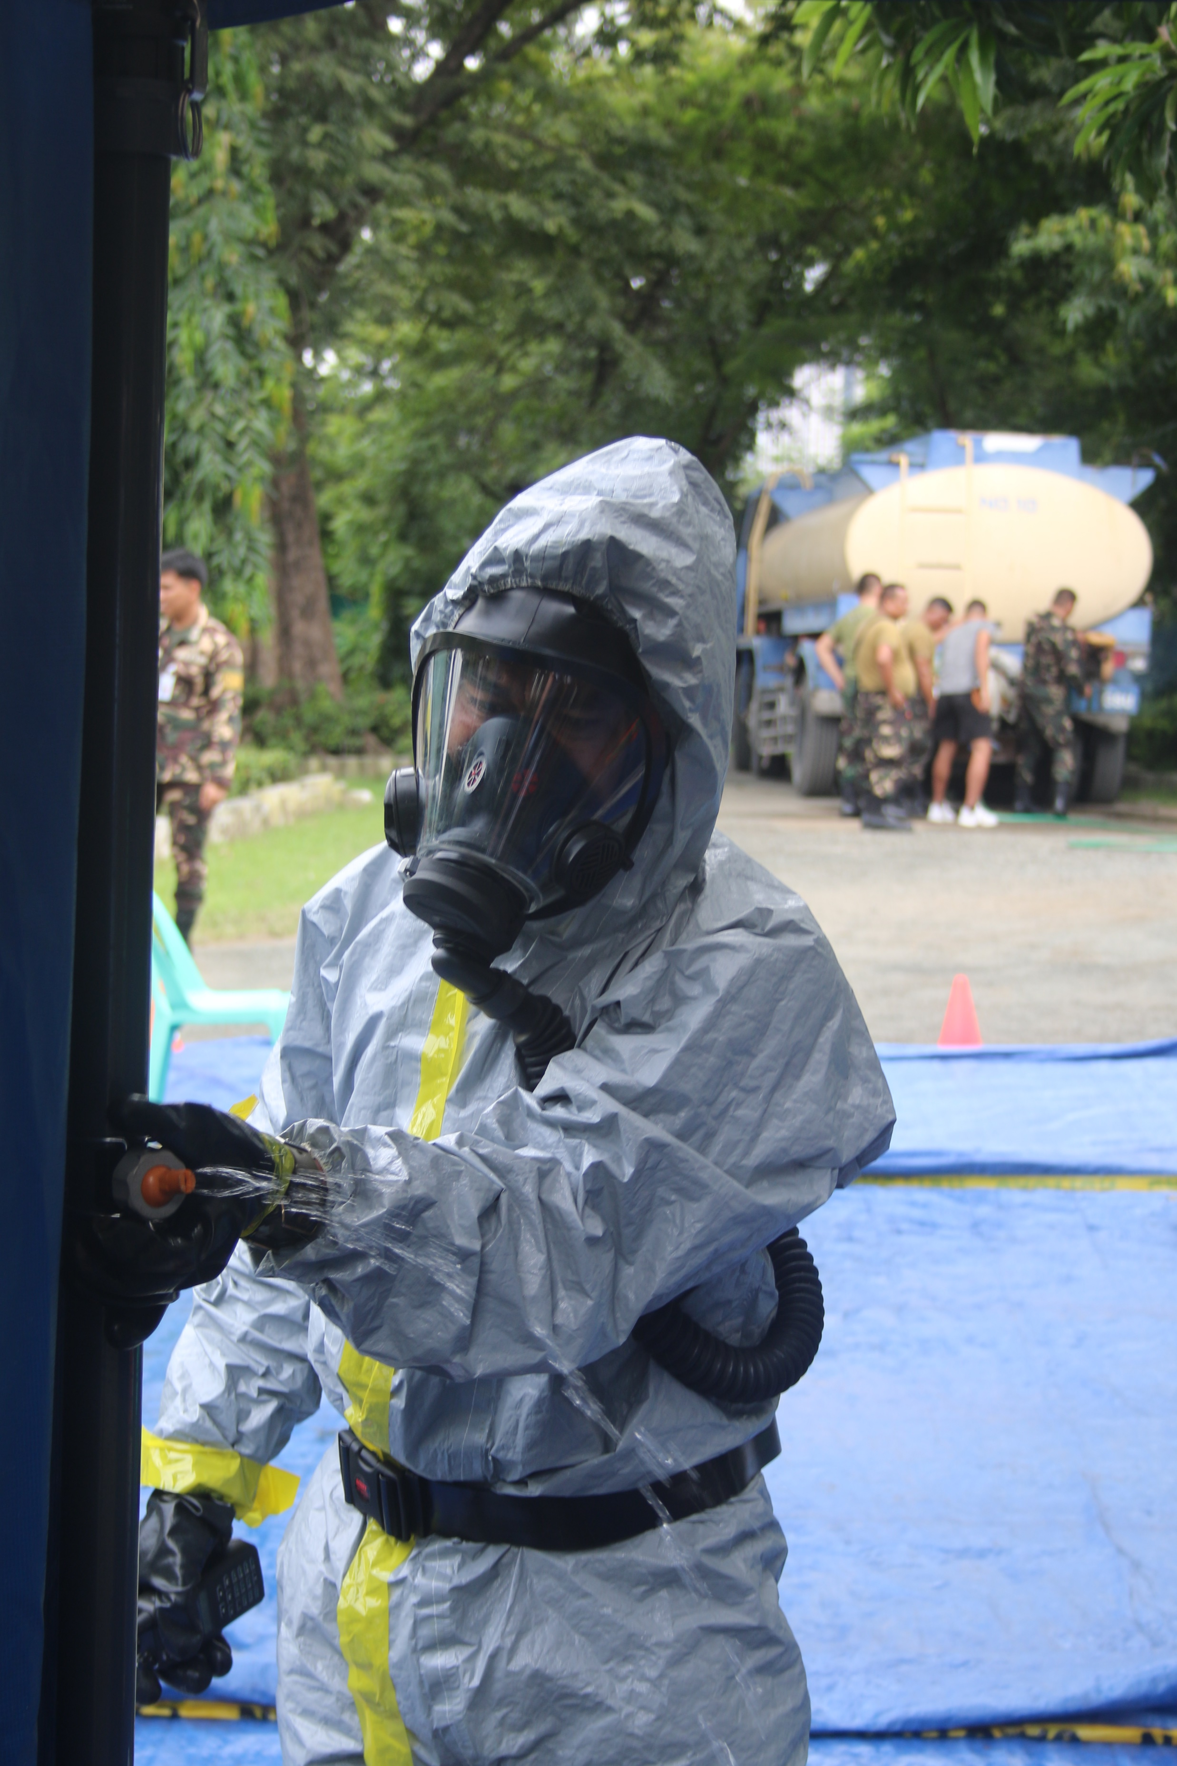
It’s not ‘which,’ it’s ‘both’
The major CBRN threats still need to be prepared for
The ‘grey threat’ is the base level threat
It allows political justification and the bed rock of CBRN defence & forensics
It brings disparate organisations together before they need to stand over the crater
It helps deliver ‘on the job’ training

Slide 17
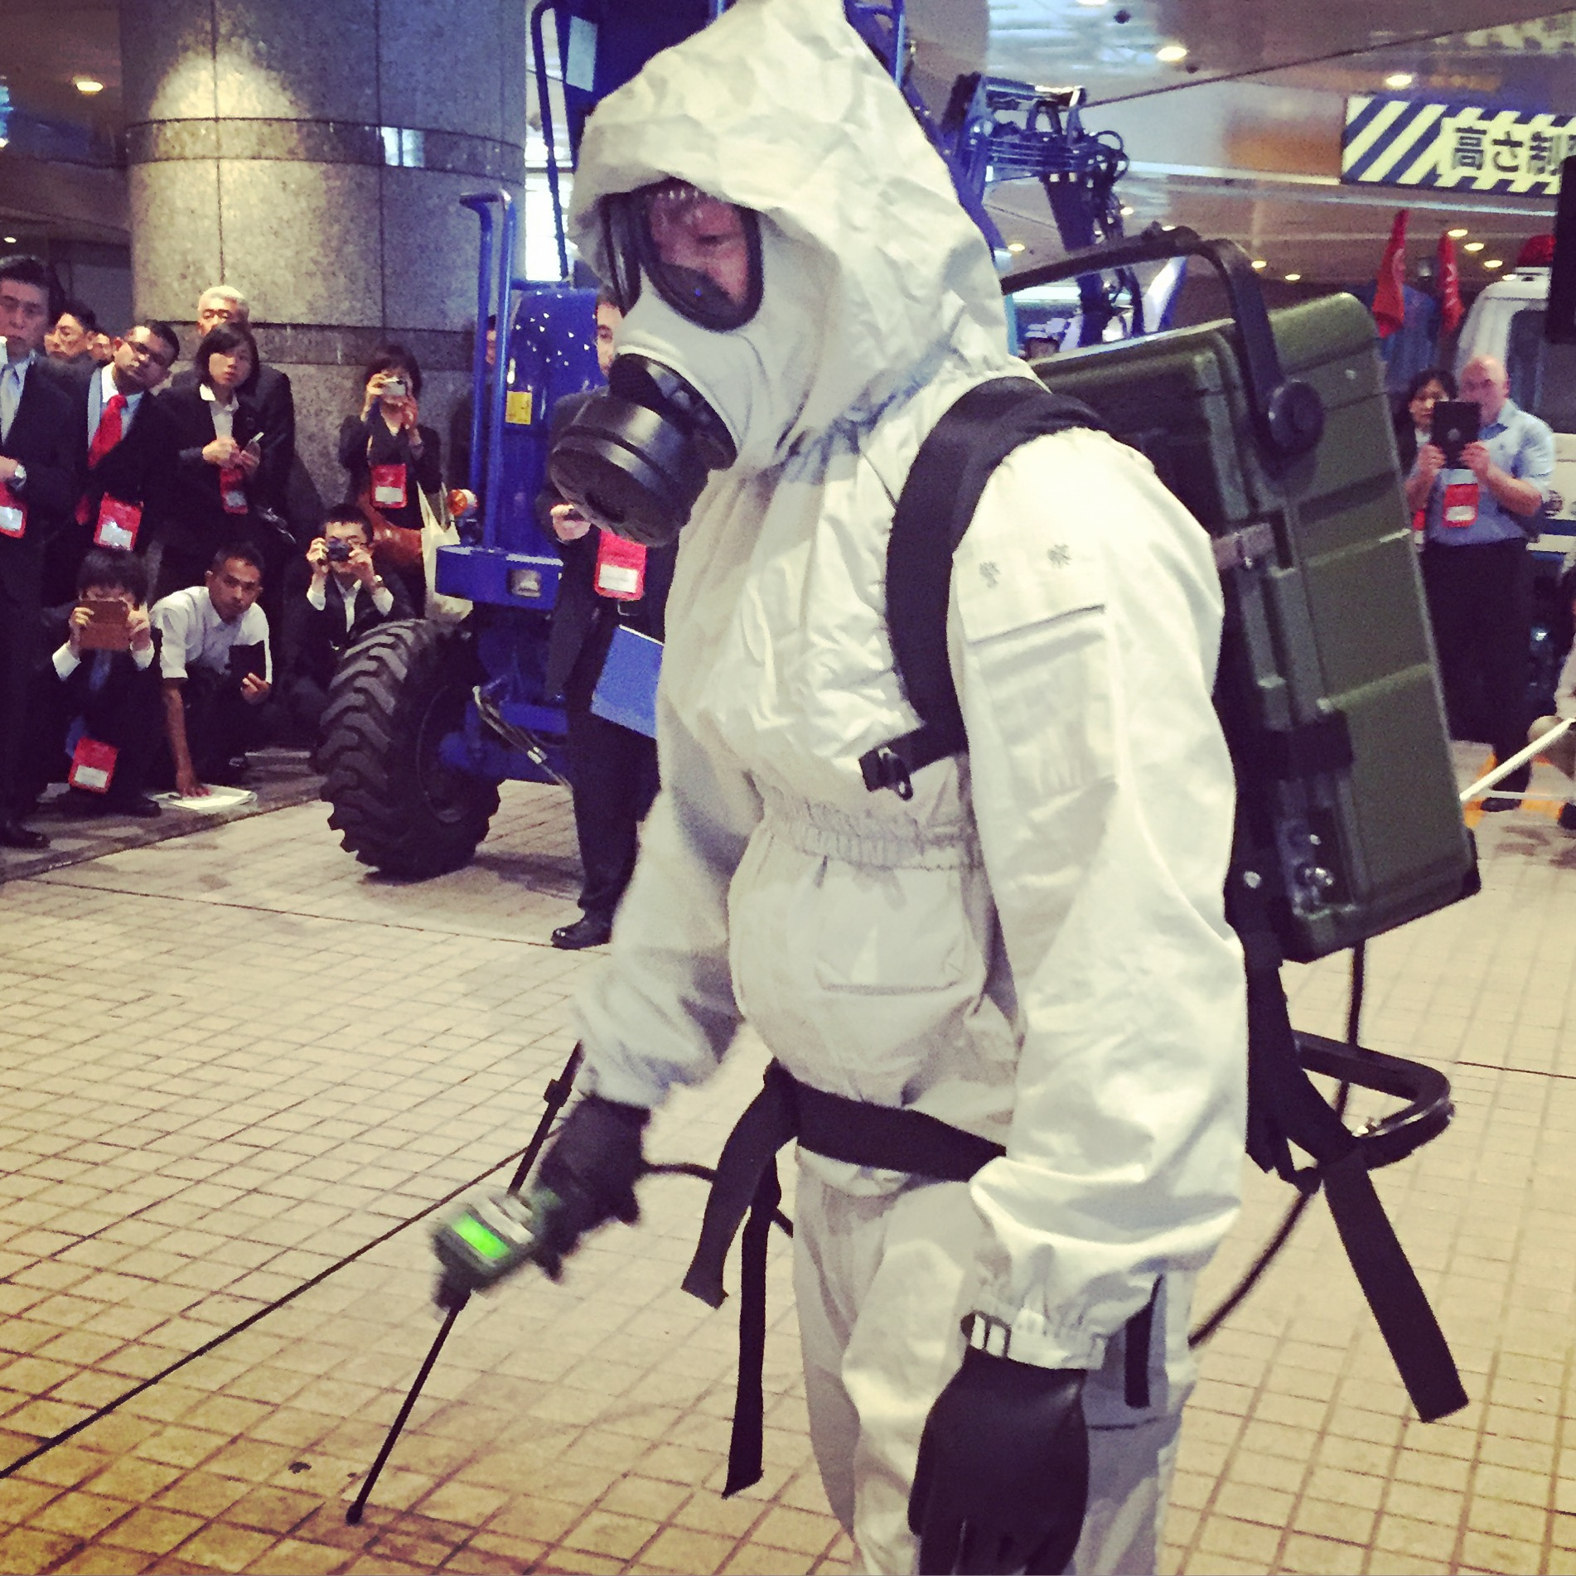
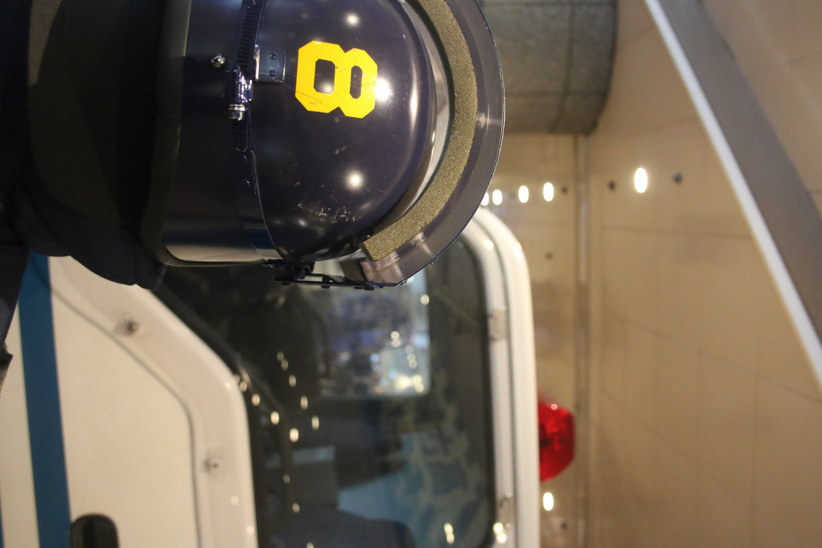

What are the first steps?
Identify the agencies. Traditional CBRN vs Grey CBRN has different players, such as counter-narcotics.
1
Do some training, preferably live agent, and work out patience/tolerance
2
Build policy that allows a ‘coalition of the willing.’ Listen…
3
Bring non-traditional agencies into the response tent – forensics, pathologists, environmental health
4
Put together a national, regional and international laboratory response network
5

Slide 18



Questions
?
Gwyn.Winfield@cbrneworld.com
+44 1962 832532
12 years of copies of the magazine including many
articles on everything featured here via
a free subscription at www.cbrneworld.com
Thanks to Markus Binder & Steve Sin at UMD, Nashville FD and UK Police
CBRNe Convergence
6-8 November, 2018
Rosen Plaza, Orlando, FL
www.cbrneworld.com/cbrneconvergence2018

