Slide 1

DOSIMETRY SYSTEMS
FOR
RADIATION
MEASUREMENT
İlkem AYDOĞAN
Msc nuclear engineer

Slide 2
Dosimetry Systems
Personal Dosimetry
  a) Passive Personal Dosimetry
    Film dosimetry systems (old system)
    Thermo Luminescence (TL) dosimetry systems,
    Optical Stimulated Luminescence (OSL) dosimetry systems
    Whole Body Dosemeters (Hp(10))
    Extremity Dosemeters (Hp(0.07))
    Lens Dosemeters (Hp(3))
    Neutron Dosemeters

Slide 3
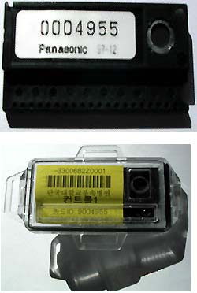
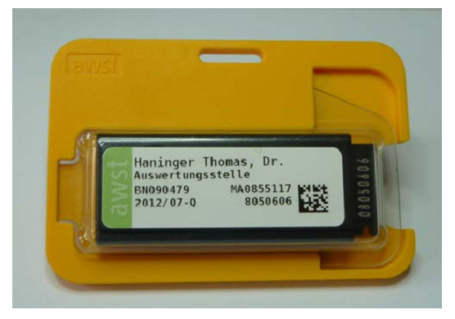
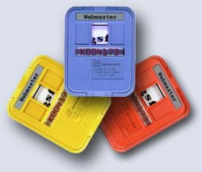
Personal Dosimetry Systems
Whole Body Dose Measurement Hp(10)
TL Dosemeters
Film Dosemeters
OSL Dosemeters

Slide 4
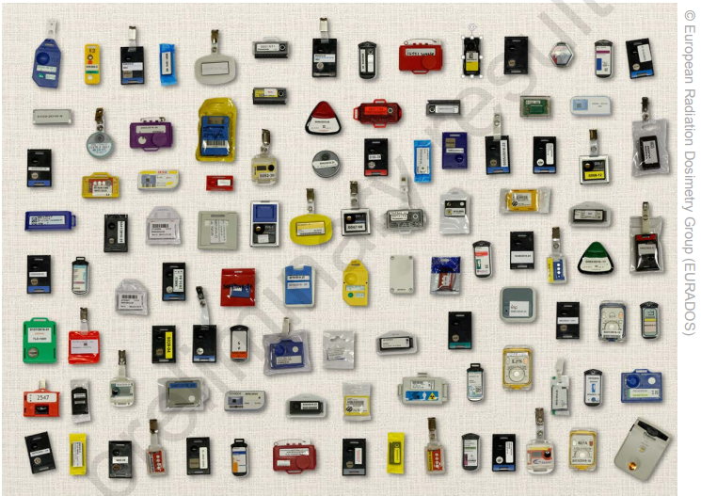
Whole Body Dose Measurement Hp(10)

Slide 5
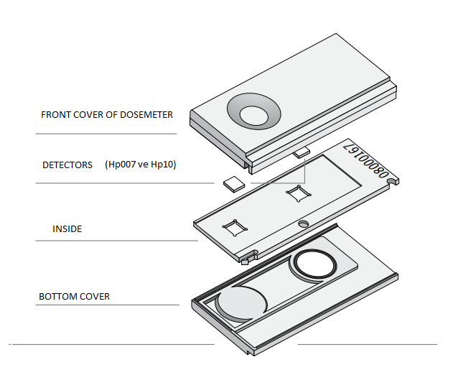
Lastest Technology:
Optical Stimulated Luminescence (OSL) Systems
Advantages:
Best of Zeff tissue equivalent,
Low dependency of energy
High resistance material
Re-readeble detectors

Slide 6
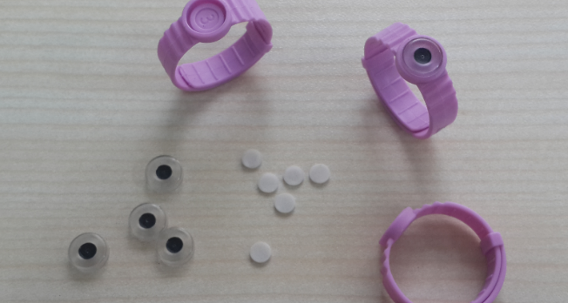
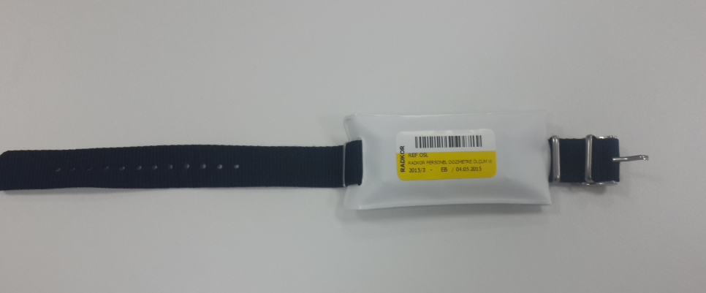
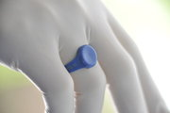
Extremity Dose Measurement Hp(0.07)
Measuring tissue dose equivalent
Ring and wrist holder options

Slide 7
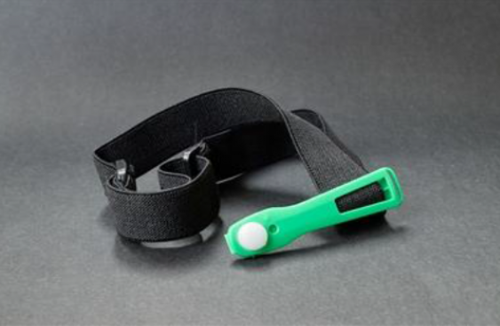
The lens of the eye dose measurement Hp(3)
20 mSv per year
averaged over 5 consecutive years,
and 50 mSv in any single year

Slide 8
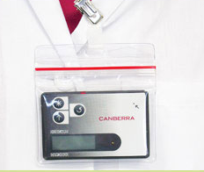
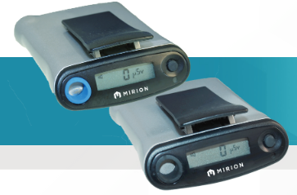
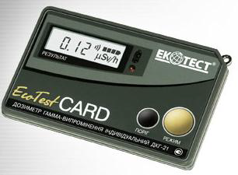
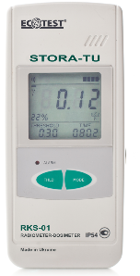
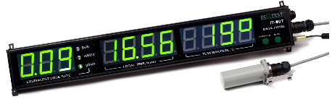
Personal Dosimetry Systems
Personal Dosimetry
b) Active Personal Dosimetry:
  Electronic Personal Dosimeter
    X-rays and gamma radiation
    Beta radiation
    Neutron
  Survey Meters

Slide 9
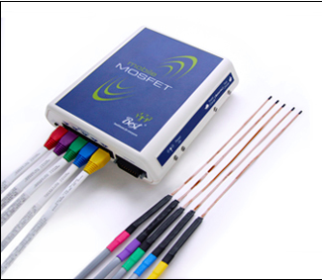
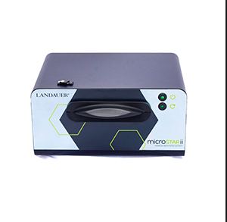
Dosimetry Systems
Patient Dosimetry
For tracking patient radiation exposure reducing radiation errors in medical imagining (diagnosis applications with radiation).
It may be obligation in Europe according to COUNCIL DIRECTIVE 2013/59/EURATOM after February 2018
Main Products as MOSFET (Best Medical),
Landauer and RADKOR

Slide 10
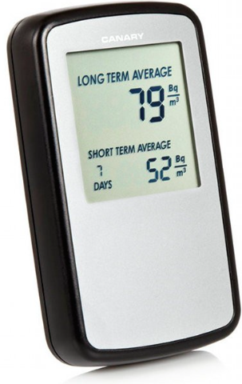
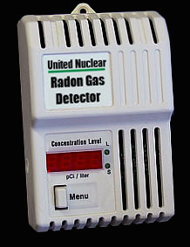
Dosimetry Systems
Environmental Dose Measuring
  Radon Gas Measuring
For determination of Rn effects in especially houses and workplaces.

Slide 11
Production by RADKOR
Design, development, production in Turkey
- Extremity OSL Dosimetry Systems (in Test Processsing)
  Ring Dosemeter
  Wrist Dosemeter
- Lens Dosemeter (in Test Processsing)
- Active (Electronic) Personal Dosemeter (at R&D stage)
- Patient OSL Dosimetry Systems (in Test Processsing)
- Neutron Dosimetry (in Project)
- Radon Gas Measurement (in Project)

Slide 12

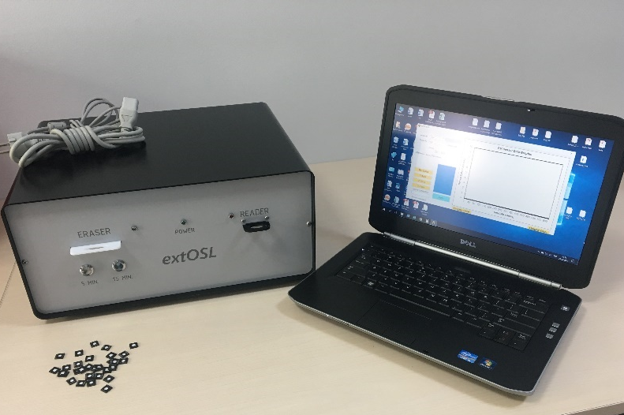
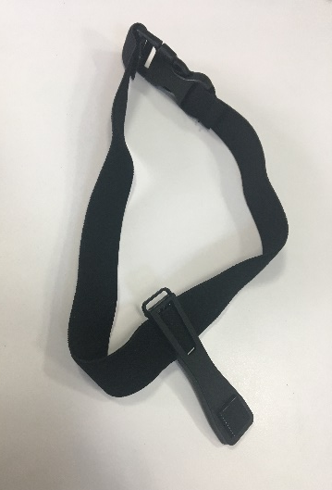
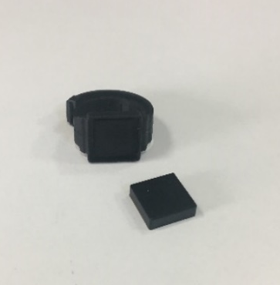
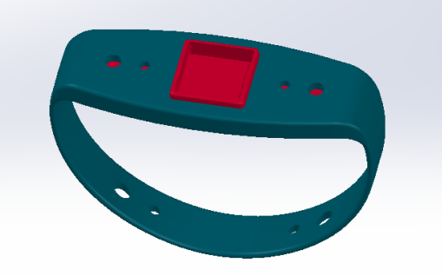
Production by RADKOR
Extremity OSL Dosimetry System was developed extremity and eye dosimetry systems, based on OSL technology, show unique property at first time in the World.

Slide 13

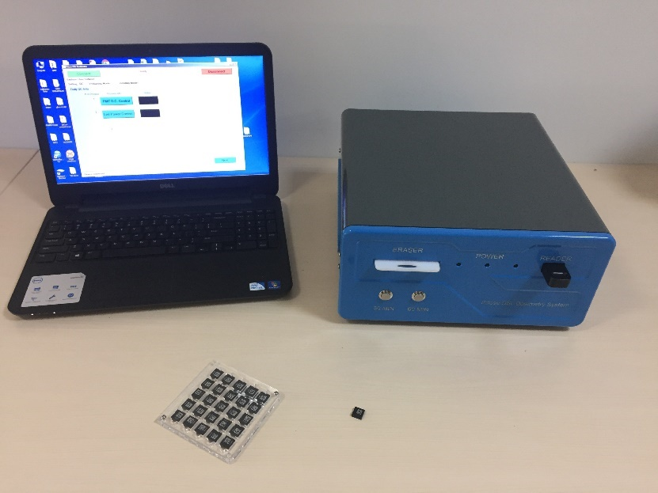
Production by RADKOR
Pdose OSL dosimetry system was designed with the intent of availability of patient dose tracking in medical applications such as Mammography, Fluoroscopy, Computerized Tomography (CT) and Radiology- X-ray in Radiology departments and Radiotherapy.

Slide 14
Production by RADKOR
- Active (Electronic) Dosemeter System (at R&D stage)
Features:
Measuring dose and dose rates in Hp(10) and der(Hp(10))
Essential precaution by Audio and Led Alarm
Alarm levels are predefined for each user
Ergonomic
PC connection and easy reporting
Rechargeable battery

Slide 15
Production by RADKOR
Designing of CR-39 based Neutron Dosimetry (Fast and Thermal neutron) and Radon Detector are continuing
Within next 5 years, whole dosimetry systems will be produced by RADKOR in TURKEY (Finalizing in 2023.)

Slide 16
Thank you for your attention…

