Slide 1

Hotzone Solutions Group
Hazardous Substances Management Solutions

Slide 2
Why Live Agents Training?
o.Mattmann
HotzoneSolutions Group CEO

Slide 3
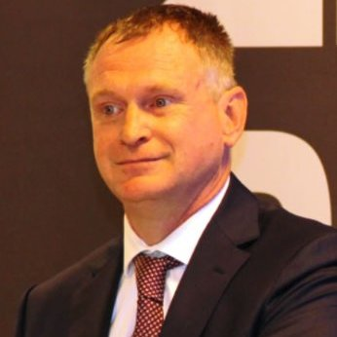
Chief Executive Officer
Olivier Mattmann
NBC defense officer
OPCW Inspector
Radiation specialist
NDE specialist
OPCW Instructor

Slide 4
OUR Mission
To enable first responders to prevent, protect, prepare for, respond to, and recover from the full spectrum of CBRNE threats,
To provide CBRNE environmental protection and remediation solutions, and
To provide a full range of solutions for management of hazardous substances.

Slide 5
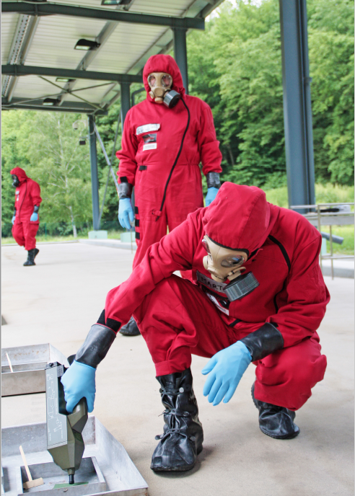
Why Live Agents Trg (LAT)?
CBRN is more difficult due to:
  EOD/IED
  Forensics
  Mixed compounds
Training & Exercises
Ensure proper control
How do you know whether personnel are adequately prepared until they actually respond to the situation?

Slide 6
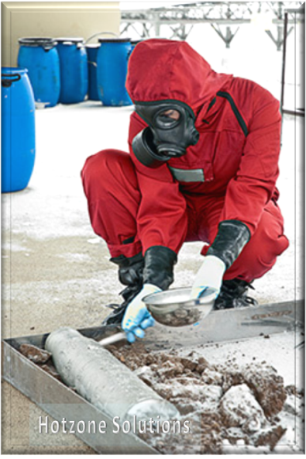
Benefits
1) Increases Protection of Personnel and organisation
Provides better understanding
Build confidence
Helps to ensure compliance with legislation
2) Leads to gains in efficiency
Ensure quicker response times from arrival on scene
Improves decision making & reduces mistakes
Allow shorter incident duration
Overall, reduced impact of incidents on communities and economies

Slide 7
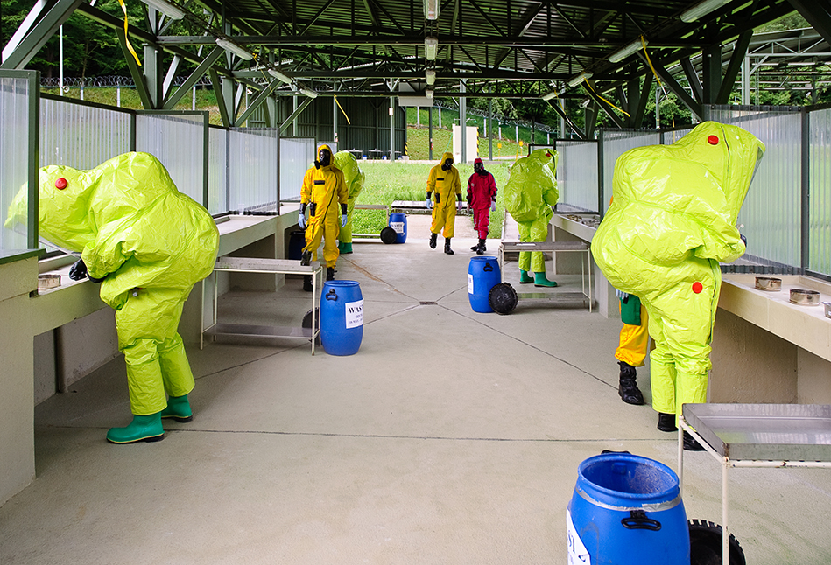
BUT
Inappropriate Training can have devastating consequences!
If Training is not adequate for the task, the additional confidence can be misplaced and have dramatic consequences

Slide 8
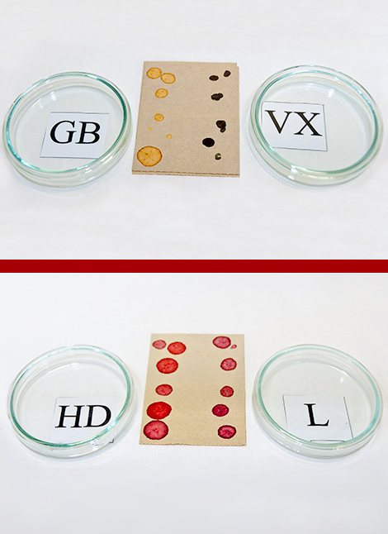
Nothing is more dangerous than “a little bit of knowledge”
“a little bit of knowledge” can lead to more active failures because Decision Makers think they know enough!
Simulants training is often not adequate to the task. It can build false confidence and understanding
LAT build REAL experience, e.g.:
  Mustard freezes below 13°C
  Detection is totally different (reality of the
  limitations of the detectors with false + and false -)
  Evaporation and behavior of GB
  Donning procedures more accurate
  Stress levels

Slide 9
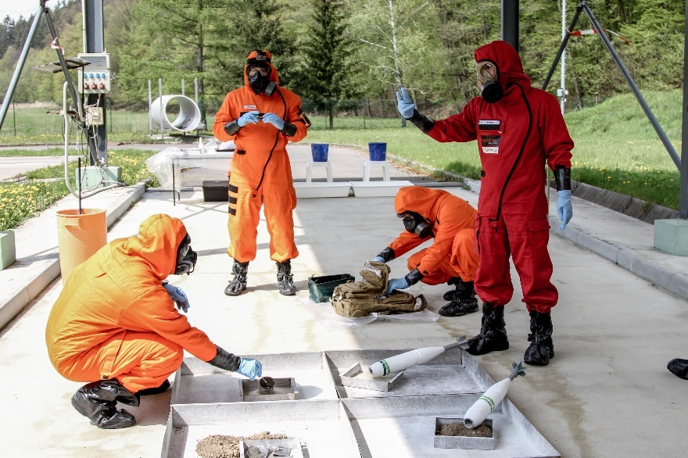
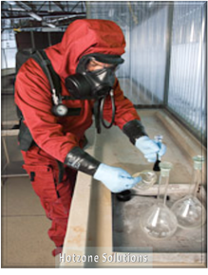
Training to perform a high stakes job requires realistic training where the situation most closely matches likely real-World conditions.

Slide 10
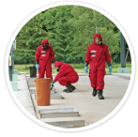
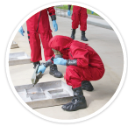
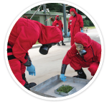
  Live agent training builds real experience and real preparedness and leads to more productivity gains than simulant training

Slide 11
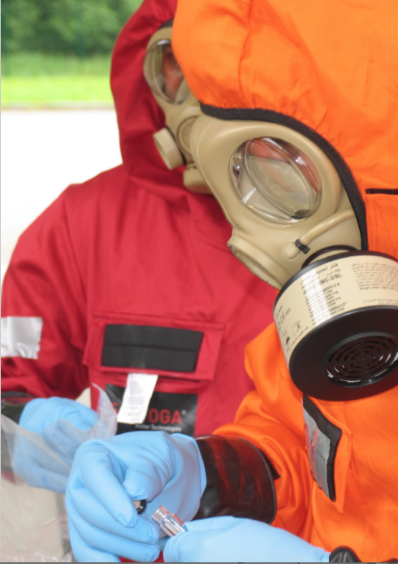
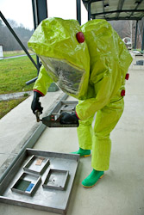
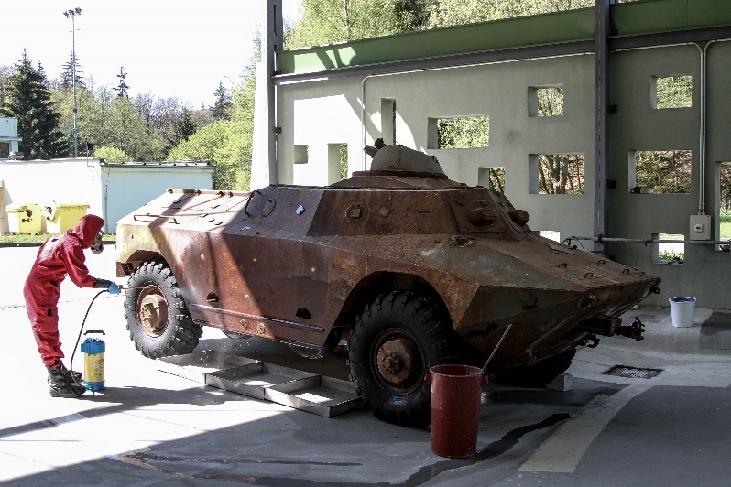
Trainers believe that training doesn’t cost; it pays.
Human resource development is an investment, not an expense, yet in tough economic times, training budgets are a soft target for cuts unless it can be shown that the return on the investment justifies the expense.

Slide 12
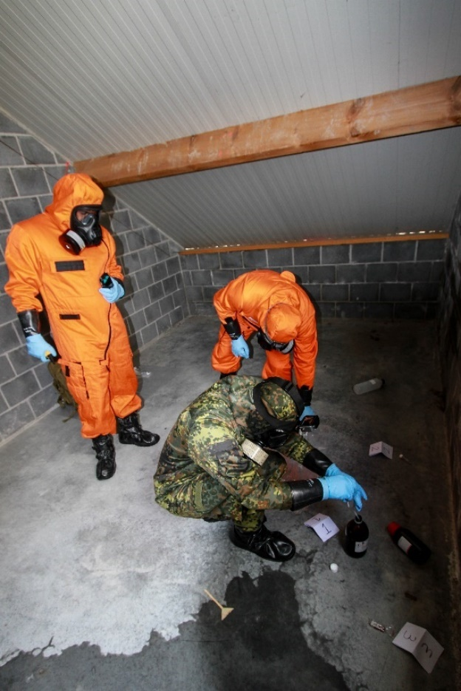
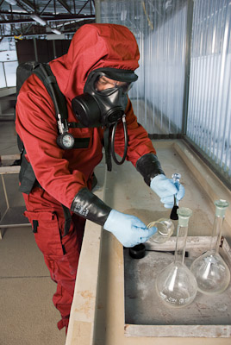
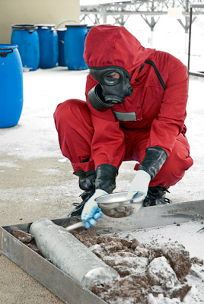
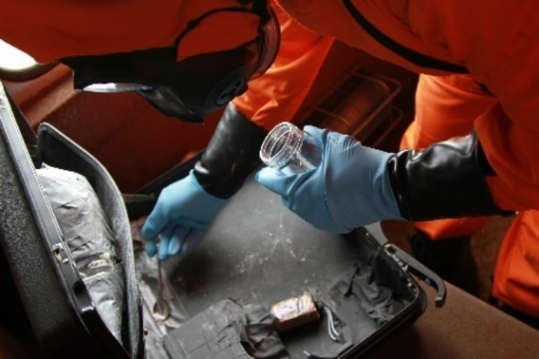
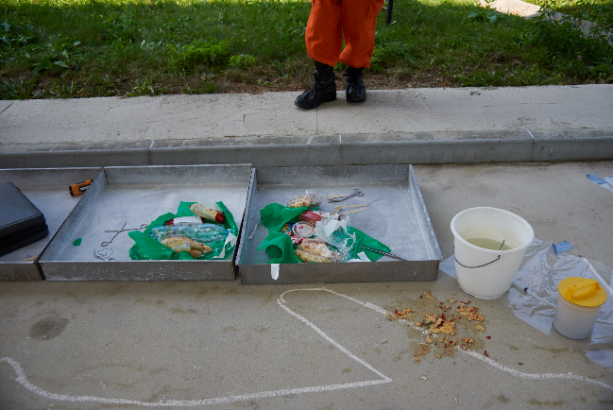
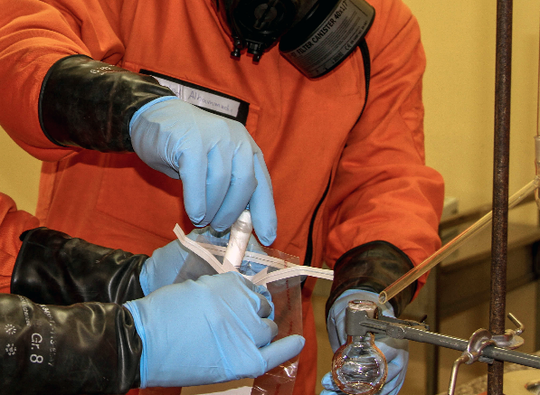
Sampling and Forensic Evidence Collection
LIVE CWA/BWA/RAD TRAINING

Slide 13
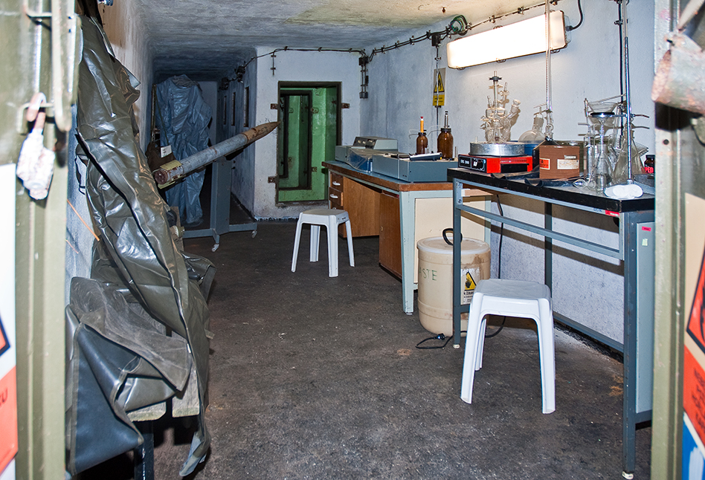
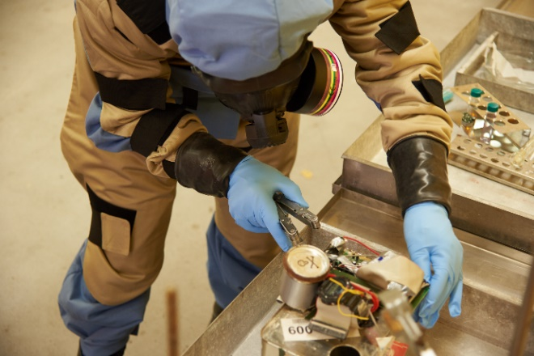
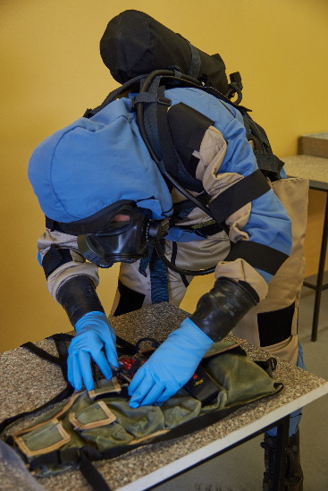
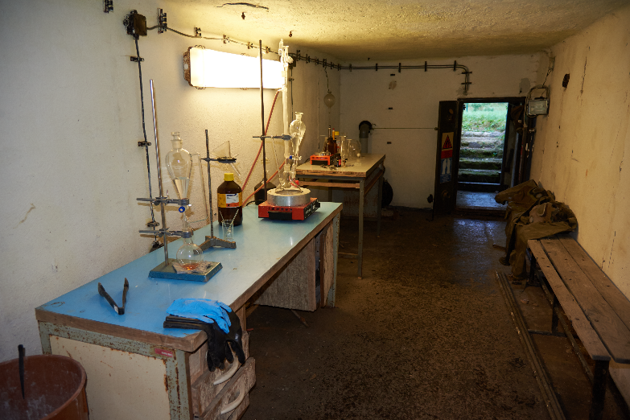
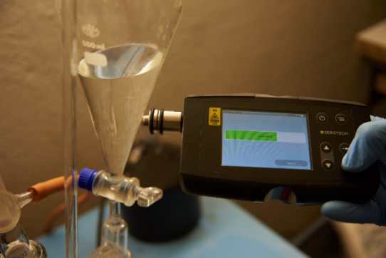
CBRNE and IED Clandestine Laboratories
LIVE CWA/BWA/RAD TRAINING

Slide 14
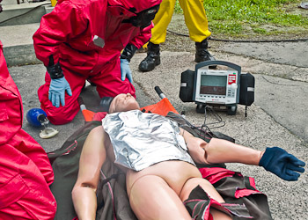
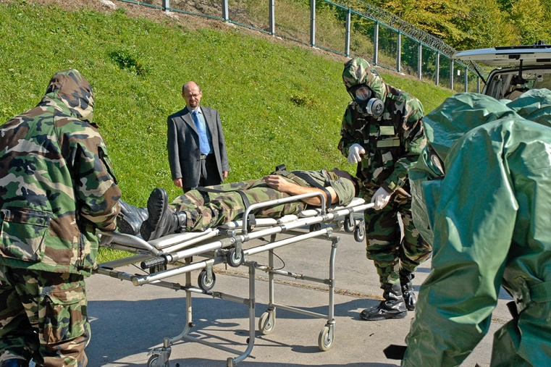
LIVE CWA/BWA/RAD TRAINING
CBRN Medical EVAC

Slide 15
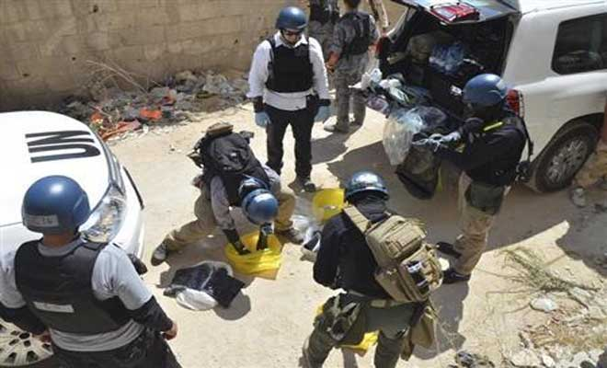
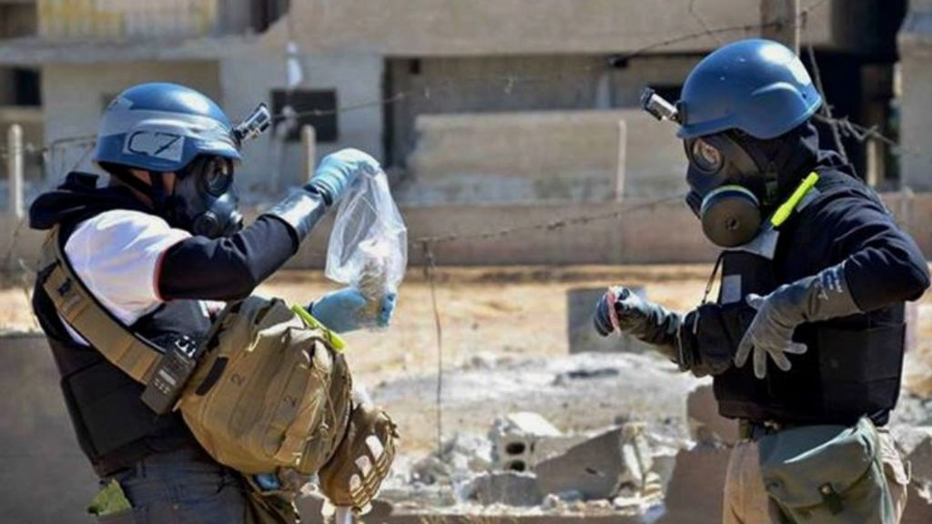
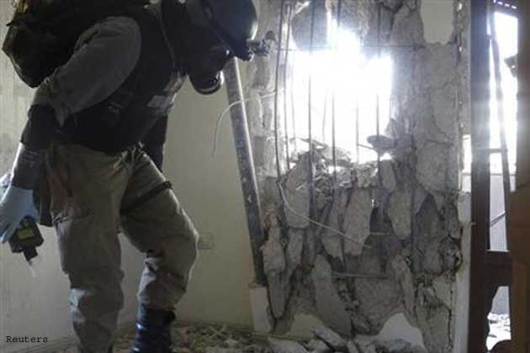
Proven Concept: used by the OPCW in Syria
HZS Video1.avi
CBRNE SAMPLING KIT (Cont.)

Slide 16
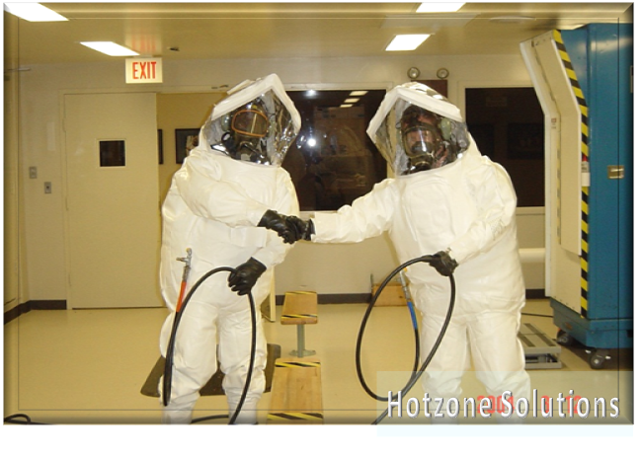
A Firemen is a real one only after his first fire!”
HotZone Solutions is committed to providing a safe place of work, while at the same time ensuring that training with live agents has value and is effective.

