Slide 1

Incident Command System
Fire Rescue Service
Czech Republic

Slide 2

Incident Command System FRS CZ
Integrated Rescue System of the Czech Republic
Fire Rescue Service of the Czech Republic
HAZMAT Support points FRS CZ
Tactical procedures FRS CZ

Slide 3
CZ Integrated Rescue System
IRS CZ is established under the Act No.239/2000
Integrated Rescue System is determined for coordination of rescue operations in case, where a situation requires operation of forces and means of several bodies
Basic IRS bodies:
  Fire Rescue Service of CZ and other fire units
  Police of the Czech Republic
  Medical Rescue Service

Slide 4
CZ Integrated Rescue System
Other IRS bodies:
Specified forces and means of Czech army
Other armed security services
Other rescue services
Public health protection authorities
Emergency, stand-by, specialized and other services
Civil Protection establishments
NGOs and civil associations, which can be used for rescue operations

Slide 6
Fire Rescue Service of the Czech Republic
Mission and Tasks FRS CZ:
State Fire Supervision
  Activities in the field of fire prevention
Civil Protection
  Area of the emergency survival, evacuation and sheltering
Crisis Management
  Emergency and Contingency Planning
Fire Rescue Units
  Professional and voluntary

Slide 7
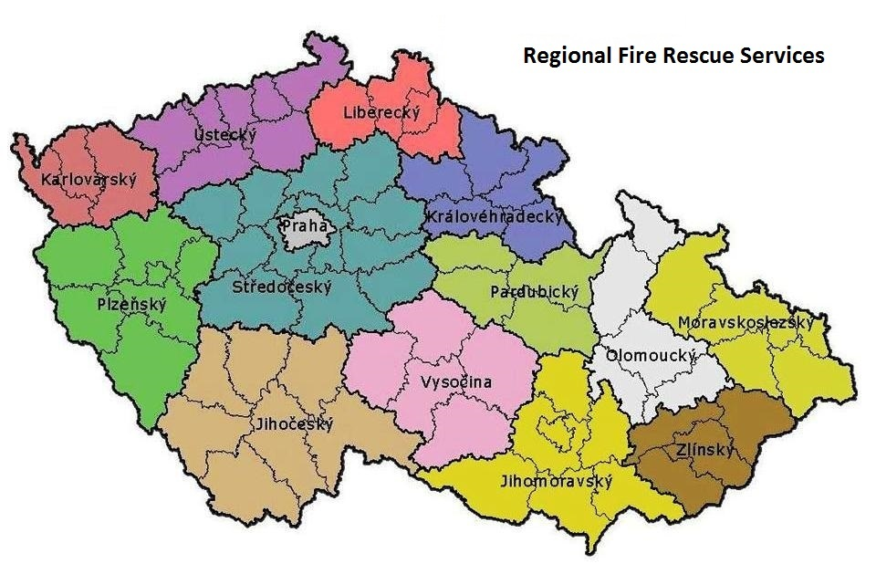
Fire Rescue Service of the Czech Republic

Slide 8
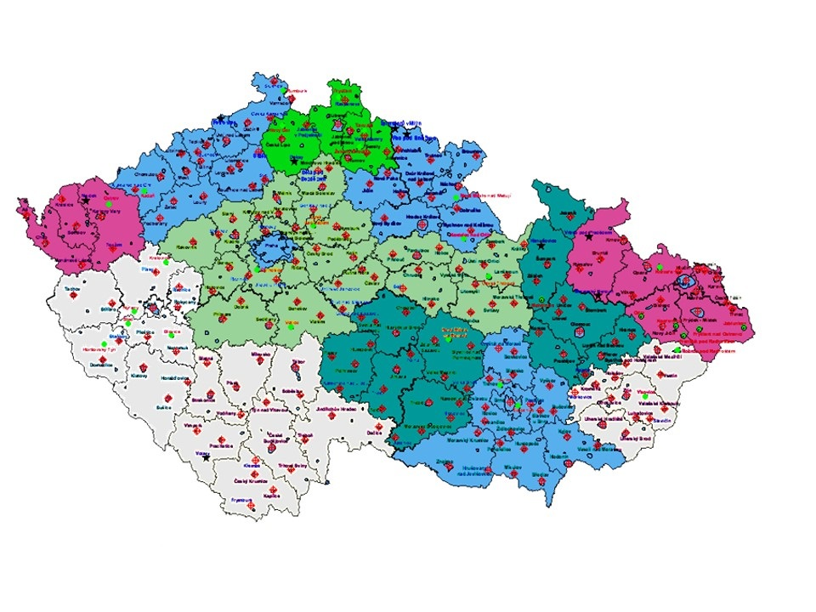
Fire Rescue Service of the Czech Republic

Slide 9
HAZMAT Support points FRS CZ
For solving CBRN issues, has the FRS CZ rules and selected fire units with special training and equipment - support points
In the Czech Rep. are 12 support points & 4 special laboratories
Tasks:
Liquidation of the dangerous substances
Extended detection of the hazardous substances
Decontamination of the fire fighting equipment and population
Oil accidents

Slide 10
Incident Command System FRS CZ
Levels of the Incident Command System:
Tactical
  Coordination by Incident Commander
  Divided to sections and sectors
Operational
  Coordination by Emergency Call Centre
Strategical
  Coordination by Regional Government/Ministry of Interior

Slide 11
Tactical procedures FRS CZ
Standard Operation Procedures for:
Determination of the incident commander
Priority in Command System
Authorization and tasks of the incident commander

Slide 12
Tactical procedures FRS CZ
Standard Operation Procedures:
Methodological sheets – tactical procedures for fire units
  Decision-making process of the Incident commander at the tactical level
Typical activities at the common intervention of the Integrated Rescue System
  A mandate and basic priorities for IRS bodies

Slide 13

Tactical procedures FRS CZ

Slide 14
Tactical procedures FRS CZ
The commander's staff:
(crisis management structure of the incident commander)
Communication
Logistics support
Analysis
Monitoring of forces and resources
Other specialists

Slide 15
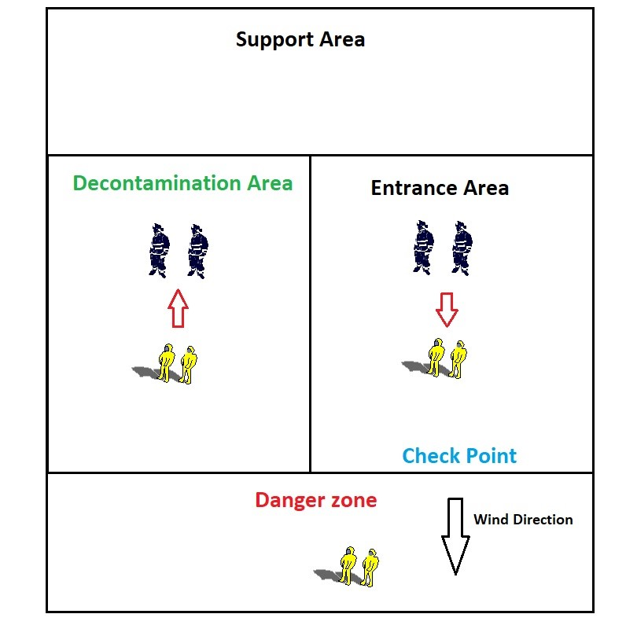
Tactical procedures FRS CZ

Slide 16
Thank you for your attention
Roman Hlinovský
Fire Brigade of Prague

