Slide 1
The Synergy Between Safety, Security and Safeguards
Prof. Dr. Sedat Goluoglu
Director, Gateway for Advanced Modeling and Simulation Lab
University of Florida

Slide 2
Safety, Security and Safeguards
Some definitions first:
Safety (güvenlik) is the protection of people from potentially harmful materials.
Security (emniyet) is the protection of materials from people who are trying to acquire it illegally.
Safeguards (güvence) are a series of technical measures taken by a state to prevent proliferation of dangerous materials.

Slide 3
Safety vs. Security
Key distinction between safety and security:
Preventive safety analysis aims at identifying vulnerabilities in the design and control philosophy
  Safety Risk = Likelihood of accident × Consequence
  In contrast, security is the degree of protection against danger, damage, loss, and crime. For a high-risk chemical/nuclear facility many security measures will relate to physical protection, safeguarding an asset from unauthorized access and acts of malevolence
  Security Risk = Threat × Vulnerability × Consequence

Slide 4
Synergy Among Safety, Security and Safeguards
Shared principal objective of “the protection of people, society, and the environment from the effects of harmful materials”
Shared Attributes:
  Recognized values
  Leadership needed for success
  Accountability
  Personal dedication and accountability
  Questioning attitudes, but rigorous approaches to actions
  Learning and experience driven
  Best when fully integrated into the system
All require a coordinated response

Slide 5
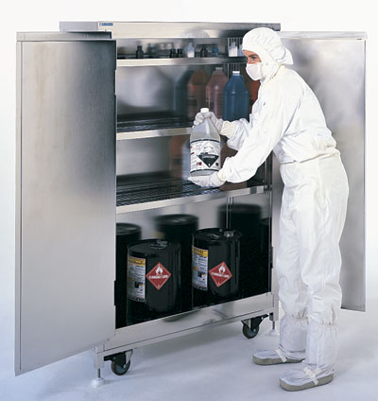
Evolution of Security Culture
Often Begins with Safety Culture
Individual commitment to safety
Personal accountability
Questioning attitude
Safety communication
Management commitment to safety
Leadership accountability
Decision making
Respectful work environment
Management systems
Continuous learning
Problem identification and resolution
Environment for raising concerns
Work processes

Slide 6
Safety and Security Concerns
Health and safety of people and environment
Community relationships
Reduce chance of release
Avoid loss and damage to facilities and equipment
Injure or kill people in nearby areas
Eliminate jobs and economic assets
Safety AND
Security
Prevent criminals and terrorists from getting dangerous materials & information
  Wide variety of materials
  Wide variety of motivations for actions
A deliberate attack on a chemical/nuclear facility could release a large amount of hazardous material
Unique to Security

Slide 7
Plant Security
Three main components:
Physical Security
Cyber Security
Process Security (for chemical and nuclear processing plants)
  Difficult to do
  Need good understanding of process operations

Slide 8
Process Safety vs. Plant Security
Although process safety management (PSM) programs typically do not explicitly address malicious acts such as theft or diversion of hazardous materials or sabotage, components of PSM can be utilized to determine requirements for security
Security programs depend upon Security Vulnerability Assessments (SVAs) as a method used to identify and address potential malicious acts
Hazards Evaluations, which are key components of process safety management, can be used as input to SVAs

Slide 9
SVAs and Hazards Evaluations
Both SVAs and Hazards Evaluations
  feature a structured and systematic brain-storming approach to identifying issues
  attempt to identify causes, contributors, and the consequences of certain types of events
  use many of the same personnel on the assessment teams (i.e., operations, health and safety)
Hazards evaluations provide a methodical approach to evaluating process conditions and hazards, especially under abnormal/adverse conditions

Slide 10
Hazards Evaluation
Hazards evaluations are routinely performed in the chemical/nuclear industry
Hazards evaluations are designed to answer the following questions:
  How likely is a release?
  How harmful would it be?
These evaluations can easily be incorporated into a vulnerability assessment
  Augments the assessment of a given facility
  Helps in evaluating whether a facility/material might be considered an attractive target

Slide 11
Process Hazards Evaluation (PHA)
PHAs may be good place to begin a vulnerability assessment for processes of security concern.
PHAs are designed to highlight areas of potential operational vulnerability, which upon further study may also be a potential target of an adversary.

Slide 12
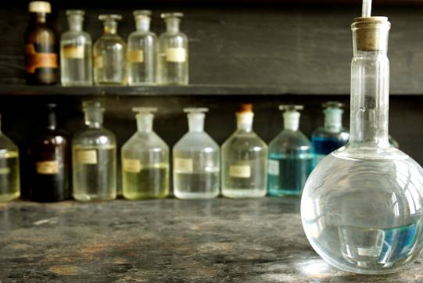
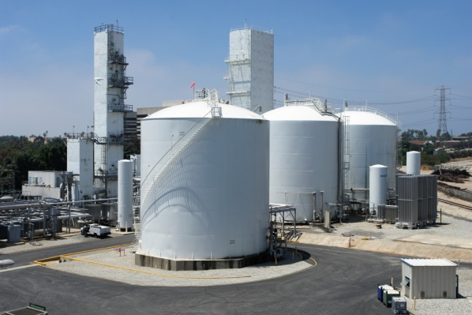
Security Measures
Potential consequence severity will determine to what extent facilities need to be secured
  Small-scale research laboratories
    Many different materials used in small amounts
  Large-scale manufacturing plants
    Limited types of materials used in large amounts

Slide 13
What is Safety Analysis?
When we talk about safety, we are talking about more than simply one area related to “nuclear safety”
  Criticality Safety
  Radiation Safety (dose to the worker)
  Facility Safety (dose to the site and public)
Notes:
When we talk about safety, we are talking about more than simply one area related to “nuclear safety”
Criticality safety
Health Physics (dose to the worker)
Dispersion (dose to the site and public)

Slide 14
Potential Conflicts between Safety and Security: Information
Safety
Label everything so people can recognize hazardous materials
Security
Labels help identify targets for theft or attack

Slide 15
Potential Conflicts between Safety and Security: Information
Safety
Let community and especially emergency responders know what dangers are there
Security
Sharing locations of materials can publicize targets for theft or attack

Slide 16
Potential Conflicts between Safety and Security: Information
Safety
Share knowledge about hazards so people know to be alert
Security
Sharing knowledge of hazards could inspire harmful behavior

Slide 17
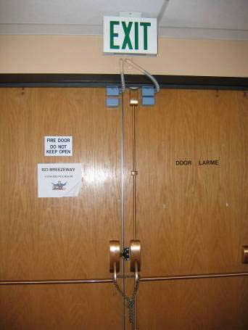
Potential Conflicts between Safety and Security: Facility Exits
Locking exit doors is secure, but not safe
For safety, people need to be able to leave the facility quickly and by many routes
For security, you want to control exits as well as entrances so materials (or equipment) are not taken

Slide 18
Resolution of Conflicts between Safety and Security
Important to have strong communications between the various stakeholders at a facility in regards to safety and security
Including security, operations, health and safety, management stakeholders on both “material” safety and “material” security evaluation teams will promote better understanding of each’s goals and requirements

Slide 19
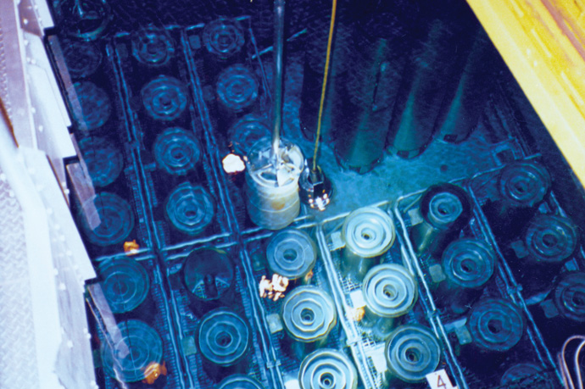
Safeguards and Safety
Predicting vulnerabilities/weaknesses in a system
Verification activities

Slide 20
Safeguards and Safety
how do safety considerations impact the safeguards design of a facility?
Many nuclear professionals will not develop new detector technologies, write new computer codes, or the like- some of us need to go out and apply these technologies…to design, build, and implement these systems
You have to spend time up front developing your model before you develop a useful simulation. Most NMC&A SME don’t run complicated computer codes.

Slide 21
In Real Life
The expert in safeguards works with a design team (part of which is safety analysis) to design and build an operation or facility, and works with operations staff to implement that design.
So how do these teams work?

Slide 22
Define the Safeguards Approach
As the NMC&A SME, you need to determine where your boundaries are, where your KMPs are, and what a batch is.
Looking at the basic process,
  Receipt
  Processing- placing the assembly in a hot cell to disassemble, dissolve, and prepare
  Sampling to ensure quality
  Shipping to next location
How would you define the MBA, KMP, and batch for the proposed operation?

Slide 23
Example: Receipt
The material is received based on the anticipated inventory- for example the spent fuel assembly that has been modeled to a specified burnup in a reactor.
However, the safety disciplines will not always use the same information, instead being required to use unirradiated (or partially irradiated) values, or measured dose rates.
This leads to the same item having different inventory definitions depending on who is looking at the item.

Slide 24
More than one inventory?
So right from the start, the facility may have more than one inventory describing the same item/batch.
Inventory control points will also vary, depending on safety controls needed.
  MBA vs. FCA
  Physical boundaries
  To facilitate operations, these differences need to be minimized and well-understood.

Slide 25
Things to watch out for…
Be careful not to rely too heavily on any one control. As an example, bar coding used to help reduce human error - sometimes doesn’t help!
A recent incident report for a DOE Facility for waste retrieval operations generated the duplicate barcode labels. When drums are retrieved, unique bar code labels are generated and affixed to waste containers for tracking purposes.
The tracking system is utilized for tracking of waste container movements utilizing bar code labels. It is also the repository for waste container characterization data from various processes, such as fissile gram equivalent for criticality control purposes, and is the credited system for accumulation of container fissile data.
Data accuracy is predicated on correct bar code labeling. It is surmised that human error during barcode labeling reprint led to the duplicate labels.

Slide 26
Things to watch out for
Watch out for equipment design. What is shown in the diagram is not an equipment drawing (flat vs. conical bottom).
As-built drawings are a running joke.
Watch for holdup points- work with criticality safety in particular on this.
Field work cannot be replaced. Period.

Slide 27
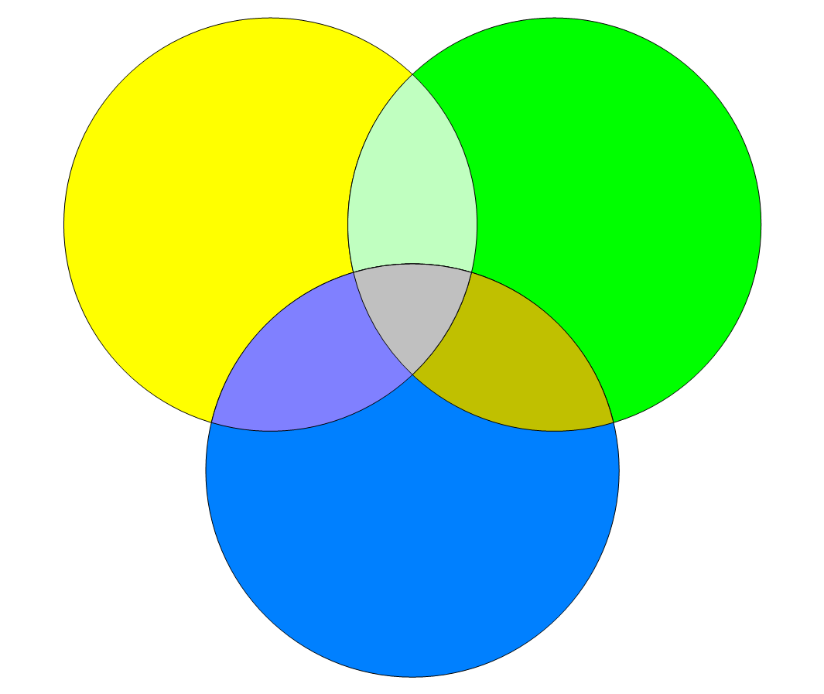
Summary
Safety
Security
Safeguards

Slide 28
Summary
Security and Safety culture must resonate throughout an organization
Responsibility lies with the individual
Technical staff vital to developing good security/safety culture
Lead by example
Adoption, diligence, and communication are keys to success

Slide 29
Nuclear Security and Insider Threat Workshop in Collaboration with Hacettepe University Nuclear Energy Engineering Department
Coming in Summer of 2018!!! goluoglu@ufl.edu

