Slide 1
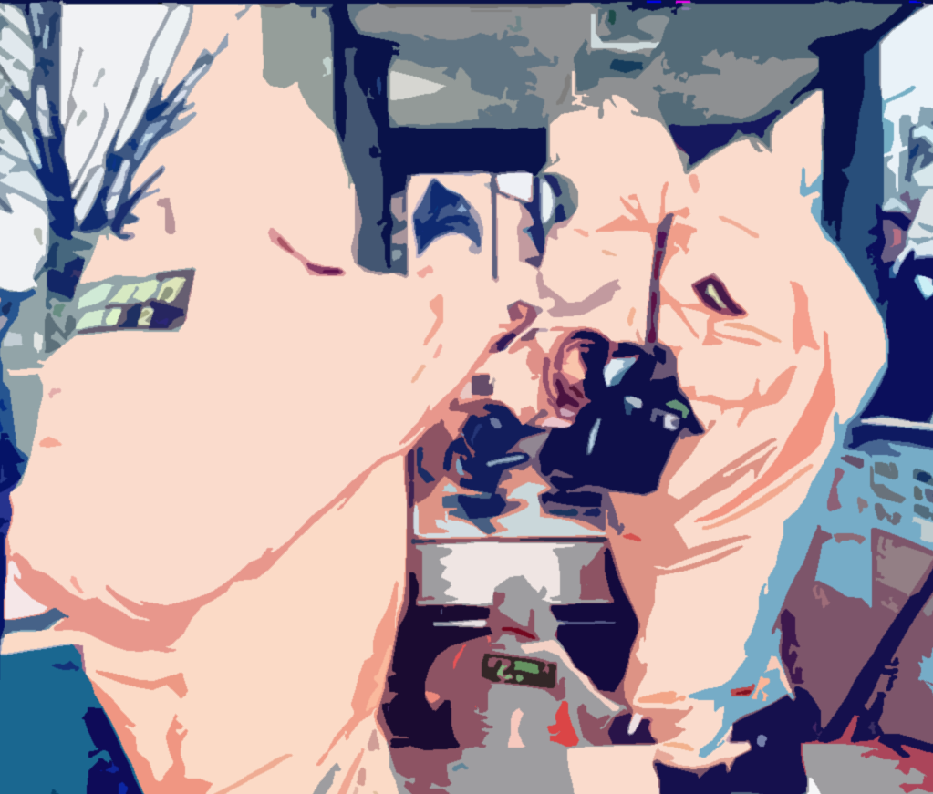

INTERNATIONAL CBRN CONGRES 05-07 DECEMBER 2017 ANKARA
Lessons Learned from the Tokyo Subway Sarin Incident
Battalion Chief Toshio Katsuragi
Hazardous Material Identification Section
Fire Technology and Safety Laboratory
TOKYO FIRE DEPARTMENT (TFD)

Slide 2
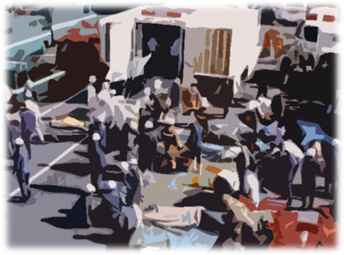
Tokyo Subway Sarin Incident
・ Date
About 8 a.m. / March 20 (Mon.) , 1995
・ Disaster
Five Aum Shinrikyo followers sprayed the
chemical agent Sarin
in the subway system.
・ Damage
13 deaths
About 5,800 injuries

Slide 3
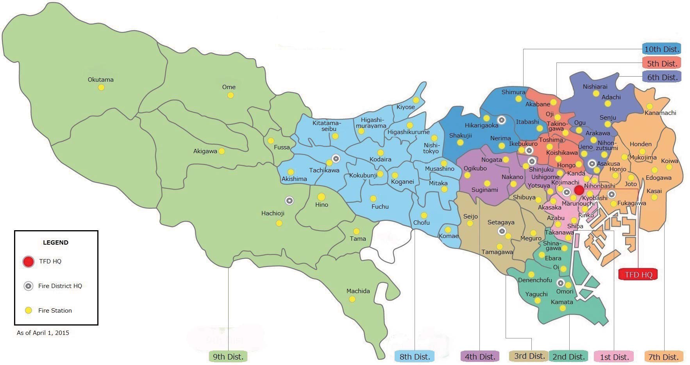

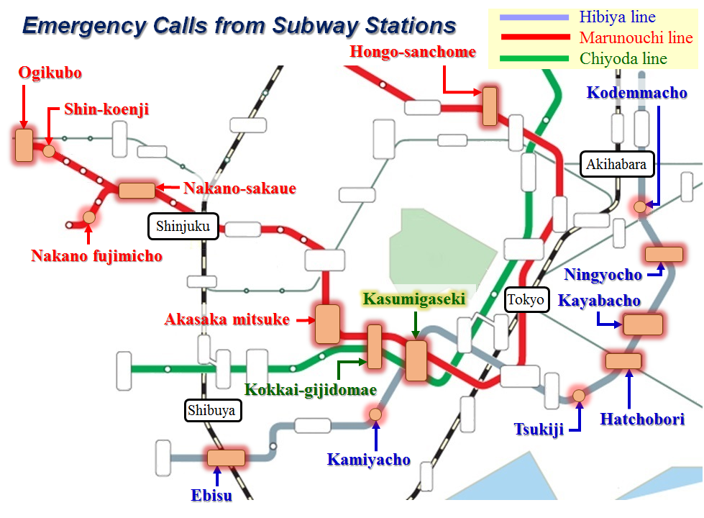

Incident Area
Tokyo Fire Department Resources As of April 1, 2016
・ 10 fire district HQ,
81 fire stations, 3 fire station divisions, and 208 fire station branches
・ 18,362 Personnel
・ 1,962 pieces of fire apparatus
such as pumpers, foam trucks, aerial ladders, rescue trucks, ambulances,
fireboats and helicopters.

Slide 4
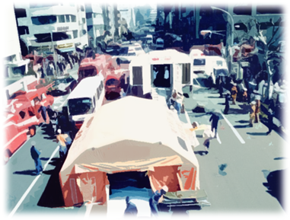
TFD’s Response
・ Apparatus : 340 (inc. 131 ambulances)
・ Firefighters : 1,364
・ Activities : Rescue, first aid, transport,
gas analysis, and cleaning
・ Victims : 688 (463 taken by ambulance)

Slide 5
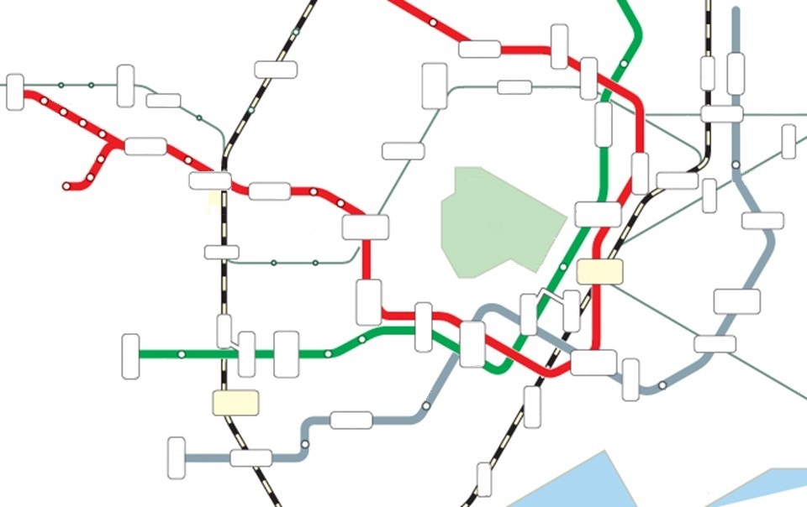
Emergency Calls from Subway Stations
Hibiya line
Marunouchi line
Chiyoda line
Hongo-sanchome
Ogikubo
Kodemmacho
Shin-koenji
Akihabara
Nakano-sakaue
Shinjuku
Nakano fujimicho
Ningyocho
Kasumigaseki
Tokyo
Kayabacho
Akasaka mitsuke
Kokkai-gijidomae
Shibuya
Hatchobori
Tsukiji
Kamiyacho
3 routes
15 stations
Ebisu

Slide 6
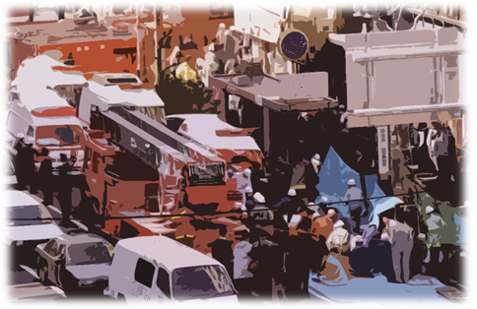

Slide 7
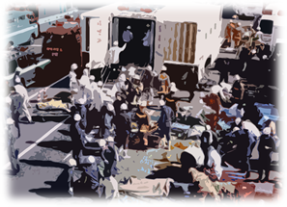
Incident Facts
Act of terrorism:
Simultaneous attacks to civilians
in underground spaces
Difficulty in grasping the whole situation
Confusion among TFD Headquarters,
incident scenes, and hospitals

Slide 8

Confusion in TFD Headquarters
・ Many calls in a short time
・ Ambulance requests and alleged “train explosion”
・ Communications control and difficulty in grasping incident facts
・ Shortage of apparatus
Confusion at Incident Scenes
・ Many incident scenes
Difficulty in unit management
・ Difficulty in on-scene activities due to firefighters’ injuries
・ Difficulty in triage
・ Difficulty in hospital selection

Slide 9
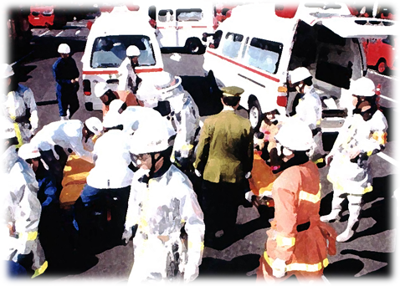

Slide 10
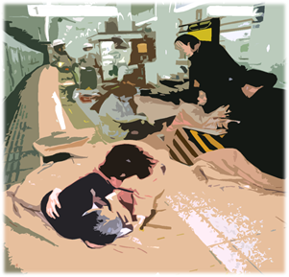
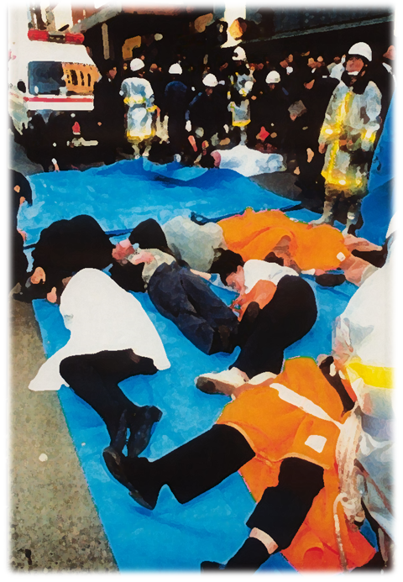

Slide 11
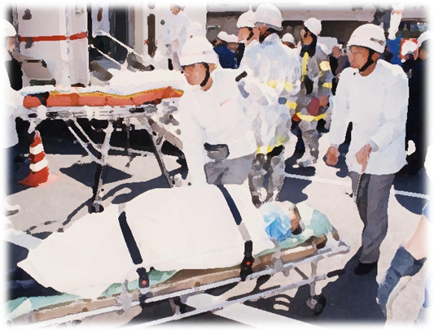
Many injured people went to the hospital
on their own.
・ Injured： 5,510
・ Transported by TFD : 688
※ The TFD transported about 12% of the total.
【As of April 1955】

Slide 12
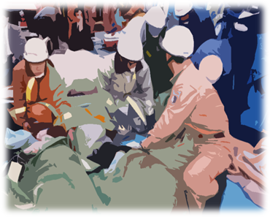
Many firefighters injured.
Firefighter Injuries:
135
At Scenes
No incident cause seen or heard
No idea of what was really going on
Causes of Injuries
No protective equipment worn
Command post wrongly located
Contamination inside ambulances

Slide 13

Problems and Solutions
Problems
Solutions
Ability to Detect
and Protect
Inability to Detect Sarin
Lack of Chemical Agent
Knowledge
CBRN Specialist Unit
Safety Education
and Training
Many Firefighter Injuries
Equipment for
Decontamination
Secondary Contamination
Lack of Coordination
with Related Agencies
Coordination
with Related Agencies

Slide 14
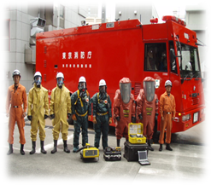
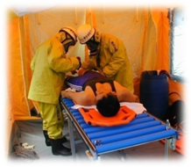

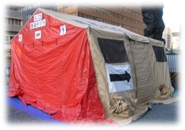
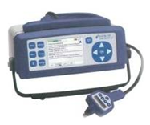
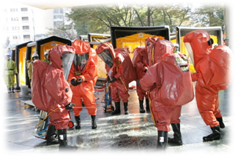
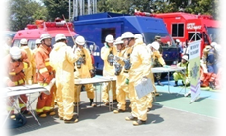
Major Measures against CBRN Disasters
since Subway Sarin Incident
CBRN specialist unit
Improved CBRN equipment
New decontamination system/policy
Deployed decontamination equipment
Higher-level CBRN disaster
training/education
Closer cooperation with other bodies
Special Incident Advisory System

Slide 15
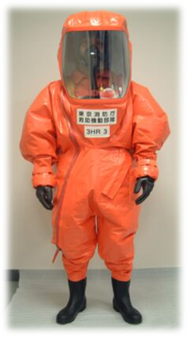
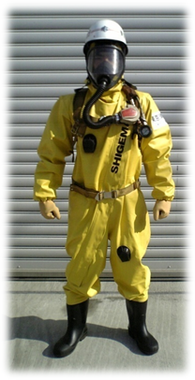
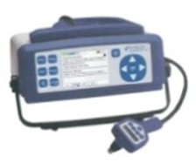
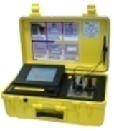

Improved CBRN Equipment
GC-MS
FT-IR
Chemical agent detector
Protective Clothing
Measurers

Slide 16
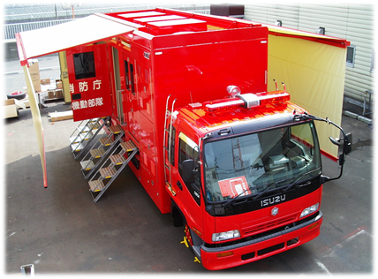
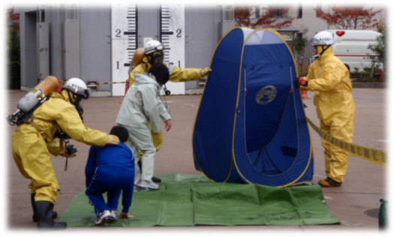
New Decontamination System/Policy
・ Decontamination tent system
・ Special hazmat truck (for decon)
・ Decontamination manual
・ Equipment for the injured

Slide 17
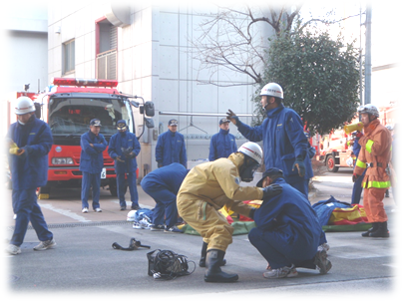
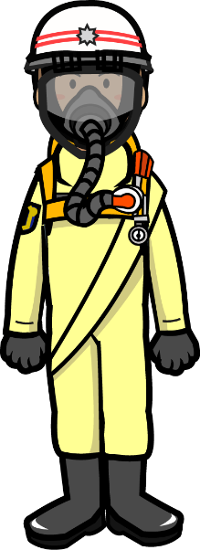
Higher-level CBRN Disaster Training/Education
Fire Academy
・ Recruit Education/Training
・ Officers’ Training
・ Specialized Training
Chemical disaster training
CBRN incident basic training
Headquarters
・ Conductor HQ Education
・ Special Incident HQ Education

Slide 18
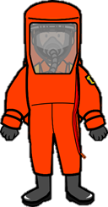
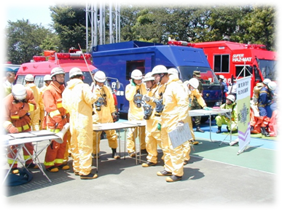
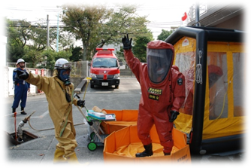
Higher-level CBRN Disaster Drills
CBRN Expert Unit Drill
By Hazmat Unit and Fire Rescue Task Forces
Unit Drill
For Command Unit, Engine Unit, Rescue Unit, and EMS Unit
Other Related Drills (ex., Civil Protection Drill)

Slide 19
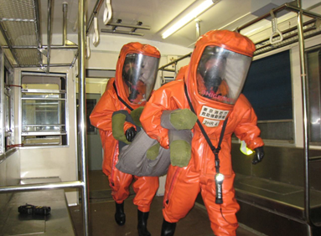
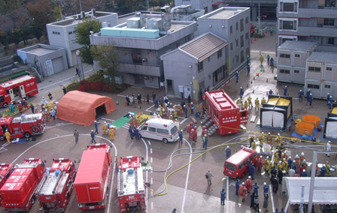
Differences between Drills and Actual Disasters
・ No disasters are the same as drill scenarios.
⇒Manuals sometimes do NOT work.
・ Disasters happen their own way.
⇒ We cannot tell when and where disasters might occur.
・ You need flexibility, imagination, decision maker
judgment, and boldness.

Slide 20

Thank you for your attention!

