Slide 1


TRAINING DRILLS EXERCISES
Veda DUMAN KANTARCIOĞLU
Disaster and Emergency Management Expert

Slide 2

WHAT IS THREAT?
IS IT SERIOUS?

Slide 3
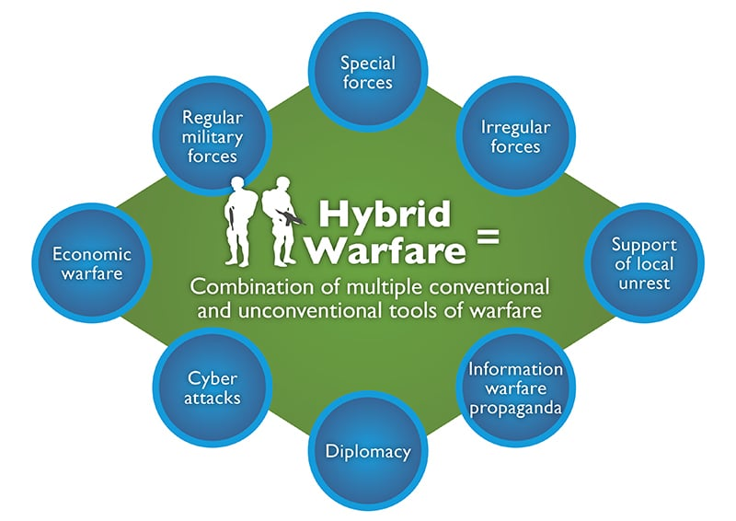
TODAY’S WORLD
Recently changed definitons of war and threats
Recently developed high technologies
Availability of dangerous goods
Accessibility to CBRN agents
Full of information on the internet

Slide 4
TODAY’S CBRN THREATS
BC WWI WW2 1980-….. 2000-….
B CB NBC CBRN CBRNe …….
B
R
NEW ORDER?
NEW THREATS?
N
C
E

Slide 5


CBRN PROTECTION CONCEPT
TRAINING & EXERCISES
lies between capacity building and preparedness
mitigate losses and strengthen response actions
reduce the time required for recovery
DEFINITION OF
NEEDS & GAPS
Capacity Building
Preparedness
SAVE LIVES & PROPERTY
Recovery
Response

Slide 6
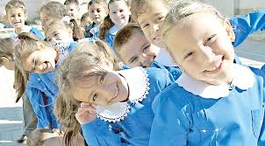
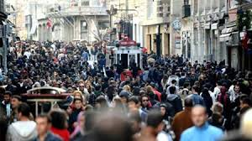
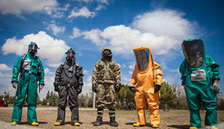
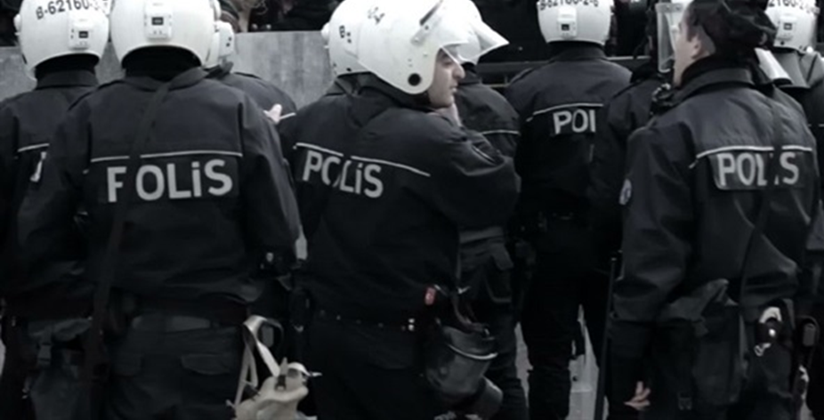
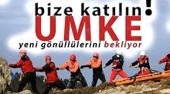
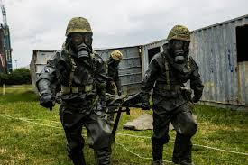
TRAINING FOR WHO?
THE POSSIBLE TARGET GROUPS
DECISION MAKERS
SPECIALISTS
FIELD EXPERTS
Children
Public
CBRN Teams/ Units
First Responders ( law enforcement, medical professionals, firefighters…)
Soldiers
CRUCIAL FOR BUILDING A RESILIENT SOCIETY

Slide 7
APPROACHES FOR VARIOUS TARGET GROUPS….
Children/ our future
AWARENESS OF RISKS AND BASIC PROTECTION ACTIONS
Public
AWARENESS OF RISKS
KNOWLEDGE ON BASIC PROTECTION ACTIONS
HOW TO GET PREPARED AND PROTECK YOURSELF AND YOUR FAMILY
TO MITIGATE LOSSES BY CULTURE OF SAFETY
CBRN Response Teams
AWARENESS OF RISKS
UNDERSTAND THE SITUATION
PROTECTING PEOPLE AND ENVIRONMENT – PUBLIC SAFETY
TAKING APPROPRIATE RESPOSE ACTIONS
First Responders
AWARENESS OF RISKS
UNDERSTAND THE SITUATION
PROTECTING PEOPLE AND ENVIRONMENT – PUBLIC SAFETY
APPLYING MEDICAL TREATMENT PROCEDURES
Soldiers
AWARENESS OF RISKS – BE PREPARED
KNOWLEDGE ON SELF-PROTECTION
ACTING IN CONTAMINATED AREAS

Slide 8
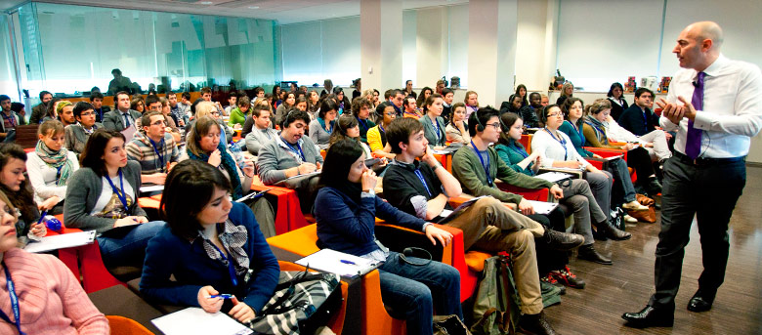



RAISING AWARENESS

Slide 9


TRAINING FOR WHAT?
Understanding hazard environment
Recognizing hazards
Safety and Response
Decontamination
Personal Protective Equipment (PPE)
Risk Assessment
Cooperation with national/international CBRN teams

Slide 10
TRAINING FOR WHAT?
CBRN Substances / materials
Effects (short term/long term)
Protection individually/collectively
Preparedness/Planning/ Response/Recovery procedures
Capacity building methods/equipment/standarts
Recovery/rehabilitation methods
Personal protective equipment
Differences between contaminated hazard zone and natural disaster hazard zones
UNDERSTAND THE RISK ORIGINATED FROM CBRN SUBSTANCES
RISK ASSESSMENT
Decontamination

Slide 11
A COMPREHENSIVE SYSTEM OF TRAINING & EXERCISE (CTES)
Practical
Exercise
Theoretical
INDOOR
OUTDOOR
LIVE AGENT
SIMULANT AGENT
SIMULATIONS - GAME BASED
AUGMENTED REALITY
CLASS
WEB BASED
INTERACTIVE LEARNING
CONTINUOUS IMPROVEMENT
CONTINUOUS MONITORING
& EVALUATION
Training System for Professionals
TABLETOP
DRILL
FUNCTIONAL
FULL – SCALE

Slide 12
BUILDING THEORETICAL KNOWLEDGE
Theory
CBRN Substances
Effects
Detection Methods /Technologies
CBRN Incidents
Types
Consequences
Medical Treatment
Decontamination
Rehabilitation
Personal Protective Equipment

Slide 13
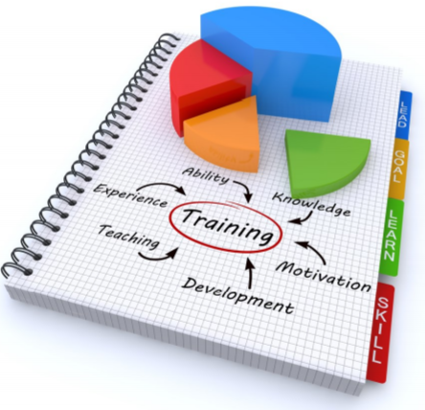
THEORETICAL TRAINING BEST PRACTICES
FRESH
UPDATED
PROPER
RELEVANT
CONTENT

Slide 14
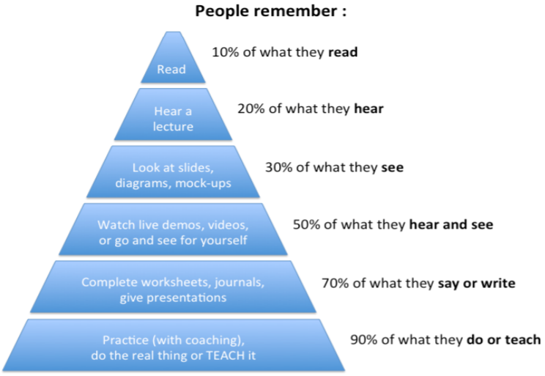
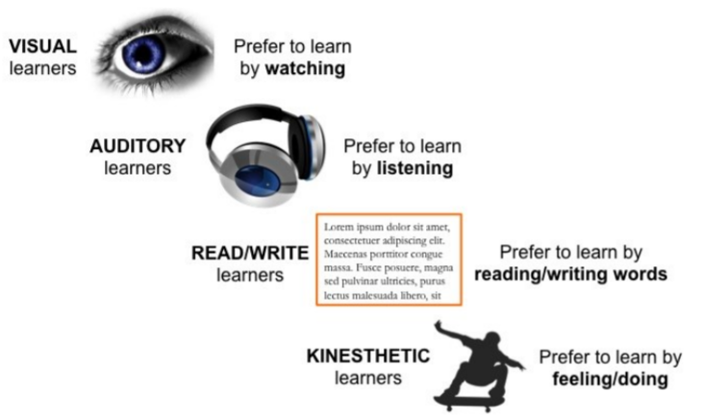
THEORETICAL TRAINING BEST PRACTICES
VARK Model

Slide 15
THEORETICAL TRAINING BEST PRACTICES
LECTURE, SHARING EXPERIENCE, READING, CASE STUDIES, SIMULATION
SMALL GROUPS, GROUP DISCUSSION, THINKING TIME, BRAINSTORM, DEMO

Slide 16
IMPORTANCE OF PRACTICAL TRAINING
Important to create best practices
Develops a better Understanding
Improves skills
Involves application and deals with real life situations
Can motivate team work
Aim is to help trainees develop skills and abilities that support professional activities and prepare them for work later on.
Provides an opportunity to learn important skills which will help in becoming a professional of the future.

Slide 17
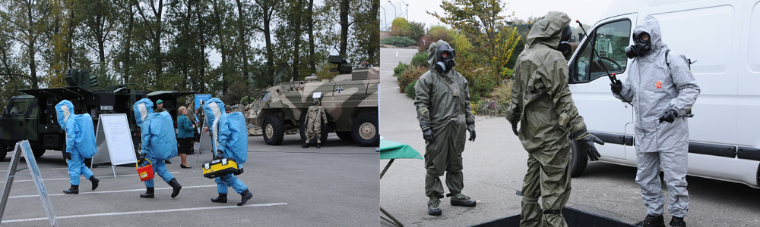
METHODS OF PRACTICAL TRAINING
Live Agent Training
Vyškov, Czech Republic
DSTL (UK)
Fort Leonard Wood (ABD) CDP (ABD)
DRES (Kanada)
Diluted chemical warfare agents are used
Detection techniques are examined
Personal protection procedures are examined
Provide real-life experience

Slide 18
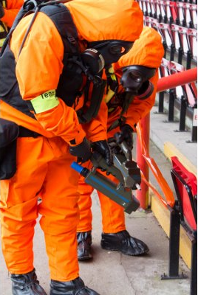
METHODS OF PRACTICAL TRAINING
Simulant Agent Training
Protect from over-exposure to live agents
Provide almost real-life experience
Scenarios for public facilities, sports stadium, subway/underground railway station, an airport or even a government building

Slide 19
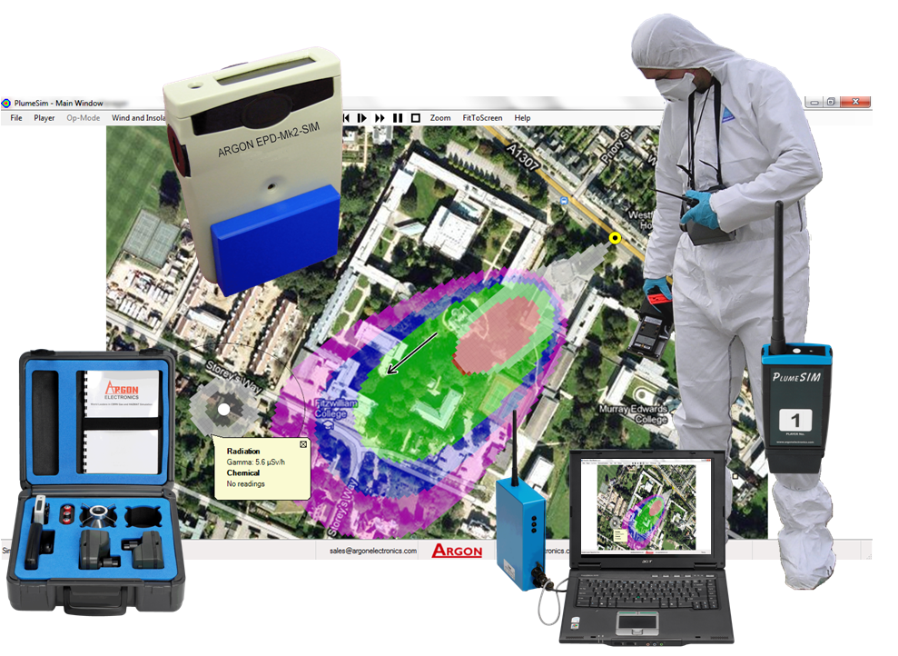
METHODS OF PRACTICAL TRAINING
Simulator Training
Is a technique to replace and amplify real experiences with guided ones
The way to develop CBRN professionals
Provides knowledge, skills, and attitudes, protecting public from unnecessary risks
Mitigates stress
The realistic scenarios and equipment allows for retraining and practice till one can master the procedure or skill.
Provides benefit to the theoretical instruction, enhance performance, and possibly also help reduce errors
SAFER, CHEAPER

Slide 20
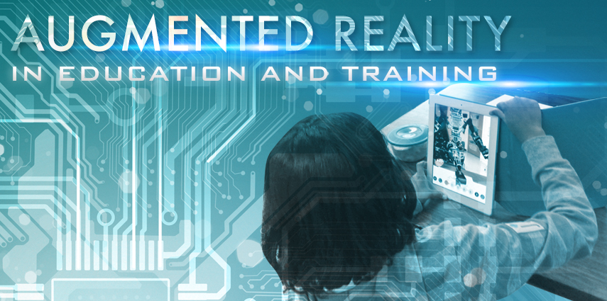
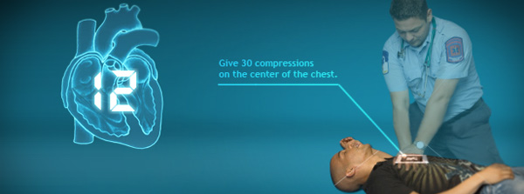
AUGMENTED REALITY IN TRAINING
Augmented reality systems can retain valuable CBRN Professional learnings and insights.
Artificial intelligence systems can actually learn and adapt by watching what today’s CBRN teams are doing right and wrong
This makes the augmented systems smarter and safer.
Training systems become evolving tools for increasing efficiency, productivity and safety.

Slide 21
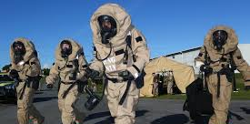
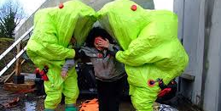
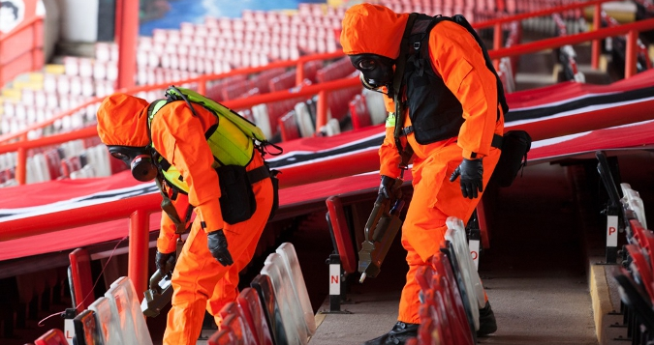
INDISPENSIBILITY OF EXERCISES
TABLETOP
The proof of concept & procedures
FUNCTIONAL
The proof of abilities
DRILL
Establishing and practising a routine
FULL SCALE
Identifying the strengths & weaknesses in procedures

Slide 22
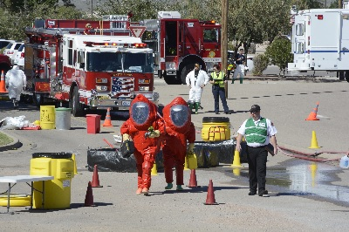
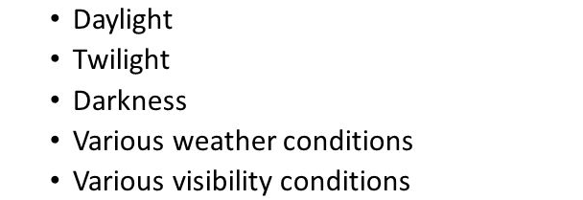
FULL SCALE EXERCISES
Realistic real-time interaction and communications
Combines the functional and drill activities
Allows utilization and testing of seldom used resources
Allows for increased public awareness of the emergency management program

Slide 23
Conclusion
Training and Exercises are crucial to develop CBRN professionals
All the training efforts and exercises must be part of a whole
Multi-layer training program construction is required to reach various decision makers, CBRN experts, first responders and etc.
Success of a training program depends on
  Diversity of training methods
  Well monitored and controlled under a system
  Understanding the target group
  Efficiency of instructors
  Continuously improved system

Slide 24
Final Comment…
‘Systems thinking is a discipline for seeing wholes. It is a framework for seeing interrelationships rather than things, for seeing 'patterns of change' rather than static 'snapshots.‘’
Peter SENGE, MIT, System Scientist

Slide 25

Veda DUMAN KANTARCIOĞLU
Disaster and Emergency Management
Expert
MSc. Nuclear Engineer

