Slide 1
Lessons Learned From Past Emergencies:
From Chernobyl to Fukushima
Vladimir Kutkov
Incident and Emergency Centre,
International Atomic Energy Agency

Slide 2
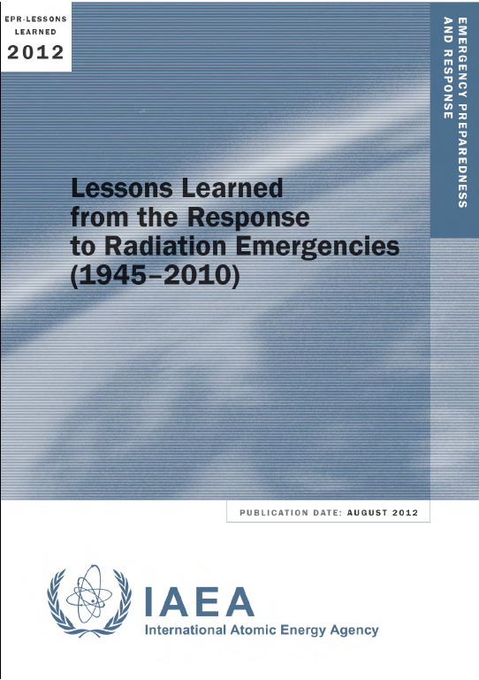
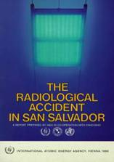
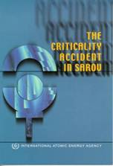
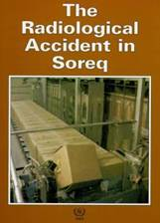
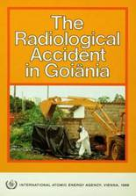
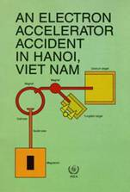
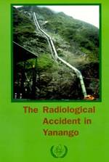
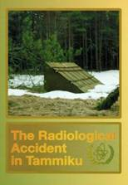
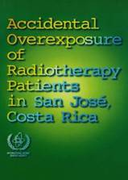
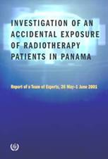
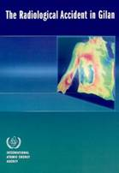
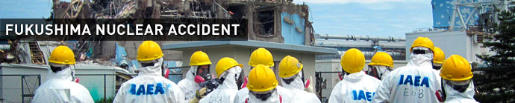
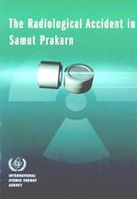
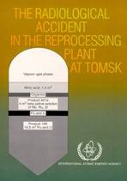
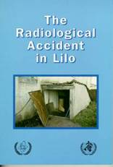
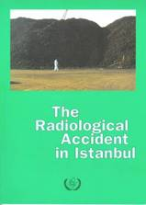
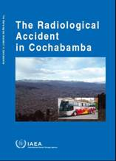
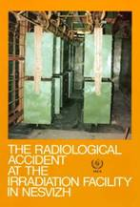
Introduction: Learning Lessons

Slide 3
Lessons for safety of a Nuclear Power Programme
To be prepared for response to nuclear emergency at the first nuclear power plant (NPP) is the key challenge for Member State embarking on a Nuclear Power Programme.
The IAEA assists the Member States to develop an adequate level of preparedness and capability for response to radiation emergencies before commissioning the first NPP and to enable emergency preparedness and response to be maintained during the life of the facility in line with international requirements in GSR Part 7.
Notes:
The slide aggravates the major points to be learned from the lesson.

Slide 4
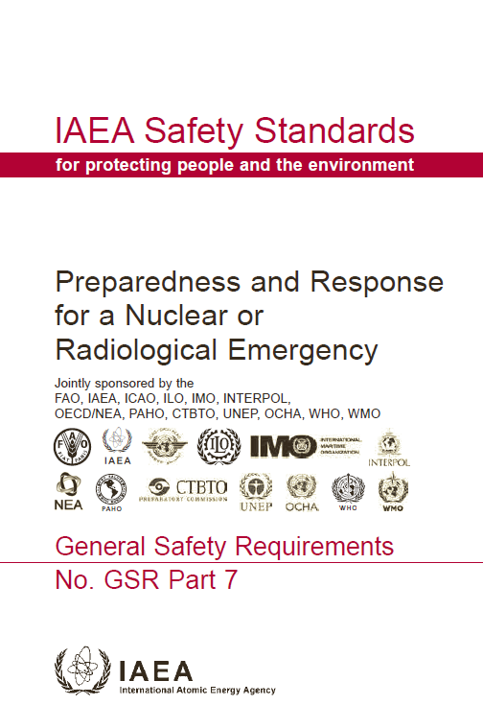
General Safety Requirements Part 7
Preparedness and Response for a Nuclear and Radiological Emergency
General Safety Requirements Part 7
No. GSR Part 7 (2015)

Slide 5
Protective actions as a components of protection strategy
Precautionary protective actions to prevent deterministic health effects. To be implemented before the major release and beginning of the exposure of the public.
Urgent protective actions to limit risk of stochastic health effects. To be implemented in hours-days after the severe release took place to correct the precautionary protective actions.
Early protective actions to limit risk of stochastic health effects.. To be implemented in weeks-months after the severe release took place.
Transition from emergency exposure situation to planned or existing exposure situation. To be implemented in month-years prior to termination of the emergency.

Slide 6
Precautionary and urgent protective actions
Upon declaration of the General emergency (nuclear) using the Emergency Action Levels (EALs) for emergency classification
The first priority – Evacuate the public from Precautionary Actions Zone (PAZ) even in hard conditions
The second priority – Evacuate the public from Urgent Protective Action Planning Zone (UPZ)
The third priority – Stop consumption of local produce at Ingestion and Commodities Planning Distance (ICPD)
After deposition of the released material on the ground - Monitor the territory at Extended Planning Distance (EPD) against Operational Intervention Levels (OILs) to recognize areas from which the public has to be evacuated

Slide 7
Emergency Action Levels (EALs)
EALs are specific, predetermined and observable criteria to detect, recognize and determine the emergency class
Initiate pre-planned response
Enable to
protect core!
Blackout for hours
Pressure above ## hPa
Temperature above ## °K
Declare
the General
Emergency!
Dose rate above ## mSv/h

Slide 8
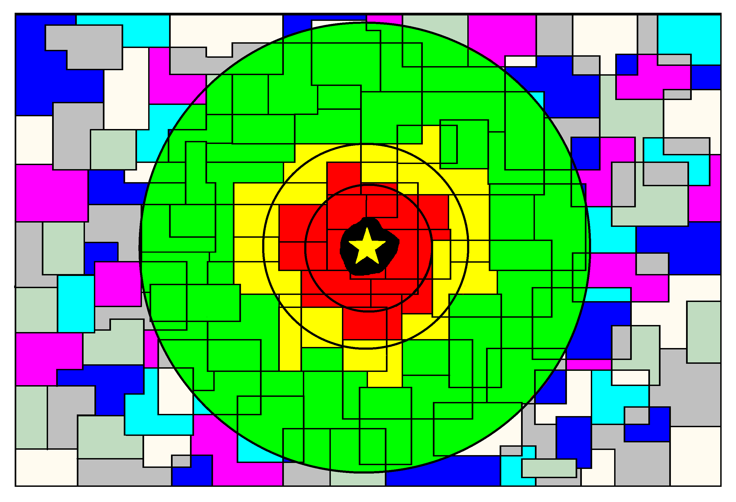
Protective actions in PAZ and UPZ
Precautionary protective actions, e.g. evacuation
Urgent protective action zone, e.g. evacuation
Field/aerial monitoring against OIL1 and OIL2
≥ 1 Gy
during
deposition
≥ 100 mSv
during deposition
≥ 100 mSv
in 1st year

Slide 9
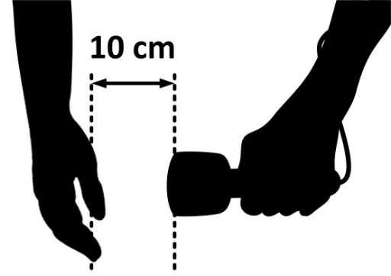

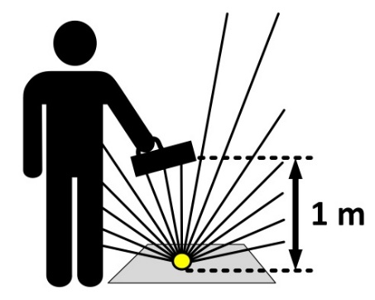
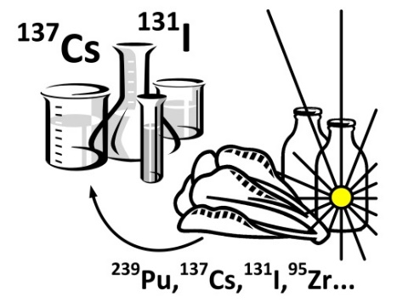
Operational interventional Levels (OILs)
OILs – a predetermined default operational triggers for quantities that are measured by a field monitoring instrument or determined by laboratory analysis.
Initiate expanded protective and other response actions
Dose rate from skin contamination
Dose rate from thyroid
Dose rate above
the ground
Food and water concentrations
OIL8
OIL1
OIL2
OIL3
OIL5
OIL6
OIL7
OIL4

Slide 10
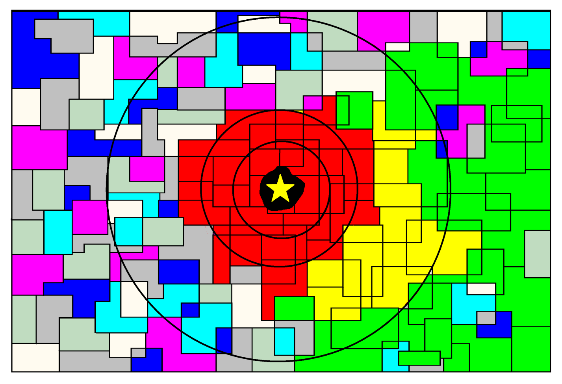
Protective actions in EPD and beyond
Evacuated zone
Urgent protective actions, e.g. evacuation
Early protective actions, e.g. relocation
≥ 100 mSv
during deposition
≥ 100 mSv
in 7 days
≥ 100 mSv
in 1st year

Slide 11
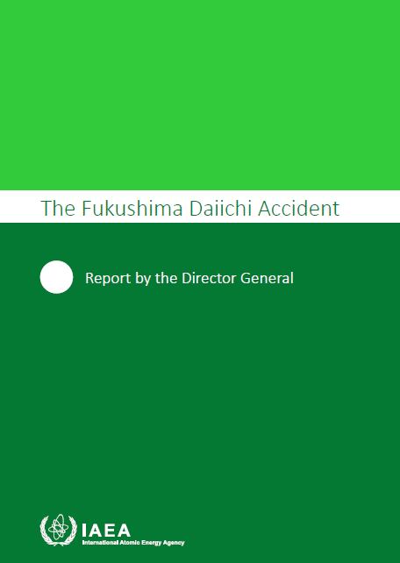
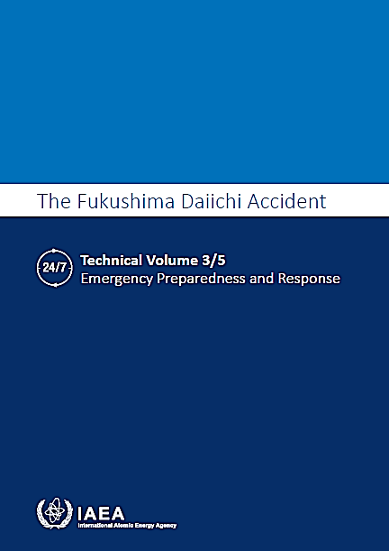
The Fukushima Daiichi Accident.
Report by the Director General (2015)

Slide 12
Events at Fukushima-Daiichi NPP
11 March, 14:46 = Great East Japan Earthquake.
15:36 = 2-nd tsunami wave started flooding site (estimated inundation height above Onahama Port +14.5 m).
15:36 (+0:00) = Blackout of the Fukushima Daiichi NPP.
16:45 (+1:09) = TEPCO (operator) reported an event classified as a nuclear emergency.
19:03 (+3:27) = Declaration of a nuclear emergency by the national Government and establishment of Nuclear Emergency Response Headquarters (NERHQ).

Slide 13
Japan (2011): Framework for urgent protective actions

Slide 14
Events in vicinity of Fukushima Daiichi NPP
11 March, 20:50 (+5:14) = Fukushima Prefect issued an evacuation order for an area of 2 km radius around Fukushima Daiichi NPP.
21:23 (+5:43) = National Government issued an evacuation order for an area of 3 km radius.
12 March, 05:44 (+14:00) = National Government issued an evacuation order for an area of 10 km radius.
18:25 (+26:40) = National Government issued an evacuation order for an area of 20 km radius.
15 March, 15:00 (+90:00) = Evacuation of all residents within area of the 20 km radius had been completed

Slide 15
Observations and lessons
Arrangements need to be in place to allow decisions to be made on the implementation of predetermined urgent protective actions for the public based on predefined plant conditions.
These arrangements are necessary because decision support systems, including those using computer models, may not be able to predict the size and timing of a radioactive release (the source term), the movement of plumes, deposition levels or resulting doses quickly or accurately enough in an emergency to be able to provide the sole basis for decisions on initial urgent protective actions.

Slide 16
Observations and lessons (2)
At the preparedness stage, there is a need to develop an emergency classification system based on observable conditions and measurable criteria (emergency action levels).
This system enables the declaration of an emergency shortly after the detection of conditions at a plant that indicate actual or projected damage to the fuel and initiation of predetermined urgent protective actions for the public (in the predefined zones) promptly following classification of the emergency by the operator. This emergency classification system needs to cover a full range of abnormal plant conditions.

Slide 17
Three pillars of protection strategy
Hazard assessment and classification of facilities and territories in terms of Emergency Preparedness Category.
Establishing the emergency planning zones and distances for timely implementation of precautionary, urgent and early protective and other actions.
Establishing the emergency classification for timely classification of the accident at NPP and declaration of the nuclear emergency.
Coordination of the emergency preparedness and response at all levels of response.

Slide 18

IAEA: Framework for urgent protective actions
Emergency class
Emergency
Protective actions
Hazard
Emergency planning
zones
Territory
Emergency preparedness category
Government
Operator
Local Authorities
Notes:
Practical goal of emergency preparedness is to assure that in case of lose control over the radiation source all together:
Emergency preparedness category based on hazard assessment,
Emergency class based on facility conditions, and
Emergency planning zone based on generic criteria and source properties
will be timely evaluated to provide a basis for concept of operations which should be followed in implementation of the protection strategy.
Different jurisdictions shall be responsible for evaluation:
Government has the primary responsibility on categorization of hazards and definition of Emergency Preparedness Category (EPC) of facility or area;
Local authorities has the primary responsibility on definition emergency planning zones and corresponding population to be protected;
Operator has the primary responsibility for classification of emergency to initiate a response.

Slide 19
IAEA: Emergency planning zones and distances (EPR-NPP PPA 2013)
Zone | Power MW(th)
 | ≥ 1000 MW(th) | 100 to 1000 MW(th)
PAZ | 3 to 5 km
UPZ | 15 to 30 km
EPD | 100 km | 50 km
ICPD | 300 km | 100 km

Slide 20
Thank you!
Notes:
Thank you!

