Slide 1
Protection Strategy for Nuclear Emergencies According to the IAEA Safety Standards
Vladimir Kutkov,
Svetlana Nestoroska Madjunarova,
Philip Vilar Welter
Incident and Emergency Centre,
International Atomic Energy Agency

Slide 2
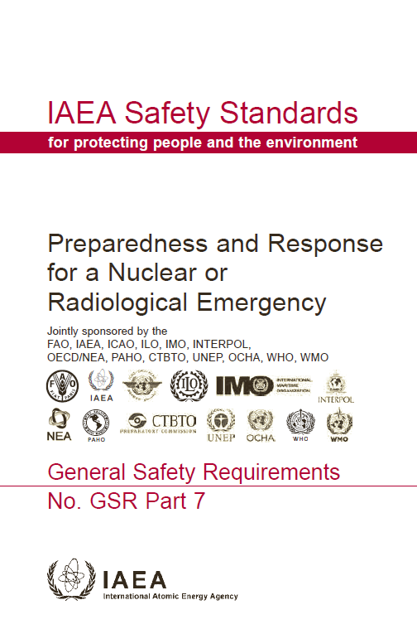
General Safety Requirements Part 7
Requirement 5
  The government shall ensure that protection strategies are developed, justified and optimized at the preparedness stage for taking protective actions and other response actions effectively in a nuclear or radiological emergency.

Slide 3
Protection Strategy
Describes in a comprehensive manner:
  What needs to be achieved in response to a nuclear or radiological emergency
    From the time the emergency is declared until the emergency is terminated
    For large scale emergency, the strategy may extend in the longer term within the framework of an existing exposure situation
  How this will be achieved implementing a justified and optimized set of protective actions and other response actions

Slide 4
Protection Strategy (cont.)
Generic approach aimed:
  To define the implementation of effective and efficient set of emergency response actions in an emergency response
  To guide the establishment of adequate emergency arrangements at the preparedness stage
    Such as plans, procedures, equipment, tools, training and exercise programmes etc.

Slide 5
Goals of protection strategy
To regain control of the situation and to mitigate consequences;
To save lives;
To avoid or to minimize severe deterministic effects;
To render first aid, to provide critical medical treatment and to manage the treatment of radiation injuries;
To reduce the risk of stochastic effects;

Slide 6
Goals of protection strategy (2)
To keep the public informed and to maintain public trust;
To mitigate, to the extent practicable, non-radiological consequences;
To protect, to the extent practicable, property and the environment;
To prepare, to the extent practicable, for the resumption of normal social and economic activity.

Slide 7
Dose Concepts
Residual dose: The dose that would be expected to be received from the initiation of the event through a specified period of time (e.g. one year), with account taken of the implementation of the protection strategy, if any.
Projected dose: The dose that would be expected to be received if protective actions were not taken.
Received dose: The dose that is incurred after protective actions have been fully implemented (or a after a decision has been taken not to implement any protective actions).

Slide 8
Dose concepts (2)
Reference level
Generic criteria
Generic criteria
Residual dose
Projected dose
Received dose
Basis to optimize and to judge effectiveness of protection strategy
Basis to implement protection strategy
Basis to implement medical actions

Slide 9
Reference level of residual dose
The level of residual dose:
  Above which it is not appropriate to allow exposures to occur
  Below which optimization of protection and safety would continue to be implemented
Role: tool for optimization of protection strategy
A residual effective dose in the range 20 – 100 mSv, acute or annual, via all exposure pathways
Reflects radiological basis for radiation protection in emergency exposure situation

Slide 10
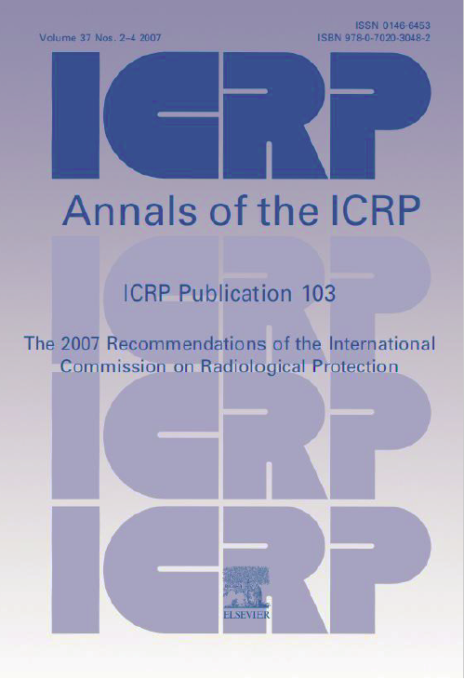
Development of Protection Strategy

Slide 11
Development of Protection Strategy

Slide 12
Projected, Residual and Received dose in perspective

Slide 13
Projected, Residual and Received dose in perspective

Slide 14
Projected, Residual and Received dose in perspective

Slide 15
Projected, Residual and Received dose in perspective

Slide 16
Projected, Residual and Received dose in perspective

Slide 17
IAEA’s Generic Criteria
Levels for the projected dose, or the dose that has been received, at which protective actions and other response actions are to be taken.

Slide 18
IAEA’s Generic Criteria (2)
Radiological Basis
  Below generic criteria, there will not be any severe deterministic effects or an observable increase in the incidence of cancer (even in a very large exposed group)
  Consistent with UNSCEAR 2000 and 2010:
    Observations are frequently unable to reveal clear evidence of an increased incidence of radiation induced health effects at low doses (less than 100-200 mGy in whole body)

Slide 19
Overall protection strategy

Slide 20
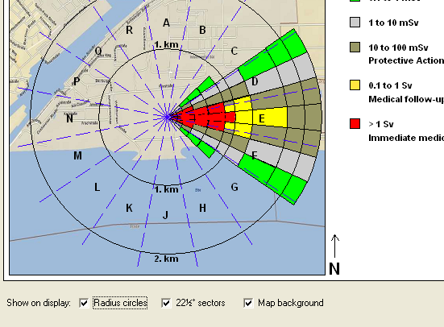
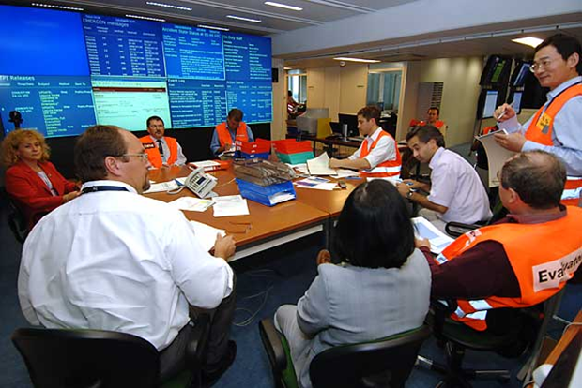
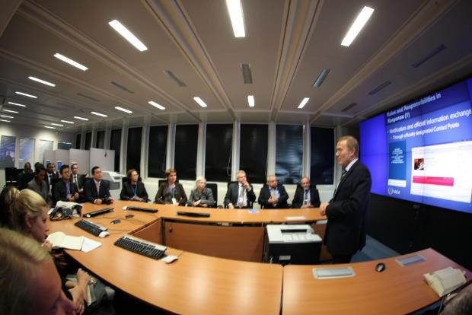
Optimization of protection strategy
At preparedness phase
Discussion with the stakeholders and involved parties on concepts of operations for development of the generically optimized National Radiation Emergency Plan (NREP).
RODOS
COSYMA
NOSTRADAMUS
SPEEDI
RASCAL
…

Slide 21
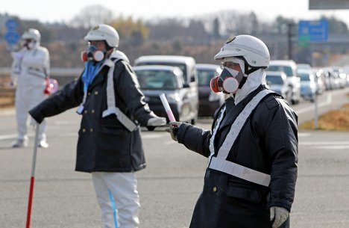
Optimization of protection strategy (2)
At response phase
Implementation under
Incident Command and
Control System the
pre-optimized concept
of operation from NREP
for actual conditions and given emergency planning zone or distance.
If the actual conditions will be beyond the accounted in NREP, the Contingency plan has to be activated to adjust the pre-planned operations.

Slide 22
Thank you!
Notes:
Thank you!

