Slide 1
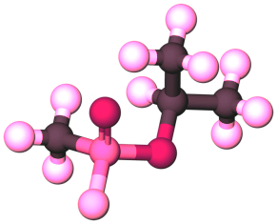
Chemical weapons destruction technologies
International CBRN Congress
Dr. Yaugen Ryzhykau
Senior Consultant/Special Project
Hotzone Solutions Group
Ankara, Turkey
5-7 December 2017

Slide 2

Hotzone Solutions
Notes:
2
As per page one of Profile brochure

Slide 3
Content
Chemical weapons (CW) destruction technologies after World War I & II
CWC and progress of CW destruction under the OPCW verification since EIF
CWC requirements and CW destruction technologies
HZS Mobile Hazardous Material Treatment Unit

Slide 4
Chemical weapons (CW) destruction technologies after World War I & II

Slide 5
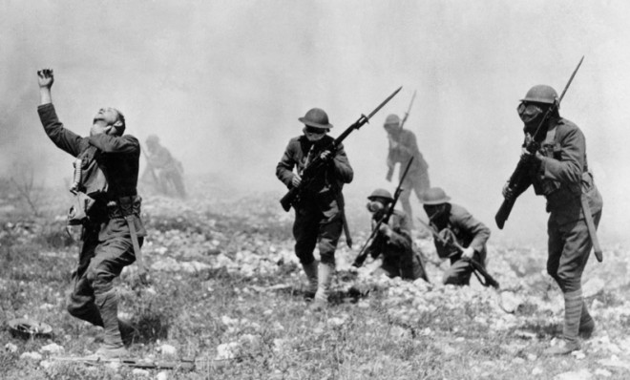
CW in World War I
Gas! Gas! Gas! Quick boys!
August 1914: tear gas (ethyl bromoacetate) in grenades and artillery shells (chloroacetone ) in November 1914
October 1914: o-dianisidine sulphate (“sneezing powder”)
November 1914: xylyl bromide
April 1915: chlorine
December 1915: phosgene
July 1917: mustard agent (“yperite”)

Slide 6
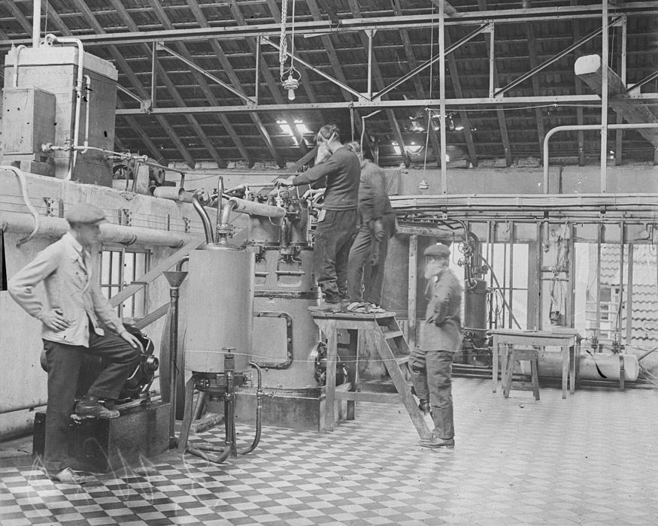
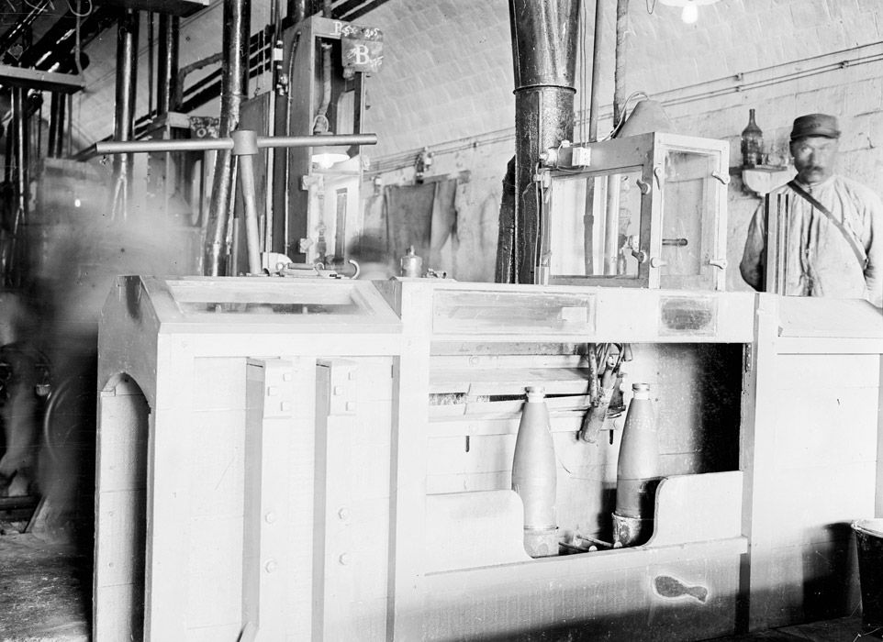
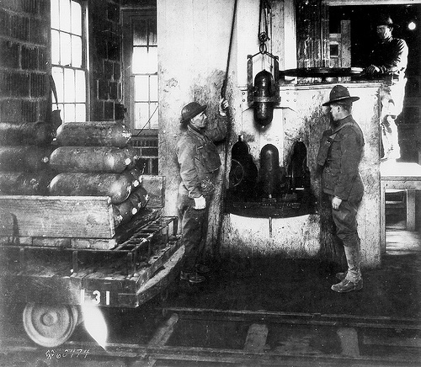
Pont-de-Claix - factory for the production of toxic gases, 1916
Production of CW during WW I
120 mm projectiles filling station with gas
Livens Projectile filling at
Edgewood Arsenal

Slide 7
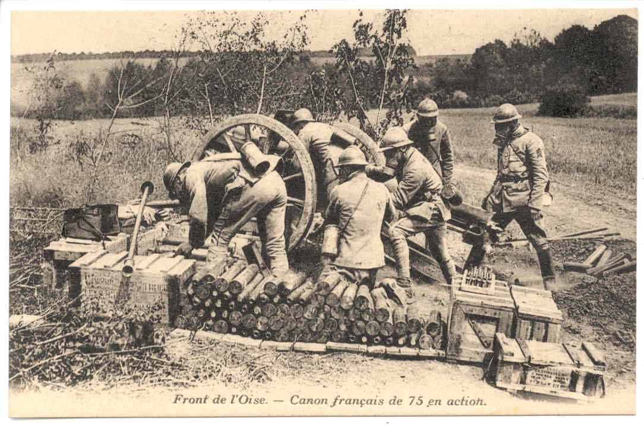
Employment of CW by French artillery
143,000.00 tons

Slide 8
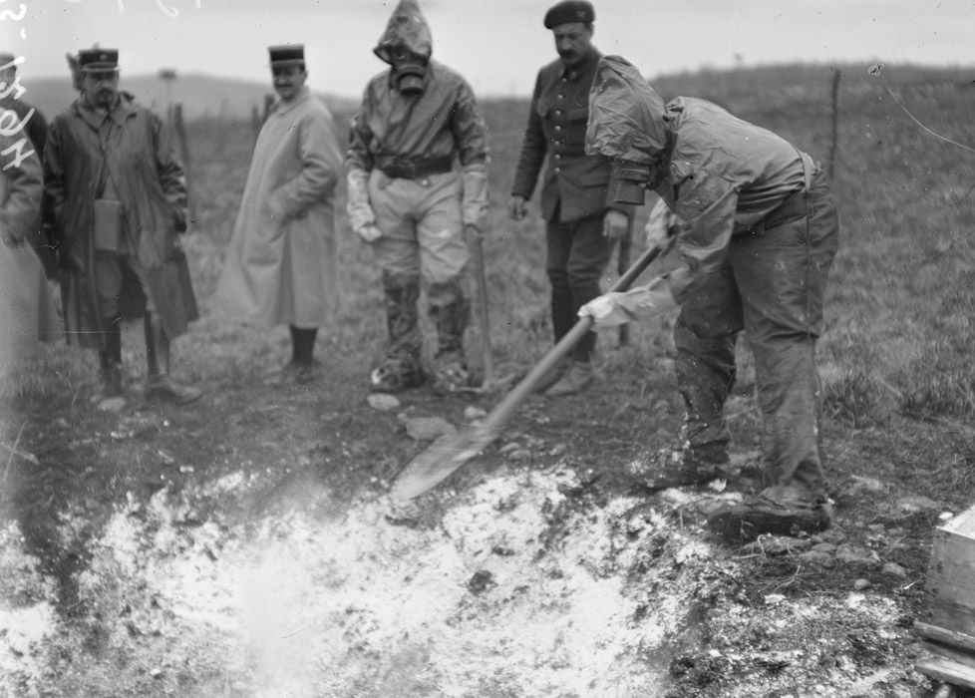
Disposal of CW, WW I
Notes:
Experiments to develop new antidotes for mustard gas. Experience is performed by physicians.

Slide 9
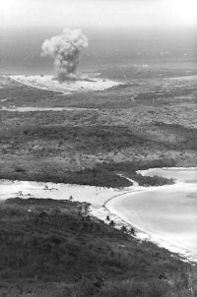
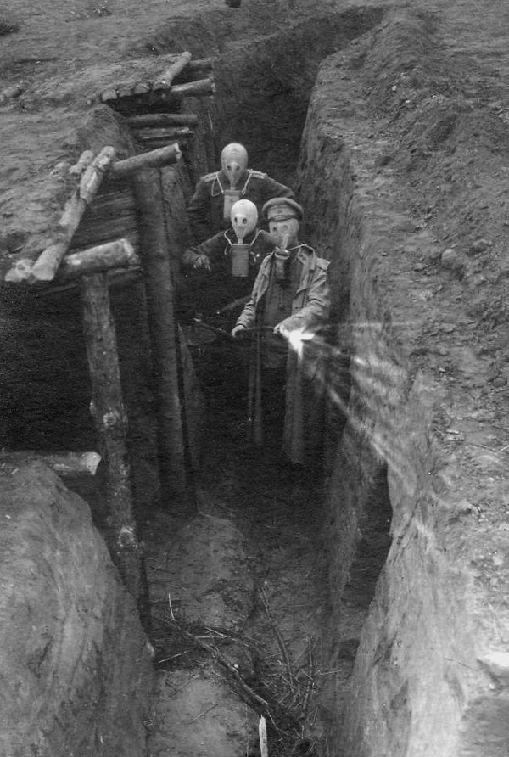
No environmentally friendly destruction method developed after WW I
CW disposal, WW I

Slide 10
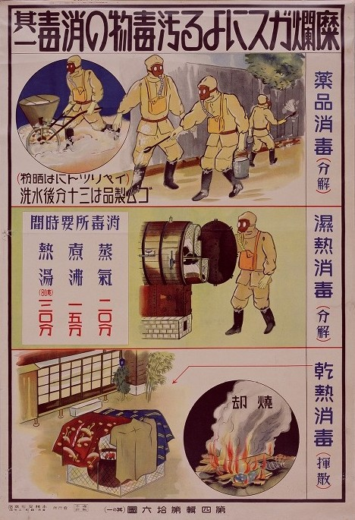
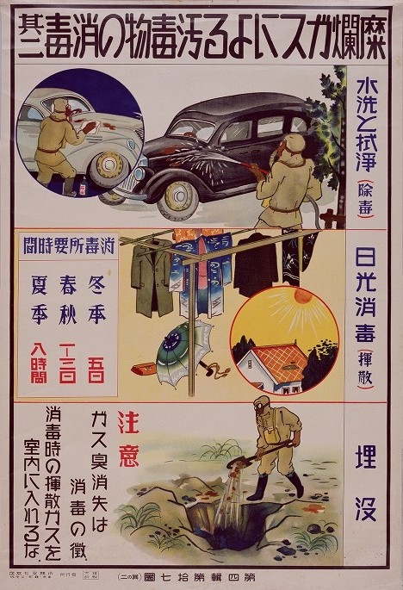
Blister Gas Decontamination
Chemical treatment
- For mustard gas, use
calcium hypochlorite.
- Wash rubber products 30
minutes after exposure.
Wet-heat treatment
- Steam: 20 minutes
- Boil: 15 minutes
- Hot water (80 degrees
Celsius): 30 minutes
Dry-heat treatment
- Incinerate
Wash and wipe
Sun-dry
- Winter: 5 days
- Spring/Autumn: 1 to 3 days
- Summer: 8 hours
Burial
- Disappearance of gas odor is a
sign of decontamination.
- Do not allow residual gas indoors when decontaminating
National Archives of Japan

Slide 11
World War II chemical weapons stockpiles
Country | 1940 (metric tonnes) | 1945 (metric tonnes)
Germany | 15 000 | 250 000
United Kingdom | 1 500 | 60 000
USA | 1 500 | 135 000
Japan | 5 000 | 10 000
Russia | 3 800* (40 000**) | 122 400 + 40 000
*Mustard gas produseed before WWII (1936);
** Total quantity of chemical agents in bombs as of 1.12.1936
617400 ????

Slide 12
CW disposal methods after WW II
Chemical weapons were destroyed at that time by many methods:
burial in the ground
disposal at sea
burning at storage sites/proving grounds in special incinerators and open pits
explosion of chemical artillery shells and aircraft bombs on specially equipped firing ranges
Notes:
The first methods of disposal were burial at sea. The British buried many tons of German gas collected after World War II in the Baltic Sea. The United States conducted Operation Davey Jones' Locker from 1946-1948 in which German ships were filled with chemical munitions and scuttled in the North Sea and Skaggerak Straight between Norway and Denmark .
In 1946, the port of Wolgast near Peenemunde on 42 trains in compliance with all security measures were delivered 35,000 tons of chemical munitions Third Reich
Command of the Soviet troops in the British zone chartered commercial vessels capable of carrying a voyage of 200-300 tons expedition was headed by commander KP Terekov . As a result of the operation from 2 June to 28 December 1947 in the Baltic Sea was sunk 35,000 tons of chemical weapons. Another 5,000 tons buried at 65-70 miles south- west of the port of Liepaja. Another 30,000 - to the south of the island Christiansen , north of the Danish island of Bornholm.
Total Soviet military sank in the Baltic Sea :
- 250 -pound bombs filled with mustard - 71,469 ;
- 250 kg and 500 kg aerial bombs filled hloratsetofenom , difinilhlorarsinom and arsine oil and 50 kg of aerial bombs filled adamites - 14 258 ;
- Caliber artillery shells 7.5 cm, 10.5 cm and 15 cm, filled with mustard , - 408,565 ;
- Chemical bombs of 20 kg and 50 kg, filled with mustard - 34,592 ;
- Flue chemical min caliber 10 cm - 10,420 ;
- Process tanks containing 1,506 tons of mustard - 1004 ;
- 8429 barrels in which there were 1,030 tonnes and adamsite difinilhlorarsina ;
- 169 tonnes of technological capacities of toxic substances, which are cyanide salt, chloroarsine , tsianarsin and akselarsin
Chemical weapons discovered in West Germany U.S. and British occupation forces (about 240,000 tonnes), at the end of 1945 and in early 1946 moved into temporary storage facility near the German port of Kiel and Emden. There also brought older German and British ships, large passenger ships, as well as from all over Europe gathered damaged vessels. Such vehicles, according to one source, was collected 42 units, on the other - 50.
По приказу правительств Англии и США десятки кораблей, загруженных химическими бомбами, снарядами и минами, а также емкостями с отравляющими веществами, своим ходом или на буксире были доставлены к местам затопления. Всего в шести районах акваторий Европы на морском дне осталось лежать 302 875 т отравляющих веществ. Кроме этого, 120 тысяч т английского химического оружия покоится в неустановленных местах Атлантического океана и в западной части пролива Ла-Манш.
Значительная часть германских химических боеприпасов была тайно вывезена в СССР, Англию, Францию и другие страны.

Slide 13
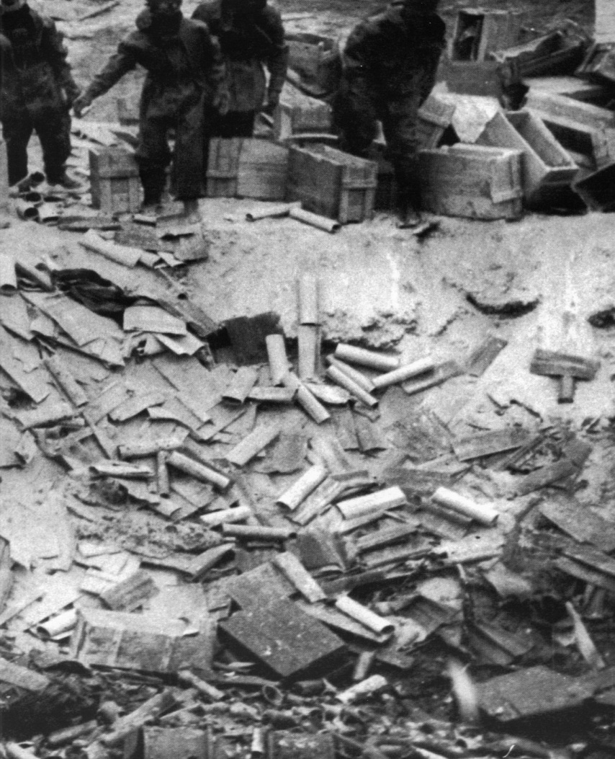
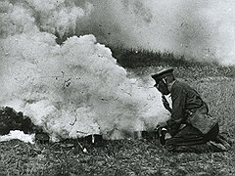
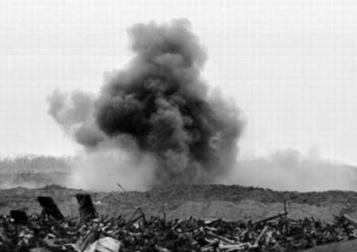
German CW disposal
Burial in the ground
Burning
Explosion of chemical artillery
shells

Slide 14
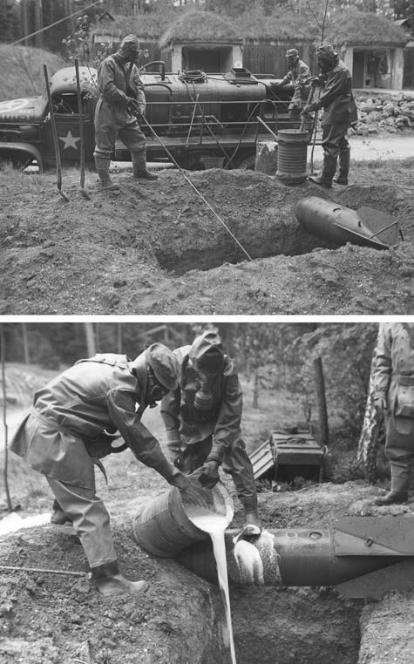
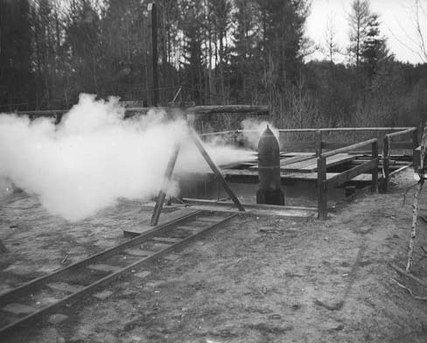
CW disposal after WWII
Mustard gas
Phosgene

Slide 15
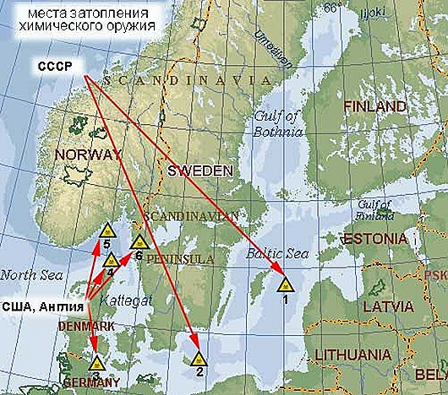
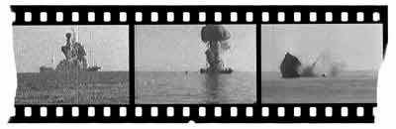
German CW dumped in Bultic sea after WW II

Slide 16
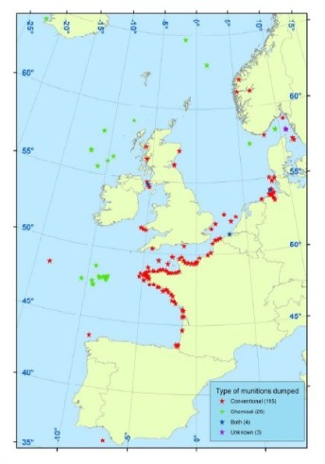
CW dumping at West coast of Europe
Estimates suggest that in excess of one million tonnes of munitions were dumped in Beaufort's Dyke (Irish Sea), some 180,000 tonnes* in Skagerrak and some 300,000 tonnes in the North Sea...There are 148 individual dumpsites spread from Iceland to Gibralter
*Vic Rodrick, “Sea Shells: Deadly Harvest of Munitions is Washed up on Scotland’s Beaches,” Red Orbit,
1 October 2006
Notes:
Estimates suggest that in excess of one million tonnes of munitions were dumped in Beaufort's Dyke (Irish Sea), some 168,000 tonnes in Skagerrak and some 300,000 tonnes in the North Sea...There are 148 individual dumpsites spread from Iceland to Gibralter
Disposals in the Beaufort Trench
The Beaufort Trench is an area of deep water between Scotland and Northern Ireland that has been used for dumping munitions since WW1. A large number of munitions, including chemical weapons, were dumped there after the end of WW2. Detailed information is not currently available.
The following is an extract from Hansard (UK Parliament - written answers) on 23 Apr 2002 - see External resource #4. Dr Moonie was the UK Junior Defence Minister at that time and Mrs. Curtis-Thomas was Member of Parliament for Crosby (Merseyside).

Slide 17
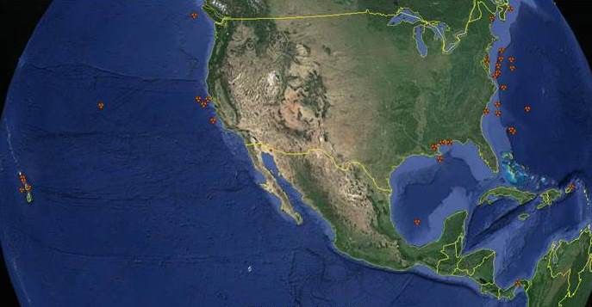
CW dumped by the USA
http://cns.miis.edu/stories/090806_cw_dumping.htm
Notes:
The United States never used nerve agents on the battlefield. However, continued testing and
long-term storage created dangers that eventually impacted the entire U.S. chemical weapons program.
In 1968, VX apparently leaked from an aerial spray tank which was believed to be empty, and drifted across Skull Valley over the borders of Dugway Proving Ground, Utah, and sickened or killed 6000 sheep.
In 1969, GB leaked from a Navy bomb, part of a secret chemical weapons stockpile stored on the island of Okinawa, injuring 23 soldiers and one civilian. As a direct result of these accidents, President Richard Nixon issued an executive order in 1969 to halt U.S. production of chemical warfare agents

Slide 18
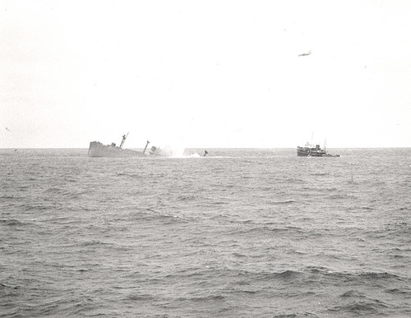
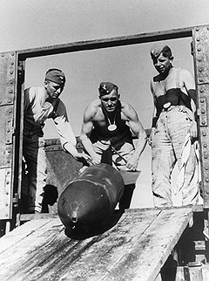
USA CW disposal at sea after WW II
Disposal By Scuttling
The SS William Ralston filled with 301,000 mustard gas bombs
and 1,500 1-ton canisters of Lewisite -- sinks in the Pacific off San Fransico in 1958. (Photo courtesy of the U.S. Army)
Notes:
The last disposal of chemical weapons at sea by the US Government was on August 18, 1970, when 12,508 M55 sarin rockets, three 155 mm sarin projectiles, and one M23 VX land mine were dumped in the Atlantic Ocean 250 miles east of Cape Kennedy, Florida. Earlier at-sea disposals by the US Government include an unknown number of mustard projectiles off Charleston; 16,000 one-hundred-pound mustard bombs off Oahu; 1,154 fifty-five-gallon drums of arsenic trichloride and 924 ten-pound white phosphorus cluster bombs in “Disposal Area Number 1” in the North Atlantic; twenty 1000-pound hydrogen cyanide bombs and 1,100 one-thousand-pound cyanogen chloride bombs off Waianae, Hawaii; an unspecified quantity of mustard projectiles in the Gulf of Mexico south of New Orleans; three phosgene bombs (German origin) in the Gulf of Mexico; 887 containers of lewisite in the Pacific Ocean twelve miles off the Aleutian Islands; and 301,000 mustard bombs (of 115 pounds each) in the Pacific Ocean 117 miles off San Francisco. The above list is just a sampling of the full list – and the full list is acknowledged to be highly incomplete

Slide 19
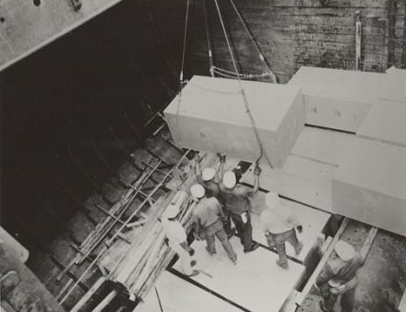
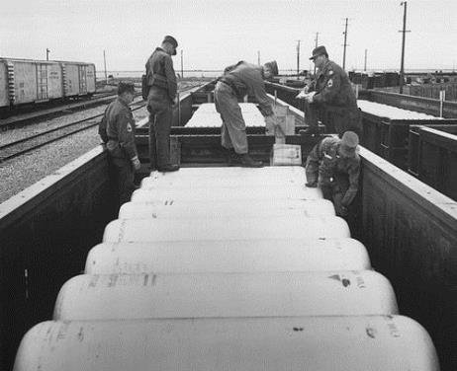
Concrete-encased M55 rockets full of nerve gas are loaded into a sea. (Photo courtesy of the U.S. Army)
US CW disposal at sea after WW II
Shipments (Photo courtesy of the U.S. Army)
Chemical warfare agents destined for ocean disposal were often shipped to port via railroad car. This 1968 shipment likely was of Lewisite, a blister agent, and dumped off the coast of South Carolina

Slide 20
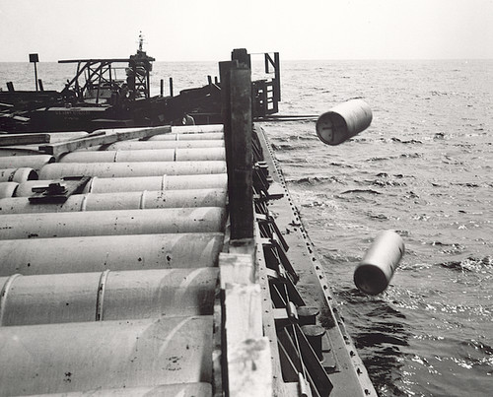
Chemical dumping
In 1964, mustard gas canisters are pushed into the Atlantic . (Photo courtesy of the U.S. Army)
USA CW disposal at sea after WW II

Slide 21
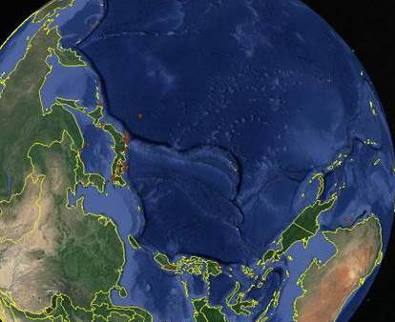
CW dumped by Russia, Japan and Australia
http://cns.miis.edu/stories/090806_cw_dumping.htm

Slide 22
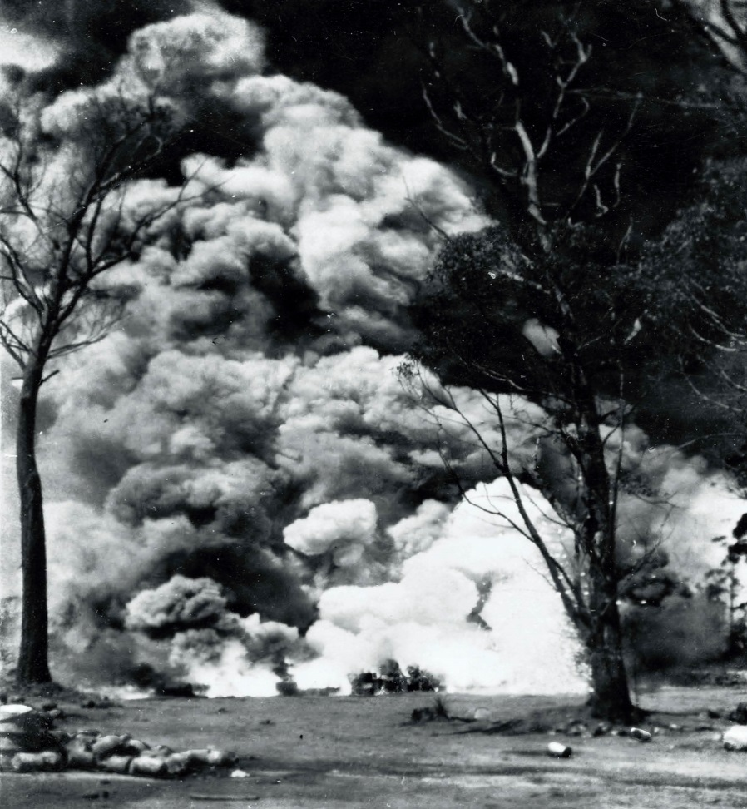
CW destruction in Australia after WW II
Mustard gas stocks burning at Newnes State Forest, west of Sydney, in early 1946. Burning
was found to be an effective method of disposing of bulk supplies of mustard. The bright flare in the center is the result of two cases of thermite incendiaries which had been mixed with the mustard stocks

Slide 23
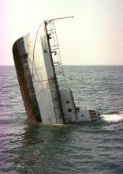
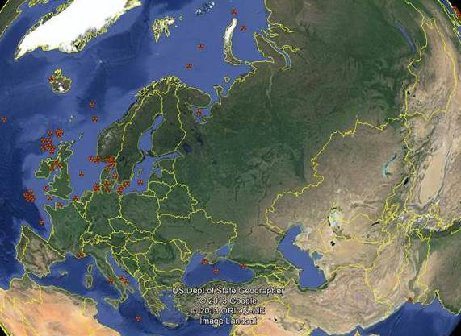
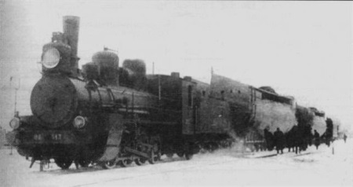
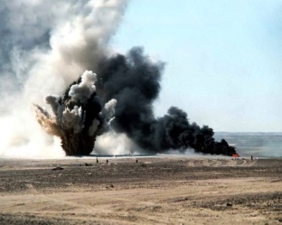
CW disposed at the land and sea in USSR
http://cns.miis.edu/stories/090806_cw_dumping.htm

Slide 24
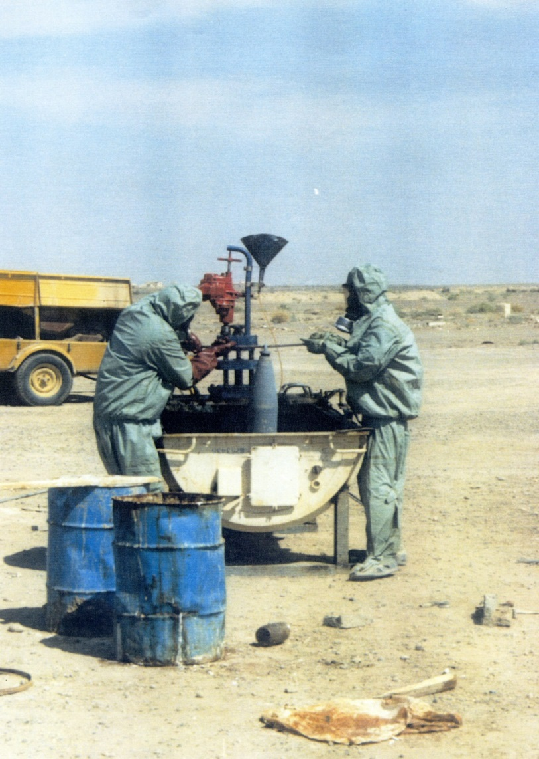
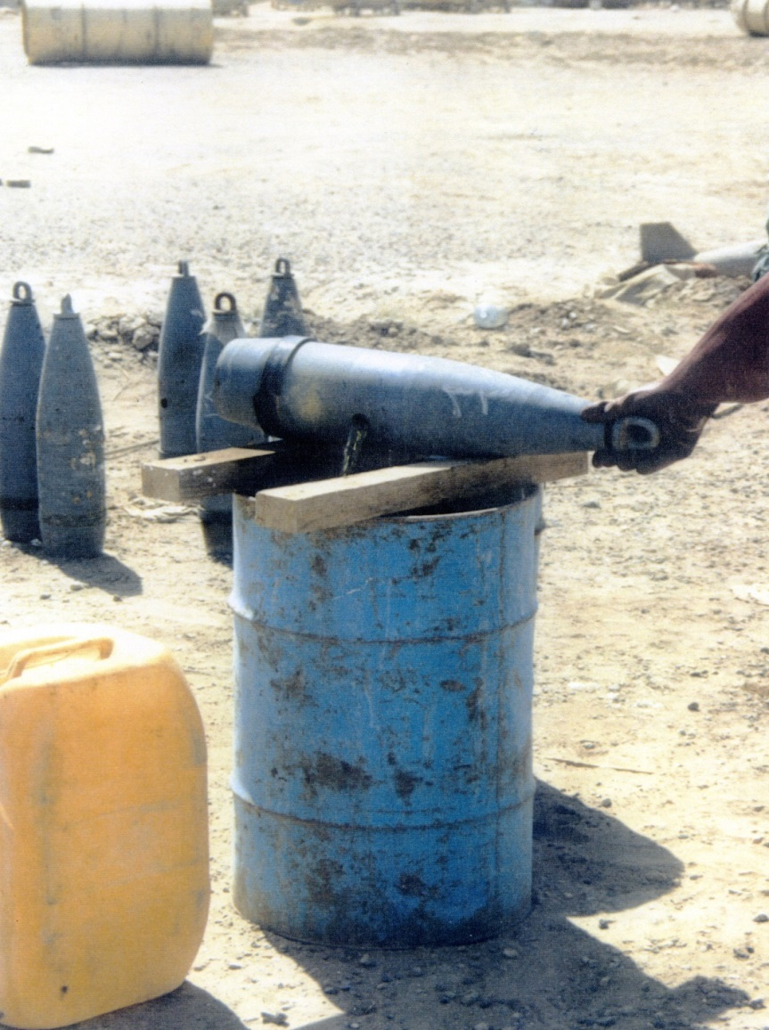
Chemical weapons destruction in Iraq

Slide 25
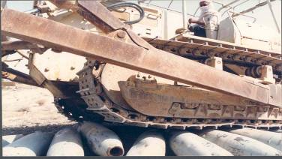
Destruction means in Iraq in1992-1994

Slide 26
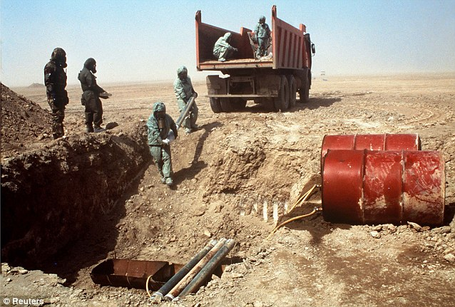
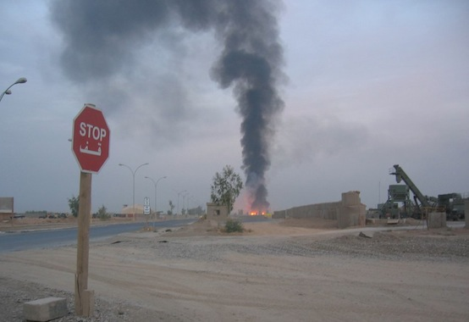
Destruction of chemical weapons stockpiled in Iraq in 1998

Slide 27
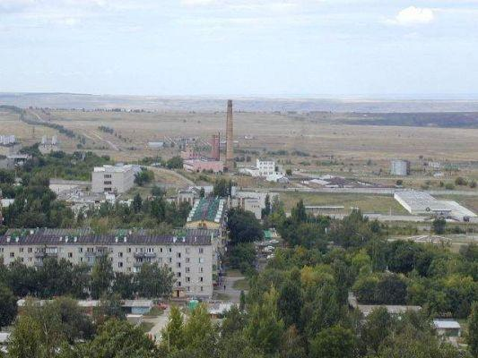
CW destruction technologies under development in Soviet Union in 80-90s
burial in ultra-deep wells
dropping of CW in volcanoes
destruction of CW in industrial blast furnaces
using of micro wave energy
production of phosporous containing fertlisers
burning together with misailes fuel
nuclear explosion at Novaya Zemlya

Slide 28
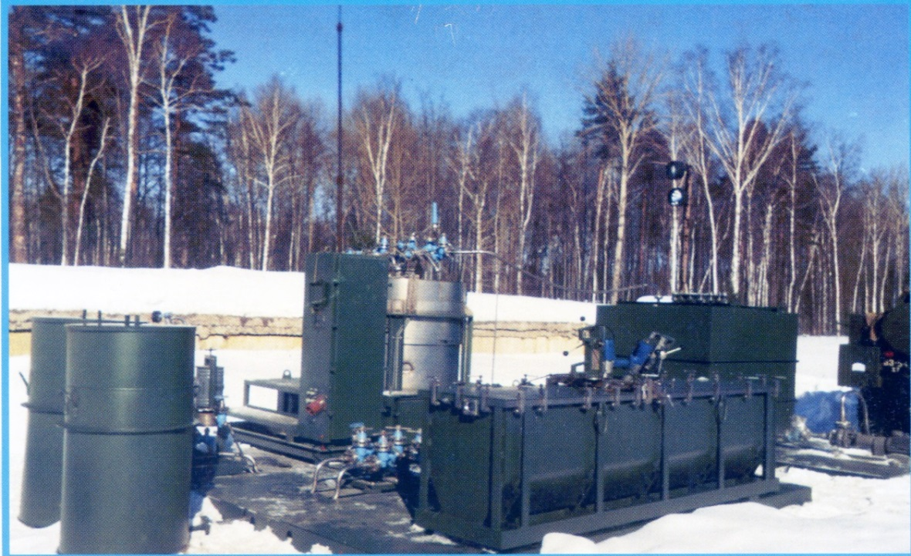
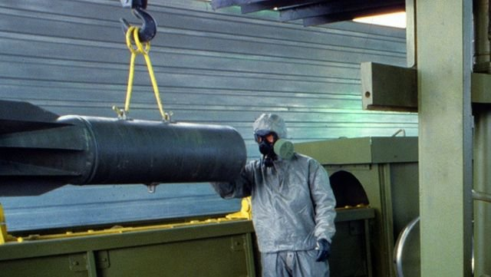
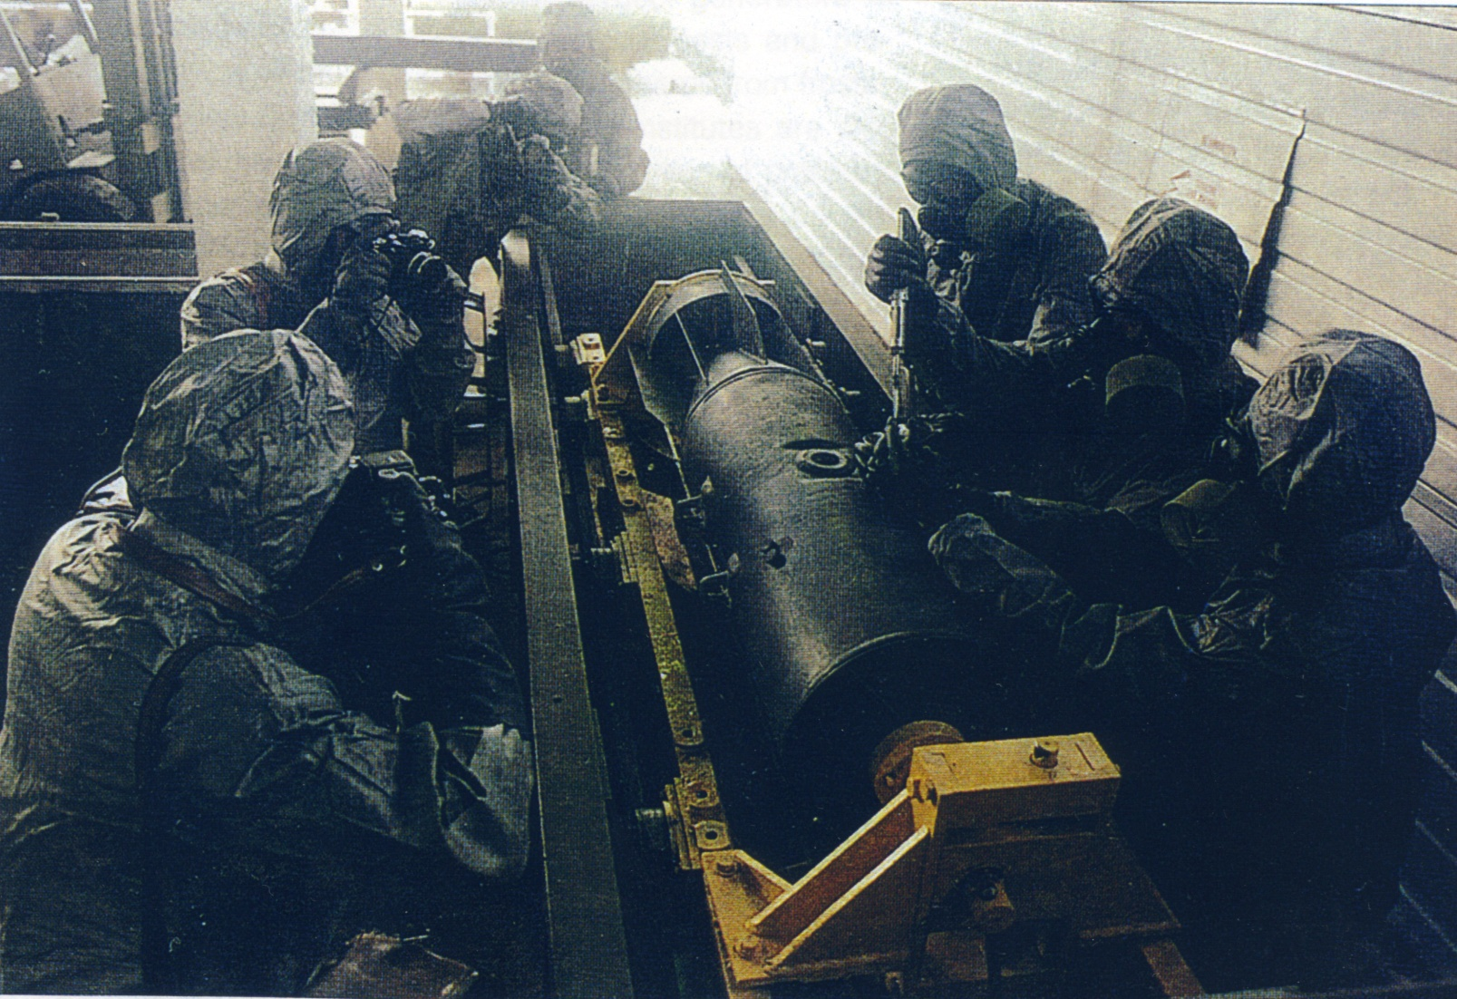
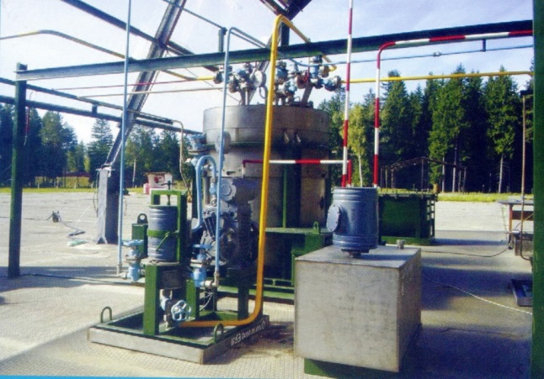
Mobile complex for destruction
of munitions in hazardous conditions, Russia
Capacity up to 300 kg
of nerve agent per day
using monoethanolamine (MEA) water solution

Slide 29
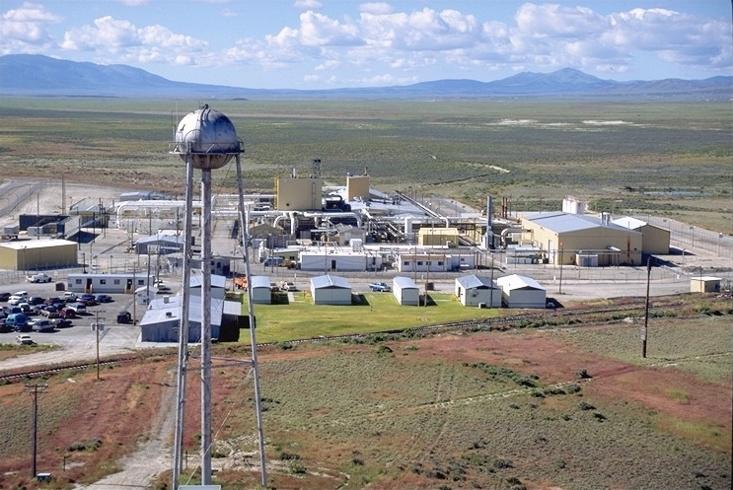
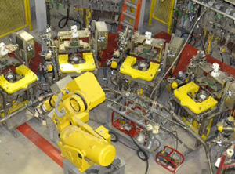
Chemical Agent Munitions
Disposal System (CAMDS) Tooele, Utah
CAMDS is where the U.S. Army’s first formal chemical weapons destruction efforts began. For more than 25 years, CAMDS developed and tested chemical weapons destruction methods and procedures, destroying more than 363,000 pounds of chemical agents and more than 40,000 munitions during that time
Notes:
CAMDS is where the U.S. Army’s first formal chemical weapons destruction efforts began. For more than 25 years, CAMDS developed and tested chemical weapons destruction methods and procedures, destroying more than 363,000 pounds of chemical agents and more than 40,000 munitions during that time.

Slide 30
CWC and progress of CW destruction under the OPCW verification since EIF

Slide 31
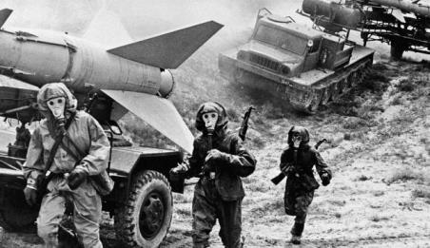
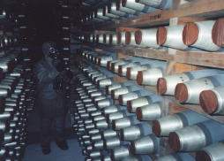
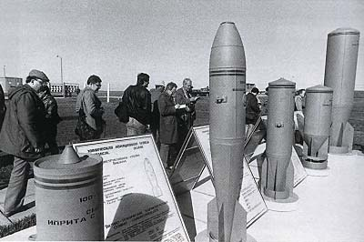
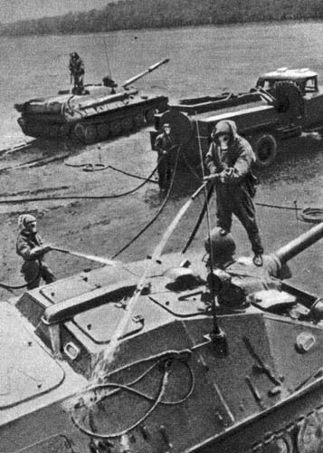
USSR CW offensive and defensive programmes in 60s-70s

Slide 32
CW Disarmament Start Points in the US
CW munitions leaking at storage facilities, including M55 rockets in dangerous condition
Operation CHASE (Cut Holes and Sink 'Em) was a US DoD program that involved the disposal of unwanted munitions at sea from 1964 into 1970s. Number of incidents occurred with CW during its transportation for dumping at sea and large scale marina environment damage
VX sprayed accidentally over large territory at Dugway Proving Ground which cause death of almost 6.5 thousands of sheep and horses which all mentioned events have triggered the protest movement around the US
Nixon Administration initiated review its CW policy in 1968 and subsequently unilaterally renounced the use of CW, in late 1969
Notes:
Composition of the Convention on Chemical Weapons: A preamble, which makes reference to the Geneva Protocol and the Biological and toxin Weapons Convention, 24 articles, an annex on chemical, which comprises guidelines for Schedules of chemicals and the Schedules of chemicals:
Schedule I chemicals have few, or no uses outside chemical weapons
Schedule II chemicals have legitimate small-scale applications.
Schedule III chemicals have large-scale uses apart from chemical weapons. An example is phosgene, which was used has a chemical weapon and is a precursor in the manufacture of many legitimate organic compound.
An Annex on Implementation and Verification
An Annex on Confidentiality

Slide 33
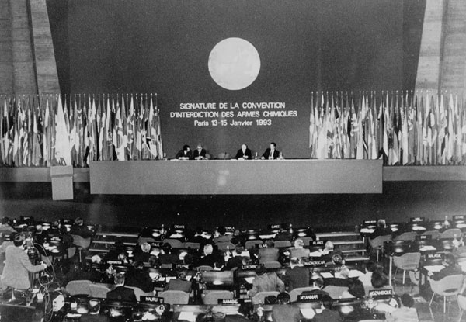
The CWC and OPCW
Negotiations concluded in 1992 and the draft CWC was subsequently endorsed by the UNGA
13-15 January 1993 - Signing Ceremony of the CWC , UNESCO Headquarters, Paris: Secretary-General Boutros Boutros-Ghali
Its entry into force was prepared for by a Preparatory Commission working in The Hague between February 1993 and 29 April 1997

Slide 34
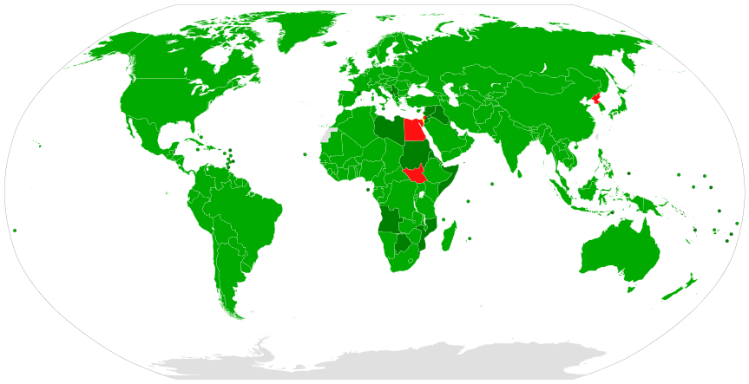
Participation in the CWC as of 2017
Has achieved almost universal adherence
192 - States Parties covering,
1 - Signatory States (Israel)
3 - States that have yet to take any treaty action (DPRK, Egypt and South Sudan)
98% of the global population
Signed and ratified Acceded or succeeded
Only signed Non-signatory

Slide 35
Category 1 CW Stockpile Destroyed as at 31 October 2017
96.29%
SPs | MTs
Albania | 15.1
A SP | 601.1
India | 1052.0
Libya | 26.3
Syria | 1062,6
Russia | 39,967.00
90.58%
100%
100%
100%
100%
100%
100%
Notes:
35
This slide shows one more time the progress achieved by individual possessor SP in destroying their respective declared Category 1 CW stockpiles.
Albania , India, ASP, Lybia and Syria have completed the destruction of their declared Cat 1 stockpiles.
1) During the inter session period, the destruction progress for US stands at 89.8%.
2) At the RF CWDFs, the overall progress reached 83.2%.
3) As for Syrian Arab Republic, the overall progress amounted to 100%.
Summing up, the overall progress was at 86.4%.

Slide 36
CWC requirements and CW destruction technologies

Slide 37
What has been declared?
Chemicals:
Nerve agents, blister agents, binary nerve agents, choking, other
Form of storage:
Munitions (rockets/rocket warheads, projectiles, spray tanks, mines, bombs, etc.)
Containers (mainly bulk – 1m³ to 50 m³)
Other:
Unfilled munitions, rocket motors, fuses, busters, shipping & firing tubes, etc.

Slide 38
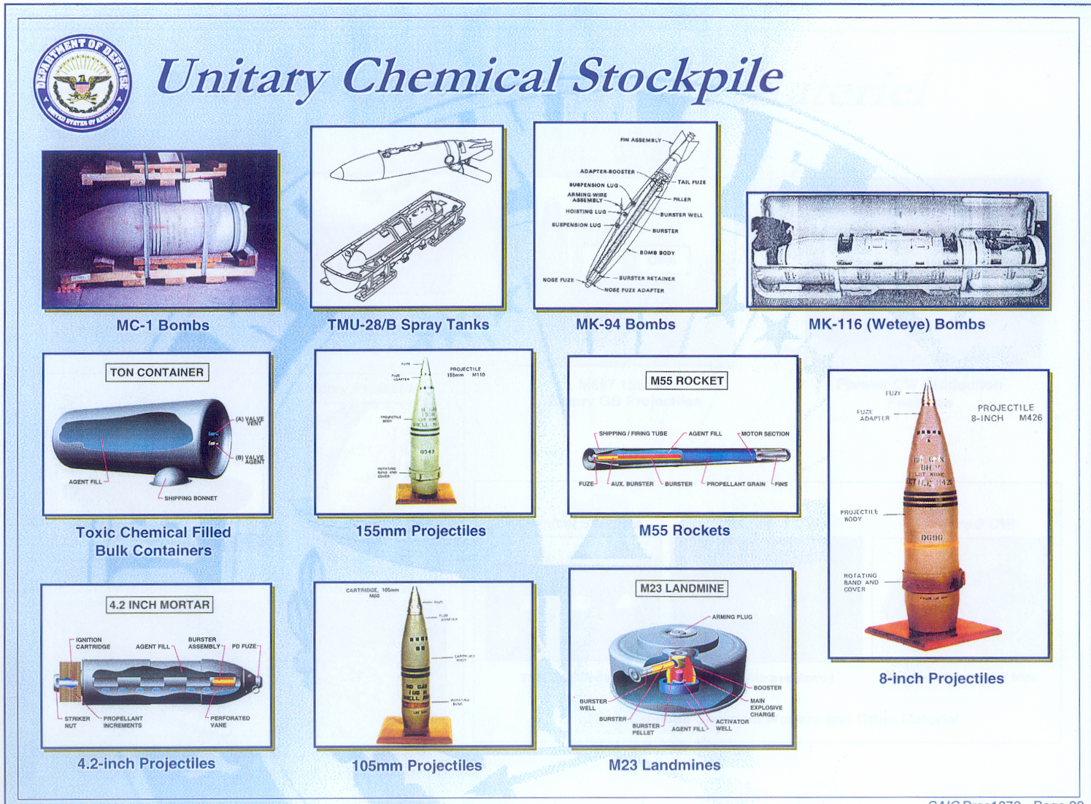

Slide 39





Stockpiled RF and USA CW

Slide 40
Obligations of the States Parties
How CWs are to be destroyed:
only at specifically designated and appropriately designed and equipped facilities (par. 13, Part IV(A),VA)
CWDFs to be constructed and operated in a manner to ensure the destruction of CW in an irreversible way (par.12 and 14, Part IV(A)
during destruction of CW the SP shall assign the highest priority to ensuring the safety of people and protection of the environment (par.10, Art.IV and par.3, Art.VII)
in accordance with general and detailed annual plans (par.1(a)(v), Art. III)
the destruction process can be verified under the provisions of the CWC (par.14, Part IV(A),VA)
Notes:
5. On the other hand the CWC is also set a number of requirements to the Inspecting State Parties on how to destroy the CW stockpiles as following:
only at specifically designated and appropriately designed and equipped facilities (par. 13, Part IV(A),VA)
CWDFs to be constructed and operated in a manner to ensure the destruction of CW in an irreversible way (par.12 and 14, Part IV(A)
during destruction of CW the SP shall assign the highest priority to ensuring the safety of people and protection of the environment (par.10, Art.IV and par.3, Art.VII)

Slide 41
CW destruction technologies used
Three main groups of CW destruction technologies used by the States Parties and verified under the OPCW verification regime:
high temperature destruction technologies
low-temperature destruction technologies; and,
explosives use detonation technologies
combined technologies and post treatment
other methods

Slide 42

Simplified diagram of projectiles processing

Slide 43


High temperature destruction technologies
Baseline incineration of chemical warfare agents (1500⁰C) followed by high temperature treatment of munitions bodies in metal parts furnace (MPF) and body deformation or cut. The same was used at JACADS, ANCDF, UMCDF and PBCDF
Tooele Chemical Agent Disposal Facility, Utah, USA
Area Ten Liquid Incinerator (ATLIC), Utah, USA

Slide 44

High temperature destruction technologies
Incineration of chemical warfare agent (1200⁰C). Munitions bodies and emptied tanks treatment (700⁰C) in metal parts furnace (MPF) and body cut
CWDF, India

Slide 45



High temperature destruction technologies
Pyrolysis in N₂ atmosphere (600-800⁰C, 18 h) followed by incineration (1100⁰C)
Qaf-Molla chemical weapons destruction facility, Albania

Slide 46



Low-temperature destruction technologies
One step process. Chemical neutralisation followed by liquid waste reduction (water evaporation)
Gorny CWDF, Russia
Kambarka CWDF, Russia

Slide 47



Low-temperature destruction technologies
Two steps process. Chemical neutralisation followed by neutralent incineration at commercial waste treatment facility (NECDF) or followed by biodegradation (ABCDF) or followed by wet air oxidation (PBBDF)
Newport Chemical Agent Disposal Facility, USA
Newport Chemical Agent Disposal Facility,
USA

Slide 48




Low-temperature destruction technologies
Shchuch'ye Chemical Weapons
Destruction Facility, Russia
Two steps process. Chemical neutralisation followed by reaction mass bituminisation Shchuch'ye (same process to be used at Kizner)

Slide 49




Low-temperature destruction technologies
Two steps process. Chemical neutralisation followed by reaction mass cementation (RHNS1)
Ruwagha Hydrolysis Neutralisation
System 1, Libya

Slide 50
Combination of Low and High-temperatures destruction technologies
CWDF at ASP
Hydrolysis followed by incineration of neutralent as well as direct incineration has been used by ASP

Slide 51


Slide 52



Explosives use detonation technologies
The EDS uses cutting charges to explosively open chemical munitions, destroying their explosive elements before the chemical agent is neutralized (DPG-EDS, AB-EDS and PB-EDS)

Slide 53




Explosives/high temperature use detonation technologies
SDC. The boxed munitions are dropped onto a heated (550°C-600°C) shrapnel (scrap) bed at the bottom of the detonation chamber, resulting in deflagration, detonation, or burning of the munition’s explosive fill. The chemical agent in the munitions is destroyed by the shock wave from the detonation or by decomposition due to the high heat in the chamber (Anniston, USA), Libya
Anniston Chemicals Disposal Facility,
Alabama, USA

Slide 54

Static Detonation Chamber at Ruwagha, Libya
On 26 January 2014 Libya completed destruction of
all Category 1 CW

Slide 55


SDC and Off-Gas Treatment System (OGT)
Thermal Oxidizer
Venturi Quench
Acid Scrubber
Neutral Scrubber
Safeguard filter
Induced Draft Fan
Stack

Slide 56


Explosives use detonation technologies
TDC Transportable Detonation Chamber.
Simplified process flow diagram. Destruction of Old Chemical Weapons at Columboola
(Image: Copyright CH2MHILL)
The TDC is a self-contained system, which includes a detonation chamber, an expansion chamber and an emission control system. It destroys munitions that are wrapped in explosive by detonating them within the fully-enclosed chamber. Applications of the TDC include destruction of recovered chemical weapons in Poelkapelle, Belgium, and at Schofield Barracks, Hawaii. Currently, the TDC is undergoing testing at Aberdeen Proving Ground, Md.

Slide 57


Explosives use detonation technologies
DAVINCH TM (Detonation of Ammunition in a Vacuum Integrated Chamber) operation is based on the process uses a detonation chamber in which chemical munitions are destroyed when donor charges surrounding the munitions are detonated. Up to 60 kg of explosives

Slide 58





OCW destruction in Belgium
3000- 5000 chemical
munitions per year
DAVINCH and
low temperature
neutralisation

Slide 59



OCW destruction in Japan
DAVINCH
Notes:
According to experts, the stockpile of chemical weapons abandoned by the Japanese army in China, in the order of 400 thousand artillery shells, bombs and canisters of mustard gas and other chemical agents . According to the calculations of Tokyo, the Imperial army left in China about 700 million of charges with poisonous substances. To date, 15 provinces in China found more than 150 people are buried hazardous ammunition.
Chemical weapons and threatens to poison the waters of the Sea of ​​Japan . Shortly after the Second World War, the Kwantung Army was flooded in the eastern part of the Inland Sea tens of thousands of aerial bombs filled with agents. Ammunition with mustard gas , lewisite , and other OS were packed in wooden boxes and hidden in an abandoned coal mine near the town of Mina ( Yamaguchi Prefecture ), where stored for months - until mid- November 1945 . Then, under the supervision of U.S. military experts deadly cargo was transported to the port of Ube , loaded on ships and sunk in 18 km from the port at a depth of 30 m.
China reported that more than 3,000 injuries had resulted from chemical weapons left in that country by Japan during World War II

Slide 60





OCW destruction in Germany
Pyrolisis and incineration

Slide 61




OCW destruction in Italy
Low temperature hydrolisis
and neutralisation.
Incapsulation

Slide 62


OCW destruction in Australia
Department of Defence has destroyed
144 mustard gas shells uncovered at Columboola, between Chinchilla and Miles using TCD

Slide 63





ACW destruction in China
A few millions of munitions are expected

Slide 64


Reaction mass post treatment
Russian nerve agents neutralisation technology – incineration and/or bituminisation
Newport VX neutralisation – mixing with the industrial waste and its incineration
Aberdeen and Blue Grass HD neutralisation – biodegradation
Pine Bluff and Pueblo - Wet Air Oxidation in Deer Park, Texas

Slide 65


Category 2 CW destruction in Libya

Slide 66

Precursors (PCL₃ and SOCl₂) destruction in Libya

Slide 67



PCl₃ hydrolysis modelling

Slide 68



Category 3 CW destruction in Libya

Slide 69






Syrian CW (HD and DF) destruction at MV CAPE RAY
?
?
France said that it was prepared to offer expertise,
but denied that it had been approached
to destroy the chemicals.

Slide 70


Field Deploeble Hydrolysis System

Slide 71

Precursors destruction sites
Danish and Norwegian Vessels
UK (Veolia) -B salt, B & BB solution (priority 1 chemicals)
Finland (Ekokem) - Priority 2 chemicals (organic) + Substance A + DF effluent (RM) (from Cape Ray)
USA (Veolia) - Priority 2 chemicals (inorganic)
Germany (GEKA mbH) - Mustard effluent (RM) from Cape Ray

Slide 72


Hith temperature industrial waste treatment used for CWC purposes
Veolia Environmental
Services Technical
Solutions, LLC (U.S.A.)
Destruction of inorganic
P2 chemicals by mixing with
other waste and incineration -150 days
CW disposal facility
of GEKA mbH in Munster, Germany
Disposal of HD effluent, incineration - 90 days

Slide 73


Hith temperature industrial waste treatment used for CWC purposes
Veolia Waste disposal
site in Ellesmere
Port, UK
Temperature Incinerator
Destruction of subst. B, BB - 30 days
Ekokem OY AB (Finland)
Disposal of DF effluent 290 days
Destruction by incineration
of subst. A and organic P2
Chemicals 177 days (43 days for subst. A and 134 days for P2 chemicals)

Slide 74
Al Muthana Site, Iraq

Slide 75
Al Muthana Site “destruction method”
In its national statement to the Twenty-First Session of the Conference, Iraq informed the Conference about its intent to start the destruction operations of the remnants of chemical weapons in March 2017. Pursuant to Article III, 1(a)(v) and Part IV(A), Paragraphs 53 and 56 of the Verification Annex, the Secretariat began consultations with Iraq with the view to assist it in the development of the general plan for destruction, the facility agreement and the agreed detailed plan for verification
OPCW is considering destruction method for “chemical waste” in Bunkers is capsulation of entire bunkers with liquid concrete

Slide 76
Hotzone Solutions
Mobile Hazardous Material
Treatment Unit

Slide 77
Waste treatment by plasma technology
Why?
Universality for different type of waste
Cost competitive
Environmentally friendly
Produces no harmful emissions or toxic waste/slag
Meets regulatory requirements worldwide
Simple to operate and requires low maintenance
Proven to be safe
Production of clean alloyed slag which could be used as construction material

Slide 78
Plasma Reactor Compared to Traditional
Combustion Furnace
Much higher degree of hazardous material destruction with the simultaneous decrease of the exhaust gas volume
Much higher degree of control of the process
Much lower weight and dimensions of the reactor and the installation
Easy and less costly maintenance
Much faster process activation and easy to shutdown
Increased safety

Slide 79
Needs for universal and mobile destruction technology
Large varaites of toxic chemicals (CWA and precuesors) and reaction masses (waste)
Remote location
Abcence of comersial waste treatment facilities
Limited technological and technical capabilituies
Limited timeframe and finance

Slide 80

Mobile Hazardous Material Treatment Unit (MHMTU)
MHTMTU – Complete mobile plasma plant for treatment of hazardous materials
Configured and optimized for destruction and conversion of:
  Solid and/or liquid material
  Chemical waste, including polychlorinated biphenyls (lPCBs), mineral oils, plastics, heavy metals, asbestos, pesticides, highly toxic chemicals, including chemical warfare agents, etc.
  Medical and bio waste
  Radioactive waste
  Industrial sludge
Modular: assembled from parts and components
Compact: fits into a 20 feet general purpose shipping
container or other appropriate mobile platform depends of required capacity

Slide 81



DC Plasma Torch in Action
Characteristics of plasma torch:
Current: 110 А – 210 А
Voltage: 200 V – 320 V
Power: 50 kW
Total plasma forming gas (air) consumption: 15 m³/h – 18 m³/h
Inlet cooling water temperature: 15°C
Outlet cooling water temperature: 50°C– 65°C
Plasma flow temperature: 4000°C - 5000°C
Efficiency: 75%

Slide 82
DC Plasma Torch in Action
Characteristics of plasma torch:
Current: 110 А – 210 А
Voltage: 200 V – 320 V
Power: 50 kW
Total plasma forming gas (air) consumption: 15 m³/h – 18 m³/h
Inlet cooling water temperature: 15°C
Outlet cooling water temperature: 50°C– 65°C
Plasma flow temperature: 4000°C - 5000°C
Efficiency: 75%

Slide 83



Shaft type furnace
1 – feeding unit
2 – shaft
3 – waste melting part
4 –receiver of slag
5 – plasma torch
6 – Slag discharge assembly
7 – syngas outlet
2.5 m high
1.5 m diameter
6.5 tonnes weight

Slide 84


3D diagram of MHMTU components integration

Slide 85






MHMTU: True Mobility

Slide 86

New MHMTU fully integrated system

Slide 87
HZS offers plasma reactors/furnaces
Waste | Product
Municipal Solid Waste | Plasma Furnace 500kg/hour
Biomass | Plasma Furnace 500kg/hour
Scrap Tires and Plastic Waste | Plasma Furnace 500kg/hour
Medical and Biological Waste | Plasma Furnace 50-250 kg/hour
Chemical and Industrial Waste | Plasma Reactor 50 -250 kg/hour
Sludge and Power Plant Fly Ash | Plasma Furnace 50-150 kg/hour
Low - Level Radioactive | Plasma Furnace 100 – 150 kg/hour

Slide 88
Hotzone Solutions
Notes:
88
As per page one of Profile brochure

Slide 89
Thank you
Questions ?

