Slide 1
Akkuyu Nuclear Power Plant and emergency management at the site
ANDREI BUDO, Akkuyu Nuclear A.Ş. Expert Department for Mobilization, Civil Defense & Emergency, Emergency Centers
III. INTERNATIONAL CBRN CONGRESS
20-22 November 2024
Notes:
Akkuyu Nuclear Power Plant and emergency management at the site

Slide 2
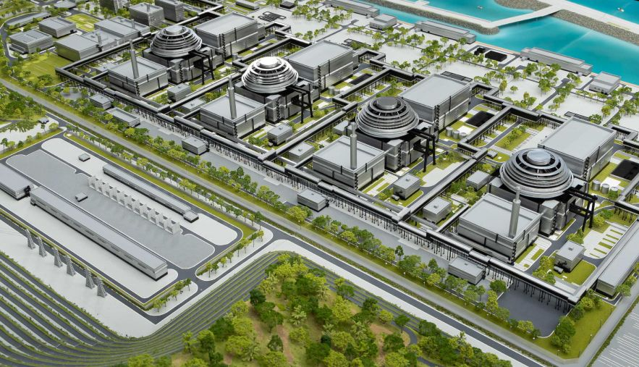
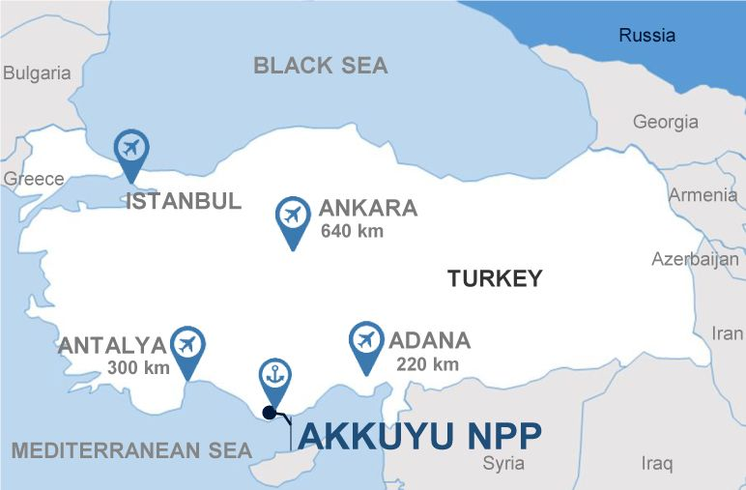
General information about the Akkuyu NPP project
Location:
Türkiye, Mersin province
Reactor:
VVER-1200
Capacity:
4 x 1200 MW
Highlights:
The first BOO (build-own-operate) nuclear power plant in the world
The first nuclear power plant in Türkiye
Project start:
2010
Основания:
•
•
IGA with the Republic of Türkiye (2010)
Power Purchase Agreement (2017)
License for construction of Unit 1 (2018)
Generation license (2019)
The estimated service life is 60 years.
02
Notes:
The AKKUYU NPP is currently under construction on the Mediterranean coast in Turkey, approximately 140 km from the city of Mersin in the province of Mersin.
The NPP will comprise four power units with a capacity of 1,200 MW each. In accordance with the intergovernmental agreement, Russia and Turkey are cooperating in the construction and operation of the nuclear power plant on a build-own-operate (BOO) basis.
The total capacity of the plant will be 4,800 MW, distributed across four units of 1,200 MW each.
The preparatory stage is scheduled for 2010-2013. The construction period will begin with the commissioning of Unit 1 in 2025. The reactor technology will be a water-moderated water reactor (VVER) 1200. The legal basis is the intergovernmental agreement of May 12, 2010. The estimated service life is 60 years.

Slide 3





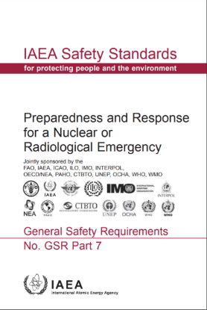
“Organizations responsible for emergency management acknowledge that good preparedness before the occurrence of any emergency may considerably improve the efficiency of emergency response. One of the most important features of emergency preparedness is the coordination of mechanism of its assurance between the various relevant bodies for well-defined allocation of responsibilities and powers”
03
Notes:
As an epigraph to my speech, I would like to cite the following words from the preface of the IAEA Safety Standards GSR Part 7, "Preparedness and Response for a Nuclear or Radiological Emergency": "Organizations responsible for emergency management recognize that good preparedness before any emergency occurs can significantly improve the effectiveness of the emergency response. One of the most important features of emergency preparedness is the coordination of its mechanisms between the various relevant bodies in order to clearly assign responsibilities and authorities."

Slide 4
Contents
01 | Emergency preparedness and response system for nuclear and radiological emergencies in the Republic of Türkiye
02 | Organization of Akkuyu NPP emergency preparedness and response system
03 | Events conducted in 2024
04
Notes:
Presentation content:
01 Emergency preparedness and response system for nuclear and radiological emergencies in the Republic of Türkiye
02 Organization of Akkuyu NPP emergency preparedness and response system
03 Events conducted in 2024

Slide 5
Emergency preparedness and response system for nuclear and radiological emergencies in the Republic of Türkiye
01
05
Notes:
Nuclear and Radiological Emergency Preparedness and Response System in the Republic of Türkiye

Slide 6





Main organizations, involved in the emergency preparedness and response system
President of the Republic of Turkiye
Cabinet Ministers of the Republic of Turkiye
Ministry of the Interior of the Republic of Turkiye
Nuclear Regulatory Authority of the Republic of Turkiye
Republic of Turkiye Disaster and Emergency Management Authority
Municipalities of provinces
For Akkuyu NPP: Municipality in Mersin Province
Governor
AFAD Disaster and Emergency Management Centers in the provinces
Fire services in the provinces
AKKUYU NÜKLEER ANONİM ŞİRKETİ
06
Notes:
Main organizations, involved in the emergency preparedness and response system.
State structures and organizations involved in the emergency response system ensure coordination between relevant ministries, institutions and organizations and provide support to governorates at the national level in the event of a radiation emergency that has occurred or is expected to occur within the country, in territorial waters and economic zone, as well as in the territory of neighboring countries and which will require the contribution of various organizations.

Slide 7
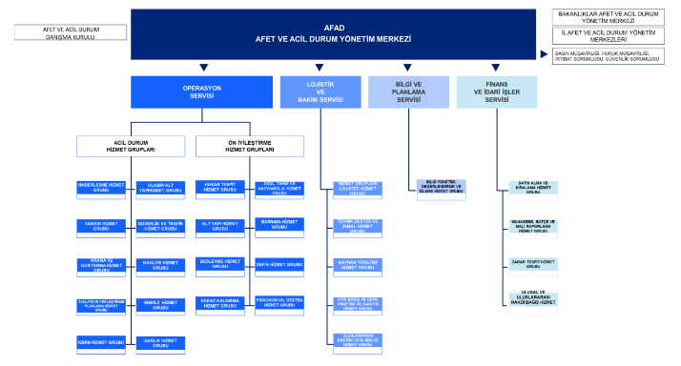
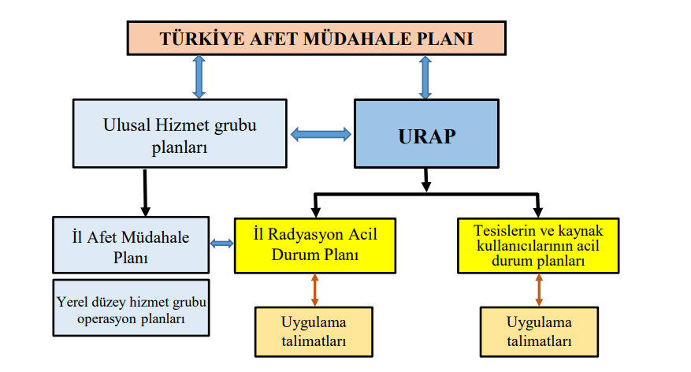
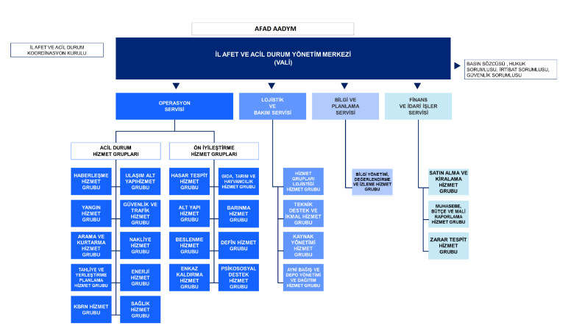
NATIONAL DISASTER RESPONSE ORGANIZATION
07
Notes:
NATIONAL DISASTER RESPONSE ORGANIZATION
The organizational charts displayed on this slide illustrate the service groups defined in the Turkish Disaster Response Plan (TAMP) at the national level. The same service group charts are defined at the regional level.
The slide also illustrates the plans to be deployed in the event of a radiation emergency, along with the interrelationship between these plans and the National Radiation Emergency Action Plan. In regions where facilities and areas are included in categories I, II, and V of the emergency preparedness plan, the Governorates are responsible for preparing Regional Radiation Emergency Action Plans with the approval of the NDK.

Slide 8
Akkuyu NPP emergency preparedness and response system organization
02
08
Notes:
Akkuyu NPP emergency preparedness and response system organization

Slide 9
Defense in depth
Level 1
Level 2
Level 3
Level 4
Level 5
Objectives and strategies
Prevention of operational occurrences
Prevention of design-basis accidents
Prevention of beyond design-basis accidents
Management of beyond design-basis accidents
Emergency planning
Instructions and guidelines
Operation manual, technical specifications
PRSO, ILNE
ILNE, IMA, BDBAMG
BDBAMG, SAMG
Emergency plan
Establishment of SPZ, CA, PAZ, UPZ, NPP safe operation management
Normal operation systems
Safety systems
Equipment and tools and means for management of BDBA
Workforce and means of EPLS
Means and measures
Responding to safety critical events
 | Response in the event of a design basis accident
 |  | Response in case of beyond design basis accident in the area of core damage prevention
 |  |  | Response in the event of a beyond design basis accident in the area of mitigation
 |  |  |  | Protection of personnel and emergency operations
09
Notes:
Defense in depth
The emergency preparedness and response system of the Akkuyu NPP is designed in accordance with the requirements of Turkish legislation, international standards set by the IAEA, and the regulatory documents of the country's nuclear technology supplier. The system has been designed with the objective of ensuring the ability to take prompt and effective measures to prevent or mitigate emergency situations during the implementation of activities related to the use of nuclear energy. It aligns with the accident management strategy based on the current defense-in-depth approach, which considers the scale of the event and the response stage.

Slide 10
Emergency Prevention and Elimination System
AKKUYU NÜKLEER ANONİM ŞİRKETİ
Emergency Response Supervisor
Chief Executive Officer of Akkuyu Nuclear JSC
NPP Shift Supervisor
Informing team
Department for mobilization, civil defense & emergencies, emergency centers
Akkuyu NPP Emergency and Fire Safety Assurance Committee
Permanent readiness workforces and means
ANAŞ Security Service
Akkuyu NPP Emergency Center
Akkuyu NPP Fire Station
PCPEA NPP, OM, MCC
ANAŞ Emergency Response Service
Akkuyu NPP Evacuation Committee
Protective structures
Accident Management Team
First-aid point
Personnel at the Akkuyu NPP site
Consolidated storage of civil defense equipment
Akkuyu NPP Operating Personnnel
Contractors carrying out construction and maintenance of NPP
AFAD (Regional Disaster and Emergency Management Center IAADYM)
Nuclear Regulatory Authority (NDK)
Nuclear Energy Agency (TENMAK)
Ministry of Energy and Natural Resources
WANO-MC Crisis Center
External organizations for interaction
10
Notes:
Emergency Prevention and Elimination System AKKUYU NÜKLEER ANONİM ŞİRKETİ
The AKKUYU NÜKLEER ANONİM ŞİRKETİ emergency response and liquidation system is integrated into the state emergency response system of the Republic of Turkey.
The system consists of:
• Coordinating body – NPP Emergency Situations and Fire Safety Commission;
• Emergency management body – Department of Mobilization Preparation, Civil Defense and Emergencies, NPP emergency centers;
• Forces and resources – emergency service groups;
• Information and management system – Akkuyu NPP emergency centers (on the NPP site and backup outside the NPP site);
• Material resource reserves.

Slide 11
Emergency preparedness and response planning system
AKKUYU NUCLEAR
ROSATOM
NATIONAL LEVEL
Man-made emergencies
Natural emergencies
Chemical emergencies
Radiological emergencies
NATIONAL EMERGENCY RESPONSE PLAN
NATIONAL ACTION PLAN FOR RADIATION EMERGENCY (URAP)
ACTION PLAN IN THE EVENT OF MERSIN PROVINCE RADIATION EMERGENCY
ACTION PLAN IN THE EVENT OF MERSIN PROVINCE EMERGENCY
AKKUYU NPP PROJECT LICENSING BASIS SUBJECT TO ACCOUNTING DURING PLANNING IN THE EVENT OF EMERGENCY (RD RT, IAEA, RD RF)
AKKUYU NPP FACILITY-BASED LEVEL
PLAN for response to radiation emergencies at the Akkuyu NPP site (EMERGENCY PLAN)
SAFETY MANAGEMENT SYSTEM AT THE AKKUYU NPP FACILITIES
RELATED TO HANDLING HAZARDOUS SUBSTANCES
Man-made emergencies
Natural emergencies
Radiological emergencies
ACTION PLAN IN EMERGENCY CONDITIONS
Comprehensive description of emergency response organization at the Akkuyu NPP site, distribution of responsibilites and duties
Classification of emergencies and criteria for declaring the "emergency preparedness" and "emergency" staes, EAL, action plans of the persons in charge and the personnel.
Propensity of the site to disasters, actions in radiation emergencies caused by impacts of the natural environment
Principles of liquidation annunciation and communication actions, interaction with the external organizations
Chemical emergencies
Radiological emergencies
Identification procedures of hazards, risk assessment and management, including determination and analysis of potential risks of major accidents
Planning in the event of emergencies at the Akkuyu NPP facilities
Organizational structure and personnel responsible for safety of handling hazardous chemical substances, information support
Operational management and change management procedures at the Akkuyu NPP facilities
Man-made emergencies
Natural emergencies
Chemical emergencies
Radiological emergencies
Duties of the employees and the Company on actions in the event of emergency
Fire safety mode, principles, fire extinguishing equipment and systems, preventive maintenance
Actions, response procedures, restrictive actions during earthquakes
Action plan in the event of mud flows and floods, control and preventive maintenance procedures
Action procedures in the event of hurricanes, lightning strikes, incl. control of power supply lines, communications etc.
Warning, preventive maintenance, actions in the event of inflammations and explosions (including pressure vessels)
Action procedure during incidents and road accidents, action plan and preventive maintenance
Actions in the event of pollution threat of the environment during operation with HCS (hazardous chemical substance), poisoning, electrical shocks, irradiation and other emergencies, including war and sabotage
11
Notes:
The emergency preparedness and response planning system of AKKUYU NÜKLEER ANONİM ŞİRKETİ is designed in accordance with the legislative requirements of the Republic of Turkey. These requirements are reflected in the Intergovernmental Agreement on the implementation of the Akkuyu NPP project and form the Licensing Base of the project.
The primary document governing emergency planning at the Company is the Response Plan for radiation emergencies at the Akkuyu NPP site, otherwise known as the Emergency Plan.
The Emergency Plan outlines the scope, timing, and procedure for implementing measures to protect personnel in the event of a radiation emergency, organizing and conducting emergency rescue and other urgent work, and determining the forces and means involved.
The Emergency Plan was developed based on a comprehensive analysis of the potential radiation consequences of the most severe beyond-design-basis accident, as well as other natural and man-made factors that could fall under the criteria of an emergency.
The Emergency Plan is aligned with the National Plan of Measures in the Event of a Radiation Emergency.
In addition to the Emergency Plan, other documents have been developed to address potential incidents involving hazardous chemicals and adverse weather conditions.

Slide 12
Classification of events and conditions for initiating response
AKKUYU NUCLEAR
ROSATOM
Emergency class | Alert | Emergency at the facility | Emergency at the site | General emergency
Protective Measures | Situation assessment and mitigation
 | - | Implementation of mitigation and protective measures and other response activities within the facility
 |  | - | Conducting mitigation measures, protective measures and other response activities to be carried out on the site and, if necessary, in the vicinity of the site
 |  | - | - | Taking preventive urgent protective measures, urgent protective measures, early protective measures and other response measures on and off the site
12
Notes:
Classification of events and conditions for initiating response
In accordance with the Manual for management of radiation emergencies Akkuyu NPP is classified under category I preparedness for radiation emergencies. The following classes of radiation emergency are established for the category I preparedness for radiation emergencies:
1) General emergency: Radiation emergencies requiring mitigation and protective actions as well as other response activities on and off site;
2) On-site emergency: Radiation emergencies that require mitigation measures, protective measures and other response activities to be carried out on the site and, if necessary, in the vicinity of the site.
3) Emergency situation at the facility: Radiation emergencies that occur at Category I facilities and require mitigation and protective measures and other response activities within the facility.
4) alert: radiation emergencies that require situation assessment and mitigation.
The use of NPP emergency states and classes of emergency situations is consistent with each other.

Slide 13
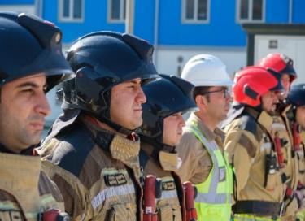

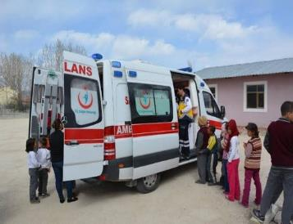
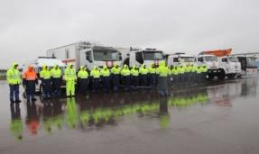
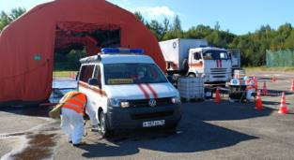
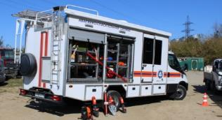
Emergency response forces
Emergency rescue service ANAŞ
AKKUYU NUCLEAR
ROSATOM
NPP ERS management group
Emergency response team on reactor equipment
Search and rescue team
on turbine equipment
Search and rescue team
on control instrumentation and automation
Search and rescue team
on electrical equipment
Team for transport and mechanization of operations
Decontamination and cleaning team
First-aid team
Team for maintaining protective structures
Emergency rescue service of
AKKUYU NÜKLEER ANONİM ŞİRKETİ
Search and rescue team
for operations with RAW
Emergency operations logistics team
The personnel of the search and rescue group of the NPP ERS has been appointed as emergency workers with consent for the planned special exposure (100 and 500 mSv).
Search and rescue team
Radiation detection team
Search and rescue team
on chemical equipment
Search and rescue team for decontamination and cleaning
Search and rescue group
on the systems providing safety
Search and rescue team
on ventilation and air-conditioning systems
Emergency Response Team at the systems of hydrotechnical facilities
13
Notes:
Emergency response forces
The company maintains a robust emergency response infrastructure, complemented by voluntary emergency services.
The fire safety service is a regular service that provides fire extinguishing and supervision in the field of fire safety.
The security service is a regular service that provides the NPP with physical protection.
The medical center is a regular service that provides initial medical assistance and coordinates first aid for injured personnel.
The emergency rescue service is a non-regular service equipped with specialised equipment, machinery, gear, tools and materials. The personnel are trained and prepared to carry out emergency rescue and other urgent work in emergency zones at the NPP site. In addition, the emergency rescue service has established a search and rescue group, comprising personnel who have been designated as emergency workers with consent to the planned increased irradiation.

Slide 14
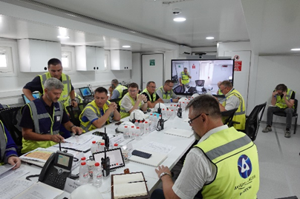
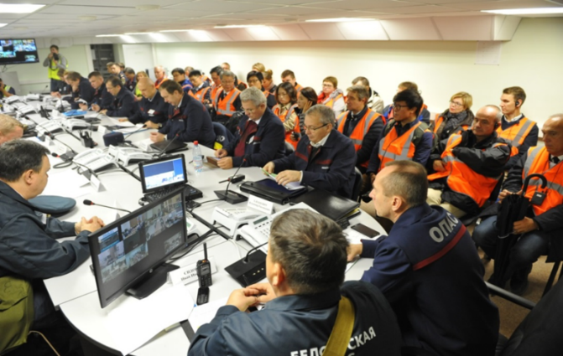
Emergency centers of AKKUYU NÜKLEER ANONİM ŞİRKETİ
14
Notes:
Emergency centers of AKKUYU NÜKLEER ANONİM ŞİRKETI
To facilitate the provision of information support for the activities of participants in emergency planning and emergency response, as well as to enable the consolidation of information in a single location, an emergency center has been established at the NPP site, with a backup center located outside the NPP site.
Furthermore, a mobile crisis center will be deployed, with the location determined based on the radiation situation and the emergency's location.
Emergency centers are equipped with the latest information, software, hardware, and telecommunications systems and tools, enabling interaction with the AFAD, NDK, and WANO-MC Crisis Centers, which provide technical support to the emergency NPP.

Slide 15
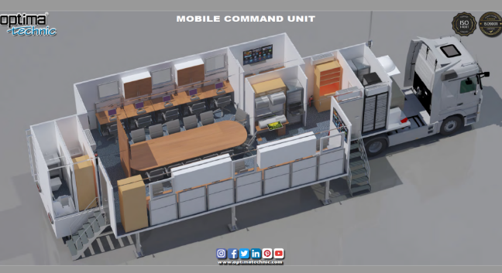
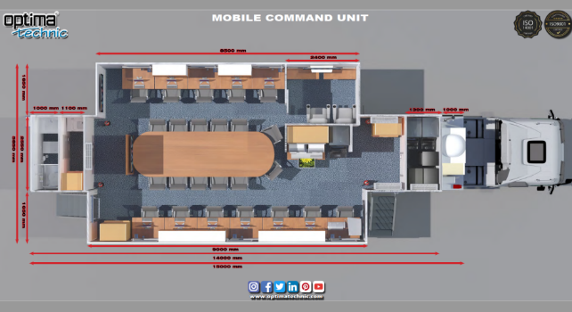
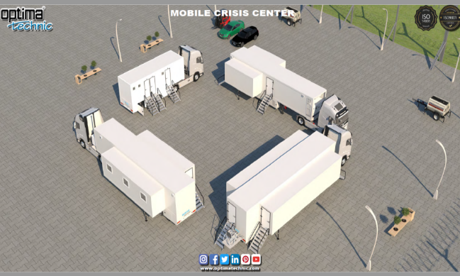
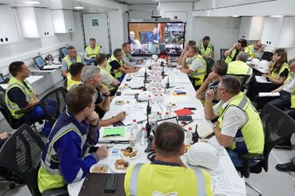
Mobile crisis center (MCC)
15
Notes:
Mobile crisis center (MCC)
A mobile crisis center was created to manage emergency response on site. Key advantage is the ability to select a location and operate autonomously. The mobile crisis center is fully equipped with the latest technical communications and ensures the continuous availability of emergency service personnel.
The MCC is currently being utilised for emergency response training and as a base for the company's management team when dealing with emergency response issues.

Slide 16
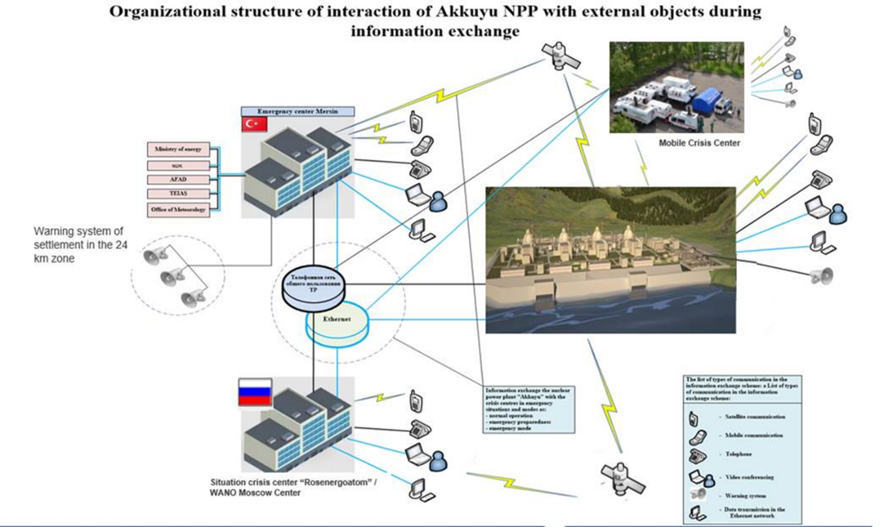
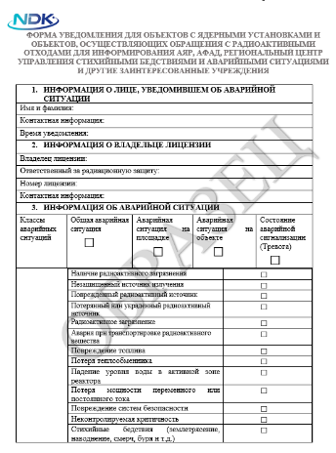
Organization of interaction
16
Notes:
Organization of interaction
In the event of a radiation accident, the procedure for organizing notification, communication, and information exchange is carried out in accordance with the National Plan of Measures in the Event of a Radiation Emergency and the Emergency Plan. This is subject to the levels of action in emergency situations for declaring accident classes being reached.
In order to notify AFAD and NDK, the NPP shift supervisor must complete a special form, the "Notification Form for Facilities with Nuclear Installations and Radioactive Waste Management Facilities for AFAD and NDK Notifications."
The relevant parties are duly notified.
The notification must be made within 15 minutes. Akkuyu NPP personnel and members of the NPP Commission, as well as personnel of enterprises (organizations) located on the territory of the Akkuyu NPP site, WANO Crisis Center for Technical Support - MC;
- within 30 minutes: The Regional Disaster and Emergency Management Center (IAADYM), the Nuclear Regulatory Authority (NDK), and the Ministry of Energy and Natural Resources.

Slide 17
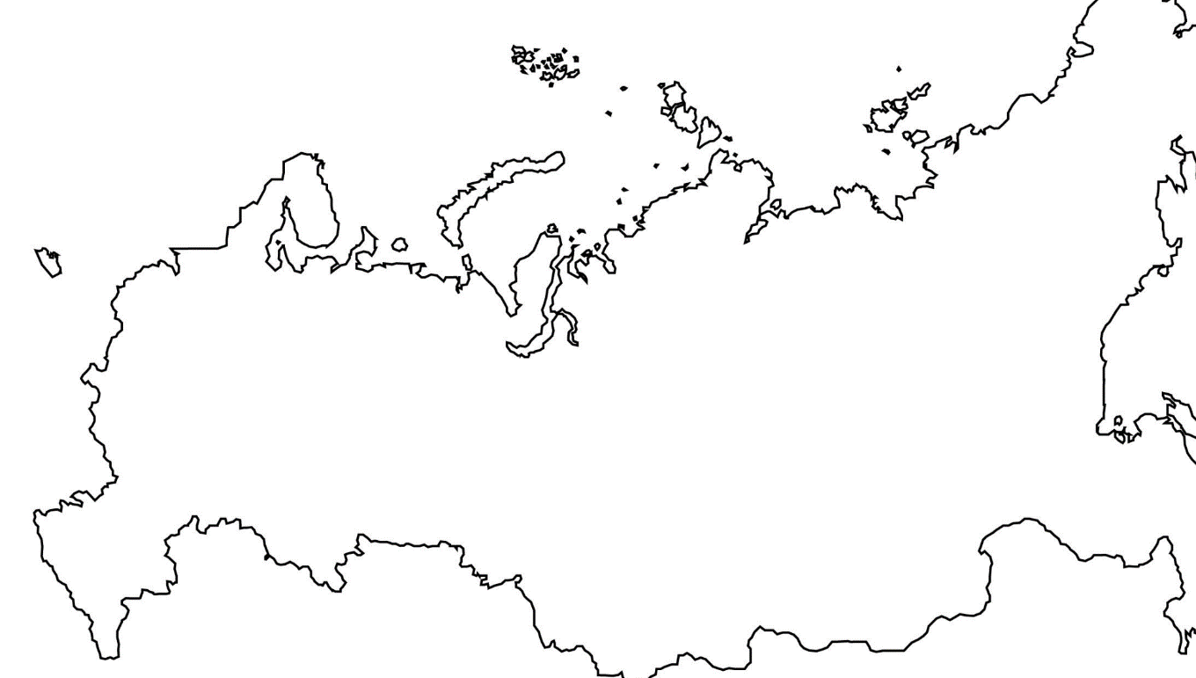
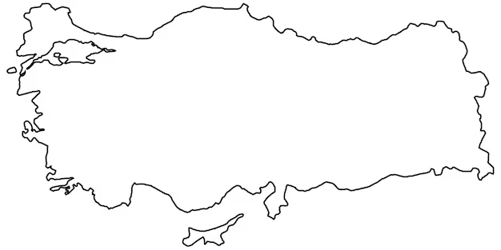
Technical support in the event of an accident
Russia
Moscow – technical support organization:
WANO regional crisis center (with the engagement of the designer organizations, RP developer, scientific coordinator etc.)
Turkiye
Ankara –
Nuclear Regulatory Authority
For in-depth technical support in the event of accident at Akkuyu NPP, the Company is working on establishing contacts with the technical support organizations.
Akkuyu NPP
17
Notes:
Technical support in the event of an accident
For in-depth technical support in the event of accident at Akkuyu NPP, the Company is working on establishing contacts with the technical support organizations.
Moscow – technical support organization:
WANO regional crisis center (with the engagement of the designer organizations, RP developer, scientific coordinator etc.)
Akkuyu NPP
Ankara – Nuclear Regulatory Authority

Slide 18
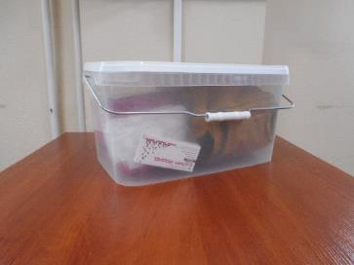
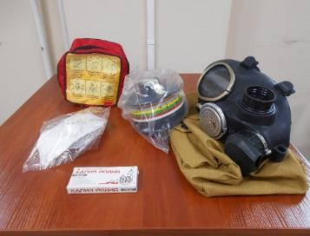
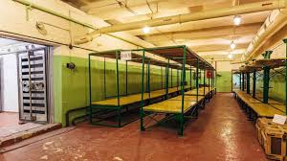
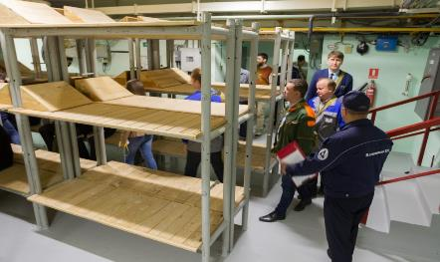
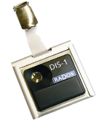

Organization of personnel protection
18
Notes:
Organization of personnel protection
Personal protective equipment for NPP personnel is stored at the work locations. In the event of an accident during working hours, NPP personnel are responsible for preparing personal protective equipment and acting in accordance with the instructions of the NPP shift supervisor or the head of emergency operations.
In the event of a radiation accident or other unfavorable circumstances that require the provision of shelter for personnel, civil defense protective structures are made available for their protection.
The shelter can accommodate up to 1,200 people.
Two shelters with a combined capacity of 600 people are located in the vicinity of units 2 and 3.
The civil defense protective structures comply with all radiation protection requirements and provide protection from shock waves. The autonomy of the system is designed to last for five days.
The protective structures are equipped with the necessary facilities to provide personnel with the appropriate sanitary treatment in the event of contamination by radionuclides.

Slide 19
Events held in 2024
03
19
Notes:
Events held in 2024

Slide 20

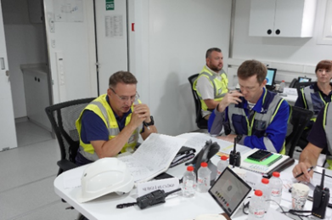
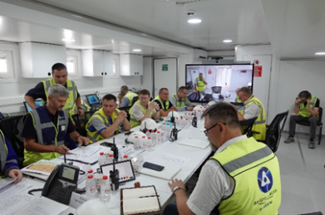
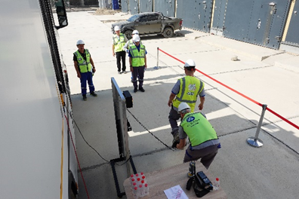
Information on drills 2024
Held drills
In accordance with the WANO-MC Regional Crisis Center (hereinafter the RCC) operation plan for 2024 on 27.06.2024 a joint emergency response drill at Akkuyu NPP Republic of Turkiye was held with the participation of NPPER group.
The objectives of emergency response drills were directed at ensuring continuous interdepartmental interaction for providing technical and advisory support to the operator in accident conditions.
The following questions were worked-out during the emergency response drills:
– emergency response of the Akkuyu NPP operating personnel;
– actions of the supervisory personnel for working out the accident management strategy;
– interaction with WANO MC RCC and NPPER group on technical and advisory support of the emergency NPP.
The results of emergency response drills were approved, including by the experts of the Turkish Regulator.
20
Notes:
Information on drills 2024
In accordance with the plan to improve emergency preparedness and response for 2024, a joint emergency drill was held on 27.06.2024 at the Akkuyu NPP in the Republic of Turkey with the participation of the Nuclear Power Plant Assistance Organization Group.
The objectives of the emergency drill were aimed at ensuring continuous interdepartmental interaction to provide technical and advisory support to the operator in an accident.
The following issues were worked out during the emergency drill:
- emergency actions of the Akkuyu NPP operating personnel;
- actions of the management team to develop an accident management strategy;
- interaction with the WANO RCC - MC and the OPAS group on technical and advisory support for the emergency NPP.
The results of the emergency drill were approved, including by the experts of the regulator of the Republic of Turkey who were present.

Slide 21
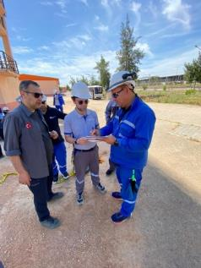
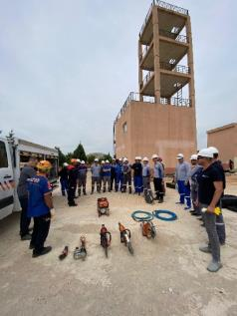
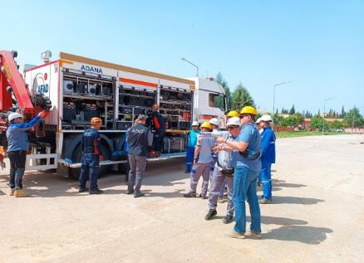
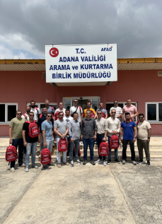
Scheduled drills
To the satisfaction of the “Regulation on response services to natural calamities and emergencies” (Official Gazette No. 5211 dated 23.02.2022), “Action plan for protection of personnel in the event of accident at Akkuyu NPP AKU.0&&&&.BW-CT-03.EPR.BS.0005, “Regulation of actions on execution of preventive actions during threat of emergency occurrence at the Akkuyu NPP caused by adverse natural events” EPR.RG.CT-03/15, for enrichment of knowledge and skills of personnel on actions during emergency occurrence at the Akkuyu NPP, working-out of the interaction with the state disaster and emergency management authorities (AFAD) engaged for emergency response at Akkuyu NPP the holding of emergency response drills has been scheduled with the NPP emergency services, search and rescue team of the Akkuyu NPP emergency response service and AFAD subdivisions for emergency response at Akkuyu NPP 28.11.2024.
Currently, the Plan for holding emergency response drills has been approved by order of the Chief Executive Officer. The training of personnel and preparation of technical facilities are in progress.
21
Notes:
Scheduled drills
In accordance with the requirements set forth in the "Regulation on the Services for Response to Natural Disasters and Emergencies", the "Response Plan for Radiation Accidents at the Akkuyu NPP Site“ and "Regulations on Actions to Implement Preventive Measures in the Event of a Threat of Emergencies at the Akkuyu NPP Caused by Unfavorable Natural Phenomena". In order to enhance the knowledge and abilities of personnel in responding to emergencies at the Akkuyu NPP, and to facilitate coordination with the state system bodies responsible for emergency prevention and mitigation (AFAD), an emergency response training is scheduled for November 28, 2024. This training will engage the NPP operational services, the Akkuyu NPP emergency rescue service search and rescue group, and AFAD units in a joint exercise to prepare for emergency response at the Akkuyu NPP.
The plan for conducting an emergency drill has been finalized and approved. Training for personnel and the technical base is currently underway.

Slide 22
Thank you for your attention!
Andrei Budo
Akkuyu Nuclear A.Ş. Expert Department for Mobilization, Civil Defense & Emergency, Emergency Centers
Tel.: +90 312 442-60-00 extn. 7841
e-mail: a.budo@akkuyu.com
www.akkuyu.com
Notes:
Thank you for your attention!

