Slide 1

The UK Novichok Attack and the Challenges of Urban Decontamination
III. INTERNATIONAL CBRN CONGRESS
2024 - Ankara
Decontamination Unit/Effort Commander/Coordinator Perspective
Boban Cekovic
Former – CWMS Inspection TL (Head, OPCW FFM); Dept. Head of OPCW Component of UNSGM IAU Syria; Head, Field Ops. OPCW-UN Joint Mission Syria; CBRN Def. Officer;
Head, Unit for Removal of Consequences of Chem. & Rad./Nucl. Accidents
Now – GMO/CBRN Spec. @ Hotzone Solutions Group International

Slide 2
Overview
Skripal Poisoning Incident Background and Overview
First Responder Experiences and Safety Protocols
Decontamination Challenges in Urban Setting
Lessons Learned/Future Preparedness Enhancements
Conclusions
Q & A
Review
All photographs/media in the presentation were available on-line / from open sources (or personal files).
Unless mentioned from open-source references, views presented are personal observations based on first-hand professional experiences/observations
Notes:
2

Slide 3
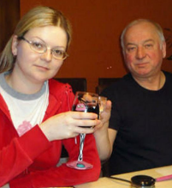

Novichok Poisoning – Salisbury & Amesbury, UK
  March 4, 2018: Sergei and Yulia Skripal poisoned in Salisbury, UK. A police officer taken into intensive care after attending the incident. All later discharged
  June 30, 2018: Dawn Sturgess* and Charlie Rowley poisoned in Amesbury, UK.
  Exposure to a Novichok, a military-grade nerve agent.
  Immediate effects on the exposed & contamination of urban locations
  High-profile case impacting public safety and international relations
  Rapid emergency response
  Public fear and long-term investigation & consequences removal.
Notes:
Joint NBC School
19-02-2008
3

Slide 4
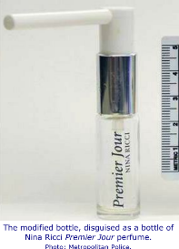
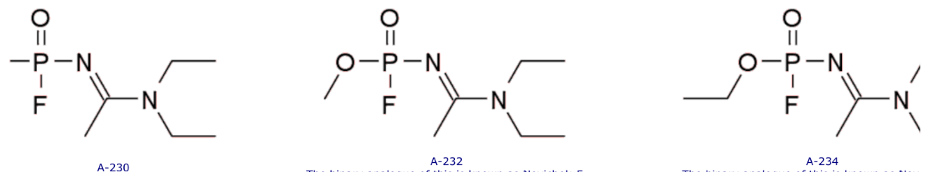
Novichok Characteristics
  Sub-families of organophosphate nerve agents - highly toxic
  Mechanism: rapidly affects the nervous system, inhibits acetylcholinesterase, causing convulsions, respiratory failure/arrest, loss of consciousness, paralysis & death;
  Persistence: Stable in various environments, resistant to environmental degradation,
  challenging to decontaminate.
  Delivery: Likely applied as a gel or liquid – aerosolised.
  Medical Response: Requiring antidote administration (e.g., atropine, pralidoxime).
Notes:
Joint NBC School
19-02-2008
4

Slide 5
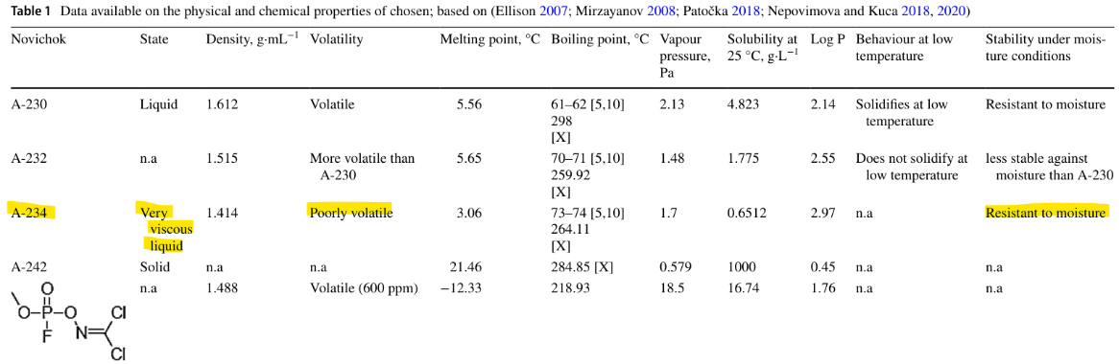
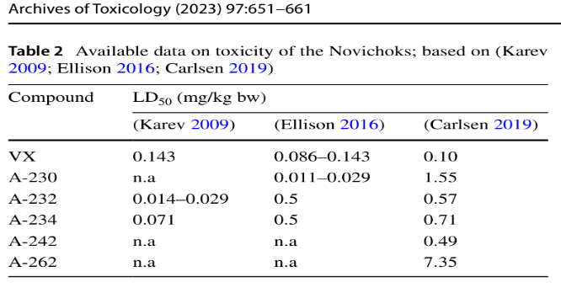
Novichok Characteristics
Notes:
Joint NBC School
19-02-2008
5

Slide 6
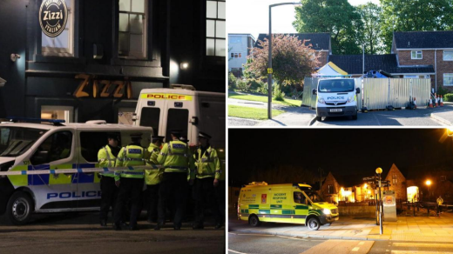
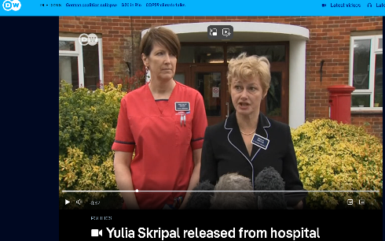
Public Health and Environment Impacts
  Immediate health risks to exposed individuals;
  Salisbury - Two civilians critically injured; several exposed individuals/officials treated
  Amesbury - Two civilians critically injured (one recovered);
  several exposed individuals treated
  Multiple urban sites contaminated, including a park and restaurant
  Long-Term Risks: Neurological damage, PTSD among exposed individuals. Long-term health monitoring for the exposed
  Responder Exposure: Risk of secondary contamination.
  Environmental persistence. long-term site decontamination
  Psychological impact on the community
Notes:
Joint NBC School
19-02-2008
6

Slide 7
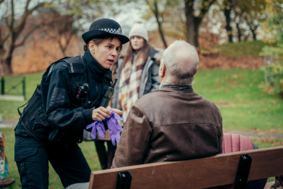
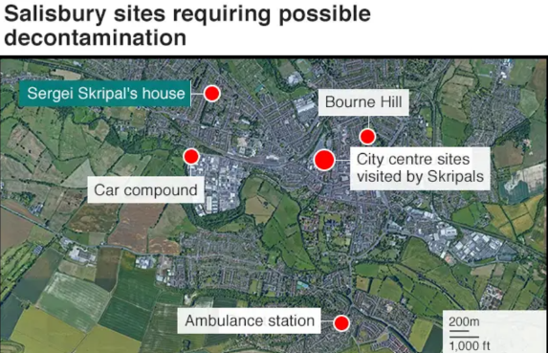
Response Timeline (1) - Salisbury
MAR 4: Affected individuals discovered unconscious.
MAR 5/6: Init. response: Initial lockdown, hospitalization*.
MAR 7/8: Public informed, suspected nerve agent, emergency cordons established**.
MAR 10-30: Identification of Novichok & confirmation of contamination & spread analysis - Response escalation
MAR 23: OPCW TAV – confirms Novichok
May 2018: Major decontamination operations
commence & prolonged decontamination efforts.
Reopening of public areas post-cleanup led to:
2019: Declared safe and reopened to the public - Final final clearance!
Notes:
7
* Drugs abuse suspected, nerve agent suspicion on later PM 5th MAR, confirmed on 06th MAR
** Five Salisbury locations are identified as possible sources

Slide 8
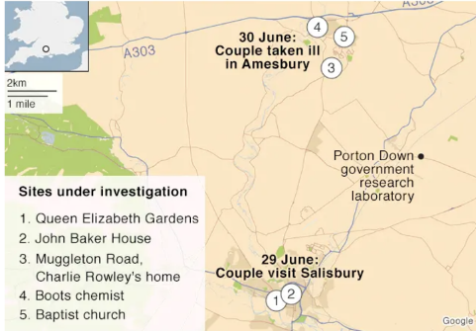
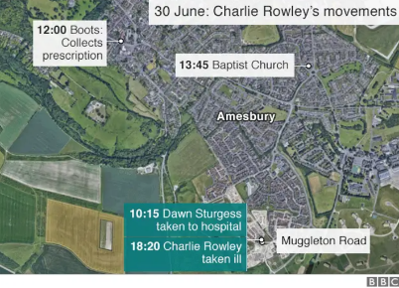
Response Timeline (2) - Amesbury
JUN 30: Affected individuals discovered unconscious.
Init. response: Initial hospitalization*.
JULY 5: Police confirm novichok exposure after
handling a contaminated item..
JULY 6: Response/Investigation escalation and decontamination efforts.
JULY 8:One of the exposed dies.
July 13: Police identified the source of the nerve agent
JULY 23/AUG 13: OPCW TAV – confirms Novichok (same as in Salisbury)
Major decontamination operations & (somewhat) prolonged Decontamination efforts. JUN 2020 – decision to demolish the flat where poisoning occurred
Notes:
8
* Drugs abuse suspected,

Slide 9
Incident Response
Five Major Management Functions
Incident
Command
Operations
Planning
Logistics
Finance/
Section
Section
Section
Administration
Section
Notes:
Instructor Notes
It should be pointed out that the ICS organization does not match the administrative structure of any single agency or jurisdiction. This was done on purpose to ensure that incident management would not be compromised by or confused with existing agency structures.
Stress that every incident requires a certain number of incident functions to be performed:
The problem must be identified and assessed.
A plan must be developed and implemented.
The necessary resources must be procured and paid for.
The above five management functions are the foundation of ICS and apply to a routine emergency, organizing for a major non-emergency event, or managing a response to a major disaster:
Incident Command – sets incident objectives, strategies and priorities and has overall responsibility.
Operations – develops tactical objectives, conducts tactical operations to carry out the plan and directs all tactical resources.
Planning – prepares Incident Action Plan to meet incident objectives, collects and evaluates information, and maintains both resource status and incident documentation.
Logistics – provides support, resources, and all services to meet operational objectives.
Finance/Administration – monitors costs, provides accounting, procurement, time recording, and cost analyses.

Slide 10
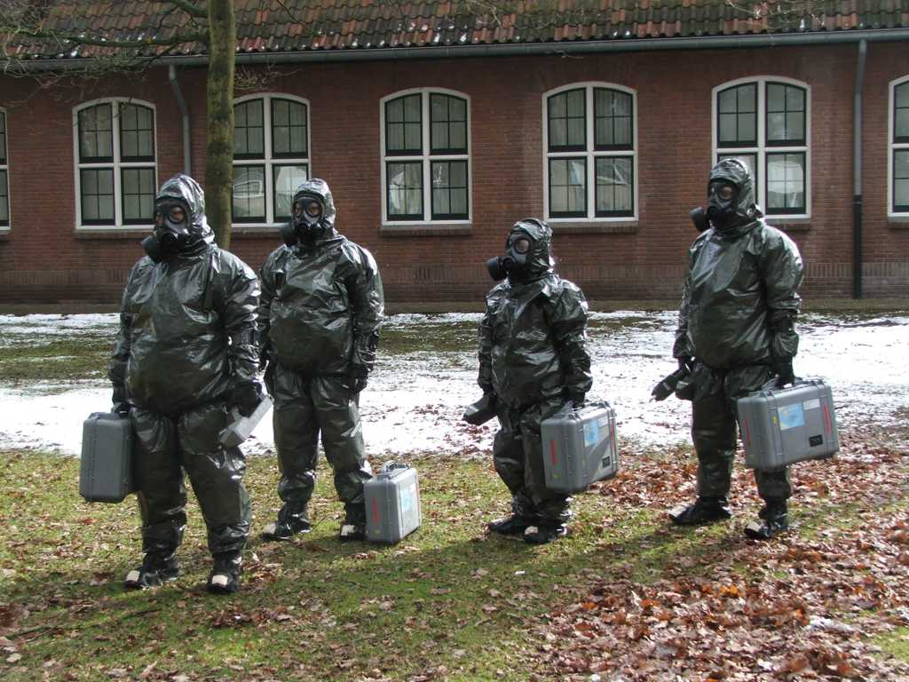
Summary of Phases
Incident Management
Phase-1: Notification
Phase-2: Response
Phase-3: Stabilisation
Phase-4: Restoration
Recognition of incident
Asset Deployment
Situation stabilised
Hazard removal
Response organisation
Site Containment
Threat contained
Site remediation
Information acquisition
Hazard confirmed
Due process

Slide 11
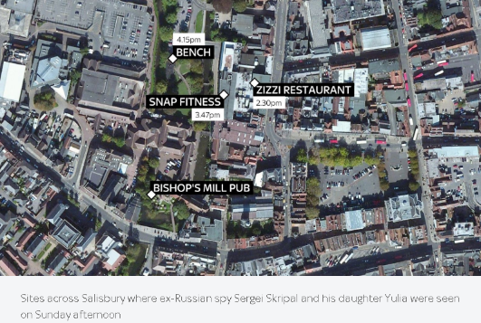
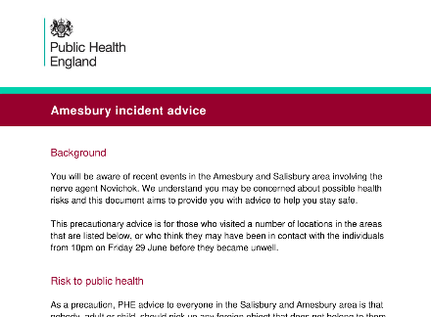
Initial Responder Actions (1)
Detection: Chemical hazard identification using field detection kits/equipment (colorimetry, IMS/FPD).
Containment: Securing the scene - Isolation of affected areas, establishing cordons/secure perimeters around affected areas.
Decontamination: Early decontamination efforts
Initial decontamination of exposed individuals and surfaces. Immediate decontamination of victims and responders.
Communication: Public evacuation and warnings
issued promptly
…
Notes:
11

Slide 12
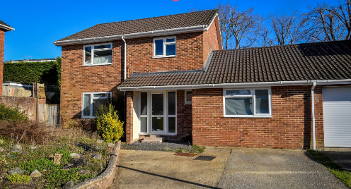
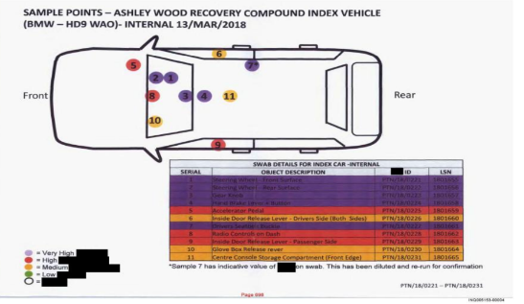
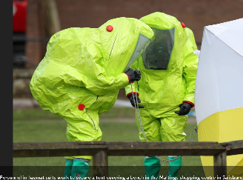
Initial Responder Actions (2)
Detection techniques used.
Initial assessments of Novichok presence with HHA (AChE inhibitor indicator) and/or IMS/FPD Detectors.
Types of PPE (used/recommended): Full-body chemical suits (Level A/OPCW Levels 5-8 protection), followed by respirators & chemical suits).
Gloves, boots, and additional splash protection.
Challenges due to prolonged
exposure: Heat stress,
mobility restrictions,
extended wear time. …
Notes:
12

Slide 13
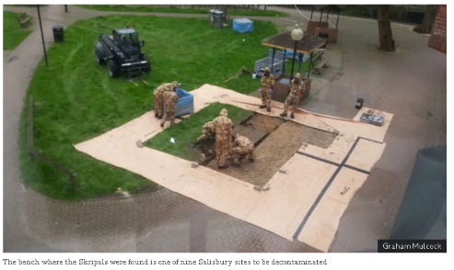
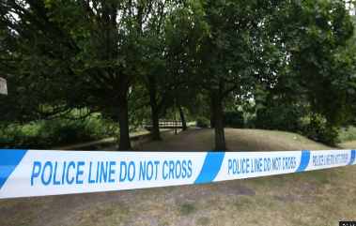
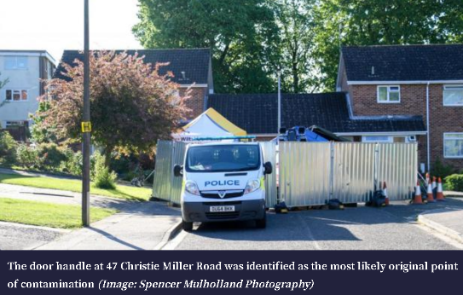
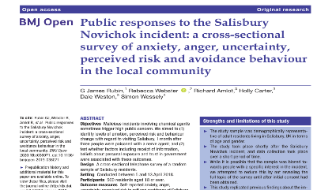
Initial Responder Actions (3)
Evacuation and Containment Procedures.
Evacuation/Exclusions zones set up.
NATO/ERG/proprietary guidelines for nerve agent incidents.
Isolation protocols to limit spread!
Health Risks to Responders.
Health impact from direct exposure.
Long-term health monitoring.
Need for specialized medical response
. …
Notes:
13

Slide 14
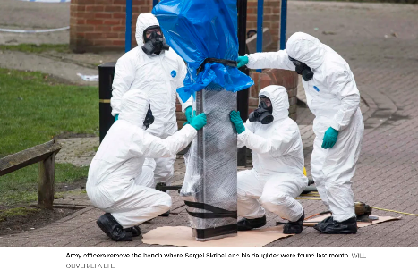
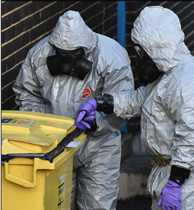
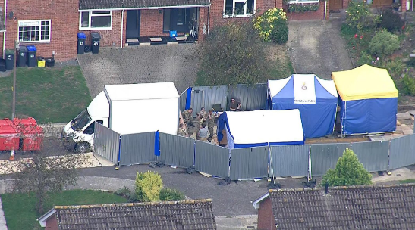
Decontamination Efforts/Actions (1)
Initial Decontamination Efforts.
Immediate Isolation and decontamination steps.
Washing and scrubbing contaminated surfaces
Focus on high-priority locations (park bench, public areas, …).
Initial use of portable decontamination units.
- Decontamination solutions (hypochlorite/bleach, …).
Challenges of decontaminating
urban areas
.…
Notes:
14

Slide 15
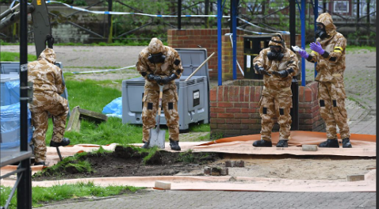
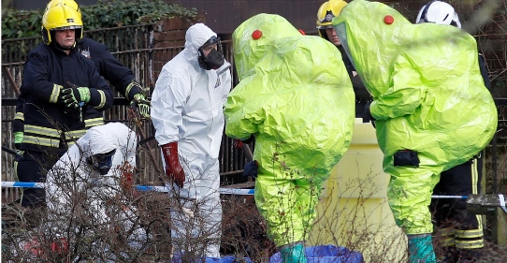
Decontamination Efforts/Actions (2)
Chemical Solutions:Common chemical agents used
Use of sodium hypochlorite (bleach) to neutralize agent. Surface and area-specific decontamination Procedures TBFD to address Novichok's high persistence
Physical Removal:
Scrubbing and washing contaminated surfaces. Removal of residues using solvents; Screening
Waste Management: Handling and disposal
of hazardous runoff.
Specialized Equipment: Portable decontamination units. .…
Notes:
15

Slide 16
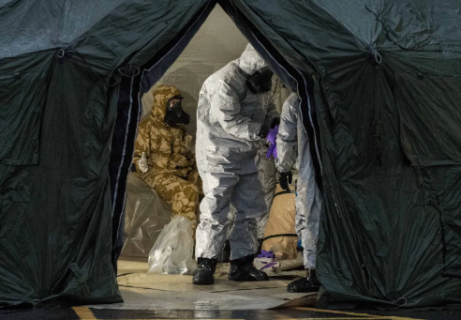
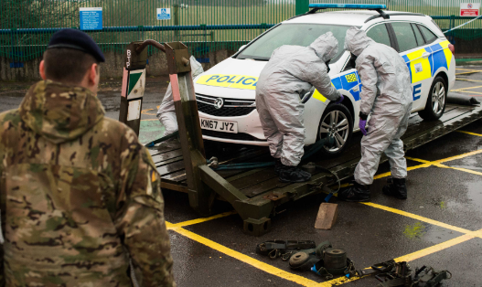
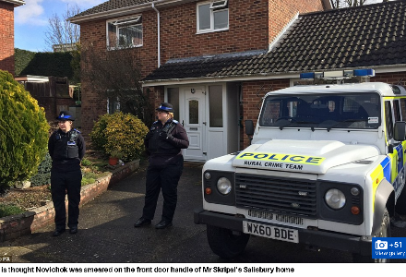
Decontamination Efforts/Actions (3)
Key Locations Decontamination in Salisbury
Specific decontamination challenges at each site.
Decontaminated locations included park benches, restaurants, and vehicles.
Over 12 months of detailed cleanup efforts.
Coordination between local and national authorities.
Final reopening declared safe in 2019
. .…
Notes:
16

Slide 17
Decontamination Challenges in an Urban Setting (1)
Complexities of Urban Environments
- Population Density: High-risk areas with large populations.
Infrastructure:
High traffic areas,
Enclosed spaces, surfaces,
Complex contamination spread through public transport or drainage.
Presence of TICs of civilian industry
Spread through ventilation and public transport
Environmental Factors: Persistent agents resistant to conventional cleaning.
Meteorological factors: Fluctuating cloud directions/movements,
- Communication Gaps: Ensuring public adherence to safety measures
. .…
Notes:
17

Slide 18
Decontamination – Principles & Difficulties
Decontamination Challenges in an Urban Setting (2)
Decontaminate as soon as possible.
Decontaminate as far forward as safely possible.
Decontaminate by priority: Basic order is - casualty, contaminated personnel, non-contaminated personnel, crucial equipment (for the immediate re-entries), and samples containers, other equipment.
Decontaminate only what is necessary.
Use only the minimum equipment and personnel required: Every entry into a contaminated area poses a risk of contamination to the personnel and equipment.
Notes:
a) Successful decontamination is based upon the immediate removal of contamination. The earlier the process of decontamination is initiated, the better the chances are of reducing the risk of personal injury. Conducting initial decontamination will reduce the risk of spreading the contamination and possible penetration of the IPE.
b) ... Set-up of the CCS (?) must be done in an area free of contamination, but as close to the area of operations as possible ..once all safety issues, including the fragmentation radius for unexploded ammunition, have been taken into consideration
c) …
d) ... Based on the resources available, personnel are to decontaminate equipment and material that is durable . Equipment that will be used in follow-on operations, and not believed to be contaminated can be used by next team re-entering hot zone
e)... Therefore, operations are to be conducted using the minimum number of people using the minimum amount of equipment for the minimum length of time to safely complete the task
Knowledge of:
contaminating agent,
capabilities and efficiency of decon. equipment,
decontaminants,
adequate choice of decontamination method,
are basic conditions for successful decontamination in minimum time and resources used.

Slide 19
Challenges of Decontamination - targets
Decontamination Challenges in an Urban Setting (3)
Decontamination surfaces/objects and/or locations
Peronnel & animals
Tech.equipment
Buildings & ground
Materiel & clothes
Food & water
Decon equipment
…
Flat surfaces
  E.g. lab bench
Interior
  E.g. the inner space and surfaces of rooms, offices, labs
Exterior
  E.g. the outer surfaces of a vehicle,building
Humans
  Professionals or civilians
Specials
  E.g. environment, electronics, drinking water, wounded

Slide 20
Decontamination Challenges in an Urban Setting (4)
Challenges of Decontamination
- End results of decontamination
Levels of decontamination:
IMMEDIATE
OPERATIONAL
THOROUGH
CLEARANCE
The most important and most effective decontamination of any espec.chemical exposure is that init. decontamination done within the first minute or two after exposure.
Good training can save lives!
Notes:
IMMEDIATE DECON
It saves lives and permits the use of individual equipment and key systems.
OPERATIONAL DECON
It reduces the spread and the level of contamination. In some cases, when combined with weathering, IPE levels may be reduced without further decon.
THOROUGH DECON
It removes the unit from the operation but allows it to return quickly with restore
CLEARANCE
Full return to normal - civilian

Slide 21
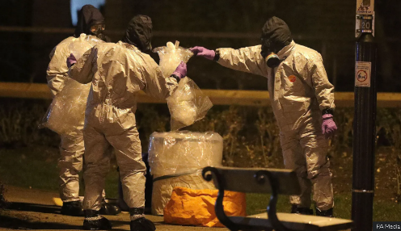
Decontamination Challenges in an Urban Setting (5)
Risk to Public and Environmental Contamination
Potential for wider environmental spread, including spread through water or air systems
Measures to protect public during clean-up.
Hazardous Waste Disposal
Handling of contaminated waste.
Regulatory challenges in hazardous disposal.
Regulatory and Safety Standards
International/Local guidelines on decontamination.
Compliance with environmental safety standards…
Notes:
21

Slide 22
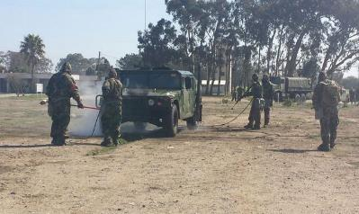
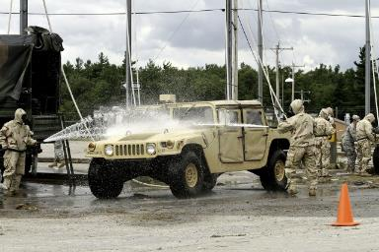
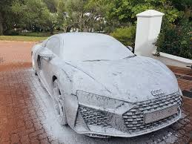
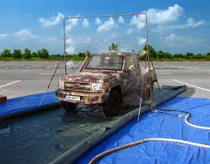
Decontamination Challenges in an Urban Setting (6)
Decontamination of Personal Effects and Vehicles
Protocols for personal and vehicle decontamination.
Challenges with porous materials and vehicle interiors
allows to continue and sustain mission after being contaminated
limits hazard of transferring contamination by removing most of gross contamination
Vehicle washdown is performed by the power-driven decontamination equipment and it is most effective within 1 hour after contamination

Slide 23
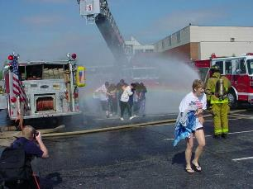
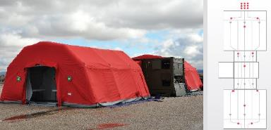
Civilians
Decontamination Challenges in an Urban Setting (7)
Procedure, discipline
Comfort, clothing
Personal properties
Privacy, gender separation

Slide 24
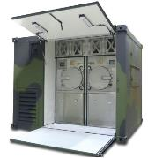
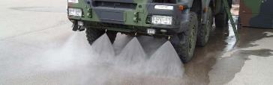
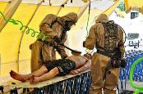
Specialties
Decontamination Challenges in an Urban Setting (8)
Electronics (in vacuum?)
Environment, e.g. roads
Wounded
Drinking water

Slide 25
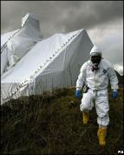
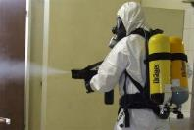

Interior space
Decontamination Challenges in an Urban Setting (9)
Small rooms
Buildings
Airport
Metrostation
Tent fumigation
Automated
or manual

Slide 26
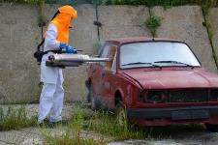
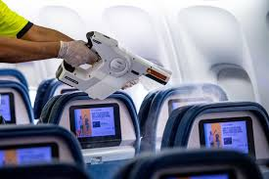
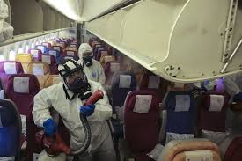
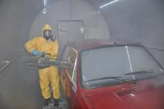
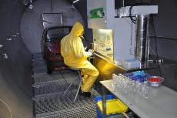
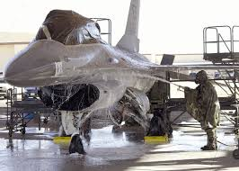
Interior vehicle
Decontamination Challenges in an Urban Setting (10)
Vehicles
Aircraft (can it fly again?)

Slide 27
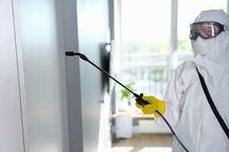
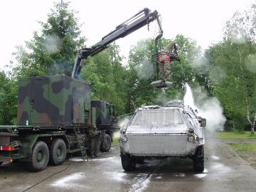
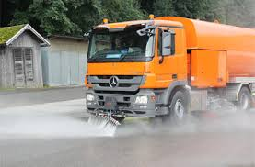


Exterior
Decontamination Challenges in an Urban Setting (115)
Vehicle
Building
City?

Slide 28
Future Preparedness Enhancements(1)
Decontamination Unit Readiness Pillars
PERSONNEL
Structure; Selection & Recruitment/Appointments
Admin & Clearance/Confidentiality & Appraisal
Qualified Experts engagement(s)
Designated Labs engagement(s)
Succession plan
What are deployment and reporting modalities (IN/OUT, support, report(s) templates, medevac, ...), risk analysis, …
2. EQUIPMENT Select accordingly to the tasking and outputs
CWA, TIC, VOC, O2 r/a, bio, … detection/alarming
Sampling & Analysis equipment ⦁ Scene exploitation equipment
IPE & PPE ⦁ Decontamination equipment
Medic. & trauma equipment ⦁ Comms & tracking equip
Meteo monitoring ⦁ etc.
Notes:
28

Slide 29
Future Preparedness Enhancements (2)
Decontamination Unit Readiness Pillars
3. Training & Readiness/Competence All/certain team members need to have
be also trained/certified in:
Scientific Aspects /Depths of CBRN Decontamination
Medical countermeasures and
(Forensic) Scene awareness & exploitation & recce
Sampling & Analysis (incl. DG handling)
Data & evidence management & analysis
Safety & Security in non-permissive environment
(Interpretation) in non-permissive environment
Crowd control
Liaising, etc. …
QDOCs, AD and/or other official docs Prior to deployment, relevant official documentation needs to be identified as guideline for particular deployment
SOP/WIs ⦁ Qualification/Training/Readiness/QC
Med./injury/death insurance ⦁ Hazard benefits (financ., welfare, etc.)
MedEvac ⦁ Unit members selection
Etc.
Notes:
29

Slide 30
Future Preparedness Enhancements (3)
Decontamination Unit Readiness Pillars
5. Coordination Modalities TL needs to clarify/receive formal guidance on cooperation & coordination/support from:
Police, First Response, Medical, Military, Counter Terrorism, Civil Defence, Firefighters, Media, Industry, Laboratories, Local Municipalities, etc. ON:
Initiation Protocol
Short/Long - term planning
Resources/Logistics/Assignments
External Units/Agencies Support
Multi-agency response drills for preparedness.
Clear communication hierarchies during incidents
OVERALL:
TEAM NEEDS TO BE CLEAR, FAMILIARISED AND DEEPLY COMPREHENDING ALL PARTICULAR MISSION PARAMETERS, WHICH CAN COME FROM:
Federal Government LAWS & DECISIONS,
Mandates, TOR and/or MOUs (if prepared/agreed/signed),
INTERNAL Unit/Ministry/Departmental DECISIONS/GUIDELINES and
Other existing AD/QDOCS/Documents
that are decided/deemed applicable for the particular MISSION!!!
Notes:
30

Slide 31

Future Preparedness Enhancements (4)
- Importance of transparent & Effective messaging to the public.
- Balancing transparency and safety.
- Managing misinformation during high-risk events.
- Regular updates to ensure public safety and compliance
Health Monitoring and Follow-up for Responders and Public
Long-term health impact studies & monitoring of
exposed individuals
Monitoring protocols for affected populations.
Psychological support for community members.
Regular health assessments for first responders
…
Notes:
31

Slide 32


Future Preparedness Enhancements (6)
Improved Urban Decontamination Techniques.
Standardized Protocols for Persistent Agents: Recommendations for standardized procedures for agents like Novichok (and other “new” agents and TICs) with high persistence in the environment.
Mixed threats Guidelines
Hazard prediction/Emergency Guide updates for nerve agents in urban areas.
Adaptations for complex urban layouts
Crowd control & Cordoning
…
Control spread of contamination
Control entry/exit of hazardous area
Facilitates safe IPE exchange
Safe decontamination
Notes:
32

Slide 33


Future Preparedness Enhancements (7)
Responder Training and Public Preparedness
Emphasis on frequent, updated training.
Scenario-based training for uncommon hazards.
Public education on recognizing hazardous materials.
Clear evacuation plans and drills…
Policy Recommendations for Hazardous Material Management
Suggested policy updates for handling chemical agents.
Importance of preparedness and rapid mobilization
Notes:
33

Slide 34
Conclusions
Skripal Novichok Incident has brought multiple lessons
Recommendations for future preparedness.
Importance of preparing for decontamination in urban settings.
Final thoughts on preparedness for urban chemical hazards.
PPE Preparedness: Ensuring stockpiles for chemical response. Need for proper PPE
Detection Technology: Need for rapid detection & Identification
(Decontamination) Responder Training: Regular drills for chemical incident response.
Inter-Agency Collaboration: Importance of multi-agency coordination & training; Improving coordination among local, national, and international entities.
Public Communication: Communication with the public to manage health risks Transparent updates to manage fear and misinformation
Notes:
34

Slide 35


HOTZONE SOLUTIONS GROUP
CORPORATE CAPABILITIES
Thank you for your attention
HOTZONE SOLUTIONS GROUP
INTERNATIONAL B.V.
www.Hotzonesolutions.org
www.Hotzonesolutions.org

Slide 36






CONTACT US
Get in touch if you needed further information
Boban.cekovic@hotzonesolutions.org
www.hotzonesolutions.org
+31-070 262 9704
Hotzone Solutions Group International BV
Dr. Kuyperstraat 5, 2514 BA Den Haag, The Netherlands.
Stay Connected
Stay Connected
@HotzoneGroup
@HotzoneGroup
@HotzoneGroup
@HotzoneGroup
@HotzoneGroup
@HotzoneGroup
@HotzoneGroup
@HotzoneGroup

