Slide 1


THE USE OF PHARMACEUTICALS AS CHEMICAL WARFARE AGENTS
Caner DERELİ
Chemical Engineer
AFAD – Civil Defence Department – CBRN Working Group
22.11.2024

Slide 2
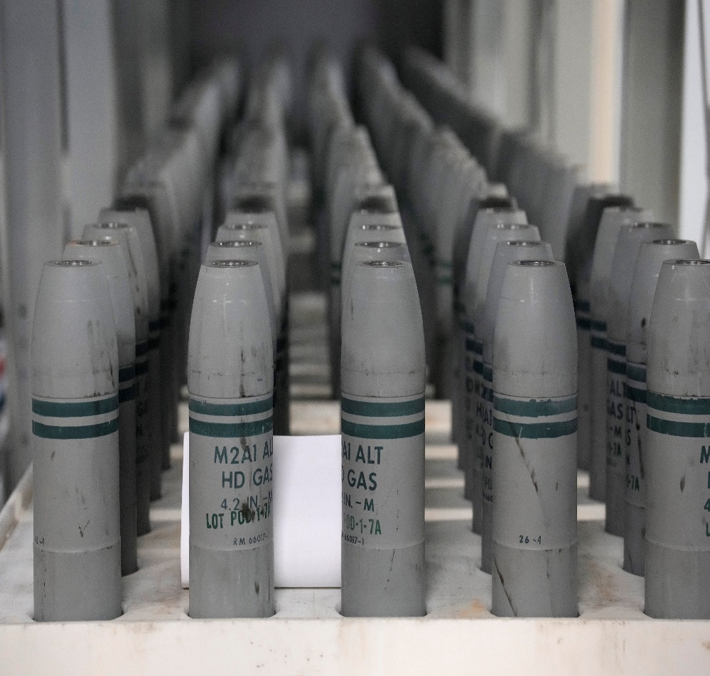
CHEMICAL WEAPONS
“Chemical Weapons” means the following, together or separately:
Toxic chemicals and their precursors, except where intended for purposes not prohibited under this Convention, as long as the types and quantities are consistent with such purposes;
Munitions and devices, specifically designed to cause death or other harm through the toxic properties of those toxic chemicals specified in subparagraph (a), which would be released as a result of the employment of such munitions and devices;
Any equipment specifically designed for use directly in connection with the employment of munitions and devices specified in subparagraph (b).

Slide 3

TOXIC CHEMICALS
“Toxic Chemical” means:
Any chemical which through its chemical action on life processes can cause death, temporary incapacitation or permanent harm to humans or animals.
This includes all such chemicals, regardless of their origin or of their method of production, and regardless of whether they are produced in facilities, in munitions or elsewhere.

Slide 4
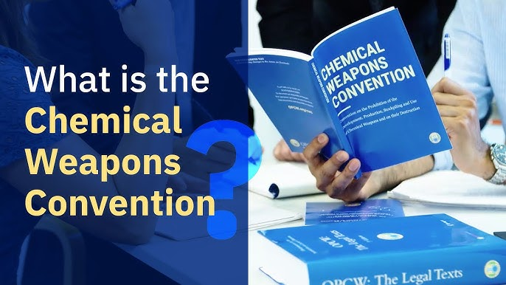
CHEMICAL WEAPONS CONVENTION
The Chemical Weapons Convention defines these chemicals and their classes.
Under this Convention, fentanyl and synthetic opioids are not classified as chemical weapons.
However, in the same convention, both chemicals used to kill are recognised as chemical weapons.

Slide 5
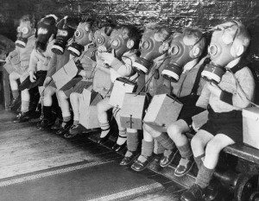
INCAPACITATING AGENTS
Incapacitating agents are usually used for their non-lethal adverse effects and can be lethal at very high doses.
Through their transient psychological and mental effects, these agents incapacitate the target population by impairing their behaviour.

Slide 6
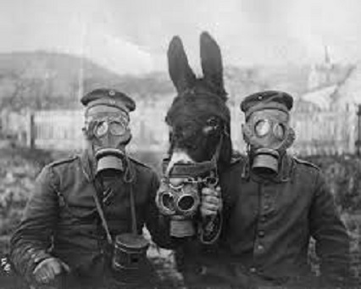
INCAPACITATING AGENTS
Incapacitating agents are not generally used to kill, although they can have lethal effects when used in large doses.
The purpose of using these substances is;
to produce temporary and non-lethal effects
to temporarily incapacitate the target or targets
preventing them from carrying out their normal activities.

Slide 7
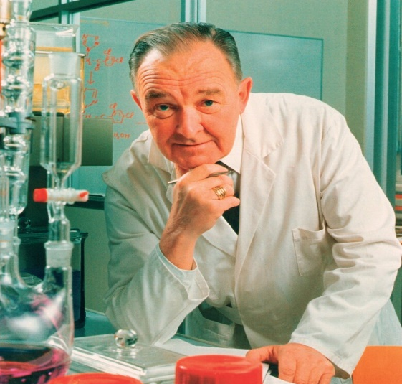
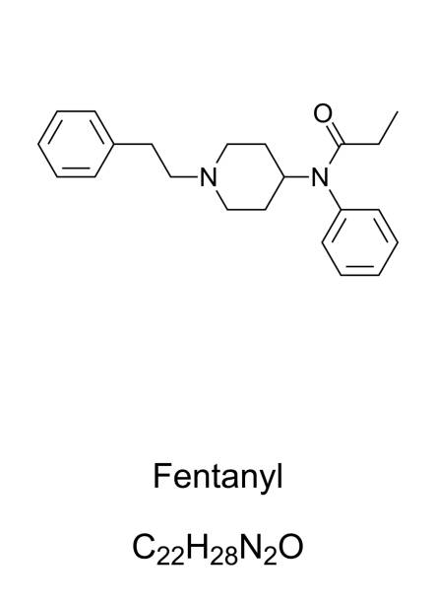
FENTANYL
Fentanyl, a potent synthetic mu(μ) opioid receptor stimulating opioid, was first synthesised in December 1960 by Dr Paul Janssen and the Janssen Company in Beerse, Belgium.
The drug was first used as an intravenous analgesic in;
Europe in 1963
United States in 1968

Slide 8
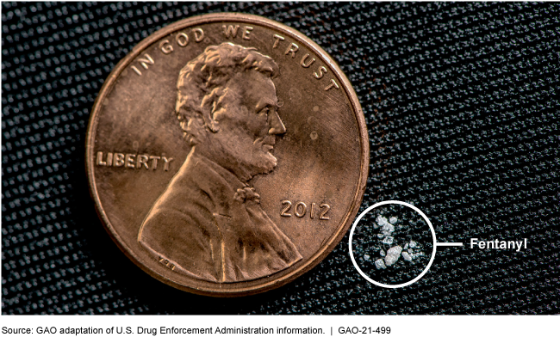
FENTANYL
Fentanyl is a synthetic opioid analgesic used both for pain relief and as an anaesthetic.
In the US in 2021, 71,074 of the total 107,521 drug overdose deaths will be associated with synthetic opioids.
Fentanyl and its synthetic derivatives, fentanyls, are also illegally marketed in many European countries.
100 times more potent than morphine
Source: GAO adaptation of U.S. Drug Enforcement Administration Information | GAO-21-499

Slide 9



FENTANYL
Respiratory depression,
Nausea,
Vomiting,
Muscle rigidity,
Bradycardia
Pruritus.

Slide 10
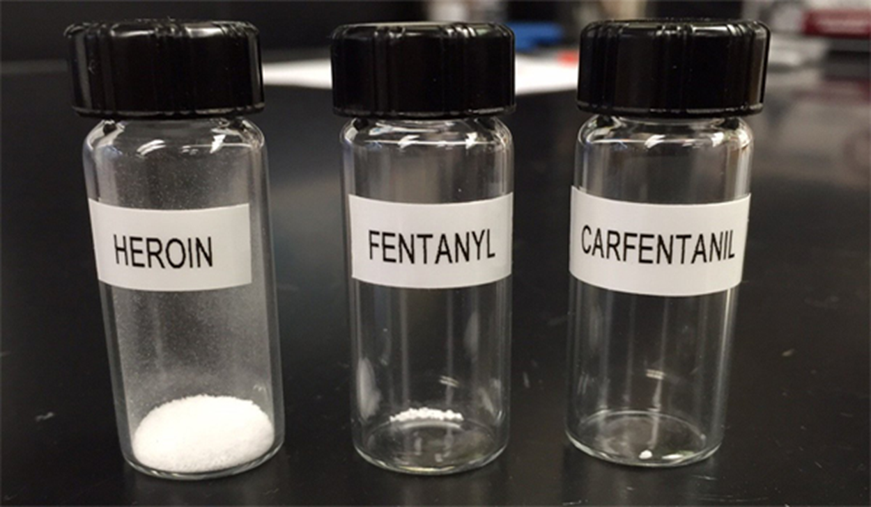
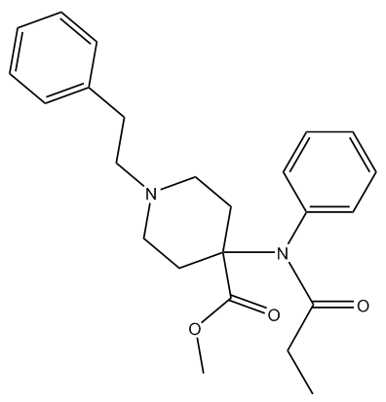
CARFENTANIL
Synthesised by Janssen Pharmaceuticals in 1976.
100 times more potent than fentanyl
10000 times more potent than morphine
Although usually associated with its use in veterinary medicine as a tranquilliser for large wild animals, carfentanil has a worse reputation for its approved use during the Dubrovka theatre crisis in Moscow in 2002.
Its increasing potential as a
weapon of mass destruction.

Slide 11
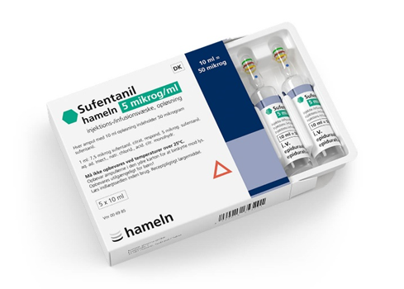
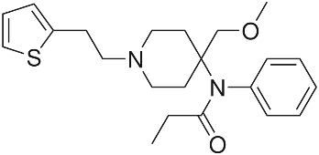
SUFENTANIL
Synthesised by Janssen Pharmaceuticals in 1976.
10 times more potent than fentanyl
500-1000 times more potent than morphine
Sufentanil is highly lipid soluble, more so than fentanyl and alfentanil.

Slide 12
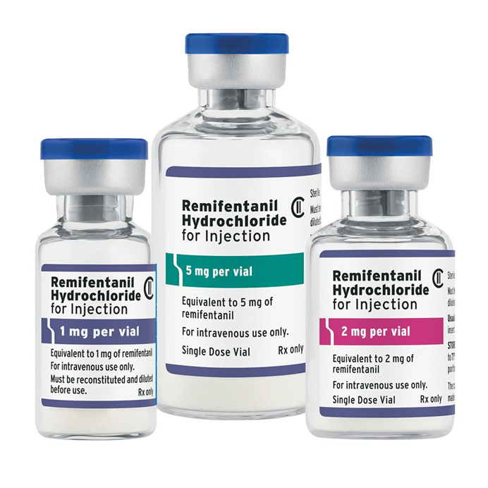
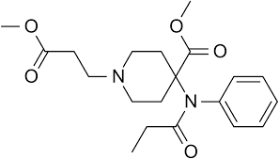
REMYFENTANYL
Remifentanil is a short-acting, highly potent μ-opioid receptor agonist with a rapid onset of action.
The effects of remifentanil are similar to those of fentanyl analogues and include respiratory depression, nausea, vomiting, muscle rigidity, bradycardia and pruritus.
Remifentanyl is same potent as fentanyl

Slide 13
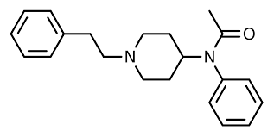
ACETYFENTANYL
Another fentanyl analogue, acetylfentanyl, was not identified until 2013.
It was identified as the primary cause of ten overdose deaths in Rhode Island.
Acetylfentanil is 15 times more potent than morphine.
Its use is becoming widespread especially in North America.

Slide 14
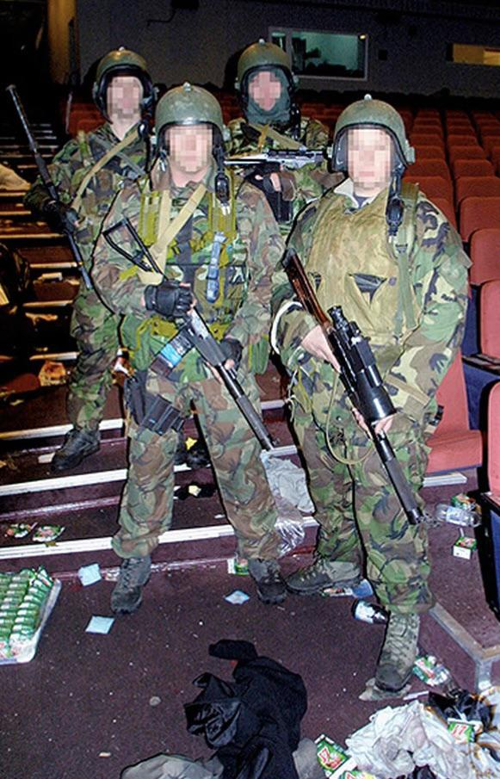
CASE STUDY PRESENTATION: MOSCOW THEATRE EVENT
The concept of rapid stunning and resuscitation for hostage rescue led to military research on fentanyl during the Cold War.
Narcosis has been glamorised and even fictionalised by some countries for military intervention.
Opiates and opioids are active and relatively stable when inhaled.

Slide 15
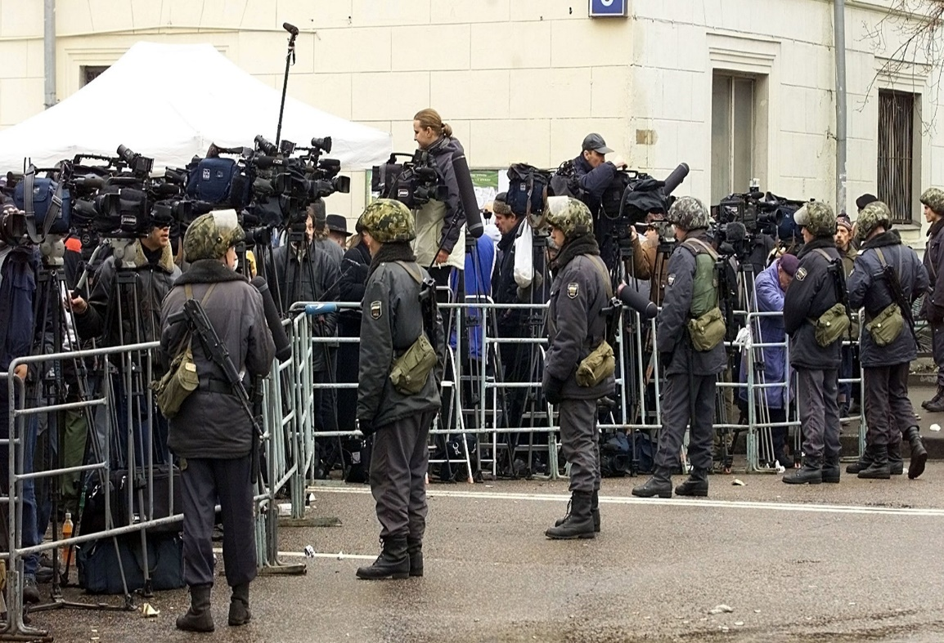
CASE STUDY PRESENTATION: MOSCOW THEATRE EVENT
In the last years cold war, fentanyl and its derivatives were investigated as possible incapacitating agents.
However, complications related to the safe dose range, i.e. the optimal dose to incapacitate rather than kill, were never resolved and the project was abandoned.
Given the potency and accessibility of fentanyl derivatives, their misuse as chemical warfare agents is a potential risk.

Slide 16
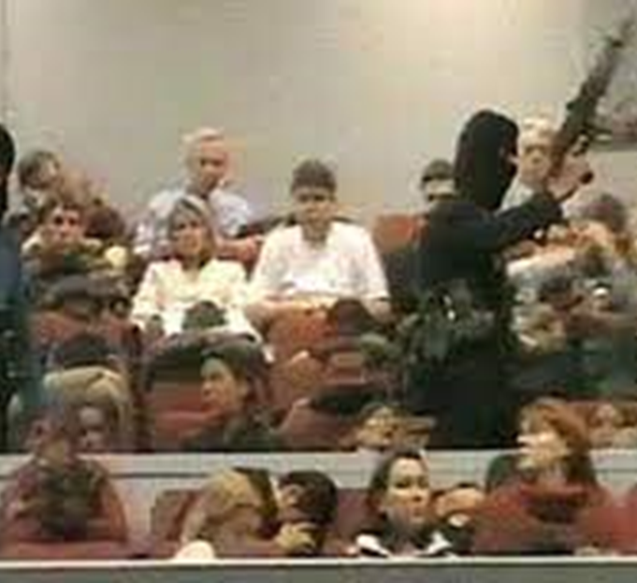
CASE STUDY PRESENTATION: MOSCOW THEATRE EVENT
On 23 October 2002, Chechen invaders seized Moscow's Melnikov Street Theatre,
Taking more than 800 people hostage.
Demanding the immediate and unconditional withdrawal of Russian troops from Chechnya.
The siege ended in the early hours of 26 October.
Special unit of Russia's Federal Security Service (FSB) pumped a chemical aerosol into the building and stormed it.

Slide 17

CASE STUDY PRESENTATION: MOSCOW THEATRE EVENT
At least 33 terrorists,
127 hostages were killed
The terrorists were shot dead after being knocked unconscious by the aerosol
The explosives strapped to them were removed and a bomb in the auditorium was defused.

Slide 18
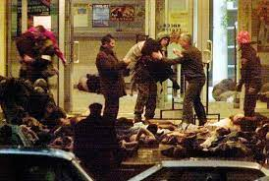
CASE STUDY PRESENTATION: MOSCOW THEATRE EVENT
2 hostages were shot by the terrorists,
125 others died as a result of a combination of the aerosol and inadequate medical treatment after the rescue.
Medical treatment of the wounded was complicated by the Russian government's failure to disclose the composition of the aerosol.

Slide 19

CASE STUDY PRESENTATION: MOSCOW THEATRE EVENT
The head of Moscow's health department said that all but one of the hostages killed in the raid had died from the effects of the gas, which is believed to be an anaesthetic or chemical warfare agent.
Foreign embassies in Moscow asked for more information about the aerosol in order to facilitate treatment, but their requests were ignored

Slide 20

CASE STUDY PRESENTATION: MOSCOW THEATRE EVENT
The Russian government, which refused to disclose the contents of the aerosol used, informed the US Embassy on 28 October of some of its effects.
Based on this information and examination of some of the wounded, the doctors concluded that the aerosol contained a morphine derivative

Slide 21


Assessment of Fentanyl as a Chemical Weapon
According to the Chemical Weapons Convention
The easy availability of fentanyl derivatives is crucial for their misuse as a potential chemical weapon
The inappropriate use of toxic compounds such as fentanyl derivatives can lead to disaster, even if the compounds are in good hands.
This situation highlighted the grey area between lethal and non-lethal weapons and led to the discussion of CWC
Can it be used as a weapon of mass destruction?

Slide 22

Assessment of Fentanyl as a Chemical Weapon
According to the Chemical Weapons Convention
Given its chemical structure and toxic effects, fentanyl may be included in the category of 'toxic chemicals' covered by CWC.
However, this assessment may vary depending on the intended use and context.
Fentanyl is not listed in the Annexes to the Chemical Weapons Convention .
Therefore exempt from its prohibitions.

Slide 23
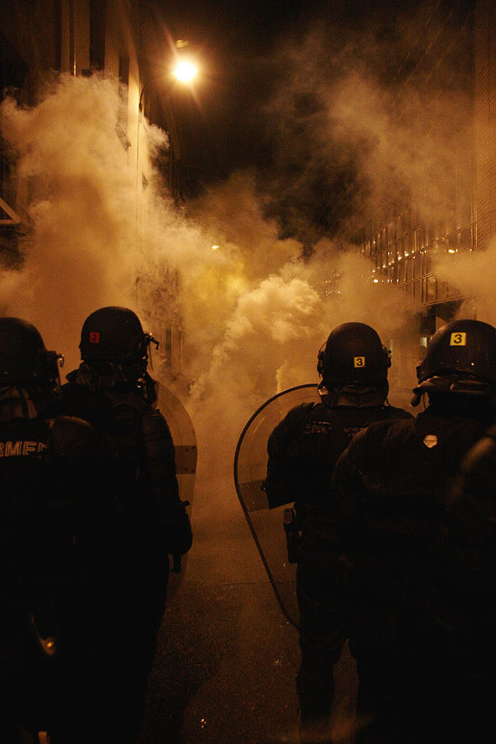
Assessment of Fentanyl as a Chemical Weapon
According to the Chemical Weapons Convention
The use of fentanyl and its derivatives by security forces for riot control or hostage rescue may be justified if it is not for the purpose of warfare or killing.
However, this use carries serious health risks and is subject to strict regulations

Slide 24
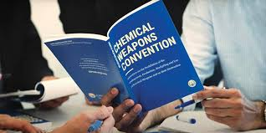
Assessment of Fentanyl as a Chemical Weapon
According to the Chemical Weapons Convention
While its use for medical and scientific purposes is legitimate, its use to harm military or hostile forces is strictly prohibited.
However, their use in security operations should be carefully assessed from a legal and ethical perspective.
For these reasons, fentanyl and fentanyl subgroups should be considered chemical weapons when used to kill or injure.

Slide 25


