Slide 1
Improvised Explosive Devices Used in Syria Civil War
Carol-Teodor PETERFI (Senior CBRN and Disarmament Expert, Former OPCW Inspector)
carolpeterfi@yahoo.com

Slide 2
DISCLAIMER
This presentation on improvised chemical munitions in Syria is provided for informational and educational purposes to support an enhanced understanding of CBRN threats within the professional community. The content draws from open-source, unclassified information to highlight operational challenges, response considerations, and safety measures related to improvised chemical threats.
The views, interpretations, and analyses presented herein reflect the author’s personal research and professional expertise and do not necessarily represent the official positions or policies of the Organization for the Prohibition of Chemical Weapons (OPCW), the North Atlantic Treaty Organization (NATO), or any other affiliated agency to which author worked for. This presentation does not promote, endorse, or encourage the manufacture or use of chemical weapons.
All material has been prepared with strict adherence to international legal frameworks, including the Chemical Weapons Convention (CWC), and is intended solely for fostering discussions on protection, preparedness, and response strategies in alignment with international law and ethical standards.
Audience discretion is advised due to the sensitive nature of this topic.

Slide 3
CONTENT
Methods of dissemination of Chemical Warfare Agents (CWA)
Delivery systems for CWA
Improvised Explosive Devices (IED) versus Improvised Dispersion Devices (IDD)
Improvised delivery systems used in the Syria Civil War
Key Take Away and Reflection

Slide 4
METHODS OF DISSEMINATION
Bursting-type Munitions: These munitions include bombs, warheads, bomblets, rockets, and artillery and mortar shells.
Spray-Type Munitions: GB, HD, and VX chemical agents may be disseminated by spray devices mounted on aircraft. A toxic chemical agent spray mission is most effective when released simultaneously by the required number of aircraft flying at the desired release height.

Slide 5
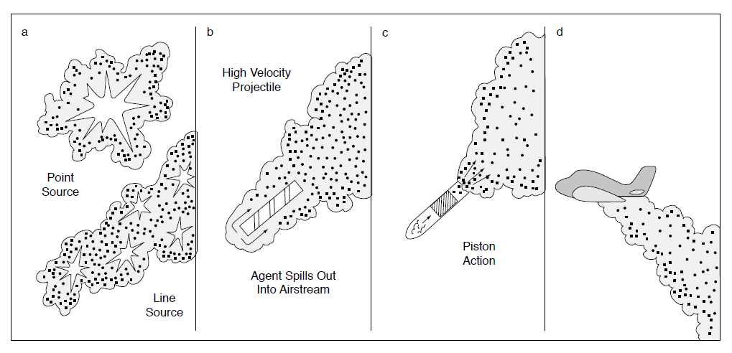
DISPERSION

Slide 6
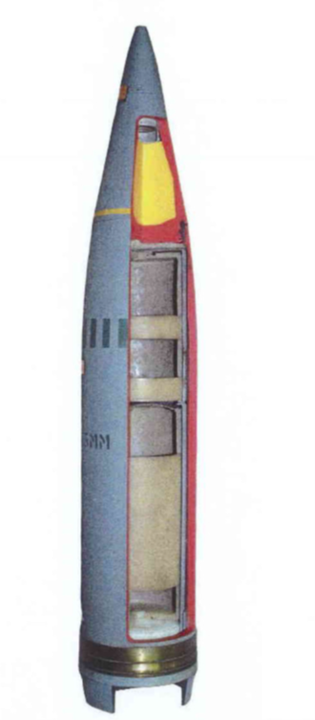
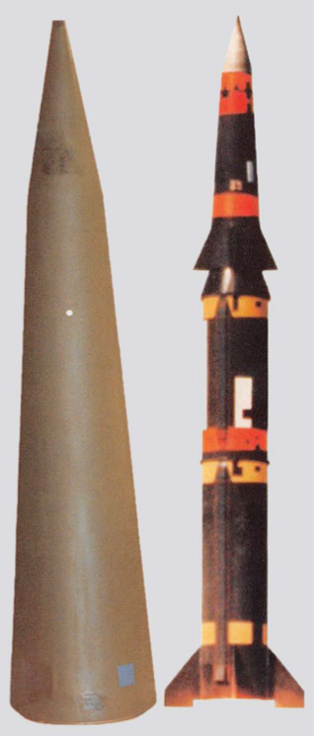
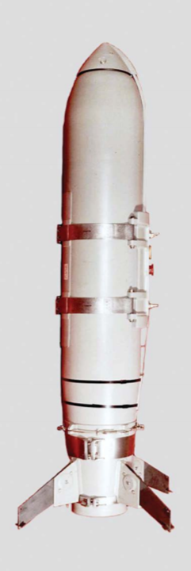
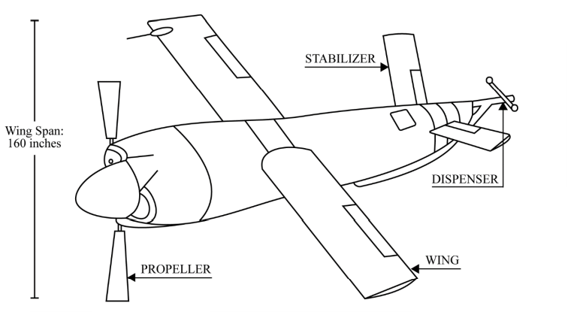
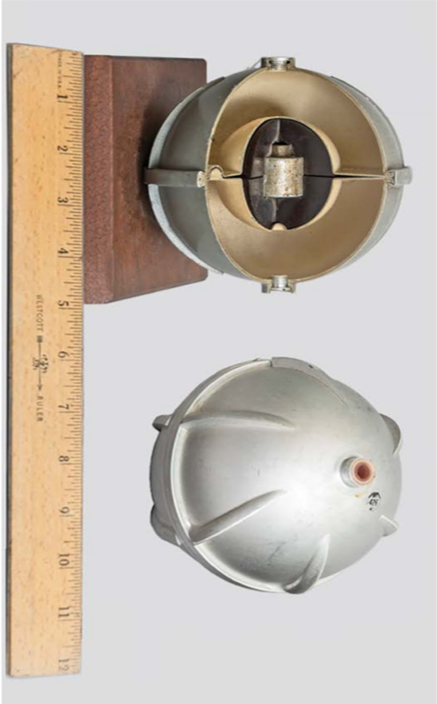
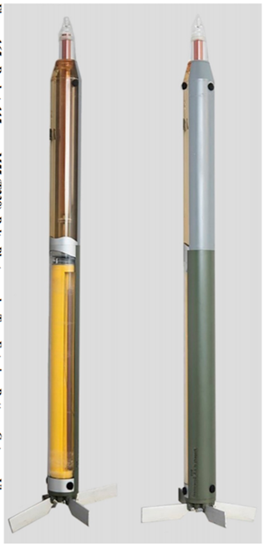
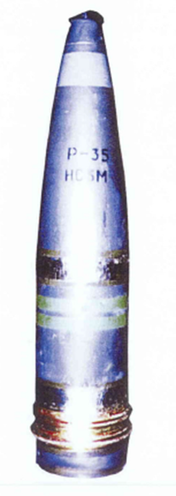
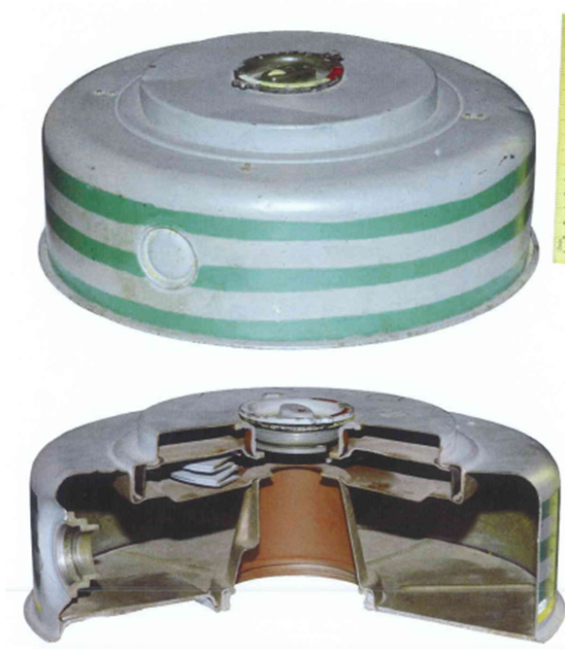
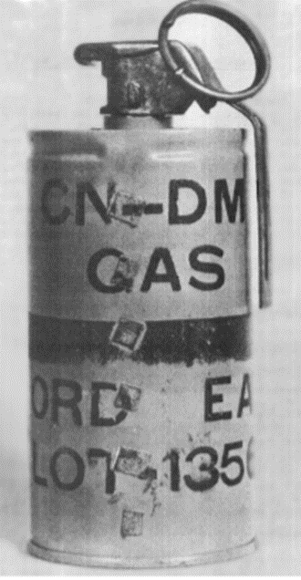
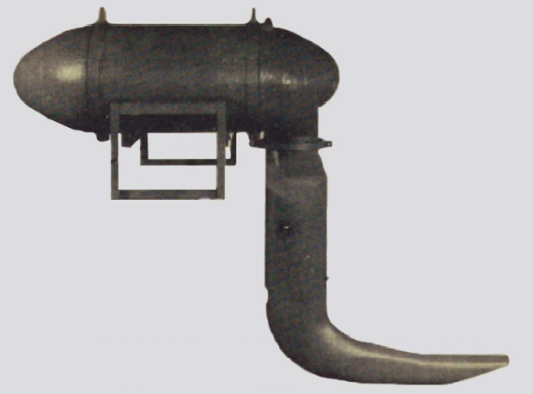
DELIVERY SYSTEMS FOR CHEMICAL WARFARE AGENTS
Cannon delivered
Rocket delivered
Guided missiles delivered
Aircraft delivered
Drones (unmanned vehicles)
Submunitions
Mines
Hand Grenades
Projectiles
Mortars
Bombs
Spraying tanks
A delivery system is needed to transport the Chemical Warfare Agents (CWA) to the target. Usually, such a system must contain a CWA container, an explosive train, a propellant, and a launching system.

Slide 7
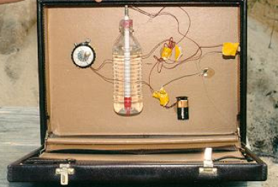
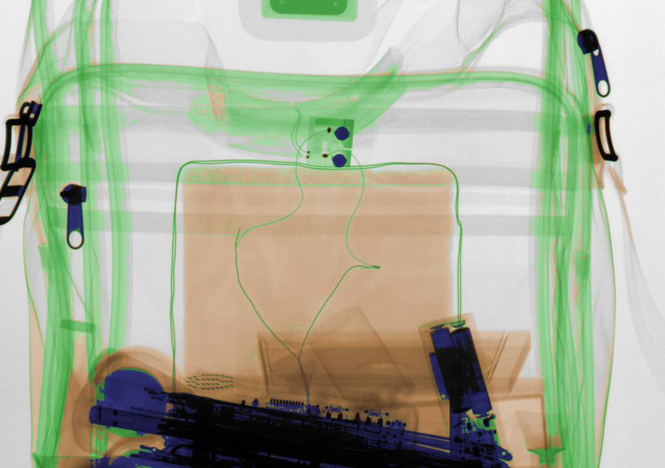
Improvised Explosive Devices (IED) versus Improvised Dispersion Devices (IDD)
Improvised Explosive Device:
Generally, a non-military device
Placed or fabricated in an improvised manner
Incorporates destructive, lethal, noxious, pyrotechnic, or incendiary chemicals
Designed to destroy, incapacitate, harass
Targets:
People:
Individuals (Royalty, Politician, Judge)
Key workers (Policemen, Vivisection staff)
General public (City street, Train, Aircraft)
Property:
Government buildings (Legislature, Police station)
Infrastructure (Electricity sub-stations, oil platform)
Financial institutions (Stock Exchange, World Trade Centre)
Means of delivery:
Man-portable:
Tape-cassette box (ALF, England)
Video cassette box / Shoebox (Mardis Gras, UK)
Rucksack or vest (Commuter trains, Madrid)
Vehicle borne:
Car [UVBT] (Omagh, Northern Ireland)
Van (Istanbul, Turkey)
Lorry (Baltic Exchange, London)
Aircraft (World Trade Centre, New York)
Remote attack:
Postal: Letter/parcel (Ricin Letters, USA)
In-direct fire: Mortar (10 Downing St, London)
Direct fire: Rocket / Missile (SIS HQ, London)
Parts:
Main charge (Explosive)
Initiator (Detonator / Cap
Switch
Power source
Safety device(s)
Container
Switch and/or safety could be on a delay/ timer

Slide 8
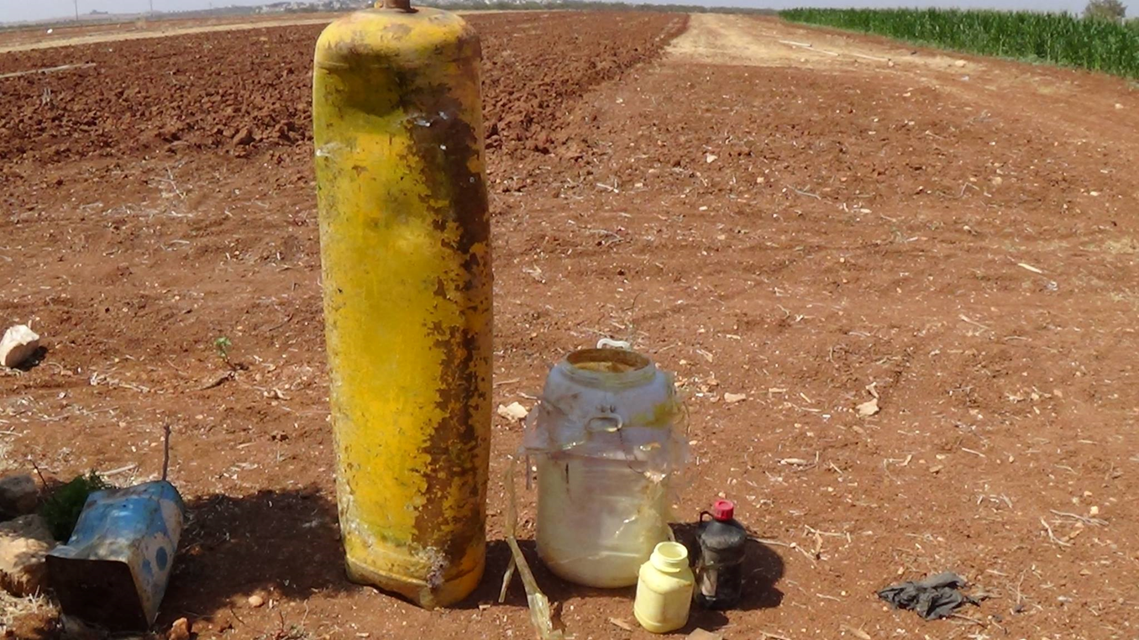
IMPROVISED DELIVERY SYSTEMS USED IN SYRIA CIVIL WAR
Placed Manually ( Chemical IEDs/IDDs )

Slide 9
DELIVERY SYSTEMS
Improvised Chemical Weapons Munitions

Slide 10
DELIVERY SYSTEMS
Improvised Chemical Weapons Munitions

Slide 11
DELIVERY SYSTEMS
Improvised Chemical Weapons Munitions

Slide 12
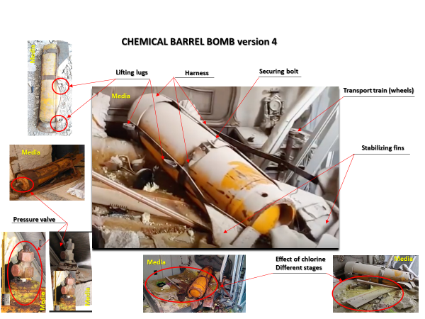
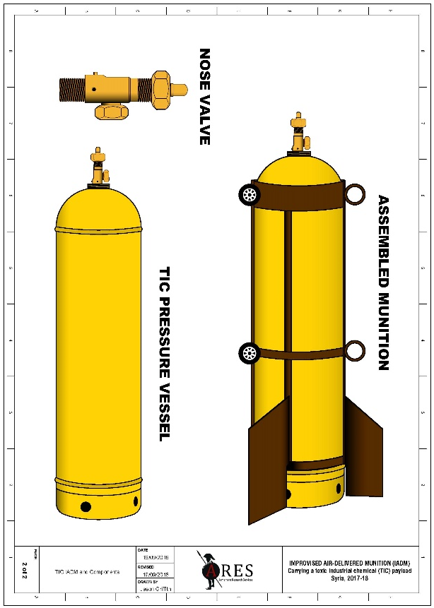
DELIVERY SYSTEMS
Improvised Chemical Weapons Munitions

Slide 13
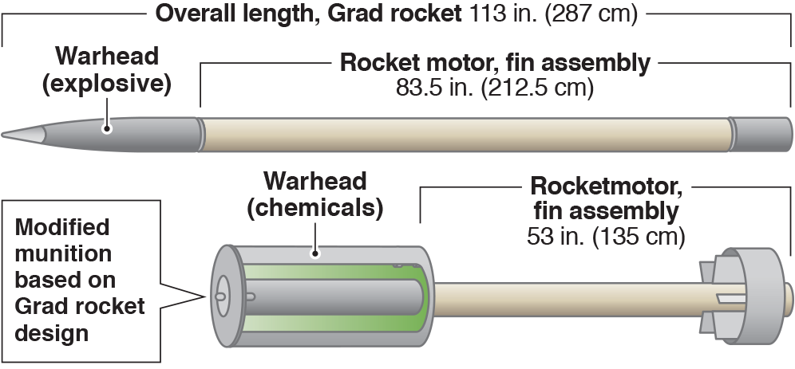
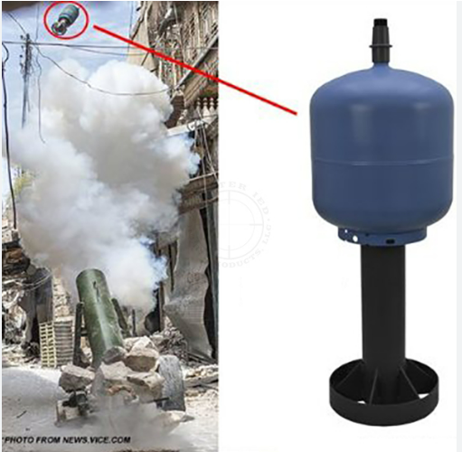
DELIVERY SYSTEMS
Improvised Chemical Weapons Munitions
Hell cannon – high explosive conventional munition
Improvised rocket-assisted chemical munition (IRAM)

Slide 14
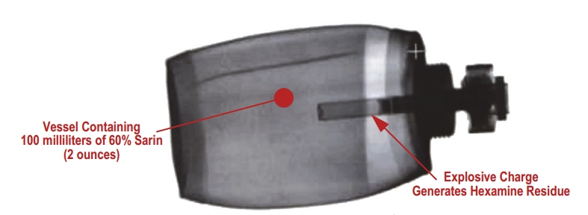
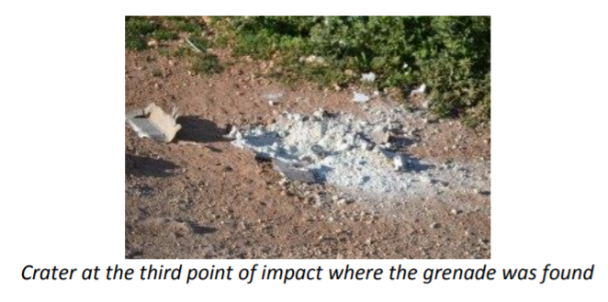
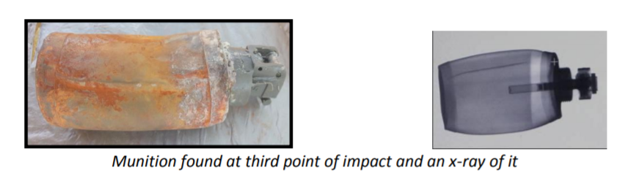
DELIVERY SYSTEMS
Improvised Chemical Weapons Munitions

Slide 15
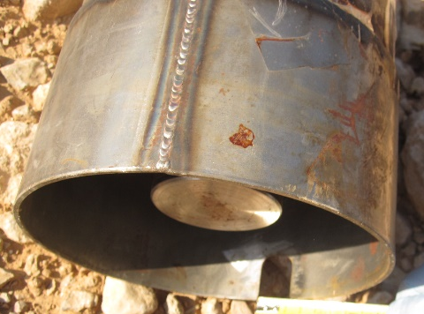
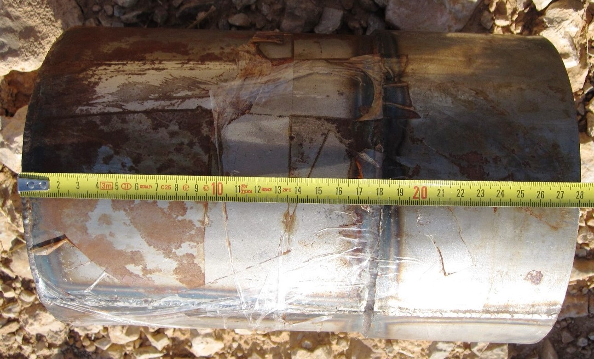
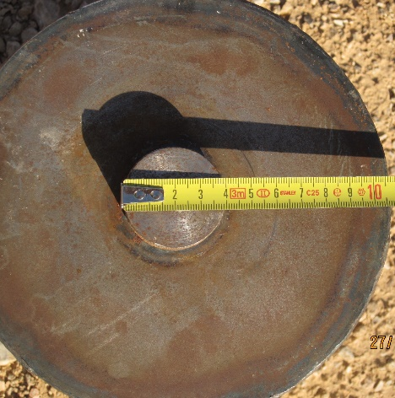
DELIVERY SYSTEMS
Improvised Chemical Weapons Munitions
Based on the X-ray findings, the alleged chemical munition has a burster pocket, a detonation cord wrapped around a central core contained within the pocket, a filling plug at the top that is not connected to the energetics, and a body filled with liquid.

Slide 16
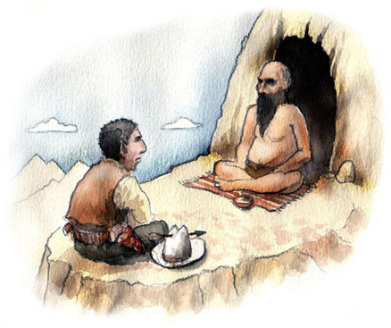
KEY TAKE AWAY AND REFLECTION
Anything that CAN explode – WILL explode
at some point in time...

Slide 17
KEY TAKE AWAY AND REFLECTION
If you want to win the “war against Chemical IEDs,” you MUST defeat ChatGPT!
Are Improvised Chemical Weapons effective and efficient?
Are the International Treaties effective?
Cooperation and coordination? What about those?

Slide 18
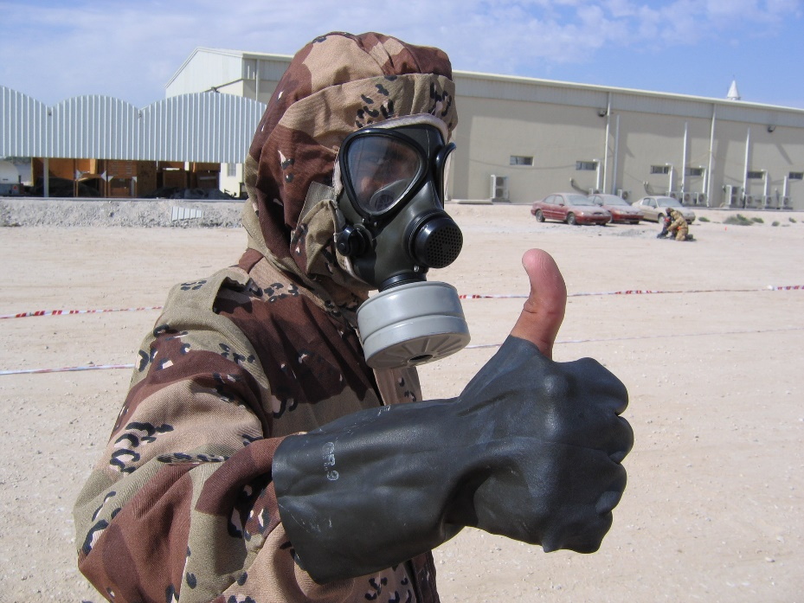
QUESTIONS?
Thank you for your attention!
I am happy to answer any questions you may have.

