Slide 1

MCI
Mass casualty medical response after chemical attack
III. International cbrn congress
Ankara, turkey
November, 21, 2024

Slide 2
I have no conflict of interest
I’m only here for the interest of the patient

Slide 3
My thanks to the organization for the invitation and special thanks to Dr Sermet Sezigen

Slide 4

Objectives
Preparation
On site
Rehab
Conclusion

Slide 5
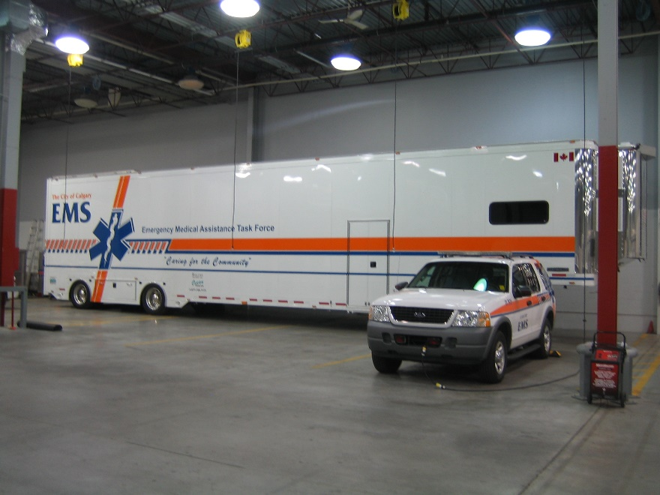
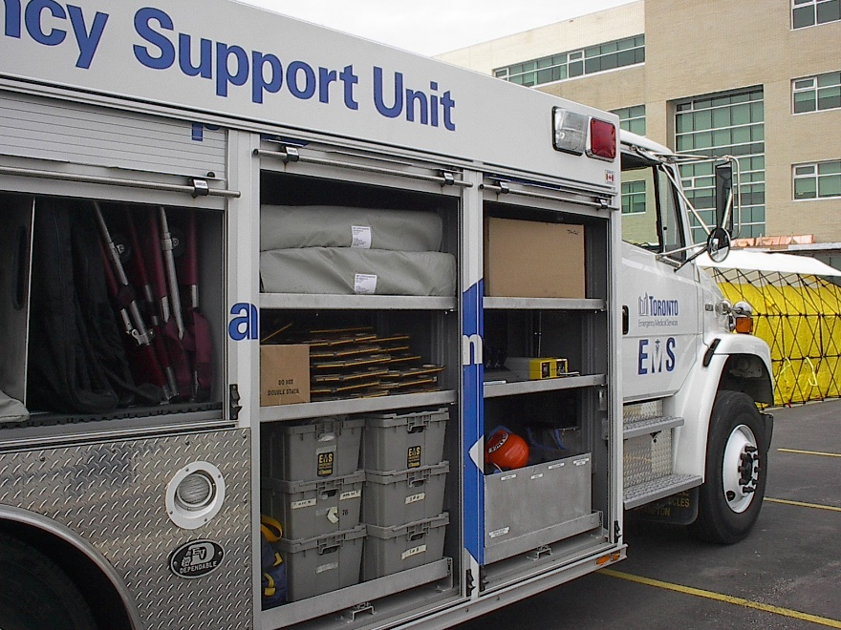
Preparation
Visualization
Logistic
  PPE
  Counter measure (Toxidromes)
  Mutual aids
  Table top training
  Multiple site
  Train like you fight
Notes:
Close your eyes
Flight sim
PPE, how many do you have? (do you have antidote, RSDL As part of your PPE ?) When i trained in Suffield we change PPE after every enteries
Counter mesure, Where are they? Rotations of the meds. Who’s aloud to evaluate and give the antidotes?
Mutual aid. Who’s you friends. Cities, Counties, militarie, Industries
Table top training, Do it for real, where gas mask
MULTIPLE SITE. What you think is a big one can be a decoy
TRAIN LIKE YOU FIGHT Run calls even though they are’nt exactly a big call Make it as real as possible !!

Slide 6
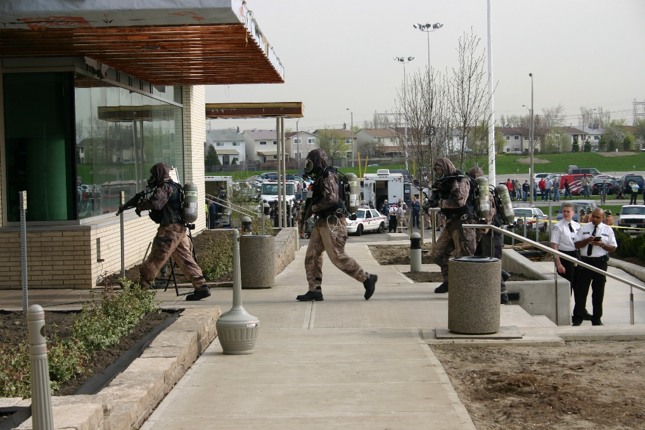
On site
You know how it’s done !
  All hasard Recce (overt or covert)
  Triage
  Extraction
  Forward triage and treatments
  Transfer
  Decon
Medical detection
Antidote, where, when and who
Notes:
All hazard RECCE Easy in training, it won’t be as easy for real!!! Multiple RECCE. The DECON as to be up and ready before
RIT TEAMS. It’ your back up RECCE
EXTRACTION on the tail on recce at the last safe place get some weels!!
T&T. TX, and triage, Bag and Tag, UNIFORME ARE RED!!! And yes! there will be uniforms unfortunatly
TRANSFERT and cross contamination
DECON. Ambulatorie and NON Ambulatorie
MEDICAL DETECTION. Be on top of your toxidromes and the intel that you can get from every one, witness etc.
ANTIDOTS: For first responder and Patient, Who as them? Everyone knows the protocols? Who treath the patients?

Slide 7
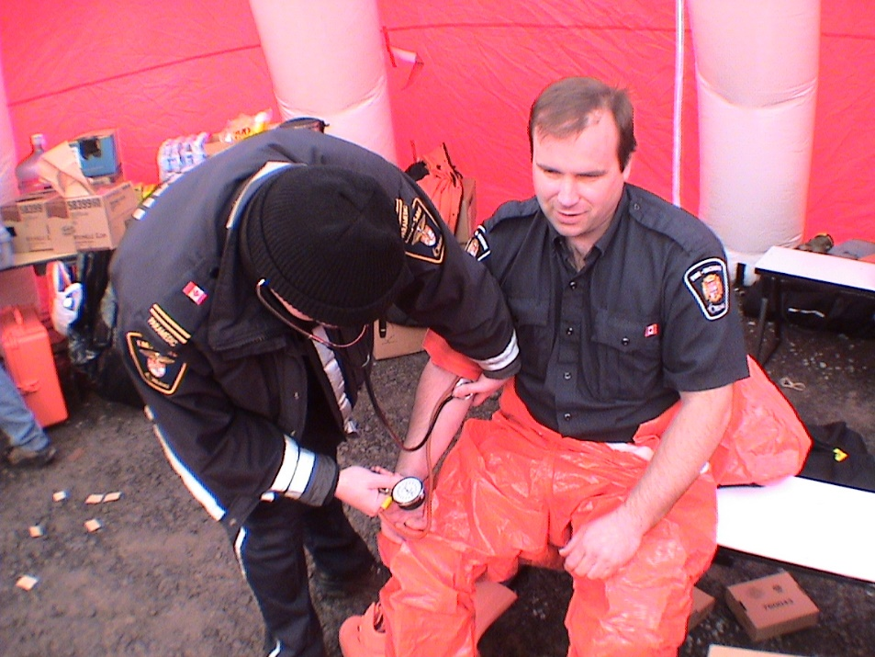
Rehab
•Secure site
•Pre-and post-medical evaluation
•Rehab protocol
•Access to scientific personnel
•Md, Pharmacist, psychologist
•Logistical support
•Food, clothing (PPE), Sleeping quarters, communication, Essential needs
•Debriefing room
Notes:
SECURE SITE Be out of site, no camera, NO OUTSIDER. The team!! Vital sign in and out! CONFIDENTIALITY
You can debrief, rest, sleep, cry
Rehab protocol you’ll have more probleme to keep the staff out then in !!
ACCES to MD, pharmacist, OTC,
LOGISTIC SUPPORT

Slide 8
Conclusion
We always prepare for the last war
We train few a hours a week to counter a terroriste attack …
Find out who your allies are now
Get your scientific personnel on board
Notes:
Let’s be realistic! They will always find a different way to hurt us!à
They are happily giving there life to screw us over
Gas cie, electrical cie, transport cie, hospital
Get your scientist to train with you get them involve get them ready to assit you

Slide 9
Thanks for your attention questions ?
charlesalexandrecampbell@gmail.com

