Slide 1
CBRN and Hazmat Events
Dan Kaszeta
Fellow of the Royal Historical Society
London, UK

Slide 2
My background – 33 years CBRN experience
US Army Chemical Corps
Maryland National Guard Civil Support Team
White House Military Office CBRN Advisor 1996-2002
US Secret Service, Chemical and Biological Countermeasures 2002-2008
Smiths Detection (UK) 2008-2011
Royal United Services Institute
Numerous consulting projects and clients
2 books and 50+ CBRN-related articles

Slide 3
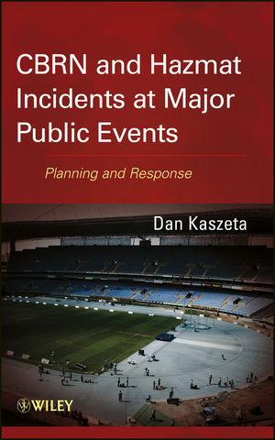
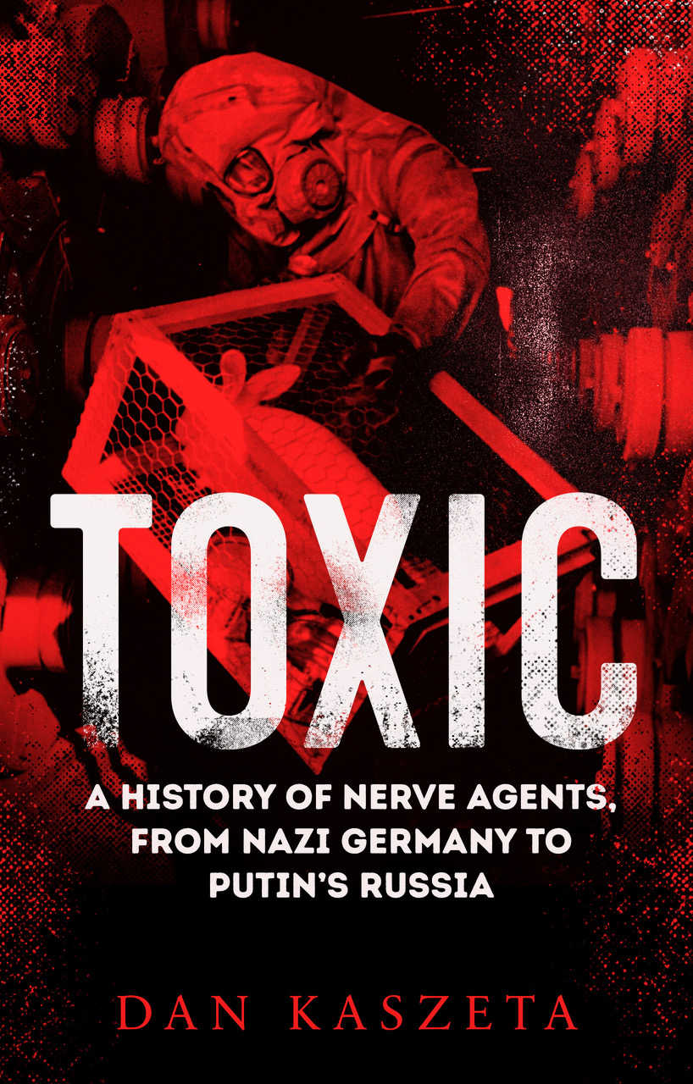
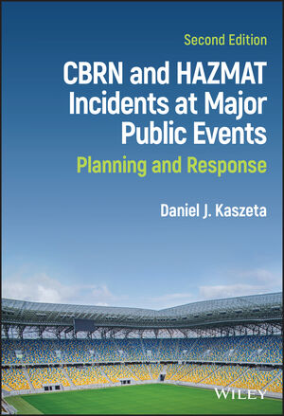

Slide 4
The Challenges
CBRN materials can cause damage disproportionate to the size of device
Major public events provide the target analysis for the terrorist and concentrate targets at well-publicised locations and times.
Major public events have a high concentration of public and media attention, thus serving as a media multiplier
Behaviour and beliefs of people
  Crowd dynamics can increase the impact of an incident
  The public can often have a fear of CBRN materials not necessarily justified by actual facts
CBRN materials can be viewed as making more political or ideological impact

Slide 5
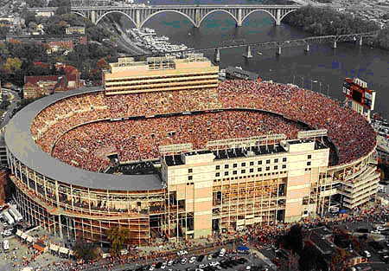

Slide 6
Advantages
CBRN terrorism is more expensive and difficult
  Extremist groups and individuals have to make decisions on resources
  Traditional kinetic methods like explosives and firearms are cheaper and have a better track record
Counter-CBRN measures have much in common with traditional security and anti-terrorism measures

Slide 7
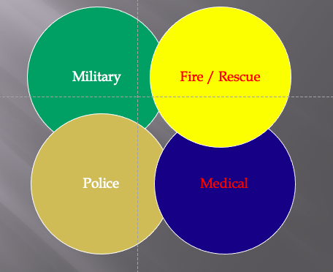
Problem Areas: Clash of Philosophies

Slide 8
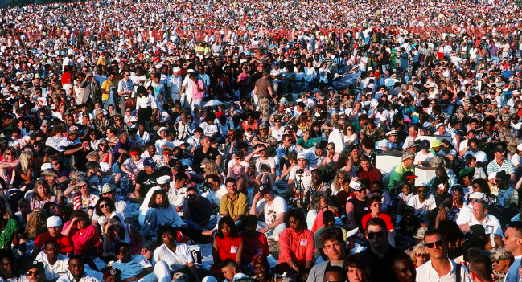
Problem Areas: Psychological and Social Factors

Slide 9
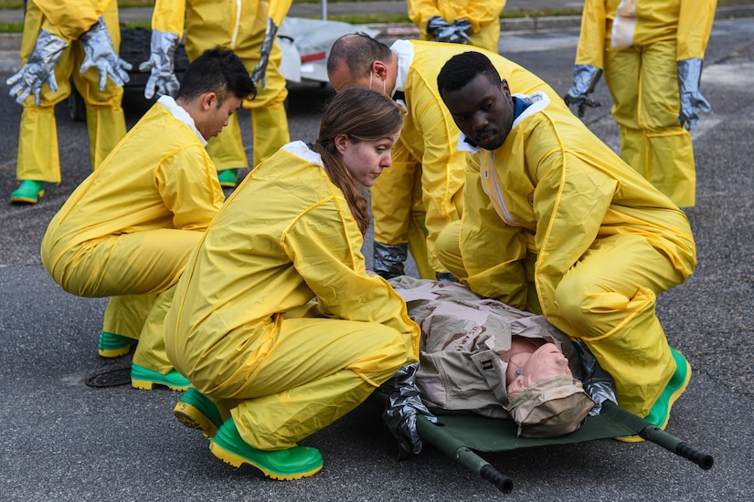
Problem Areas: Capacity

Slide 10
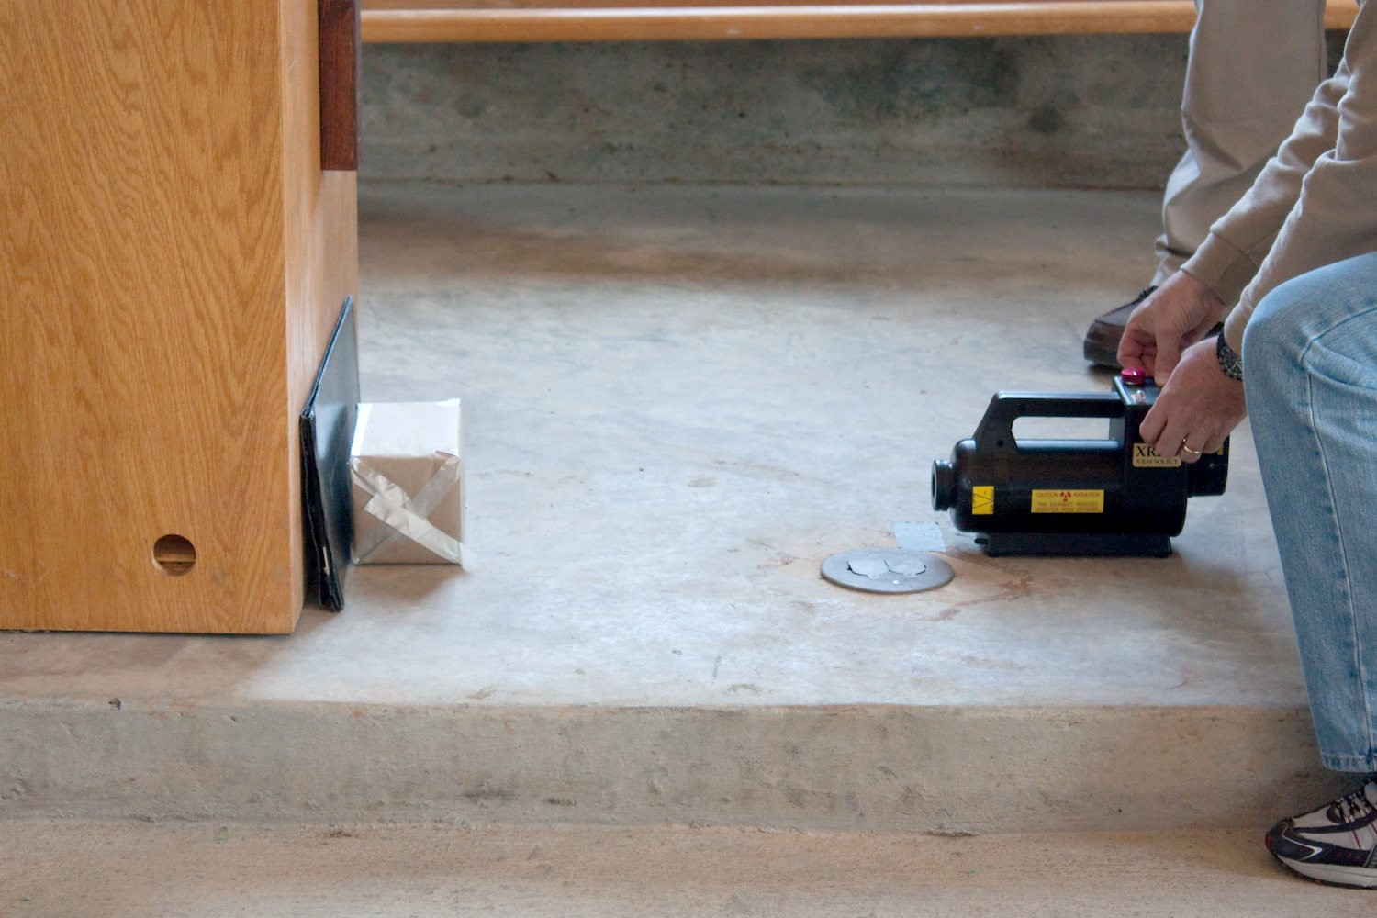
Problem Areas: Escalation of intermediate scenarios

Slide 11
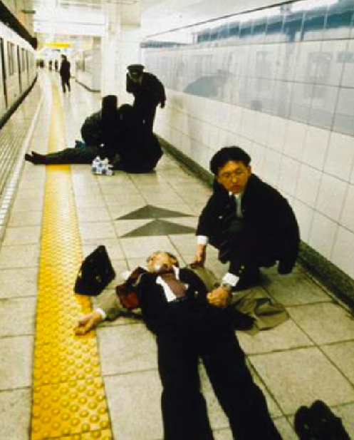
Problem Areas: Rescue and intervention in contaminated environments

Slide 12
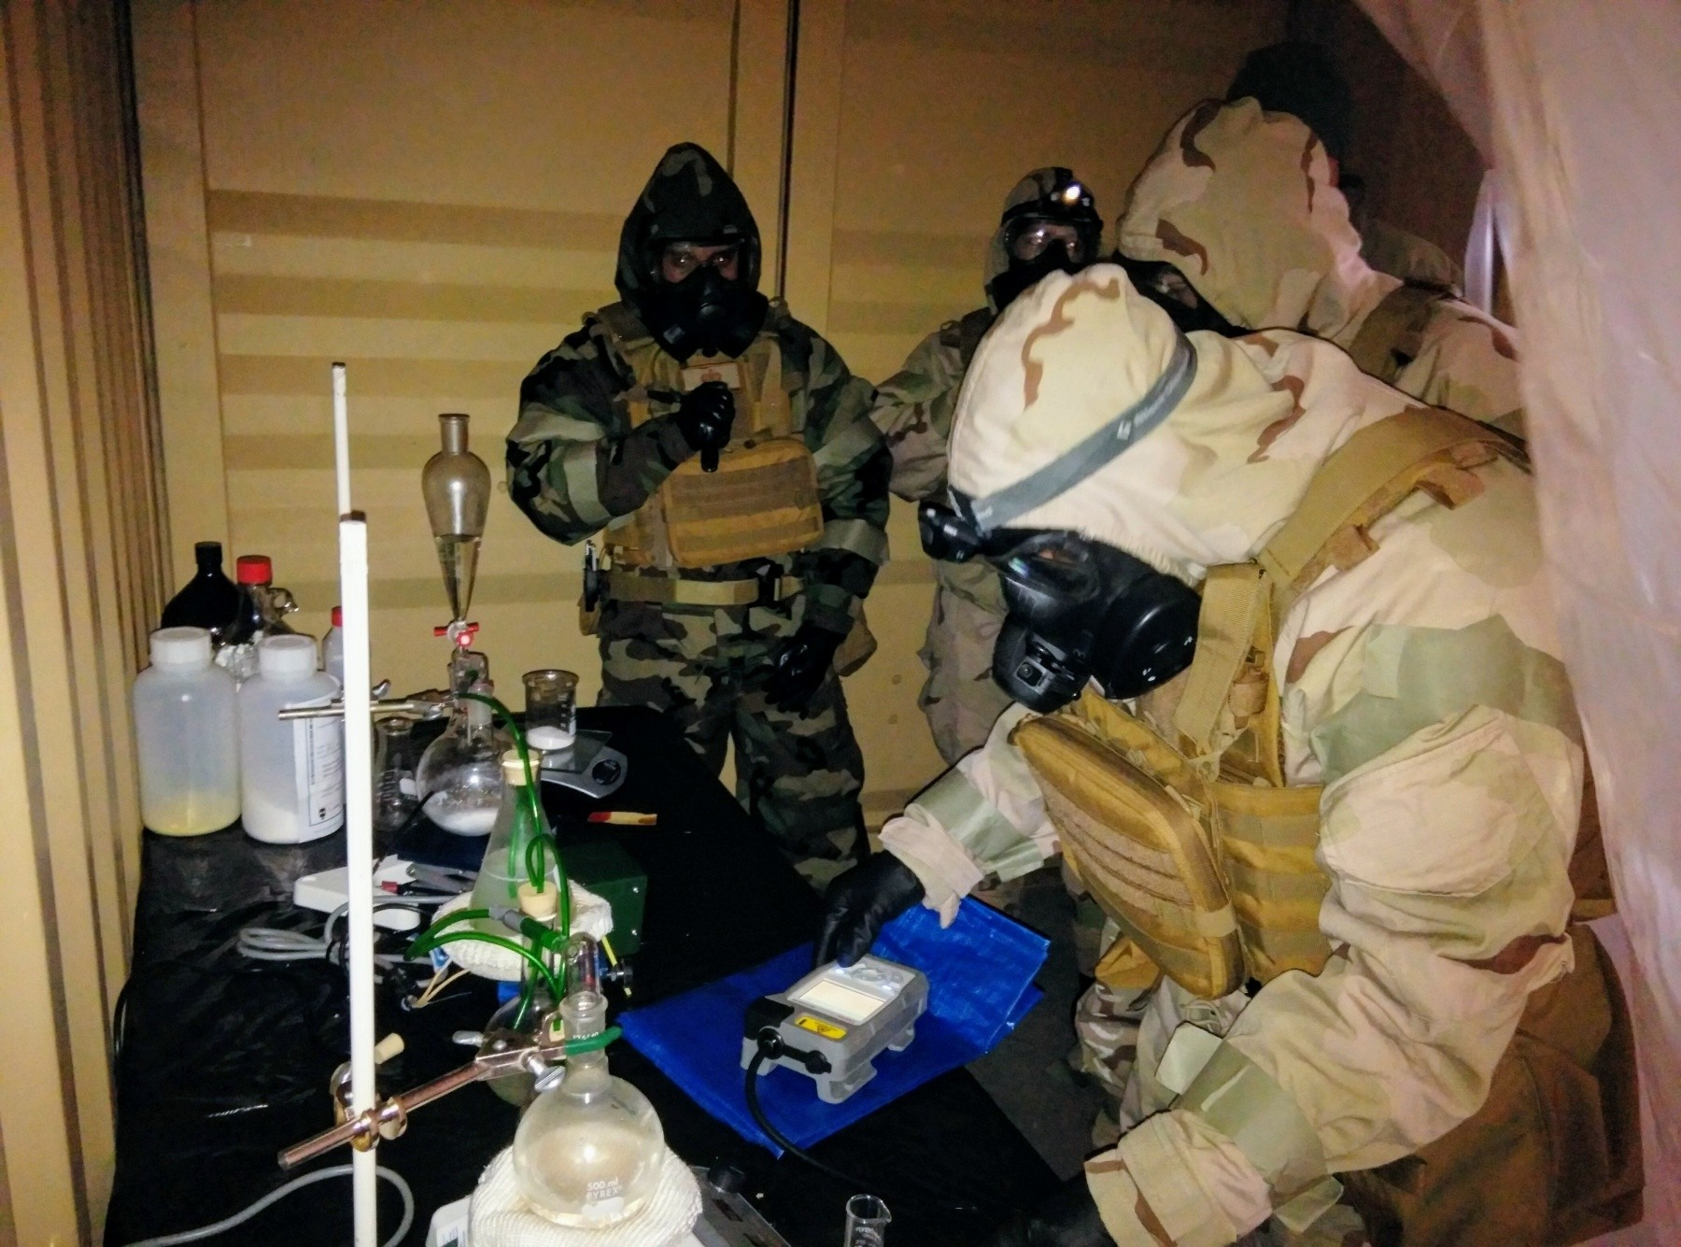
Problem Areas: Forensics and Evidence

Slide 13
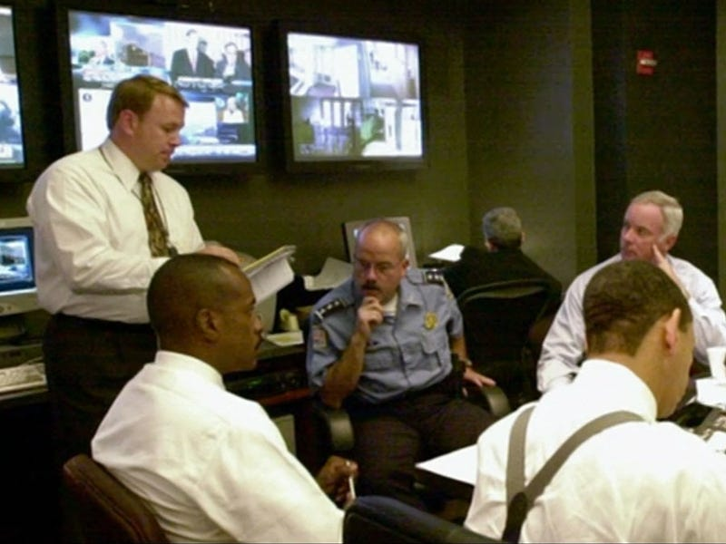
Countermeasures: Liaison and Common language

Slide 14
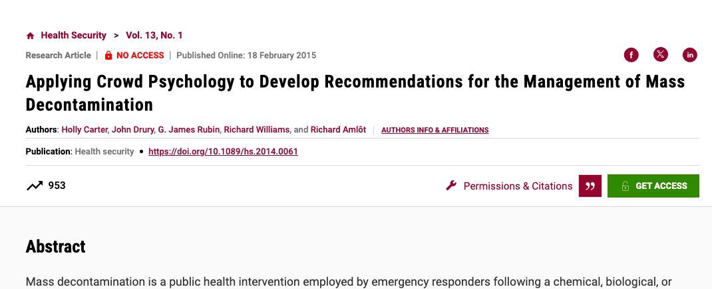
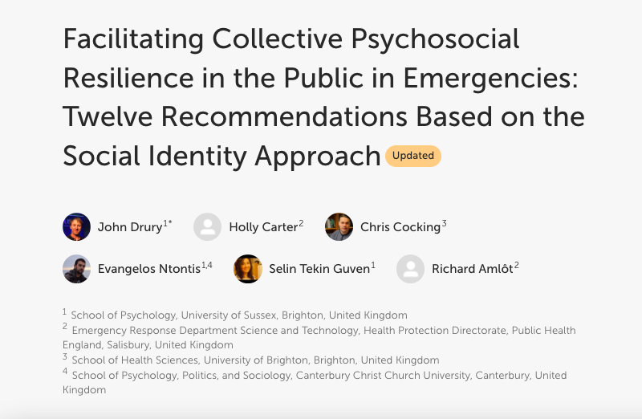
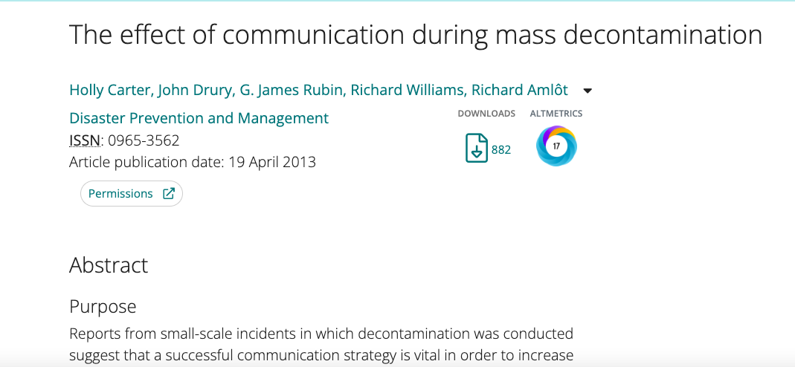
Countermeasures:
Understand social and behavioural facts

Slide 15
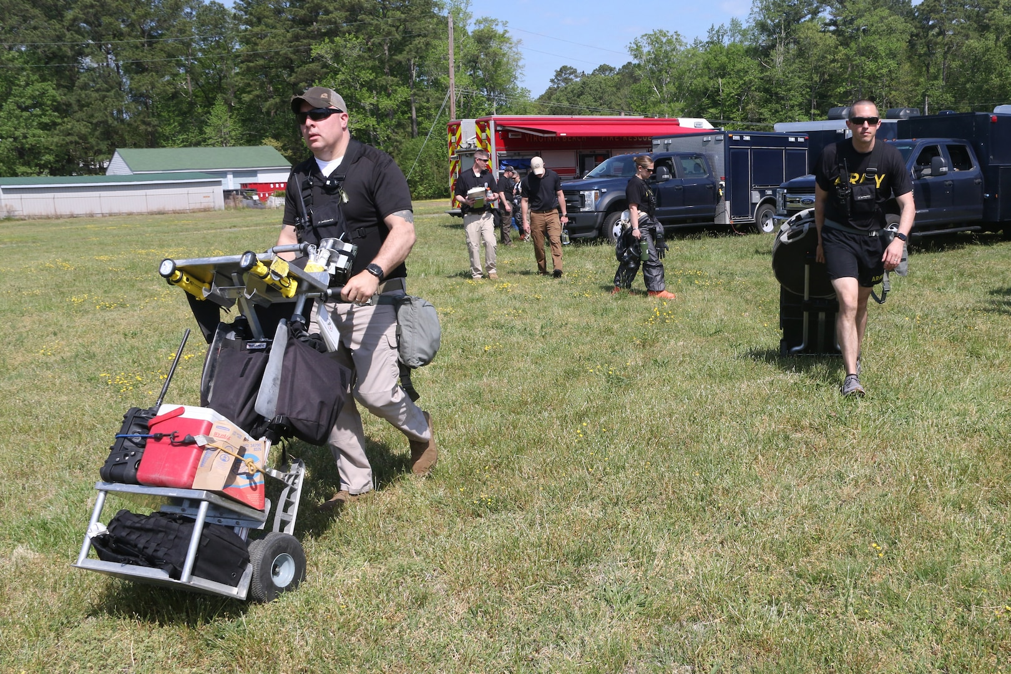
Countermeasures:
Joint Assessment Teams

Slide 16
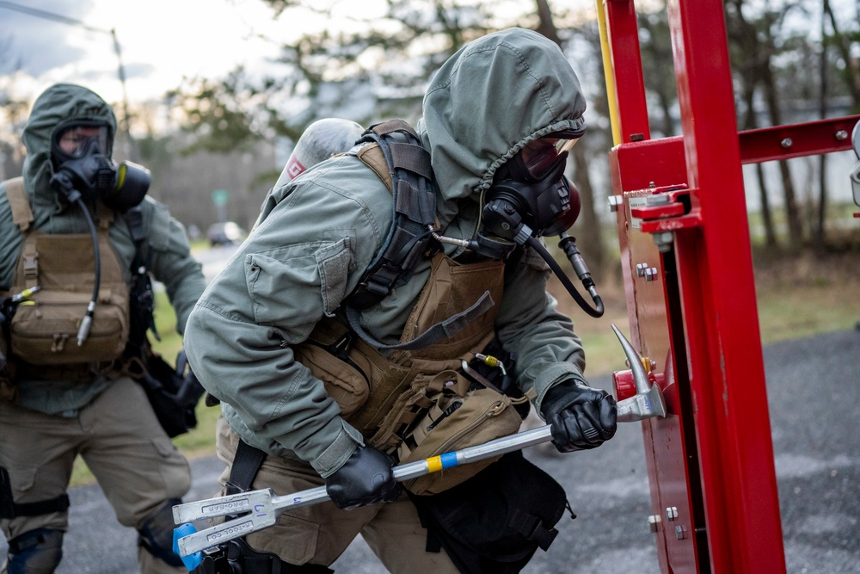
Countermeasures:
Develop rescue and extrication capability

Slide 17
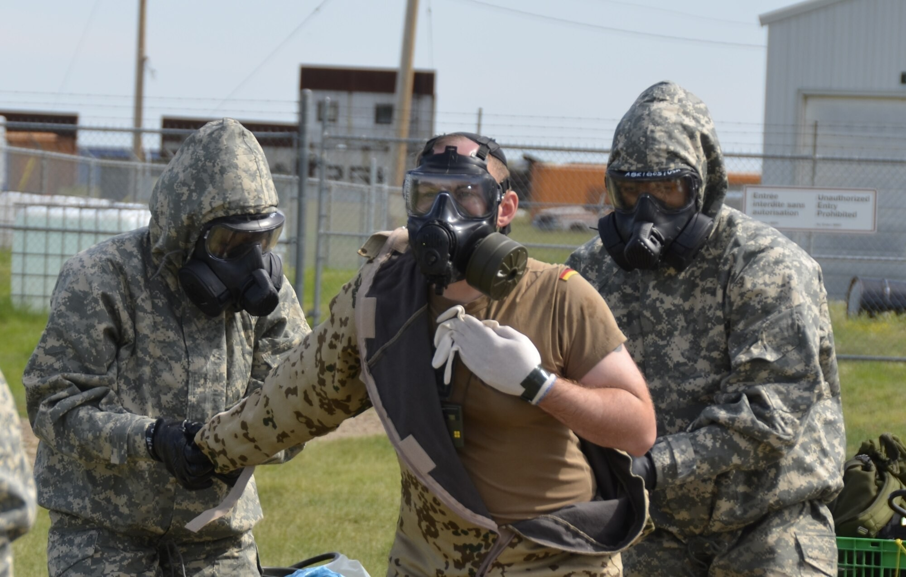
Countermeasures:
Exercises

Slide 18
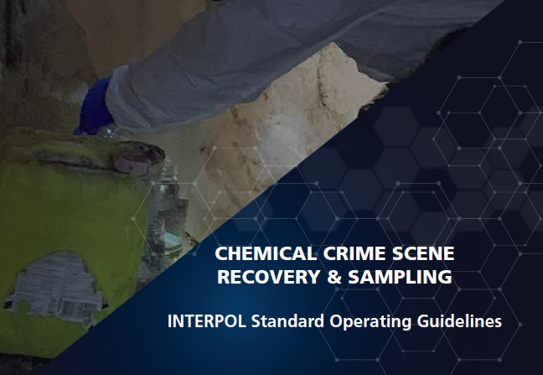
Countermeasures:
Forensic Processes and Procedures

Slide 19
Questions and Comments?

