Slide 1

Mr. Donald Parman,
Integration Division,
Research and Development
Reflections on the US History of Non-Proliferation Efforts in the Former Soviet Union Nuclear States
11-20-24
APPROVED FOR PUBLIC RELEASE

Slide 2
Presentation Disclaimer
Disclaimer:
This presentation is a discussion of my personal experiences as a Military Officer, START, INF, and CFE Treaty Officer, Arms Control Chief at two US Embassies, and as a Project Manager and On-site Manager for many elimination projects in the former Soviet Union Countries. The opinions expressed are my own and not necessarily those of the Defense Threat Reduction Agency and/or the Department of Defense.

Slide 3
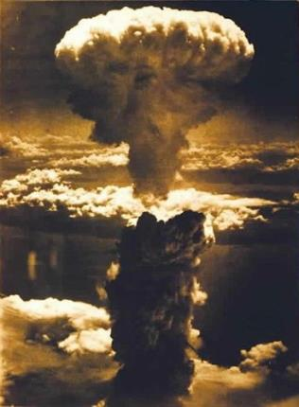
EUROPE and the end of WWII
The end of one war led to further ideological division and escalation in the nuclear arms race between the West and the Soviet Union
4–11 February 1945
Allied leaders Roosevelt, Churchill and Stalin meet in Yalta

Slide 4
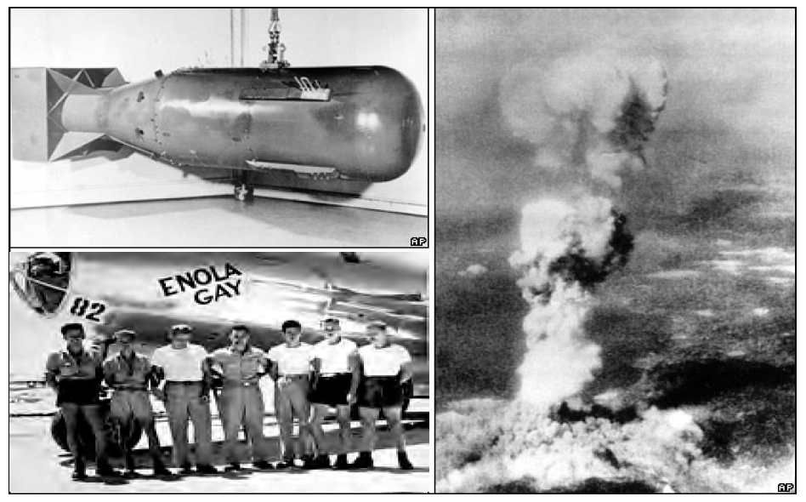
Hiroshima August 6th 1945

Slide 5
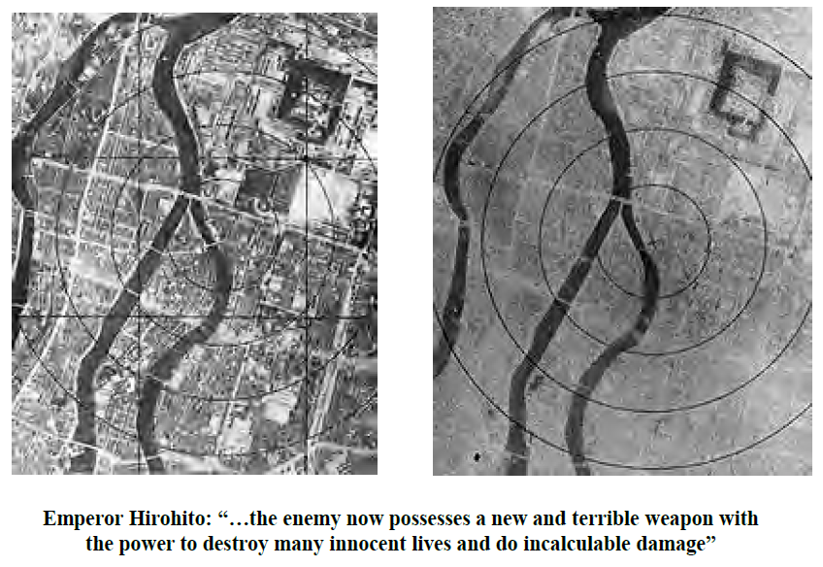
“…incalculable damage” to Hiroshima

Slide 6
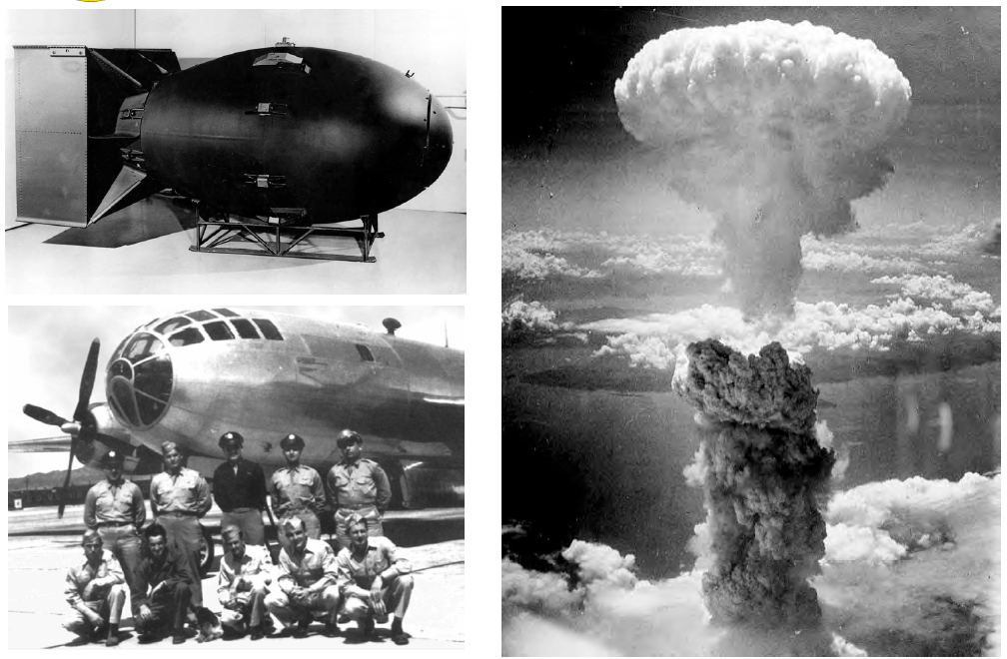
Nagasaki August 9th 1945

Slide 7
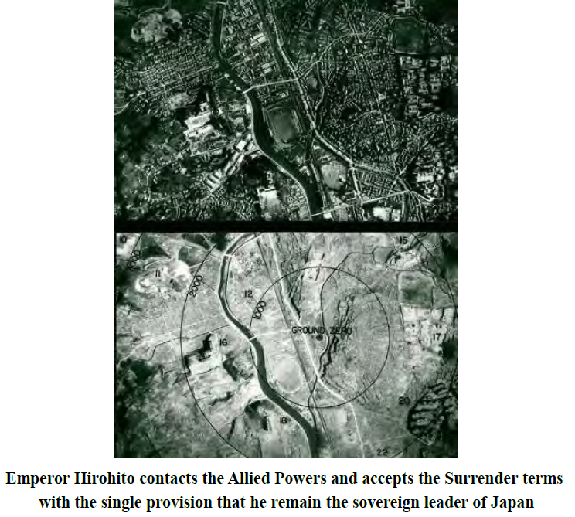
“I am become death…destroyer of worlds” – Robert J. Oppenheimer

Slide 8
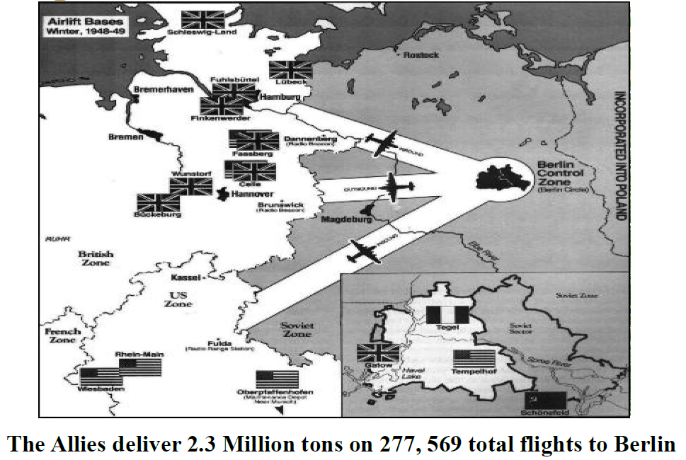
A House Divided – Berlin is Blockaded
24 June 1948 – 12 May 1949

Slide 9
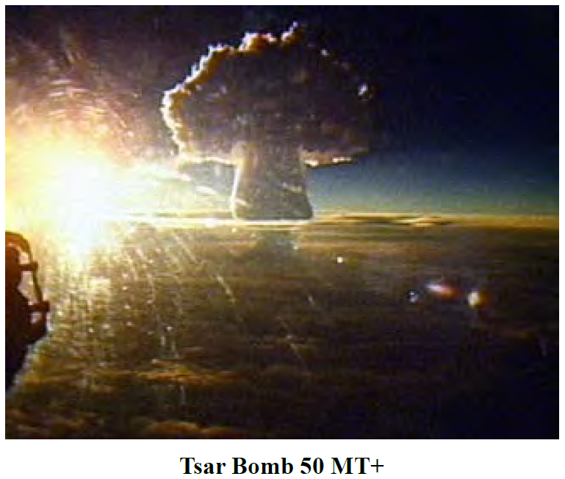
The Midnight Sun

Slide 10
“We shall bury you”
November 18, 1956 Nikita Khrushchev In Russian said, "Whether you like it or not, history is on our side. We will dig you in" ("Нравится вам или нет, но история на нашей стороне. Мы вас закопаем").

Slide 11
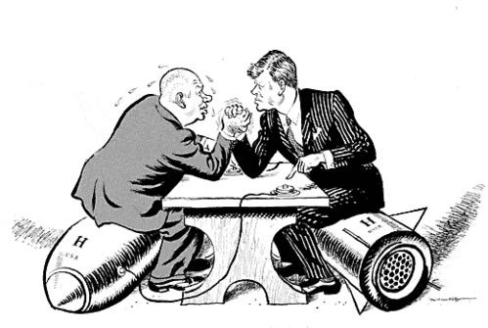
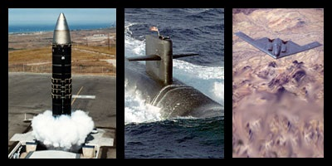
Diplomacy versus Deterrence
Both have a place in National Defense and International negotiations
Negotiations seek to achieve boundaries and an acceptable balance of defensive and offensive capability

Slide 12
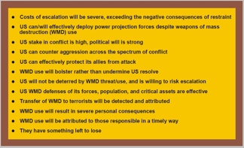
Deterrence Challenges: What the opposing leaders must believe

Slide 13
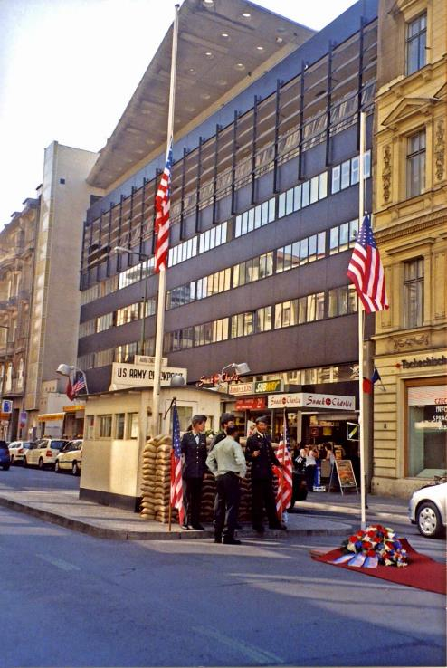
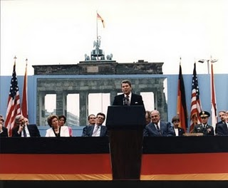
European Independence versus Soviet Control
President Reagan 12 June 1987

Slide 14
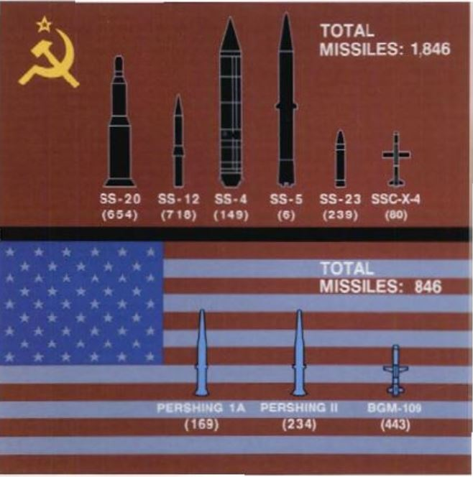
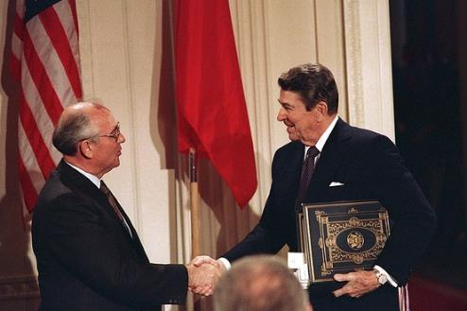
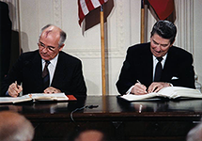
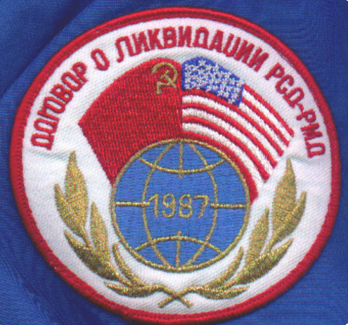
Nuclear de-escalation negotiations in Europe led to the first Arms Control Treaty - INF

Slide 15
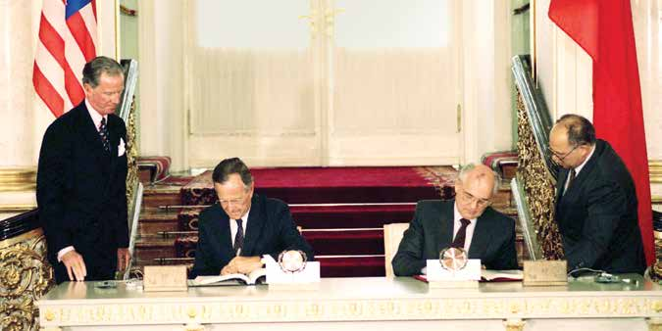
Success with INF led to Strategic Nuclear Reductions under START
START signatory nations:
United States
Russia
Belarus
Ukraine
Kazakhstan

Slide 16
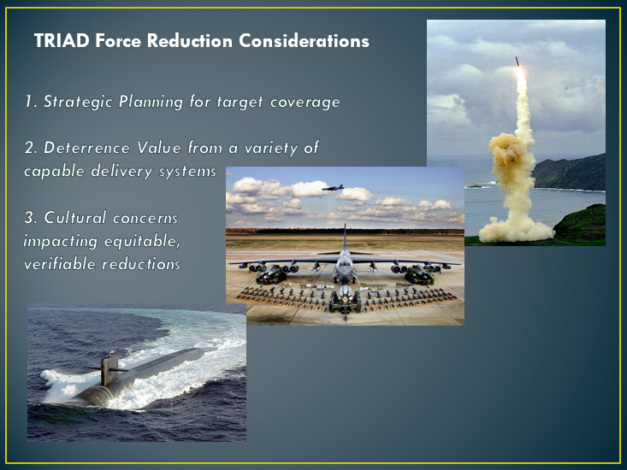
What to consider for arms control reductions
What are your real goals?
What does your opponent fear?
Is there mutual trust or distrust?

Slide 17
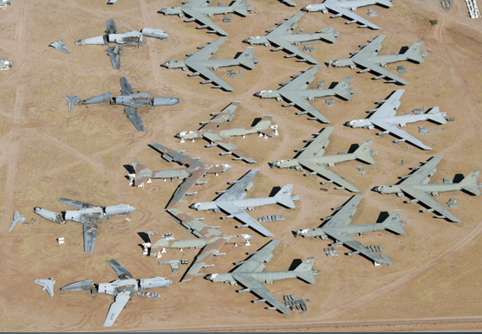
Trust but Verify – Integrity

Slide 18
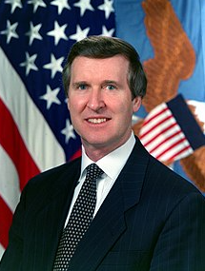
Assistance for elimination - CTR
Treaty on Conventional Armed Forces in Europe Nov. 1990
Chemical Weapons Convention entered into force Apr. 1997
US Secretary of Defense William Cohen:
“Your charge is perhaps the most vital national security mission ever to face our nation. To persevere in reducing the nuclear, chemical, and biological arsenals of the world…”

Slide 19
Good Intentions – Nunn-Lugar CTR Funding
“When will you make your good intentions a reality?”

Slide 20
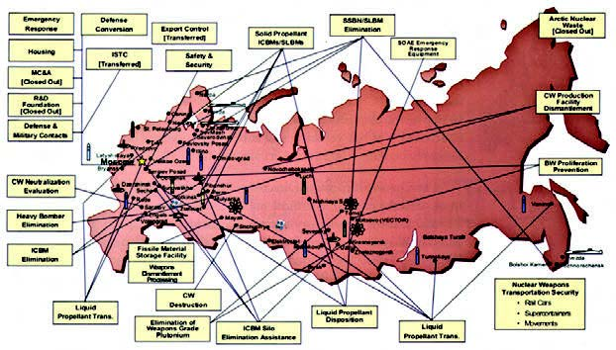
CTR Elimination Sites in the FSU

Slide 21
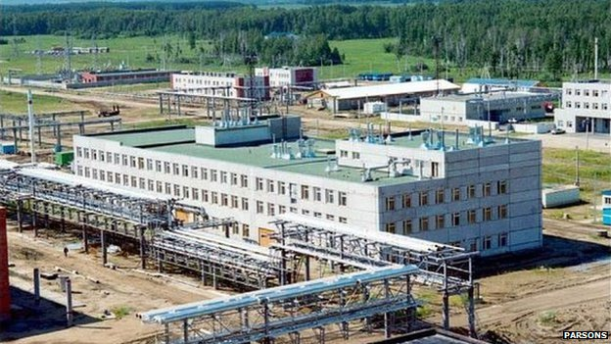
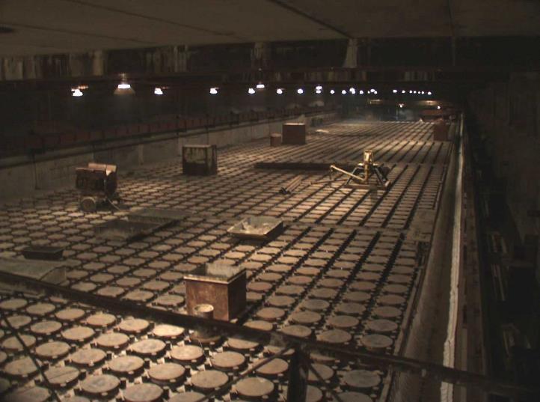
Nuclear and Chemical Weapon Demilitarization
MAYAK storage site
Shchuchye Chemical Weapons Disposition Site

Slide 22
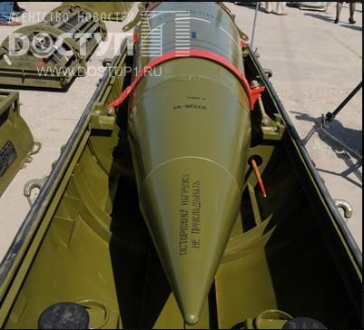
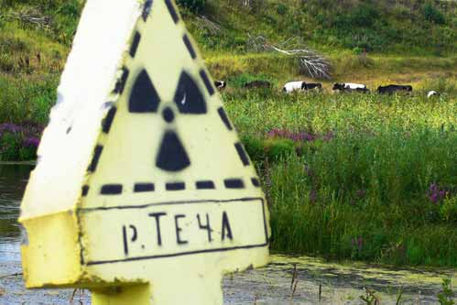
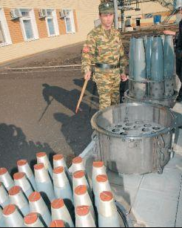
Contaminated and dangerous worksites
Russian SCUD Missile chemical warheads
Aging Chemical artillery shells
MAYAK - Kyshtym disaster 29 Sep 1957

Slide 23
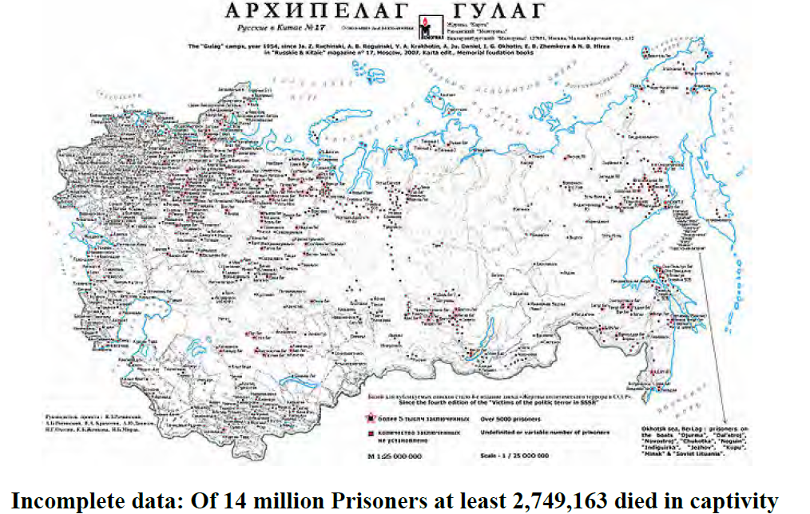
Mistrust and Misinformation

Slide 24
What will happen to us?
They hadn’t been told about the drastic changes ahead

Slide 25
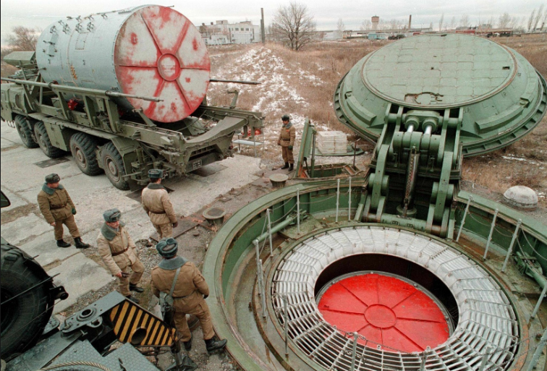
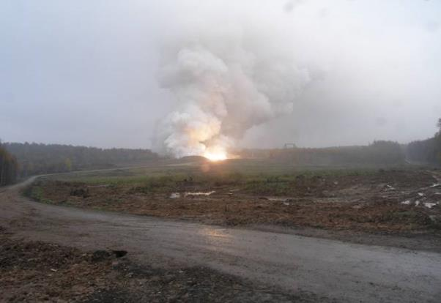
Rocket Motor and Chemical Elimination
Burning of separated stages or water washout for elimination
Removal from active missile silos and silo elimination

Slide 26
SS-24 ICBM Burn Facility
Perm, Russia May 2007

Slide 27
Anomalous Rocket Disaster – October 2007
Perm Rocket Motor Elimination suffers catastrophic explosion

Slide 28
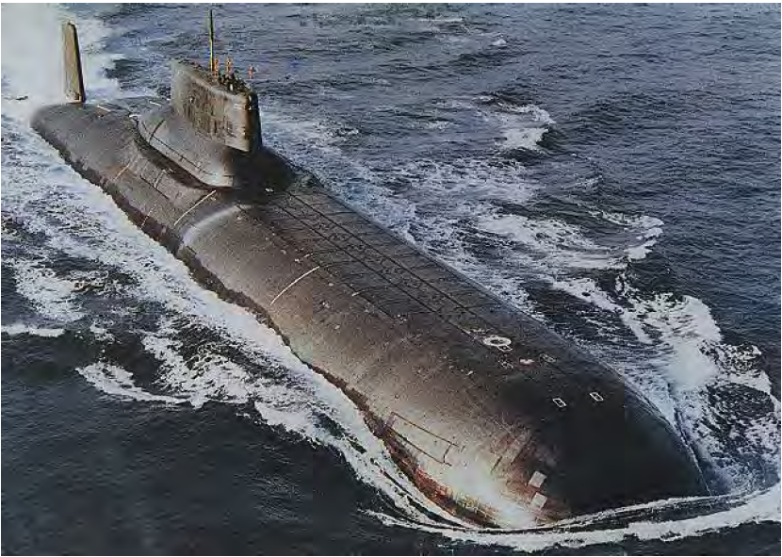
Submarine and SLBM Elimination
Carries 20 SSN20 SLBMs with 6-10 Warheads

Slide 29
Missile Launch Tubes Destroyed
SLBM tubes destroyed at Severodvinsk, Russia – January 2010

Slide 30
Aircraft and Air Launched Missile Elimination
The TU-160 is still a front-line Supersonic Russian Long-Range Bomber

Slide 31
U.S. Cooperative Threat Reduction

Slide 32
Nunn-Lugar Program Funding

Slide 33
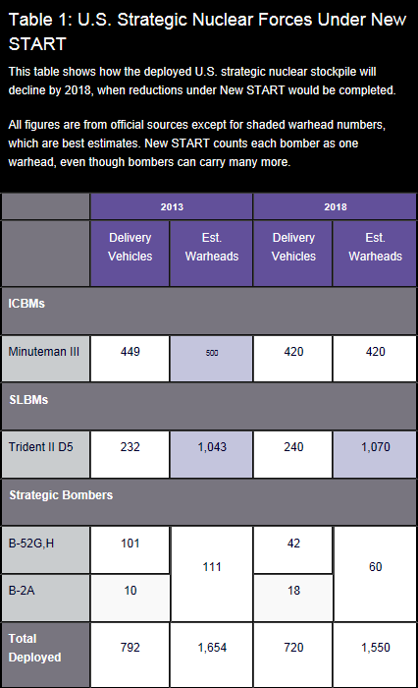
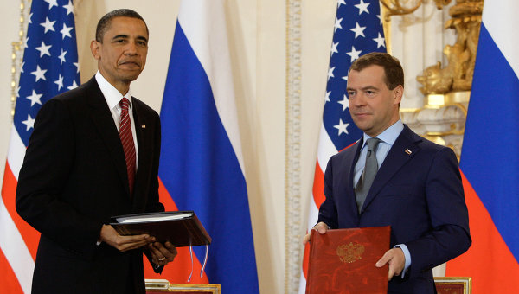
New START Treaty

Slide 34
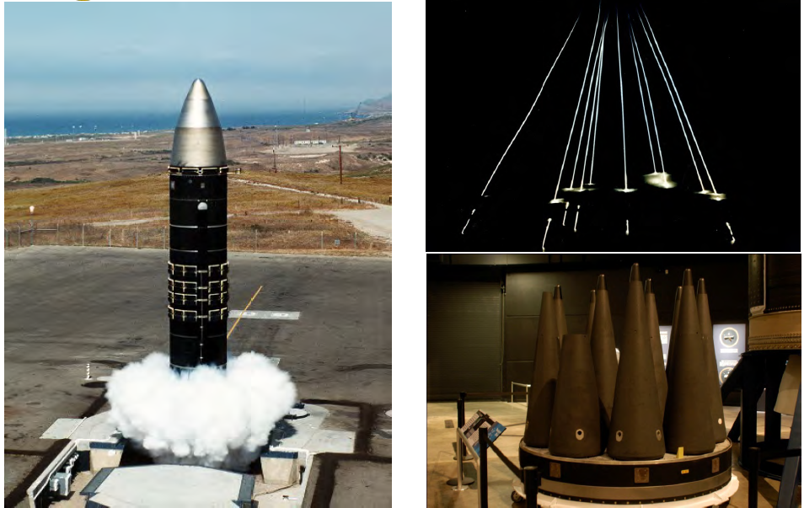
Accuracy, MIRVs, Advances in Technology, AI, and the danger to all of us

