Slide 1

REGULATORY LEGISLATION IN THE MANAGEMENT OF RADIOLOGICAL & NUCLEAR EMERGENCIES
Meltem Nihan KILINÇ
Nuclear Regulatory Expert-Environmental Engineer (M.Sc.)
meltemnihan.kilinc@ndk.org.tr
NÜKLEER DÜZENLEME KURUMU

Slide 2
National Legislation
Law on Nuclear Regulation (LNR, 2022)
Presidential Decree on Organization and Duties of Nuclear Regulatory Authority (2022)
Regulation on Management of Radiation Emergency (RMRE, 2023)
Regulation on Tasks Regarding Chemical, Biological, Radiological and Nuclear Threats and Hazards (2020)
Regulation on Disaster and Emergency Response Services (2022)
Regulation on Disaster and Emergency Management Centers (2011)
National Disaster Response Plan (NDRP, 2022)
National Radiation Emergency Plan (NREP, 2019)
Provincial Radiation Emergency Plan (Mersin & Iğdır)

Slide 3
RADIATION EMERGENCY MANAGEMENT
On-site
Off-site
AFAD (Coordination)
Authorized person
Provincial authorities
National Authorities
Authorized Person
Nuclear & Radiological
NDK
AFAD
NDK
LNR, RMRE
LNR, RMRE
Radiation Emergency Plan
Provincial REP
NREP
NDRP
Primarily Responsible
RMRE
Notes:
Regulation on Management of Radiation Emergencies
Law on Nuclear Regulation

Slide 4
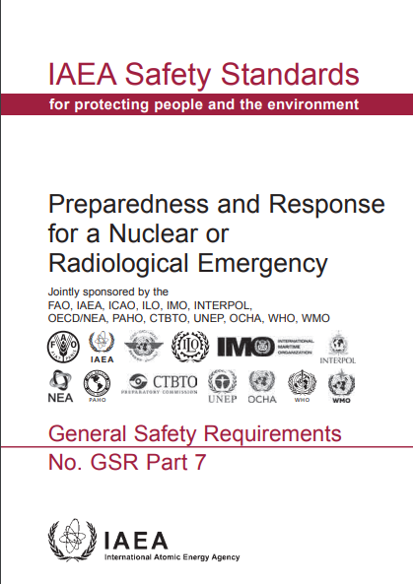
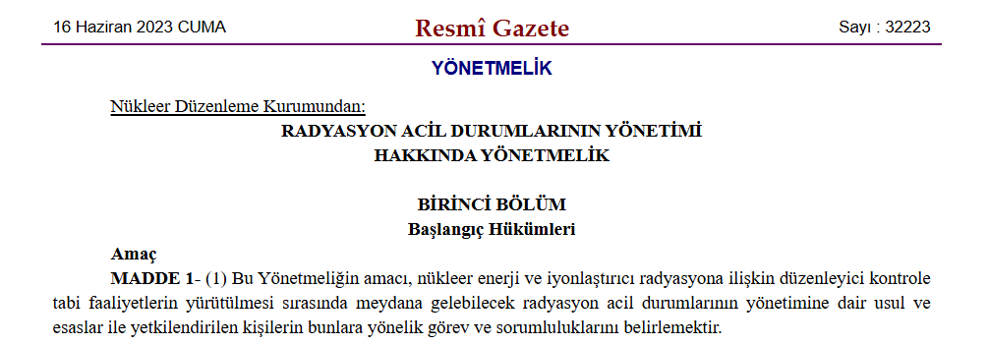
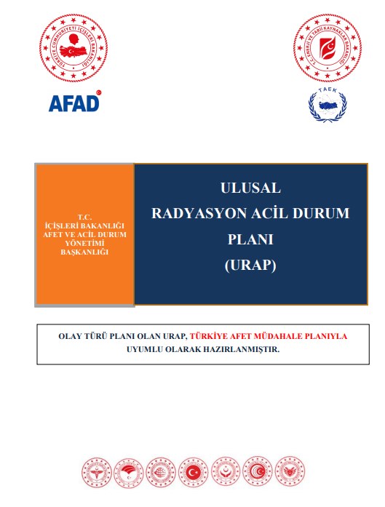
EPC I
EPC II
EPC III
EPC V
EPC IV
Regulation on Management of Radiation Emergencies, 2023
Hazard Assessment
Emergency Preparedness Categories
National Radiation Emergency Plan
2019
Notes:
Hazard Assessment: Based on the facility and rad,at,on application, radiological and non- radiological and security related
Category I-IV is explained in Regulation on Management of Radiation Emergencies
Category I-V is provided in National Radiation Emergency Plan

Slide 5
EPC
I | Akkuyu NPP Sinop NPP Nuclear powered aircraft carriers visiting national ports
II | TR-2 Research Reactor - Çekmece / İstanbul Nuclear powered submarines visiting the national ports
III | TRIGA Research Reactor - Istanbul Technical University / İstanbul Industrial irradiation facilities Proton Accelerator Facility - Sarayköy / Ankara Waste Management Unit - Çekmece / Istanbul Medical practices
IV | Mobile radiography sources Transportation of radioactive material in dangerous amounts Satellites re-entering the atmosphere Use of dangerous sources for malicious acts Facilities/locations at which there is a significant probability of encountering an uncontrolled dangerous source, such as: Large scrap metal processing facilities; National border crossing points, seaports and airports Nuclear Power Plants located around Turkey except Metsamor NPP which is in EPC V
V | Areas within the Urgent Protective Action Planning Zone (UPZ), Extended Planning Distance (EPD) and Ingestion and Commodities Planning Distance (ICPD) of the Metsamor NPP which lie within the national borders
On-site & Off-site
RMRE
On-site & Off-site
RMRE
On-site
RMRE
Unpredictable place/facility
RMRE
NREP

Slide 6
Regulation on Management of Radiation Emergencies
Alarm
Facility Emergency
EPCI
Site Emergency
EPCI
General Emergency
EPCI
EPCI
EPCII
EPCIII
EPCII
EPCIII
EPCII
EPCII
Emergency Classes
Public information by AFAD
Other Emergencies
EPCIV
Public information by NDK
Notes:
Nuclear facilities, radioactive waste facilities, radiation facilities and radiation applications

Slide 7
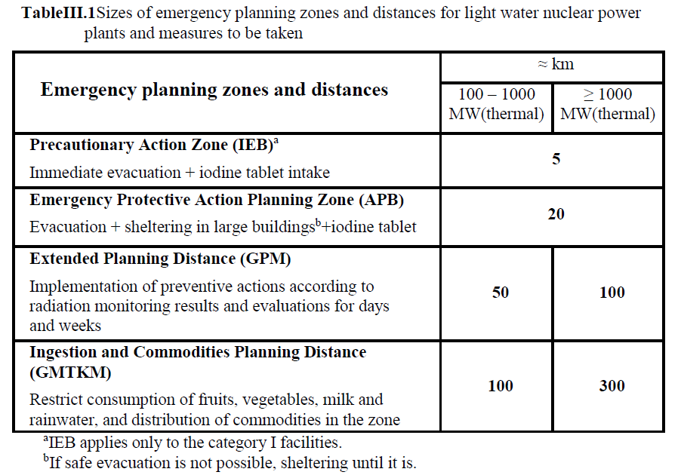
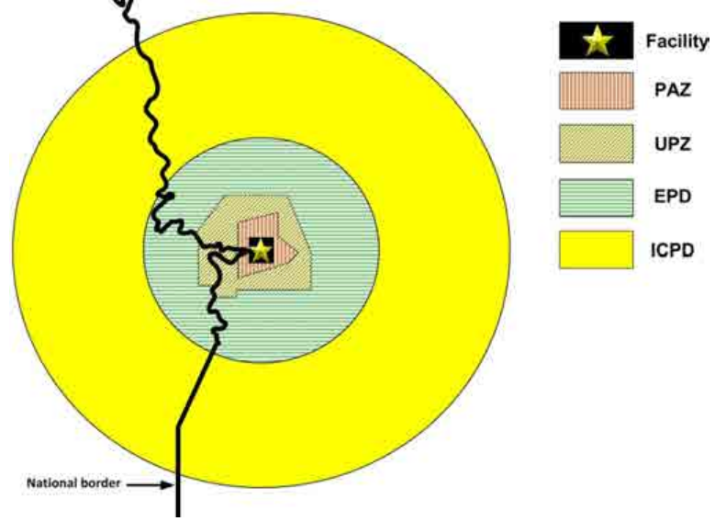
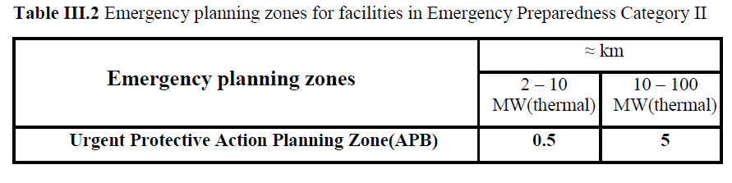
Emergency Planning Zones & Distances for EPCI & EPCII
RMRE refers to NREP

Slide 8
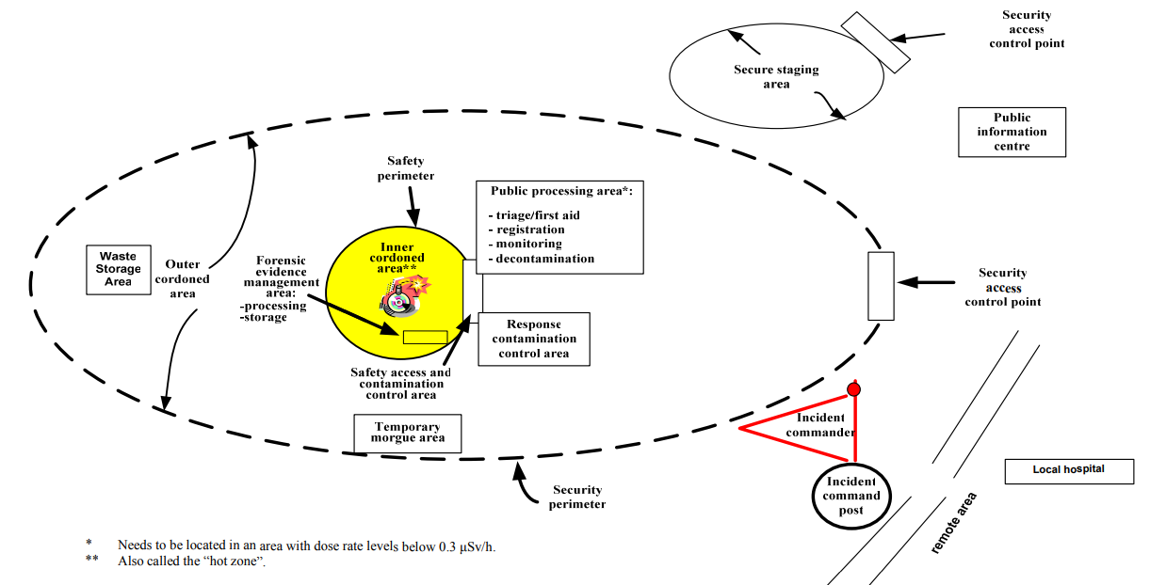
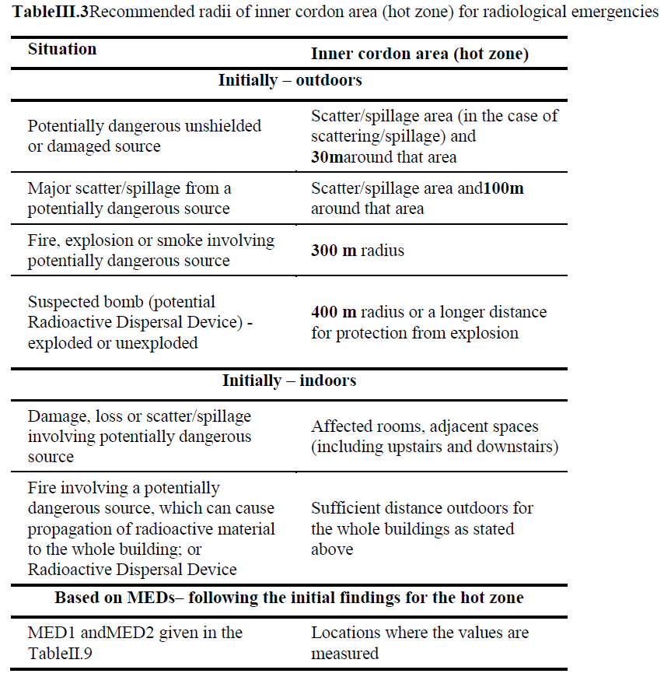
Areas Formed by First Responders for Radiological Emergencies
RMRE refers to NREP
Notes:
To be formed by first responders

Slide 9
Regulation on Management of Radiation Emergencies
Emergency response organization
Radiation emergency plan
Coordination of preparedness to radiation emergency
Centers to be used in the response of radiation emergencies
Emergency equipment and communication
Instructions
Training & Exercises
Decision support systems
EMERGENCY PREPAREDNESS

Slide 10
Regulation on Management of Radiation Emergencies
EMERGENCY RESPONSE
Classification, notification of emergency, initiation of response
Implementation of response activities
Radiation protection of emergency workers
Public information in radiation emergencies
Monitoring of plant and site parameters
Termination of the response
Records and reporting

Slide 11
Presidential Decree on Organization and Duties of Nuclear Regulatory Authority
NDK regulates the management of radiation emergency.
To cooperate with AFAD and relevant institutions and organizations in the management of radiation emergencies that may occur as a result of activities which are not under regulatory control is within the duties and authorities of NDK.
NDK cooperates with other authorized authorities and organizations in terms of security and safety in other areas where NDK is a stakeholder in emergency planning and response, and provides recommendations to these institutions and organizations.
Issues regarding on-site management of radiation emergencies are regulated by NDK, while issues regarding off-site management are regulated by AFAD after receiving the approval of NDK. In the management of off-site emergencies to be carried out under the coordination of AFAD, the authorized person and the relevant authorities and organizations act in cooperation.
Within the scope of fulfilling the obligations arising from international agreements and conventions regarding radiation emergencies, AFAD, TENMAK and relevant authorities and organizations act in cooperation with NDK.

Slide 12


















Regulation on Tasks Regarding CBRN Threats and Hazards (2020)
Notes:
The duties & responsibilities, the necessary cooperation and coordination of AFAD, NDK, the ministries, TENMAK, YÖK, TUBİTAK, governerships and provincial directorates, NGOs
AFAD: Disaster And Emergency Management Presidency
NDK: Nuclear Regulatory Authority
Ministries
YÖK: Council of Higher Education
TÜBİTAK:The Scientific and Technological Research Council of Türkiye
Governorships
Presidency of Defence Industries
Non Governmental Org.s
M.Of Environment, Urbanization and Climate Change
M. Of Trade
M.Of Foreign Affairs
M.Of Agriculture and Forestry
M.Of Health
M.Of National Defence
M.Of Family and Social Services
M.Of. Industry and Technology
M.of. Transport and Infrastructure
M.Of National Education
Duties and responsibilities of the relevant authorities and organizations and the Turkish Armed Forces within the framework of civil-military cooperation before, during and after the incident and the principles of necessary cooperation and coordination in order to prevent or minimize the damage to human health and the environment against CBRN threats and hazards that may occur at home or abroad and affect our country.

Slide 13
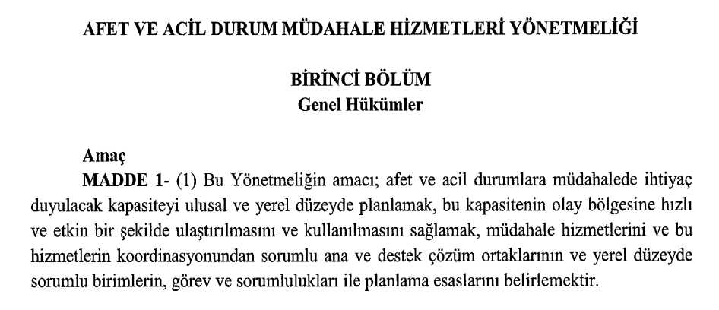
Regulation on Disaster and Emergency Response Services
The aim & the scope
To plan the capacity needed to respond to disasters and emergencies at national and local levels,
To ensure that this capacity is delivered to the incident area quickly and effectively and used,
To determine the response services and the duties and responsibilities of the main and support solution partners (relevant authorities and organizations, ministries, governorships, district governorship, natural and legal persons, NGOs etc.) responsible for the coordination of the response services and the planning principles of the units responsible at the local level.

Slide 14
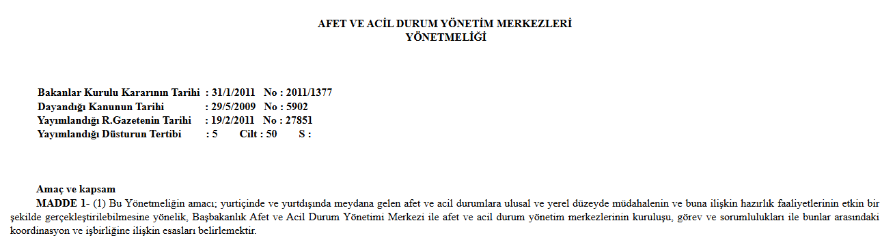
Regulation on Disaster and Emergency Management Centers
The aim & the scope
To determine the principles regarding the establishment, duties and responsibilities of the AFAD Disaster and Emergency Management Center and disaster and emergency management centers and the coordination and cooperation between them, in order to effectively carry out national and local response and related preparedness activities in disasters and emergencies occurring at home and abroad.

Slide 15
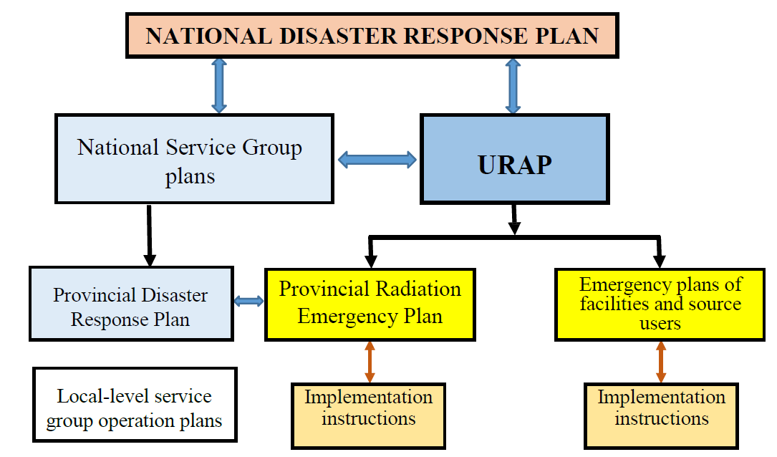
(TAMP)
(NREP)

Slide 16
ANY QUESTIONS?

