Slide 1

Chemical and Microbiological Forensics in Investigations of Alleged Uses of Chemical and Biological Weapons
Dr Ralf Trapp, International Disarmament Consultant / CBWNet
Ankara, Türkiye, 21 November 2024

Slide 2
Content
Terminology
Agent spectrum
Legal frameworks (UNSGM, CWC, BWC)
Purpose and scope of CBW use investigations in the context of arms control
The role of forensics in such investigations
Chemical forensics – State of the art and challenges
Microbial forensics – Sate of the art and challenges
Outlook

Slide 3
Terminology
Forensics:
  Application of science to the law (criminal, civil, international such as genocide, war crimes, crimes against humanity, and the crime of aggression)
Chemical forensics:
  Attempts to trace the history of a chemical sample
  Looks at synthesis products, byproducts, impurities, degradation products
  Deduces synthetic pathway, source of materials used, manufacturer, links between samples of different origin
Microbial forensics:
  Attempts to characterise a questionable source as “could not have originated from”, is “consistent with having originated from”, or “absolutely did originate from” a known source
  Attempts to discriminate between natural disease outbreaks, accidents, and deliberate released of pathogens

Slide 4
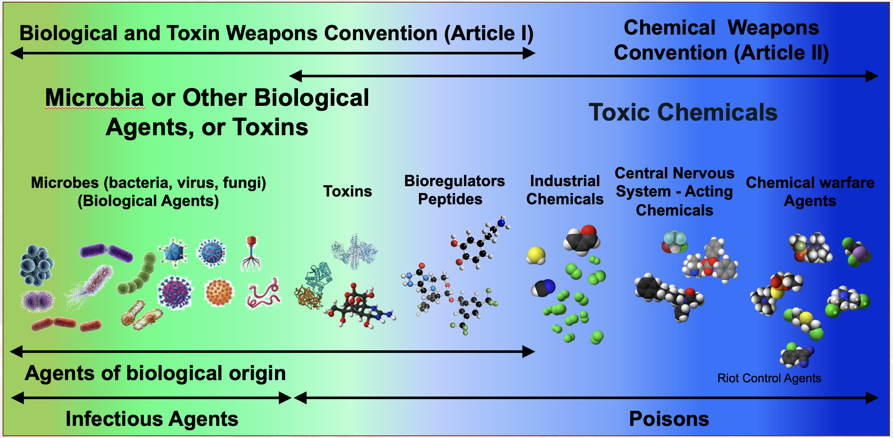
The CBW spectrum

Slide 5
The legal context - the international dimension
 | UNSGM | BWC | CWC | Other mechanisms
Legal authority to investigate | The UNSG has authority to investigate reports by States about alleged CBT weapons uses | No investigation mechanism, but consultative procedures: Article V, referral to UNSC | Investigation of alleged CW use under either Art. X or X; support for UNSGM; IIT | Syria CW investigation: JIM (no longer in existence ) CoI Syria, IIIM (WHO, WOAH, FAO)
Mandate(s) / scope of investigation | Establish whether CBT weapons have been used | None UNSC may request the SG to conduct an investigation | Establish whether CW have been used and what the circumstances were | Depending on the body establishing the mechanism and on the context
Attribution of responsibility | Report information that may help establishing the origin of the weapons used, if possible | Depends on mandate given by the UNSC, if any | Report any information that may help establishing the origin of the weapons used IIT: identify individuals and entities responsible for use of CW confirmed by FFM | JIM: essentially the same as IIT CoI-SAR/IIIM: identify those responsible for serious violations of human rights law (includes use of prohibited weapons)

Slide 6
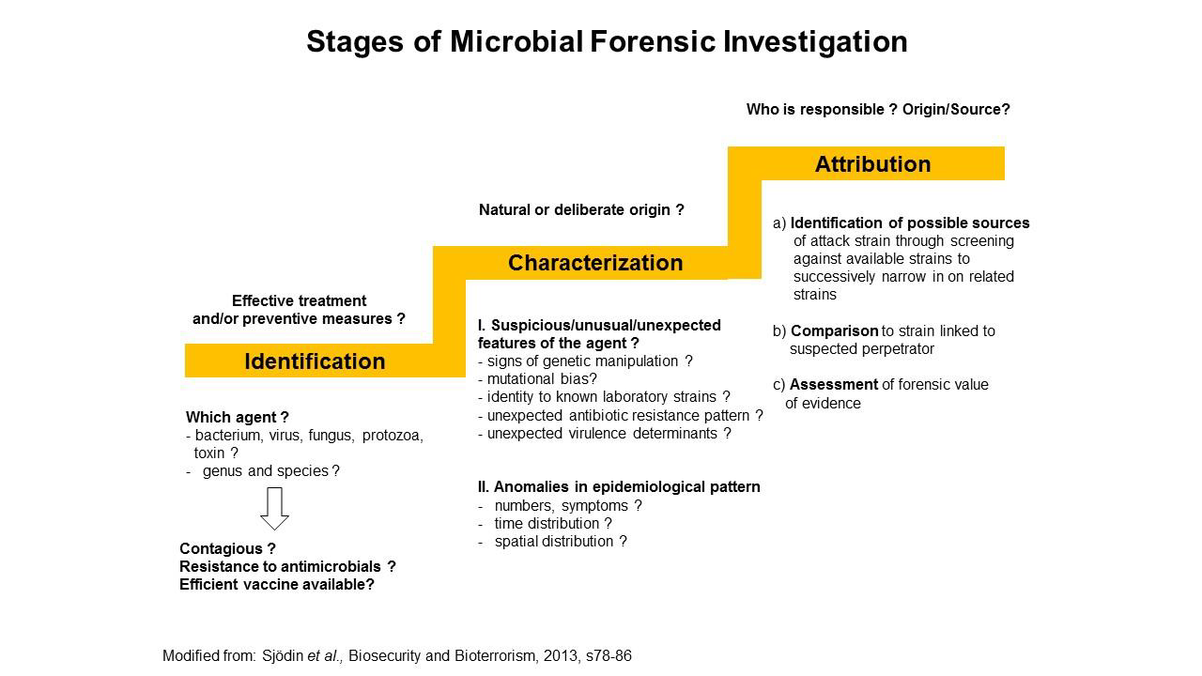
The role of chemical/microbial forensics in an investigation - example BW investigation

Slide 7
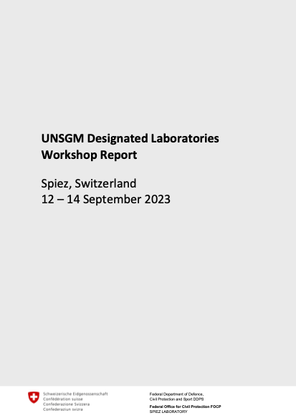
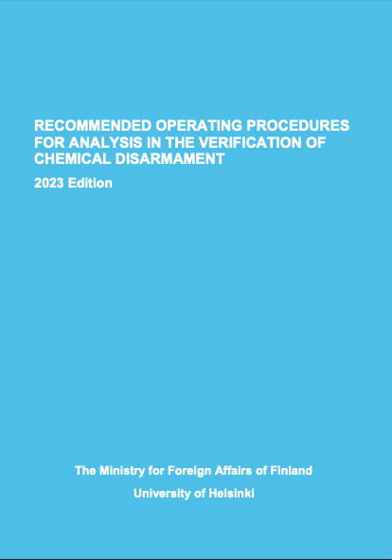
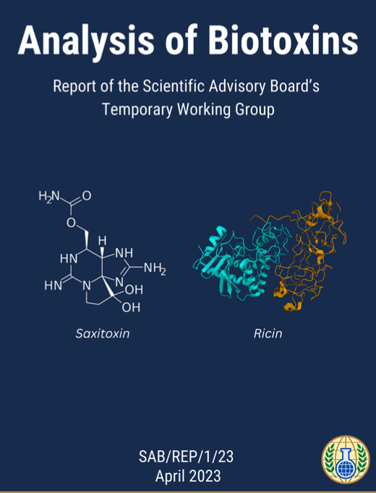
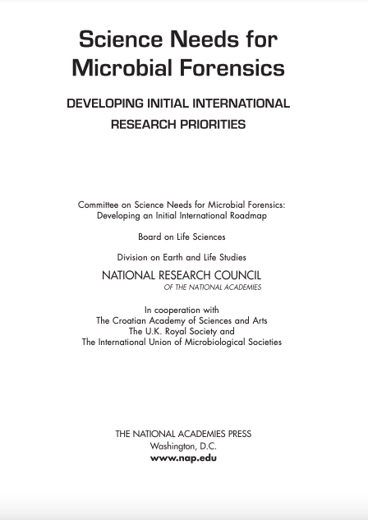
State of the Art - where to look (examples)

Slide 8
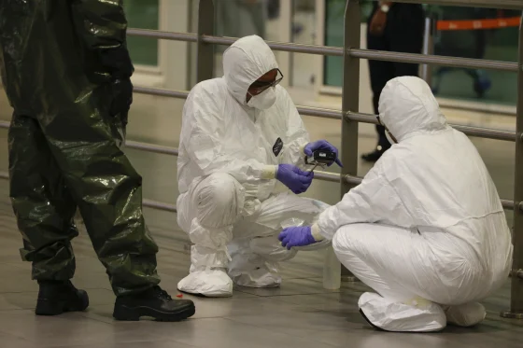
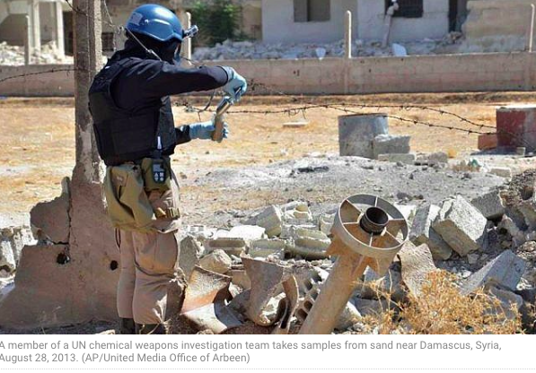
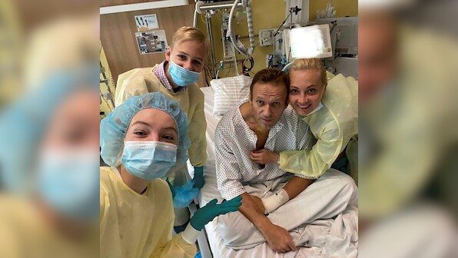
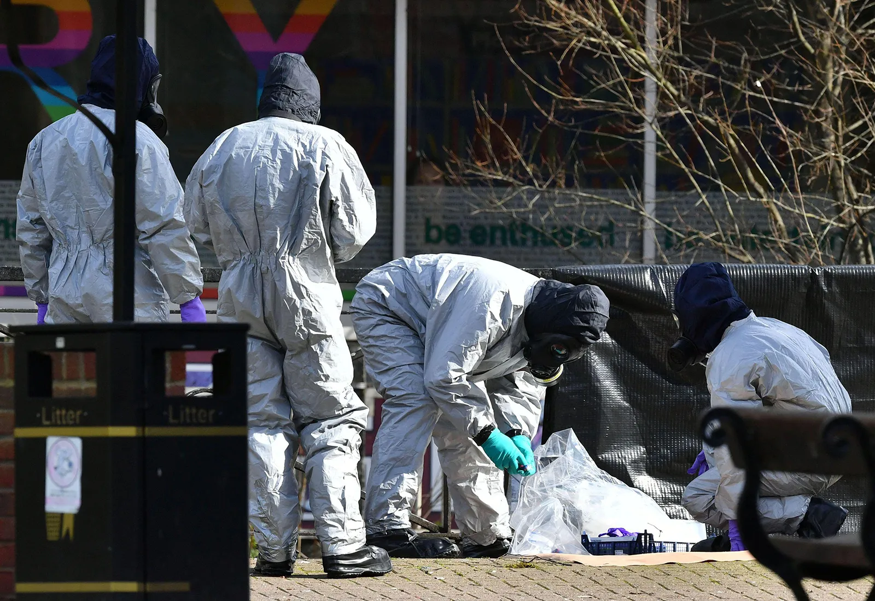
Examples of recent CW use investigations (JIM/OPCW)
“Binary” VX
CF6
“Novichoks”

Slide 9
Chemical attribution analysis:
1. Matching samples of know and unknown origin
Chemical profiling:
A select set of chemical constituents and their relative analytical signals (or amounts) that may differentiate samples from different sources or origins.
If the chemical profile of the unknown sample is similar or statistically identical to the chemical profile of a specific reference sample(s), then the unknown sample and reference sample(s) might share the same origin.
Samples connected through a plausible shared origin may help investigators locate and attribute a chemical weapon to a perpetrator
Carlos G Vargas: Chemical attribution - sample matching; VERIFIN Blue Book (2023) Section 5 Chapter I

Slide 10
2. Attributing the route of manufacture
Identifying and interpreting chemical signatures:
Determination of chemical signatures can provide information about the synthetic route of an agent found an incident scene. It may:
  Provide information on how a CWA was produced
  What starting materials were used
  Indicate the technical competence of the producer and/or the sophistication of equipment used
Basis: presence of route specific chemical profiles in samples (impurities arising from starting material, solvents etc., and by-products formed during the synthesis steps)
Crister Åstot, Karin Höjer Holmgren, Rikard Norlin: Chemical attribution - route attribution. VERIFIN Blue Book (2023) Section 5 Chapter II

Slide 11
3. Sourcing specific batches or raw material sources
Isotope analysis:
Site specific isotope abundance data can be used for attribution of CWAs to match isotopic content between different samples
The natural abundance of isotopes varies in molecules depending on their origin. This variation can be measured by NMR at individual positions of a molecule and the variation forms an isotopic fingerprint which is often unique for batches of organic chemicals
Position-specific isotope analysis has been shown to be capable of sourcing specific batches of starting materials from the analysis of CWA, or even from the analysis of degradation products or by products
Rikard Norlin: Chemical attribution - position specific isotope analysis. VERIFIN Blue Book (2023) Section 5 Chapter III

Slide 12
4. Data analysis
Chemometrics for chemical attribution is still under development; therefore, even though several experimental studies have already been published, extensive methodological studies of the data analysis workflows are quite sparse.
Grégoire Delaporte: Chemometrics. VERIFIN Blue Book (2023) Section 5 Chapter IV

Slide 13
Microbiological attribution analysis
There is no OPBW
Work is done in the context of the UNSGM, including amongst others:
  UNSGM designated laboratories workshops at Spiez Laboratory (platform for information sharing and planning)
  External quality assurance exercises (RefBio by Germany, dry-lab exercises organised by Denmark, Sweden and Germany and financially supported by the US, “Disease X” and “Future pandemic testing” by China)
  Harmonization of toxin analysis between OPCW and UNSGM
  Sampling guidance (collection, packaging, shipment, interaction with lab) associated with training (Canada)
  Training and field exercises (general and specialized training for roster experts; Capstone exercise 2023 in Germany)
  Development of templates (lab reporting, technical arrangements between labs and UN)

Slide 14
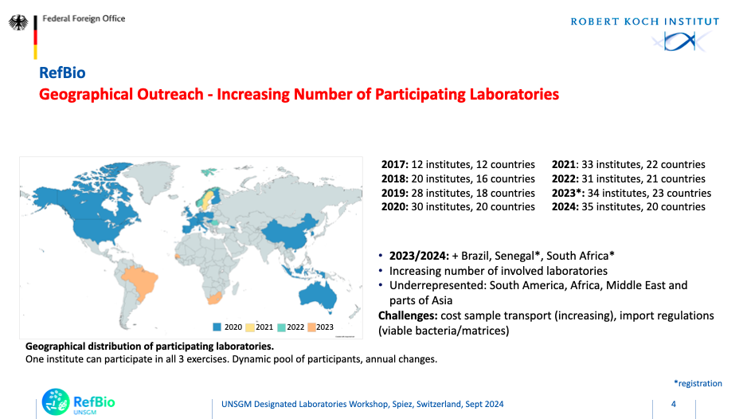
Example RefBio
- Implemented by RKI
started 2017
- Funding extended
until 2026
- EQAE in analysis of
viruses, bacteria and
toxins
- Increasing levels
of difficulty:
species, strain/clade,
presence of markers
for genetic
modifications, …

Slide 15
Microbial forensics: some key points
Gold standard: isolation, cultivation and characterisation of the agent - often not possible in forensic investigations
DNA sequencing: NGS is a powerful tool but by itself not sufficient, and sometimes misleading (capability vs. actual functionality)
Attribution typically relies on a combination of multiple types on evidence
  Use of multiple orthogonal analytical methods - no “silver bullet"
  Epidemiology, medical and clinical data, autopsies, lab results (transcriptomics, genetics, isotopic analysis)
  Classical forensics
Some challenges for labs: agreed acceptance criteria; ROPs / accreditation, curated reference DB and standards; chain of custody compliance; reporting

Slide 16
Outlook
Chemical and microbial forensics are relatively new fields and are still evolving
Challenges exist in terms of, amongst others, scientific knowledge, validated methods, reference data and standards, and tools for data analysis and results interpretation
International cooperation is needed to take the fields forward and create confidence in the results
Funding of the necessary research remains a challenge

Slide 17
Thank you for your attention!
CBWNet
Working together to strengthen
the norms against chemical and biological weapons.

