Slide 1


International Cooperation is Key: countering nuclear and radiological terrorism through prevention and preparedness
1

Slide 2
Global Material Security (GMS)
Our Vision: A world in which nuclear and radioactive materials are secure and used only for peaceful purposes
Our Mission: Enhance global security by working with partners worldwide to secure and prevent the smuggling of nuclear and radioactive materials and promote the development of secure nuclear technologies.
2

Slide 3

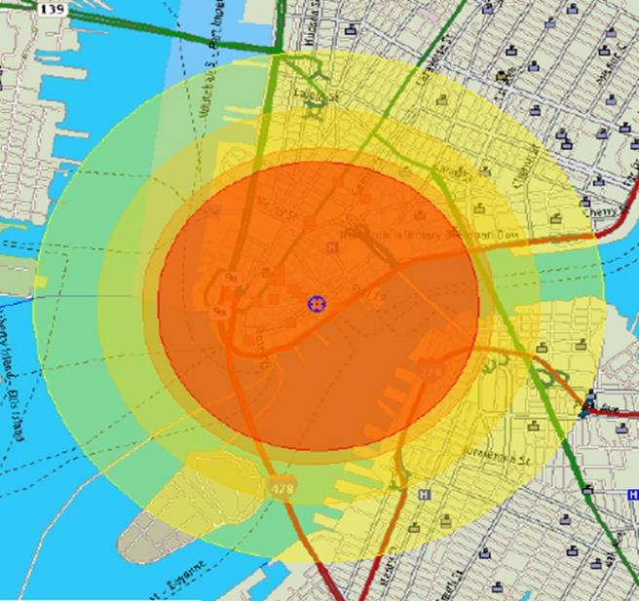
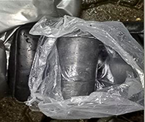
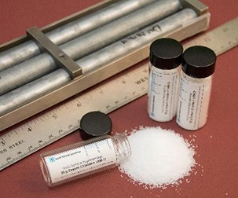
Nuclear and radiological materials have been intercepted around the world
“The consequences of any event would be significant”
3

Slide 4
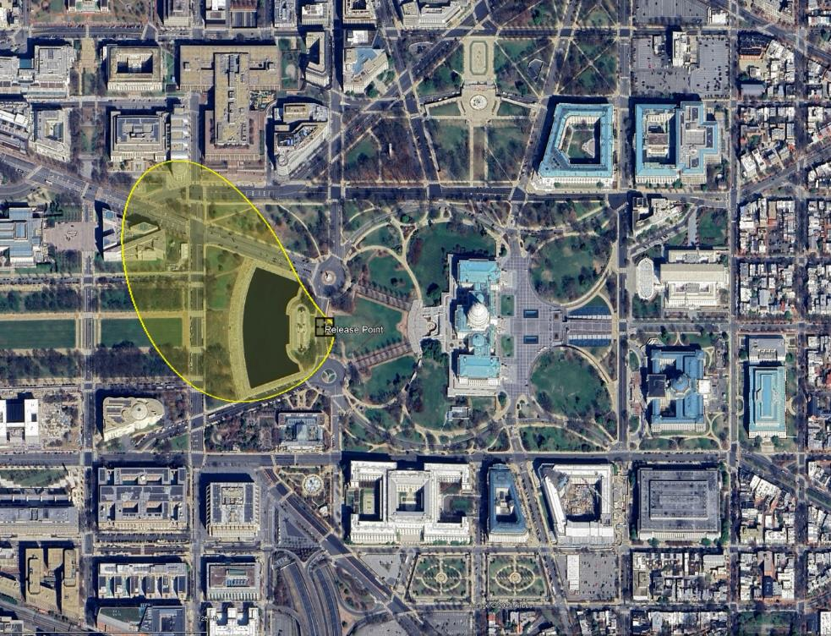
Cesium-137 Blood Irradiator Scenario
Source: One Cesium irradiator source, 37 TBq (1,000 Ci)
  Found in hospital blood irradiators; there are typically 3 in the device
Explosive: 18 kg TNT
  Commercially available, weight can be carried by one person
Yellow field: Recommended relocation of public in first year
Red circle: Recommended evacuation area for suicide bomber
4

Slide 5

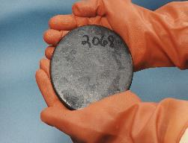
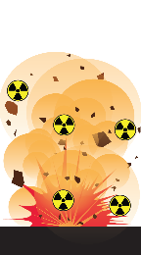
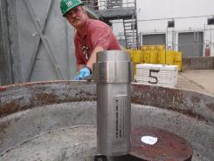

Materials and Weapons of Concern
Materials of Concern
Weapons of Concern
Improvised Nuclear Device
(IND)
Special Nuclear Material
Used in nuclear weapons
Highly Enriched Uranium
Plutonium
.
Radiological Dispersal Device (RDD)
Radiological Material
Primarily used in medical and industrial devices
Americium-241
Cesium-137
Cobalt-60
Iridium-192
Radiological Exposure Device (RED)
5

Slide 6
The Evolving Radiological and Nuclear Landscape
More than 20 countries possess weapons-usable nuclear materials and over 100 nations hold radioactive materials for diverse applications, including medical and industrial uses.
Security threats and risks include:
Non-State Actors
State Actors
Destabilized International Regimes, Standards, and Norms
Emerging and Disruptive Technologies
6

Slide 7
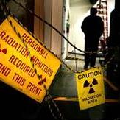

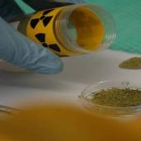
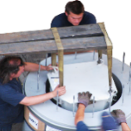
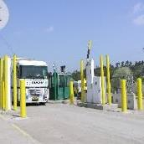

The GMS Strategy
REDUCE the use of attractive radioactive material and replace with non-radioisotopic alternative technologies
PROTECT facilities with nuclear and radioactive materials
INVESTIGATE nuclear
and radioactive material seizures to analyze signatures and attempt attribution
REMOVE orphan and disused radioactive sources to prevent proliferation
DETECT and INTERDICT radiological/ nuclear smuggling
INNOVATE security solutions to meet today’s landscape
7

Slide 8



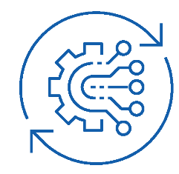
GMS Capacity-Building Approach
GMS provides partners with the knowledge and expertise necessary to establish effective, sustainable nuclear security capabilities.
Provide bilateral technical
expertise, security systems,
and experience
Tailor our partnering
approach to address specific
partner security gaps
Strengthen
international guidelines
and frameworks
Maintain engagement
to promote sustainability and
continue U.S. influence
8

Slide 9
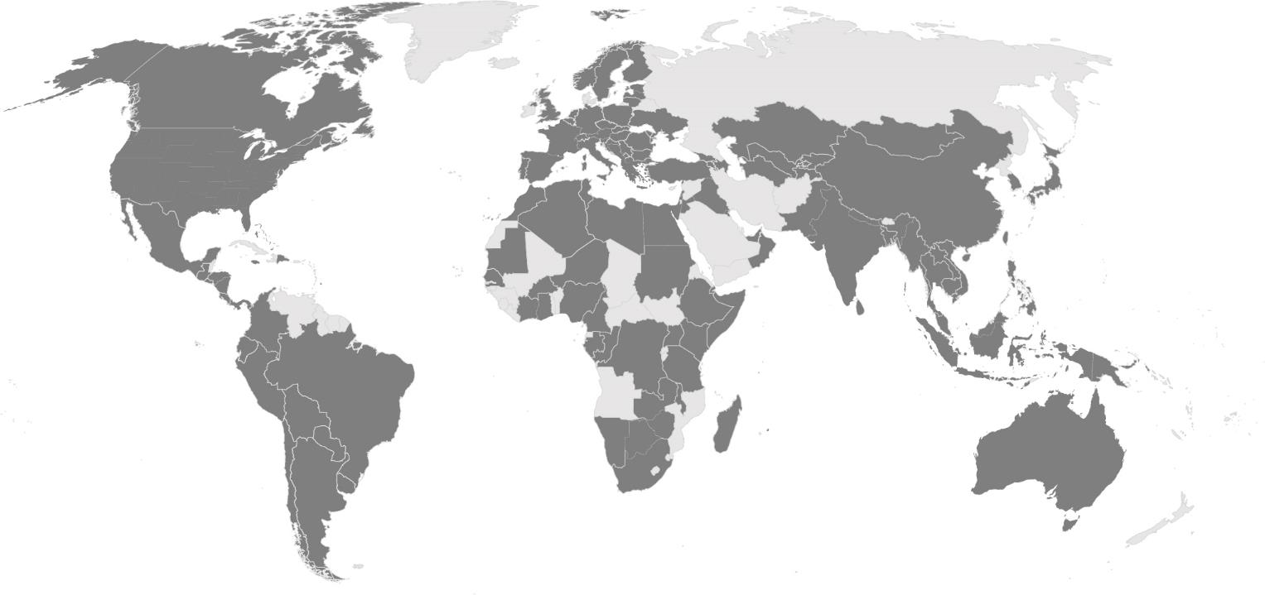
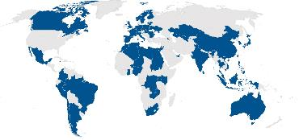
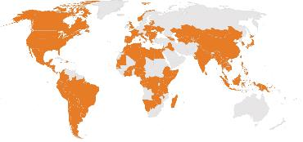
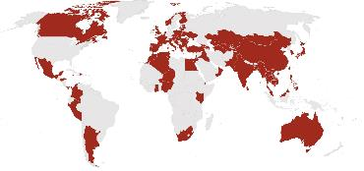
GMS works in the U.S. and with over 100 nations around the world
International Nuclear Security
Office of Radiological Security
Nuclear Smuggling Detection
and Deterrence
9

Slide 10











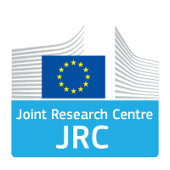


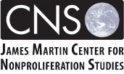









GMS partners with organizations inside and outside the U.S.
Interagency Partners
Department of
Energy National Laboratories
International
Organizations
Academic and
Non-Governmental Organizations
Global Partnership
10

Slide 11
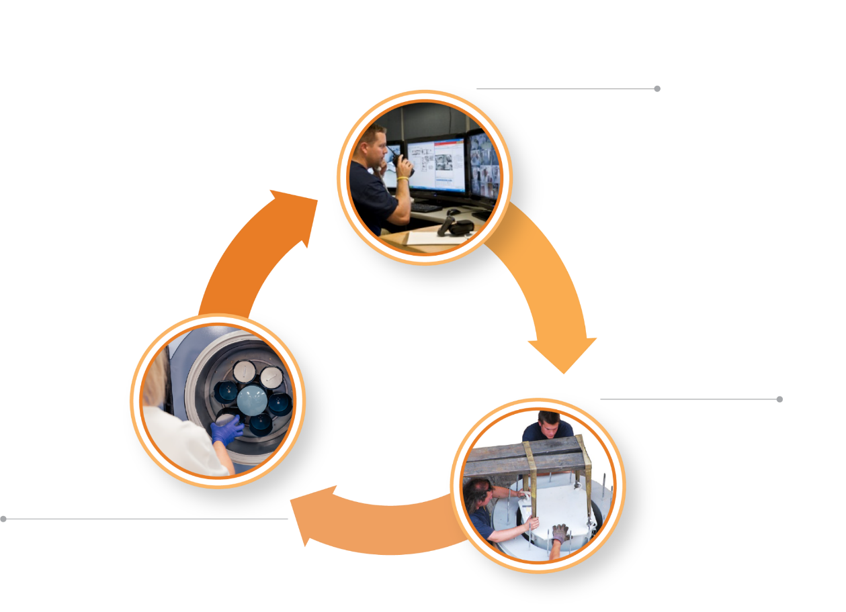
Office of Radiological Security (ORS)
Prevent high-activity radioactive materials from being used in acts of terrorism.
Protect high-activity
radioactive sources
Reduce reliance
on high-activity
sources by
encouraging
the adoption and
development of
non-radioisotopic alternative technologies
Remove and
dispose of disused
radioactive sources
11

Slide 12

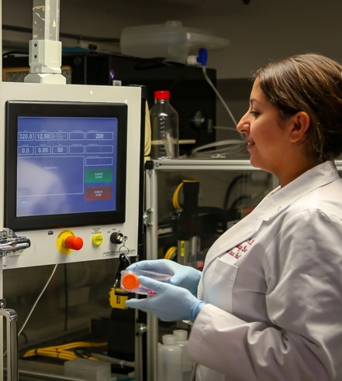
Why Consider Alternatives?
Benefits
Permanent radiological risk reduction
No security or radioactive waste management costs
Decreased regulatory requirements and liability
Consistently fast patient treatment and product throughput
Often state-of-the-art and the preferred technology for their applications
Equipment upgrades available
‘Versatile and safer than radioactive sources because the energy can be varied, and when the accelerator is turned off, so is the radiation.’ – IAEA
12
12

Slide 13
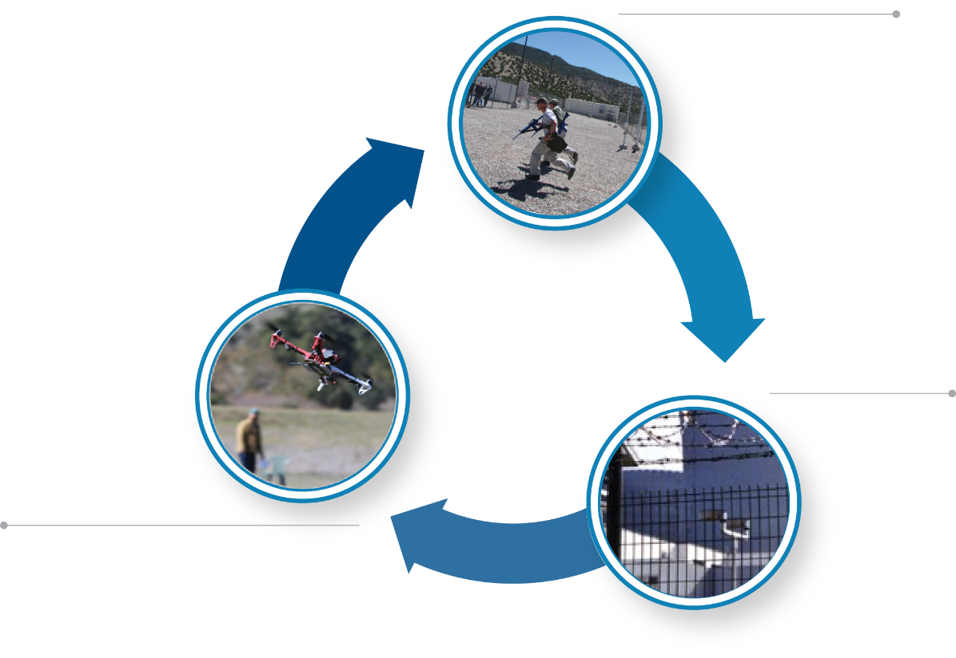
Office of International Nuclear Security (INS)
Prevent theft and sabotage of nuclear materials and facilities worldwide.
Build enduring technical partnerships
Promote strong norms
and standards
Support the
development of skilled
nuclear security
workforces
Provide site level
risk reduction
Raise awareness of
emerging threats
13

Slide 14
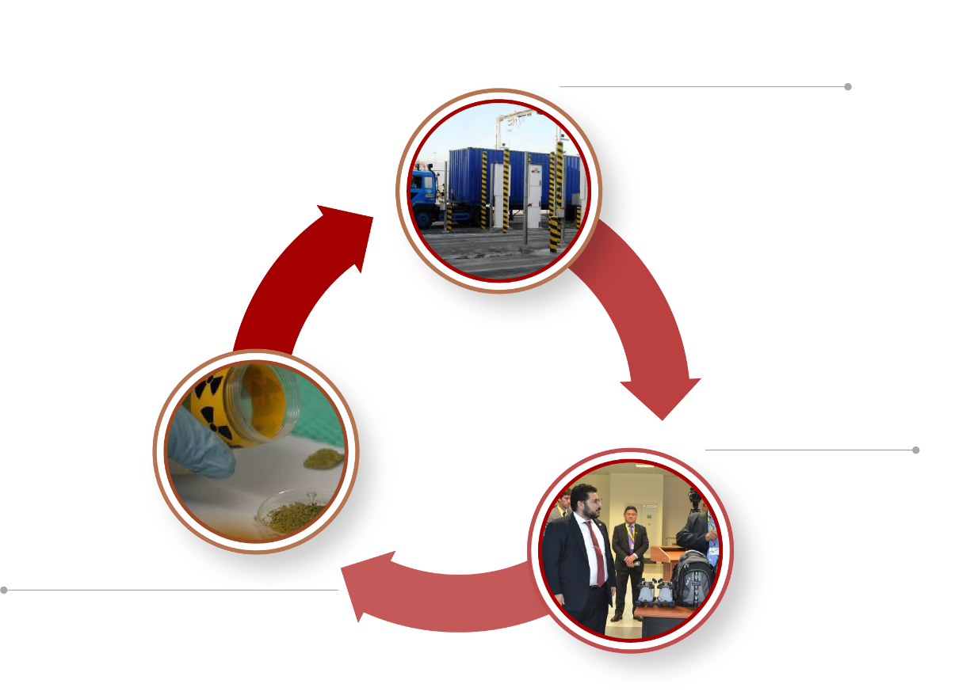
Office of Nuclear Smuggling Detection & Deterrence
Build global capability to detect, disrupt, and investigate the smuggling of nuclear and radioactive material before it can be used in an act of terrorism.
Deploy sustainable, layered defenses to defeat nuclear smuggling networks
Borders
Interiors
Aviation routes
Maritime routes
Build technical
capabilities to
investigate and prosecute nuclear smuggling incidents
Link intelligence, law enforcement, and technology for sustained detection operations
14

Slide 15






GMS Accomplishments
Replaced 386 U.S. irradiators and 71 irradiators worldwide with alternative technologies
On track to meet the Congressional goal to eliminate all U.S. cesium blood irradiators by end of 2027.
Implemented nuclear security upgrades in Ukraine, Belarus, South Africa, Jordan, Morocco, and Armenia
Enhanced security at >2,450 buildings containing radioactive material
Completed >1,200 trainings, workshops, and exercises to build counter nuclear smuggling capabilities
Detected dozens of materials outside of regulatory control
Removed >100,000 disused or unwanted radioactive sources in the U.S. and worldwide
Deployed 935 detection systems and partnered with 88 countries
Met the FY22 target of 76% of partner agencies with operational detection capabilities
Adapting to address
changing technologies
  Drones
  AI-enabled security technologies
  Advanced/Small Modular Reactors
15

Slide 16
Questions?
16

