Slide 1

Critical Moments, Critical Decisions:
5W 1H of Evacuation in CBRN Response
Dr. Veda Duman Kantarcıoğlu

Slide 2
April 29, 2001 - 77,000 people evacuated in Vicenza, Italy.
September 11, 2001 - 500,000+ evacuated in New York City during the World Trade Center disaster.
January 2002 - 300,000 evacuated in Goma, Democratic Republic of the Congo.
August 2002 - 200,000 evacuated in Czech Republic, 120,000 in Dresden, 36,000 in Saxony-Anhalt, and 1,500 in Hungary due to European floods.
September 2004 - Over 2.8 million evacuated in Florida for Hurricane Frances.
July 2005 - 20,000 evacuated in Birmingham, UK, due to a bomb scare.
August 2005 - 80% of 484,000 residents evacuated in New Orleans for Hurricane Katrina.
September 22, 2005 - 2.5 million evacuated in Texas and Louisiana for Hurricane Rita.
July-August 2006 - 15,000 American citizens evacuated from Lebanon.
October 2007 - 1.4 million evacuated in China for Typhoon Krosa.
October 2007 - 900,000 evacuated in Southern California due to wildfires.
May 2008 - 200,000 evacuated in Beichuan County, China, after the Sichuan earthquake.
August 2008 - 1.9 million evacuated in Louisiana and 300,000 in Cuba for Hurricane Gustav.
March 2011 - 170,000-200,000 evacuated in Fukushima, Japan, due to the nuclear disaster.
August 2011 - Mass evacuation from North Carolina to New York for Hurricane Irene.
June 2013 - 1,000,000 evacuated in Uttarakhand, India, due to floods and landslides.
October 2013 - Nearly 1,000,000 evacuated in Odisha and Andhra Pradesh, India, for Cyclone Phailin.
December 2014 - 1,000,000 evacuated in the Philippines for Typhoon Hagupit.
April 2015 - Evacuation during Operation Maitri in Nepal.
April 2015 - 4,640 Indians and 960 foreigners evacuated from Yemen during Operation Raahat.
May 2016 - 88,000 evacuated in Fort McMurray, Canada, due to wildfires.
October 2016 - 2.5 million evacuated in Florida, Georgia, and South Carolina for Hurricane Matthew.
February 2017 - 188,000 evacuated near Oroville Dam, California.
July-September 2017 - 35,616 evacuated in British Columbia, Canada, during wildfires.
September 2017 - 700,000 evacuated from Florida, Georgia, and South Carolina for Hurricane Irma.
October 26-27, 2019 - 185,000 evacuated in Sonoma County, California, for the Kincade Fire.
September 2021 - 7,000 evacuated in La Palma, Spain, due to the Cumbre Vieja volcanic eruption.
2022 - Millions evacuated from Ukraine due to the Russian invasion.
2023 - 25,900 evacuated in Northwest Territories, Canada, due to wildfires.
2023 - Evacuation of the northern Gaza Strip.
October 23-24, 2024 - Over 1.1 million evacuated in Bangladesh and India for Cyclone Dana.
21th century
Mass Evacuations

Slide 3
Introduction
Effective and timely decision-making during CBRN incidents is crucial to save lives and minimize impact.
Evacuation is essential to relocate affected individuals to safe areas, prevent spread, and safeguard public health.
The '5W 1H' method can be applied in evacuation planning processes for CBRN incidents.
Who
What
Where
Why
When
How

Slide 4
Mass Evacuation is Necessary in CBRN Incidents
Because of…
High Fatality Risks
Widespread Contamination
Rapid Health System Overload
Panic and Chaos Amplifies Damage
Economic and Environmental Costs
Long-Term Risks

Slide 5
Importance of Mass Evacuation
Saving
Saving Lives
Protects people from immediate threats like radiation, toxins, or biological agents.
Reducing
Reducing Secondary Risks
Prevents contamination spread and further harm to others.
Relieving
Relieving Pressure on Healthcare
Ensures organized access to medical care, avoiding system overload.
Preventing
Preventing Panic and Chaos
Coordinated evacuation minimizes disorder and ensures public safety.
Mitigating
Mitigating Long-Term Health Risks
Reduces exposure to hazardous materials, limiting future health issues.
Protecting
Protecting Critical Infrastructure
Allows better response by safeguarding affected areas.
Boosting
Boosting Public Trust and Morale
Effective evacuations foster trust in authorities and maintain societal order.

Slide 6
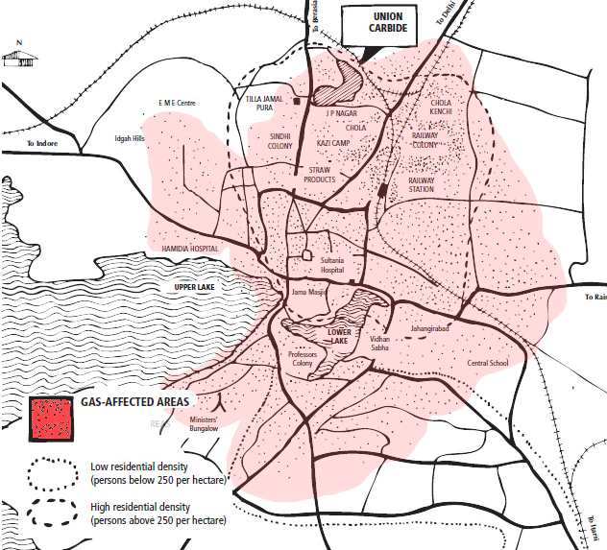
Bhopal Accident
The gas that spewed out of the hi-tech factory of the multinational Union Carbide spread over some 40 sq km and affected people seriously as distant as five km to eight km downwind. For nearly 200,000 people, a quarter of the city’s population, Bhopal became a gas chamber.
Estimates of the death toll vary from as few as 3,800 to as many as 16,000, but government figures now refer to an estimate of 15,000 killed over the years.

Slide 7
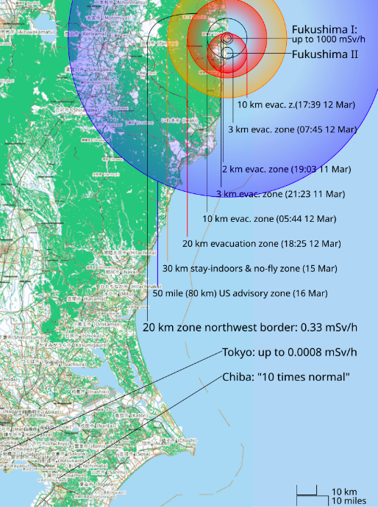
Fukushima NPP accident

Slide 8
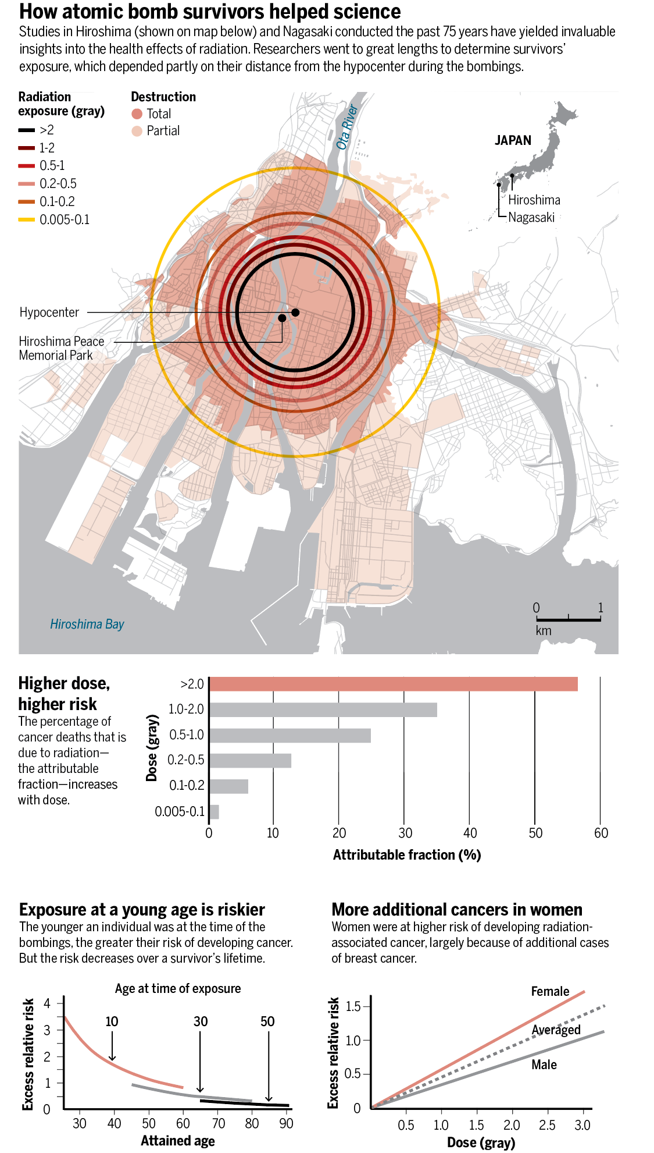
What did it look like in the Hiroshima
Source for images: https://www.science.org/content/blog-post/mapping-hiroshima-s-legacy

Slide 9
Challenges of Mass Evacuation during CBRN incidents
Rapid Threat Assessment: CBRN threats are often difficult to detect and identify quickly, complicating timely evacuation decisions.
Public Awareness and Response: Panic and lack of training can lead to chaos, hindering an effective evacuation.
Protection and Decontamination: Lack of proper protective equipment and decontamination methods increases exposure risks.
Transportation and Logistics: Overloaded and contaminated transportation systems make it difficult to evacuate large populations safely.
Coordination Between Agencies: Inadequate coordination between agencies can slow down the evacuation process.

Slide 10
Challenges of Mass Evacuation during CBRN incidents
Sheltering and Medical Care: Providing sufficient shelter, healthcare, and basic needs for evacuees is a major logistical challenge.
Vulnerable Populations: Special needs of vulnerable groups (e.g., elderly, disabled, children) add complexity to the evacuation.
Sustainability of Evacuation: Long-term evacuations require effective resource management and safe relocation options.
Psychological Impact: CBRN events can cause significant psychological stress, affecting public cooperation and response.
Legal and Ethical Issues: Mandatory evacuations and liability concerns raise legal and ethical challenges during a CBRN event.

Slide 11
Key Lessons Learned
Preparedness: Pre-design evacuation plans for high-risk areas.
Coordination: Multi-agency collaboration to ensure resource availability.
Communication: Clear, transparent messaging to maintain public trust.
Training: Regular drills for emergency responders and public education campaigns.

Slide 12
The 5W 1H Method
The 5W 1H method is widely used in critical decision-making processes:
- Who: Who needs to be evacuated?
- What: What measures should be taken?
- Where: Where will the evacuation take place?
- When: When should the evacuation start?
- Why: Why are these measures chosen?
- How: How should the evacuation be executed?

Slide 13
Who: Who Needs to Be Evacuated?
Affected Individuals: Especially vulnerable groups (elderly, children, pregnant women, patients).
Emergency Response Teams: Health, safety, and CBRN specialists on site.
Sensitive Facilities: Schools, hospitals, and care centers.

Slide 14
What: What Measures Should Be Taken?
Safety Measures: Protective clothing, masks, and decontamination steps.
Public Information: Informing the public about evacuation procedures.
Equipment: Radiation detectors, gas masks, sterilization kits,etc.

Slide 15
Where: Where Will the Evacuation Take Place?
Assembly Areas: Identify safe evacuation zones.
Contamination Zones: Map areas with high hazard levels.
Safe Routes: Determine and inspect evacuation routes.

Slide 16
When: When Should the Evacuation Start?
Early Intervention: Make evacuation decisions swiftly in the initial phase.
Severity Assessment: Evaluate the spread and impact of the CBRN event.
Warning Systems: Utilize rapid alarm systems.

Slide 17
Why: Why Are These Measures Chosen?
Life Safety: Protect people from life-threatening risks.
Contamination Prevention: Prevent the spread of contaminants.
Public Safety: Ensure general public health and safety.

Slide 18
How: How Should the Evacuation Be Executed?
Coordination: Collaborate with health teams, emergency responders, and local authorities.
Evacuation Routes: Ensure route safety and traffic control.
Post-Evacuation Support: Provide psychological and health screenings.

Slide 19
Mass Evacuation Planning and Response
Planning and Risk Assessment
Evacuation Routes and Traffic Management
Public Communication Systems
Transportation Coordination
Shelter and Temporary Housing
Evacuation Prioritization
Mobile and Static Command Centers
Public Order and Crowd Control
Technology and Data Management
Coordination with Neighboring Regions
Post-Evacuation Support
Recovery

Slide 20
Evacuation Time Estimation Methodology By
USNRC & IAEA
Key Factors
Permanent, transient, special populations
Road networks, nodes, congestion points
Mass transit, persons without vehicles
Preparation and assembly time estimates
Adverse behaviors
Adverse weather and special events
Physical barriers
*Source: Evacuation Time Estimates Richard Emch, Adstm, USNRC,2014

Slide 21
Evacuation Time Estimation Methodology By
USNRC & IAEA
Analysis
Demand Estimation
  Estimate the number of people to be evacuated
  Estimate the number of vehicles during evacuation
  Include all persons located within EPZ
  Permanent residents
  Seasonal population
  Transient population
  Special facilities population
Traffic Capacity
  Road capacity may be impacted by
    Obstructions in flow (road repair, accidents)
    Adverse weather
    Roadway design (intersections, on-ramps, lane width, pavement)
    Driver behavior
  Build models build to simulate traffic behavior, validate through field surveys
  Include only the evacuation routes
*Source: Evacuation Time Estimates Richard Emch, Adstm, USNRC,2014

Slide 22
Evacuation Time Estimation Methodology By
USNRC & IAEA
Analysis
Trip Generation Time
  Total time required by individual or family to prepare for evacuation
  Can be obtained through surveys
  Assumptions or generalized data are also acceptable, but basis must be provided
  Can assume sequential events or distribution functions
  Identify sensitive parameters/conditions of large impact on the trip generation time
Evacuation Scenarios
  Normal/adverse weather
  Various seasons (winter / summer)
  Time of the day
  Day of the week
  Special events
  Various evacuation sectors (by wind direction)
*Source: Evacuation Time Estimates Richard Emch, Adstm, USNRC,2014

Slide 23
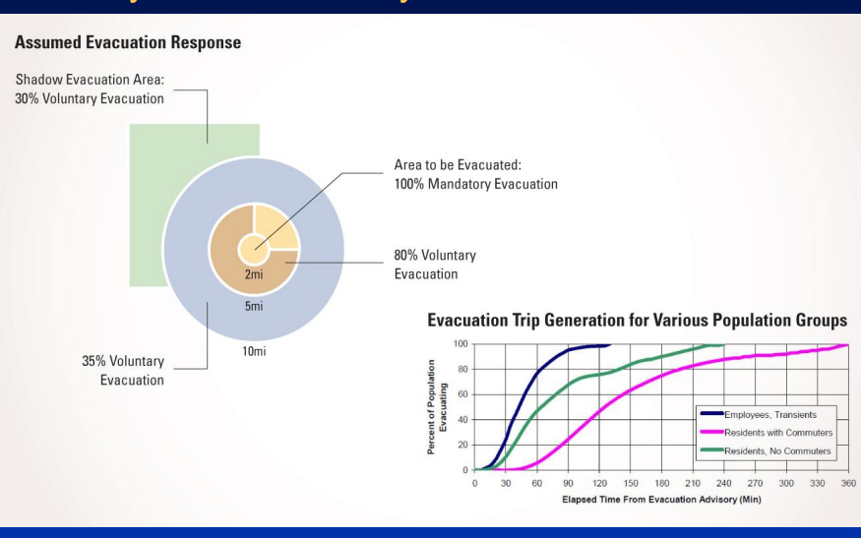
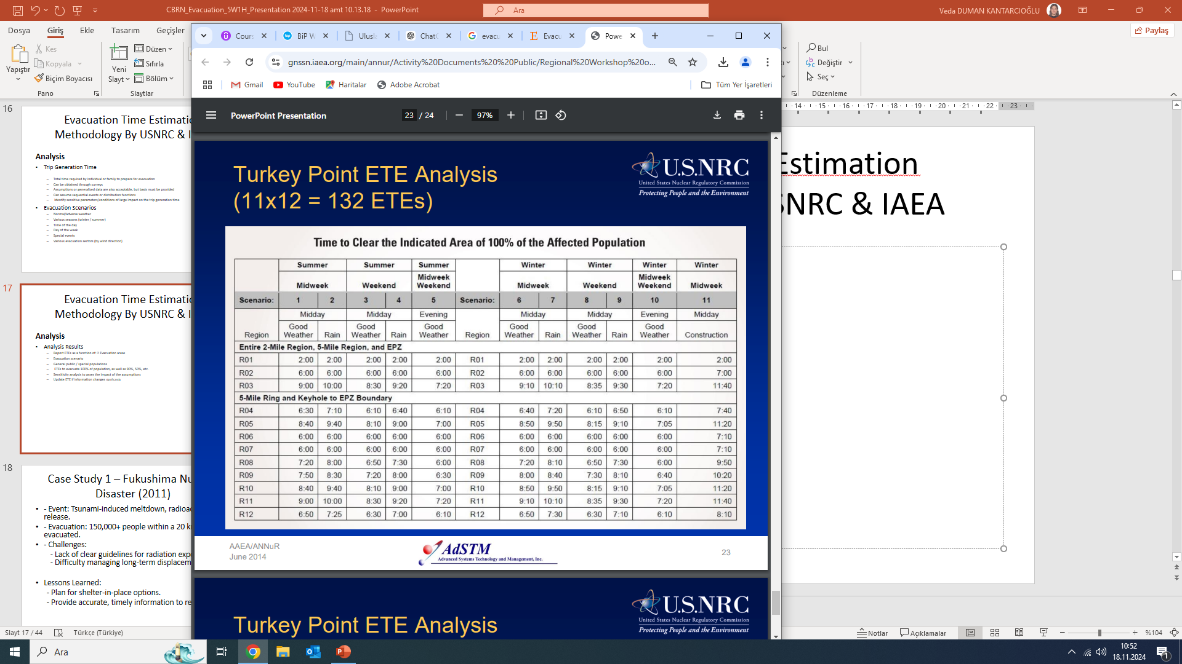
Evacuation Time Estimation Methodology By USNRC & IAEA
Analysis Results
Report ETEs as a function of:
  Evacuation areas
  Evacuation scenario
  General public / special populations
  ETEs to evacuate 100% of population, as well as 90%, 50%, etc.
Sensitivity analysis to assess the impact of the assumptions
Update ETE if information changes significantly
*Source: Evacuation Time Estimates Richard Emch, Adstm, USNRC,2014

Slide 24
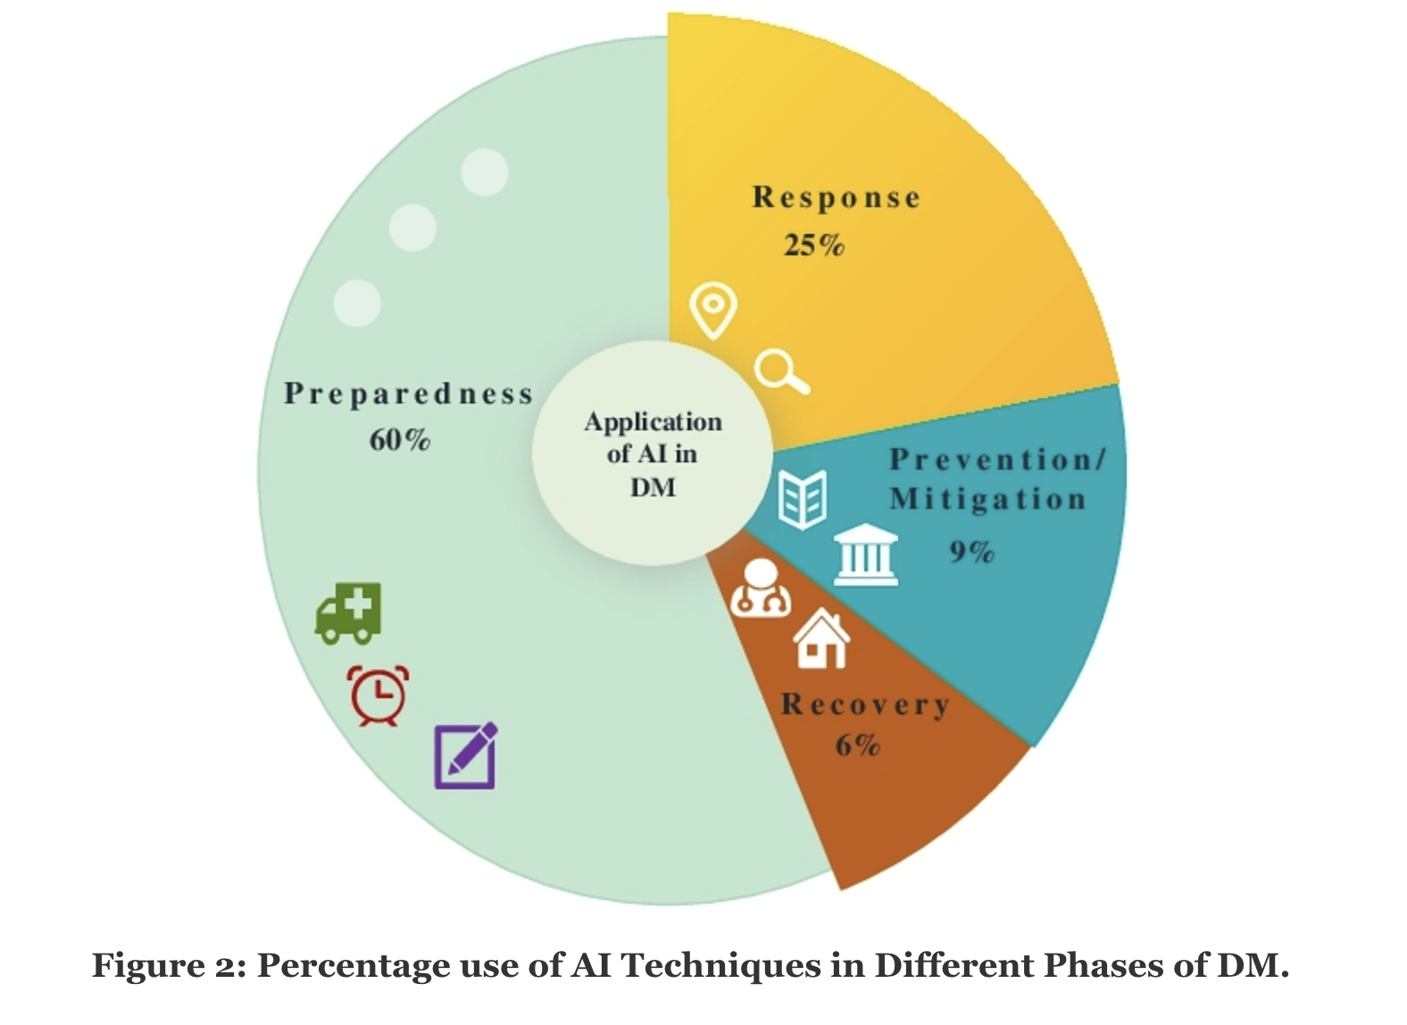
Artificial intelligence use for DM
*https://dl.acm.org/doi/fullHtml/10.1145/3669754.3669802

Slide 25
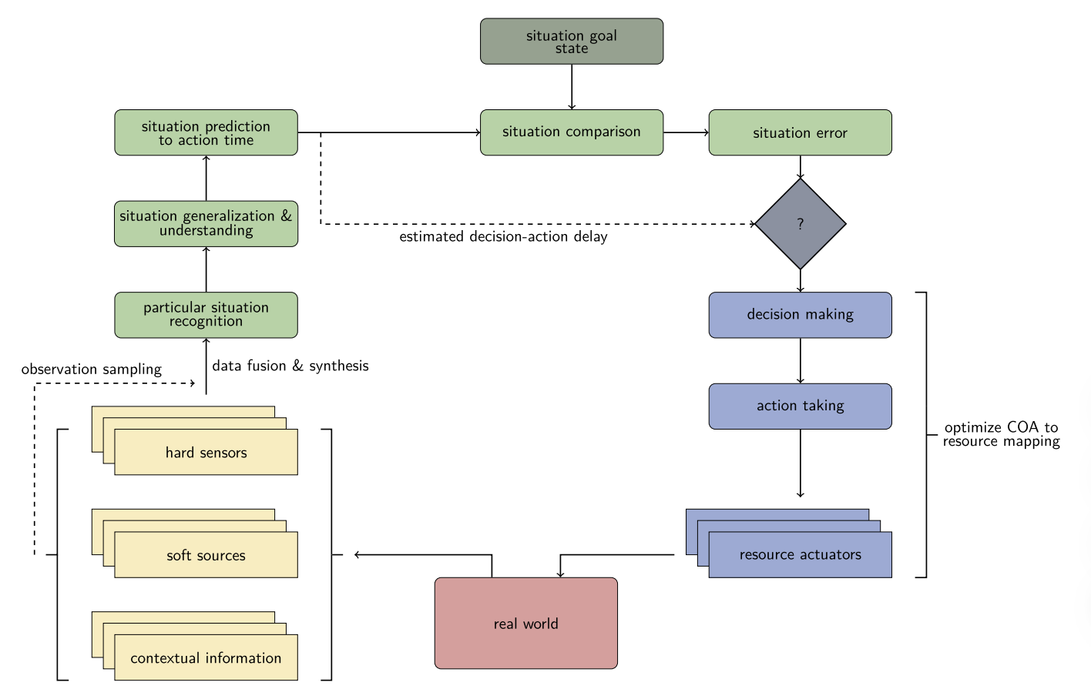
Decision Support Systems & Artificial intelligence for mass evacuation
Cognitive situation control*
AI-powered decision support systems offer invaluable assistance in making critical choices during disaster response.
These systems use machine learning algorithms to process data, predict future developments, and recommend optimal strategies for relief and recovery.
By considering a wide range of factors, including population density, infrastructure damage, and resource availability, AI-driven decision support systems empower disaster response teams to make informed and efficient decisions.
This not only saves lives but also helps maximize the impact of humanitarian aid efforts, ultimately improving the outcomes for affected communities.
The chart represents a process flow of getting observation samples from sensors and further information sources, recognizing the current situation, identifying the most similar known situation, and finding the optimal actions to reach the goal state in a continuous repeating cycle
*Machine learning -based decision support framework for CBRN protection (Tamás Kegyes, Zoltán Süle, János Abonyi,2014)

Slide 26
Mass evacuation efforts become smarter, faster, and more adaptive to changing circumstances
Predictive Hazard Modeling
Enhanced Decision Support Systems
Public Communication
  AI algorithms can analyze vast datasets (e.g., weather patterns, seismic activity, or chemical dispersion) to predict hazard progression.
  Machine learning models improve over time, making predictions more accurate for identifying at-risk areas.
  AI processes complex scenarios and recommends the most efficient evacuation strategies.
  It can simulate thousands of possible outcomes in seconds, allowing decision-makers to choose the best course of action under pressure.
  AI chatbots and virtual assistants provide real-time updates, safety instructions, and personalized evacuation guidance to the public through mobile apps and social media.
  Sentiment analysis on social media helps authorities identify and address public concerns promptly.
Real-Time Route Optimization
Dynamic Resource Allocation
Surveillance and Monitoring
  AI-driven navigation systems calculate and continuously update optimal evacuation routes based on live traffic, environmental changes, and road conditions.
  Autonomous vehicles or drones guided by AI can assist in clearing paths or transporting supplies.
  AI-powered tools optimize the allocation of critical resources (vehicles, shelters, medical supplies) by analyzing demand and supply in real time.
  Autonomous robots can assist in deploying these resources more efficiently.
  AI processes data from drones, cameras, and IoT devices to monitor the evacuation zone, detect bottlenecks, or identify individuals needing assistance.
  AI also analyzes patterns to predict crowd movements and mitigate risks such as stampedes or congestion.

Slide 27
Conclusion
Natural disasters and CBRN threats require similar evacuation processes.
CBRN incidents are complex but manageable with proper preparation.
Learning from real-world cases is essential for enhancing safety.
Effective evacuation plans save lives and reduce long-term impacts.
Effective early warning systems and swift response prove vital in successful evacuations.
“Review the CBRN evacuation protocols and be prepared for emerging threats”

Slide 28
Thank you for your attention! veda.duman@gmail.com

